Slide 1
MODULE 7_{(Listening & Speaking skills)}
7b
Let’s have fun

Slide 2
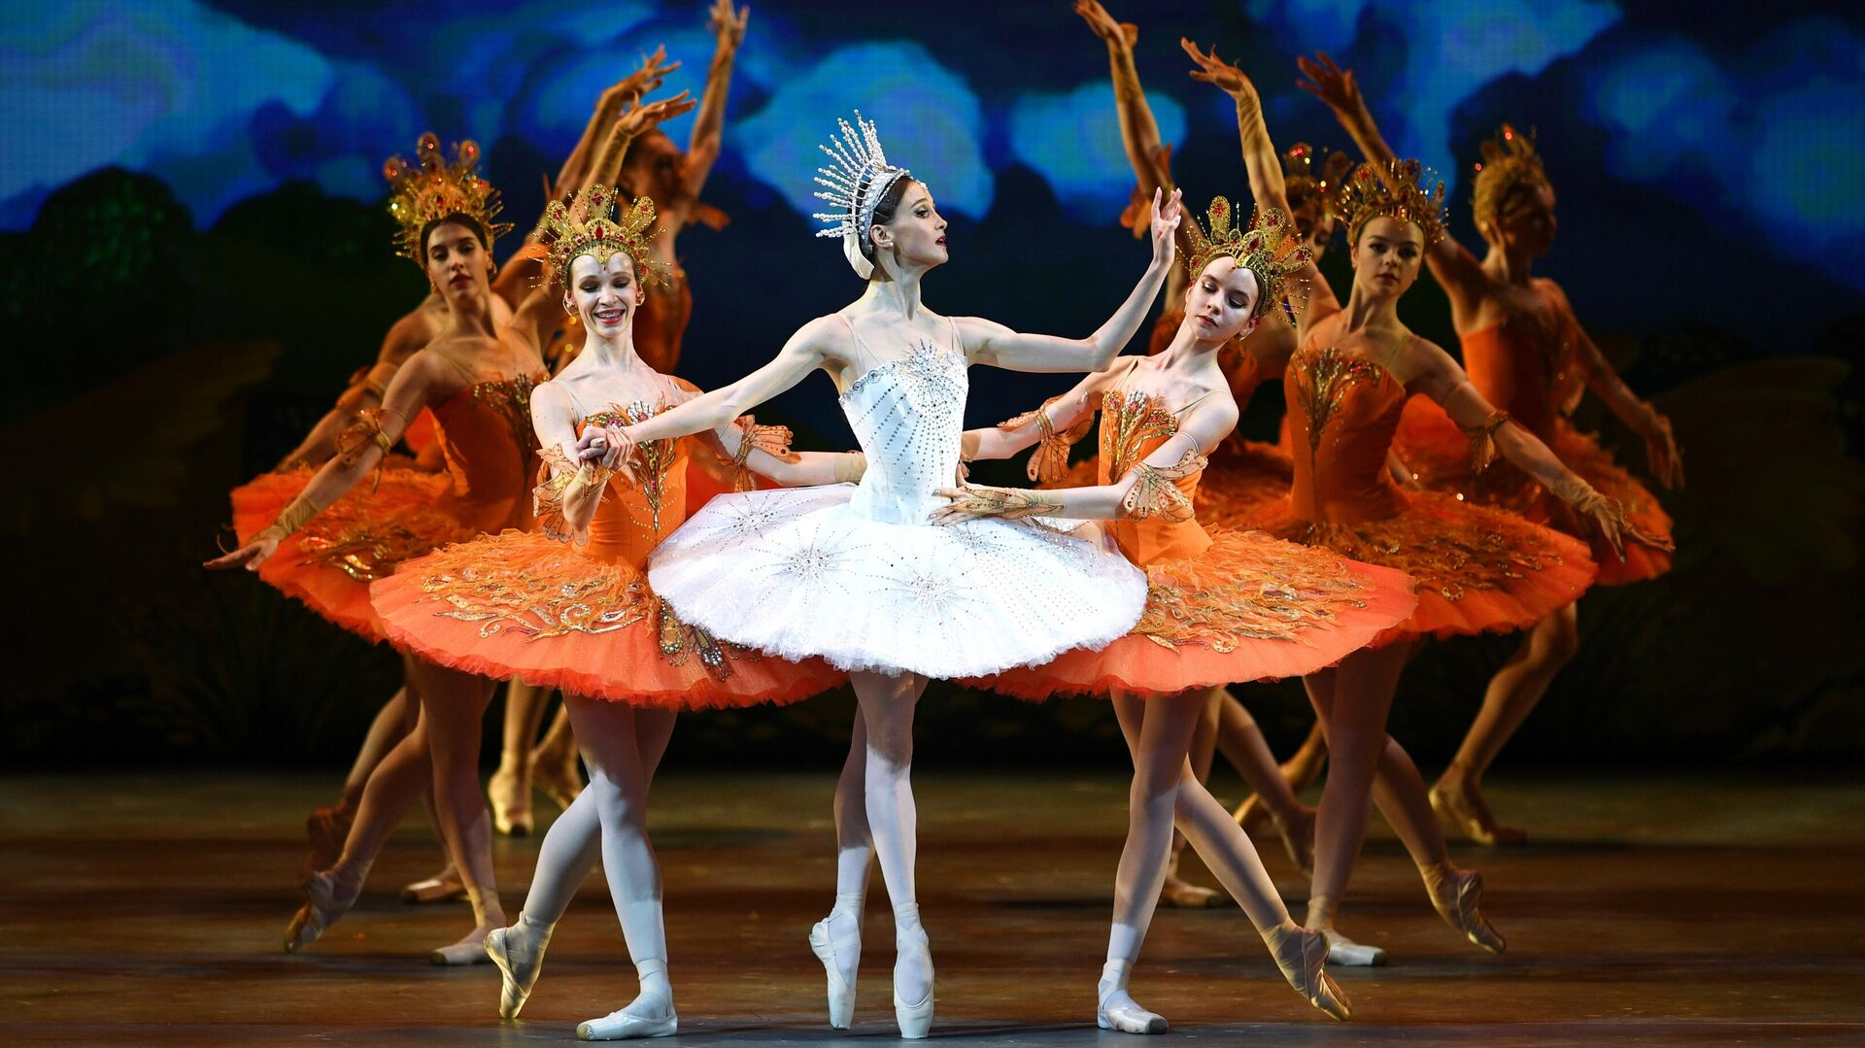
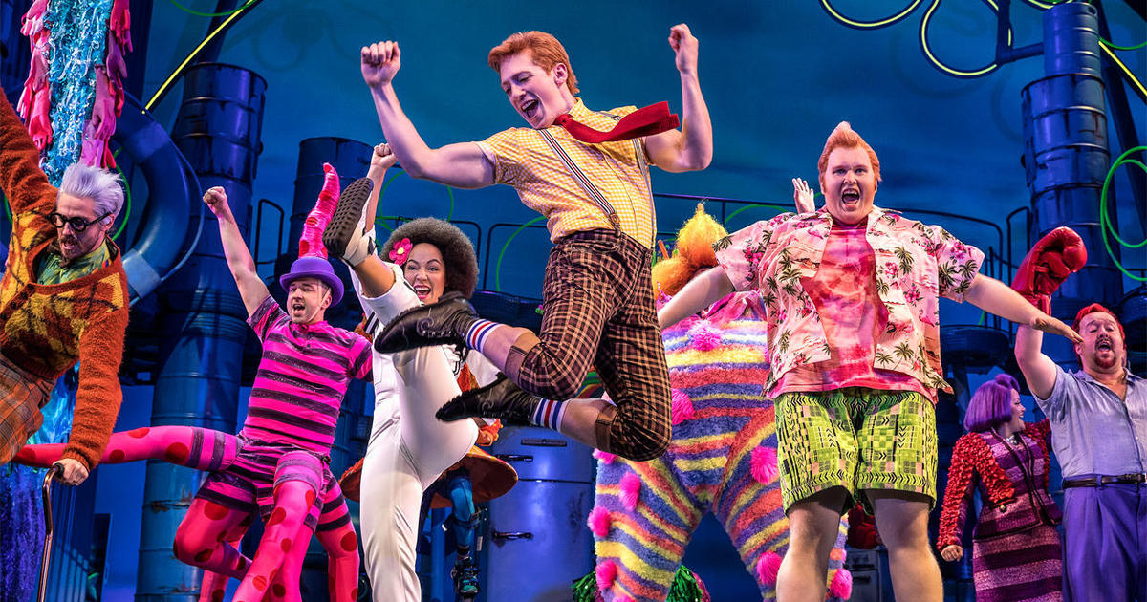
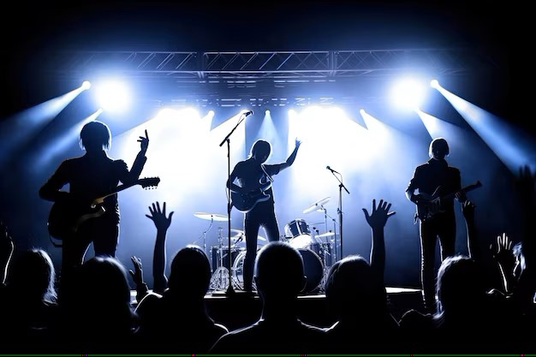
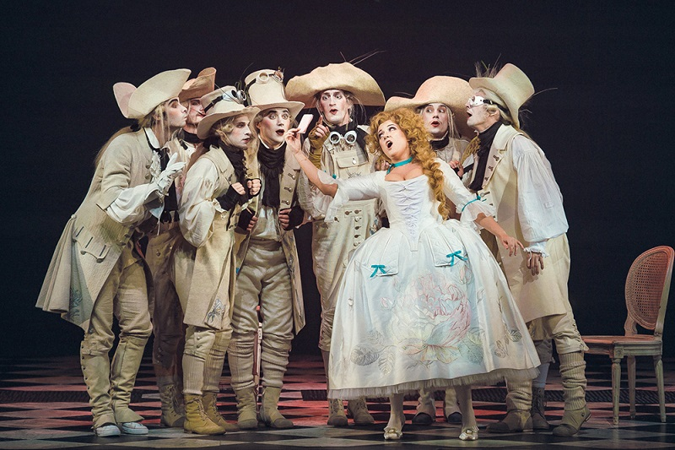
Types of performances
ballet
musical
music concert
opera

Slide 3
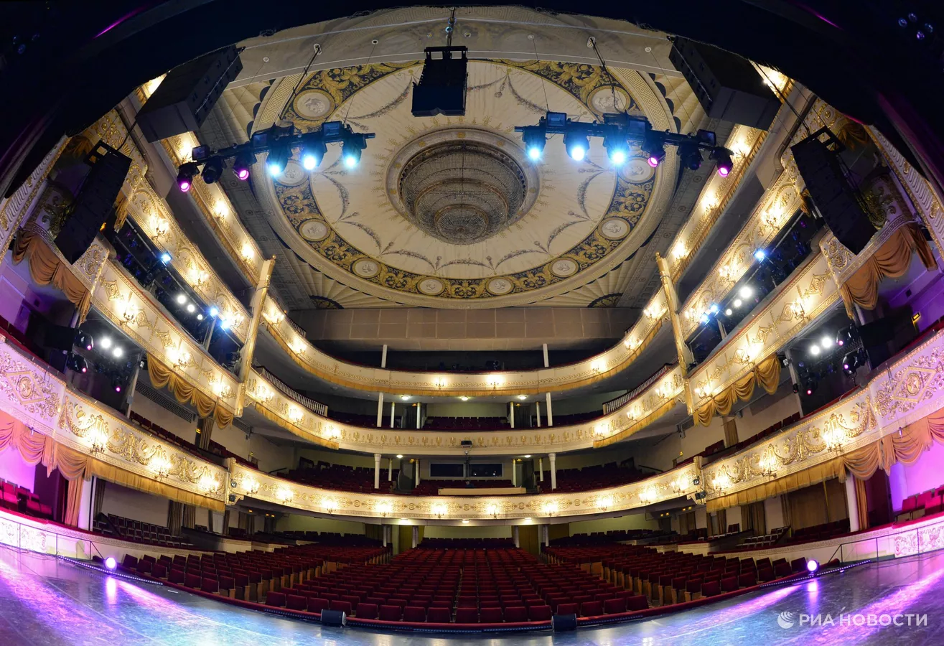
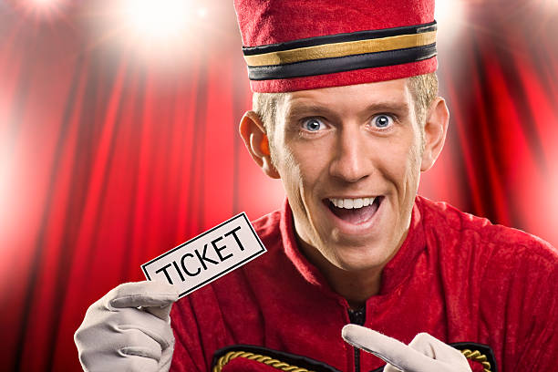
Лексика
Stalls
Orchestra
Opera glasses
Aisle
Balcony
Stage
Curtain
Usher
Оркестр
Портер
Театральный бинокль
Билетер
Сцена
Проход
Занавес
Балкон
stalls
usher

Slide 4
curtain
stalls
usher
opera glasses
aisle
balcony
orchestra

Slide 5
DIALOGUE
B
F
E
D
A
C

Slide 6
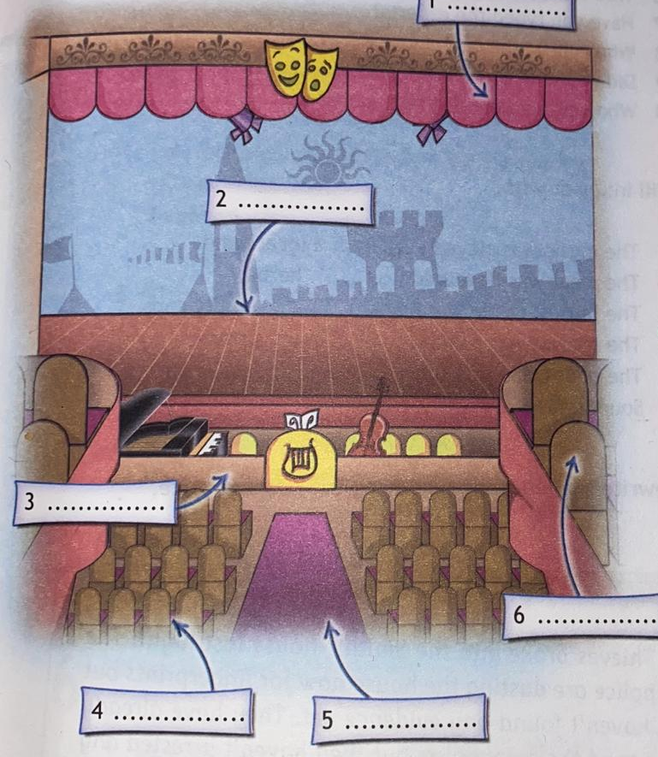
stalls
orchestra
aisle
balcony
stage
curtain

Slide 7
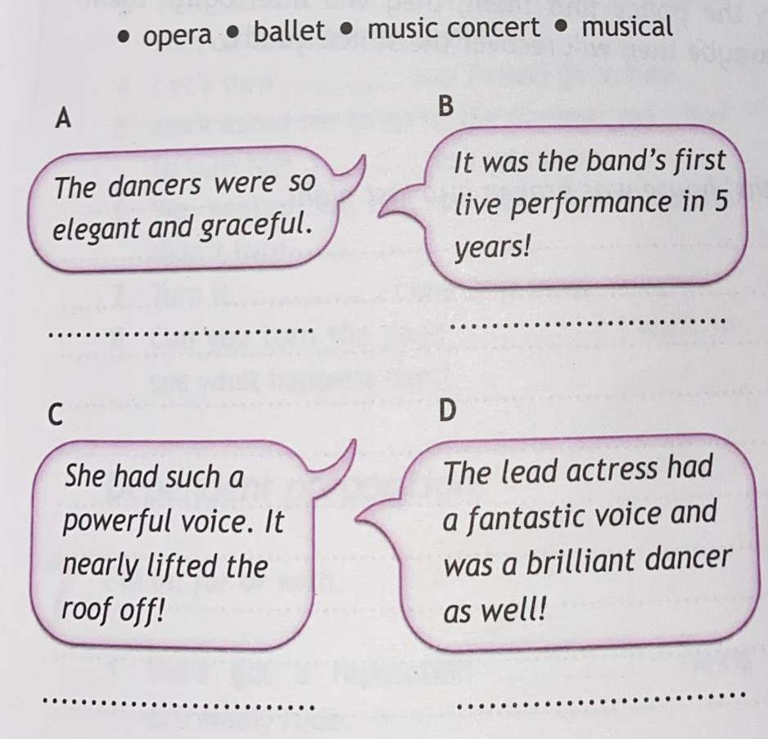
ballet
music
opera
musical

Slide 8
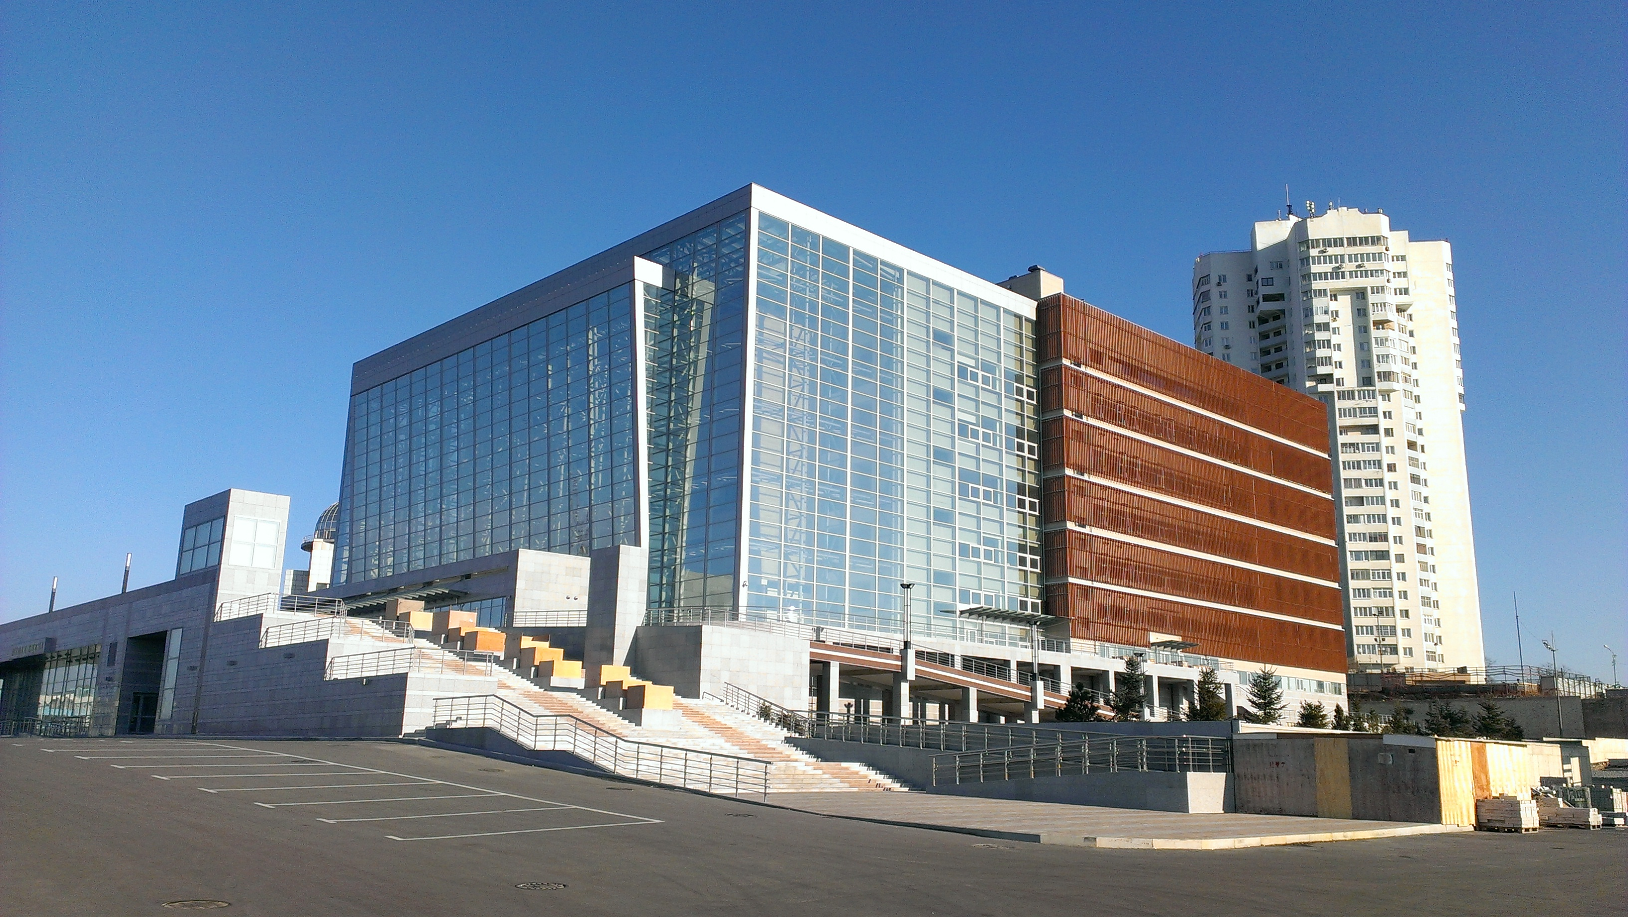
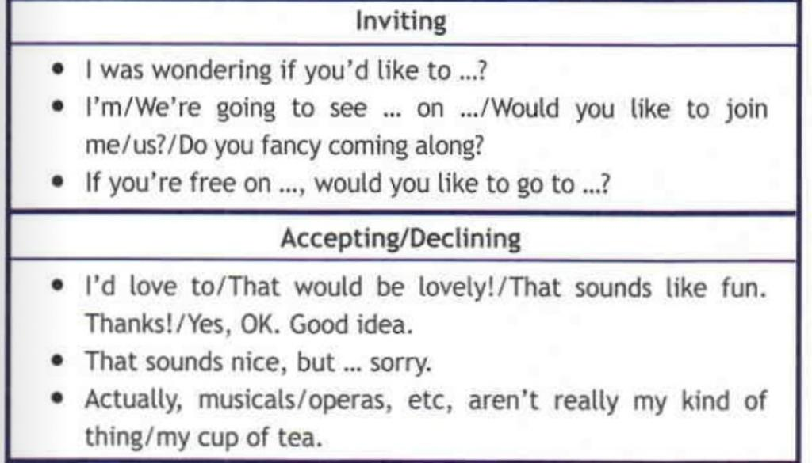
EVERYDAY ENGLISH_{(Dialogues)}
The Mariinsky Theatre presents

Slide 9
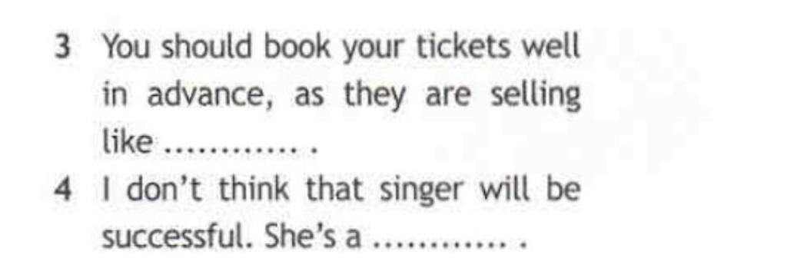
Hard of hearing
Daylight robbery
Hot cakes
One hit wonder

Slide 10
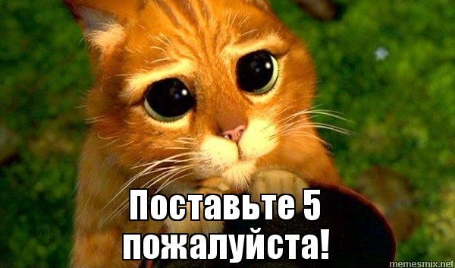
Thank you for your attention

