Slide 1
УМК К. Кауфман, М. Кауфман «Happy English.ru» 7 класс
МОУ АСОШ № 3 Линкевич Н.И., учитель английского языка;
МОУ АСОШ № 2 Никифорова Е.Б., учитель английского языка.

Slide 2
Unit 2, lesson 1 “We are going camping”

Slide 3
fine
hot
jummy
tasty
cold
Food
Weather
bad
cool
fast
awful
disgusting
special
cheap
lucky
Holidays
Clothes
happy
wonderful
warm
expensive
summer

Slide 4
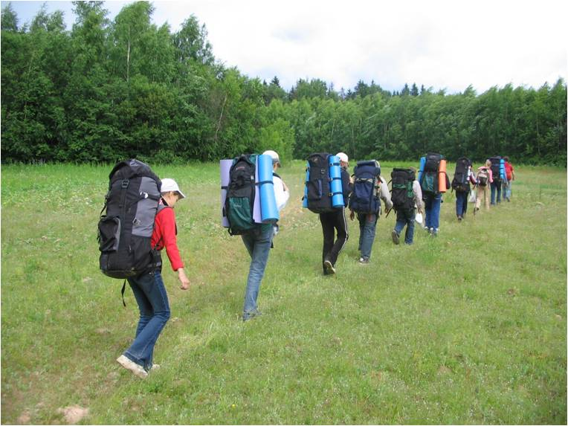
ST David’s
Blackstone Road
York YO24 3HF UK
13 August
A telegram
We have our ------------------ holidays. The weather is -------------and ---------------.Let’s go camping together. Take some -------------- food and ---------------- clothes with you. We’ ll get together at 10 o’clock on August, 20. Look forward to meeting you.

Slide 5
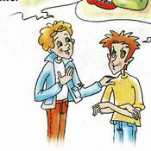
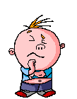
Do you think Misha and Rob will go camping ?
there are a lot of mosqutoes in the forest.
I think they will
the weather is fine.
because
I think they won’t
you can swim and sunbathe.
It’s a great idea !!!
Let’s think it over.
the ground is hard and cold.

Slide 6
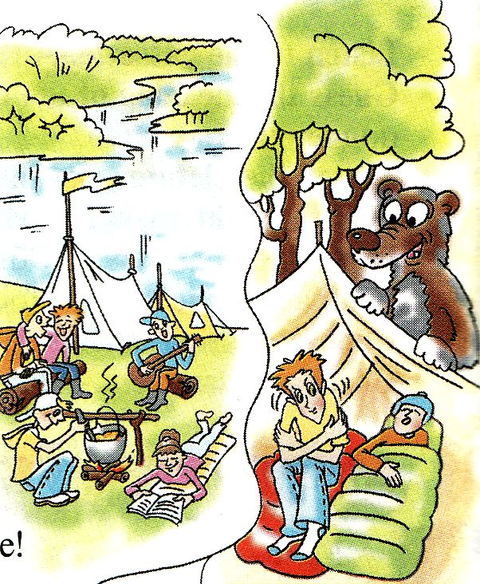
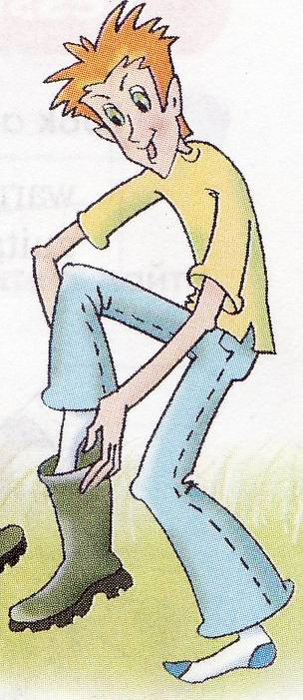
Read the text and find out what Rob and Misha really think about camping.
Why did Rob say, “ I will go with you”?

Slide 7
Use the following signs to mark the text while listening to it.
What does Mark think about camping? Why?
What does Rob think about camping? Why?
Why did Rob say “I’ll go with you”?

Slide 8
big
a
bear
great
river
a
Russian
horrible

Slide 9
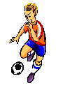
to swim
to sunbathe
to fish
to cook on the campfire
to pick up mushrooms and berries
to sing songs
to play football

Slide 10
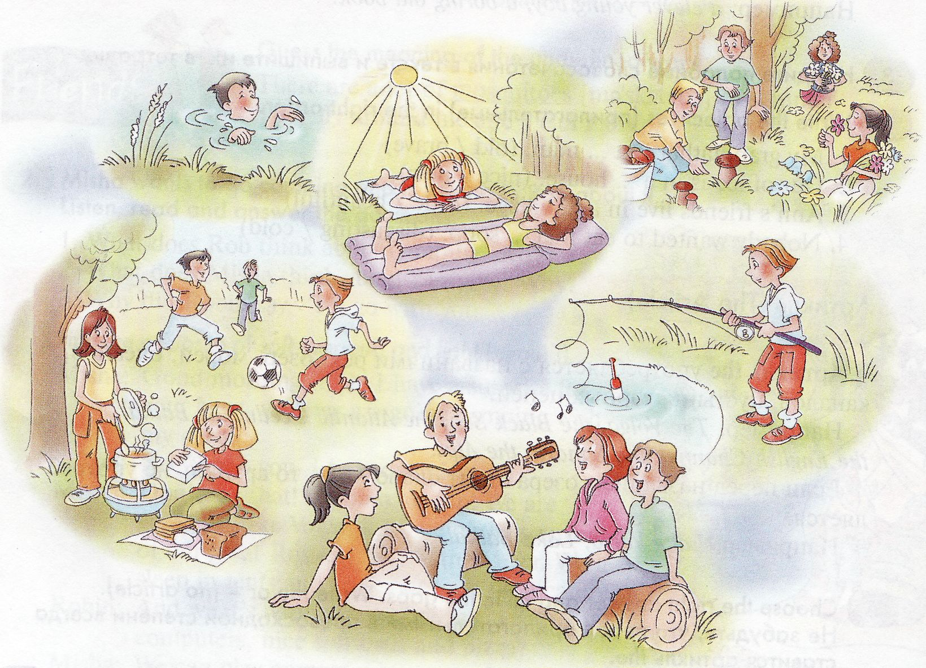
What is good about camping?
Model:
Camping is fun. The boys are playing football.

Slide 11
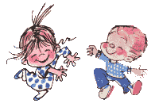
TALK ABOUT CAMPING
I think
Camping is fun.
I believe
I’m sorry but
I’m afraid
Probably
I hate camping.
I agree

Slide 12
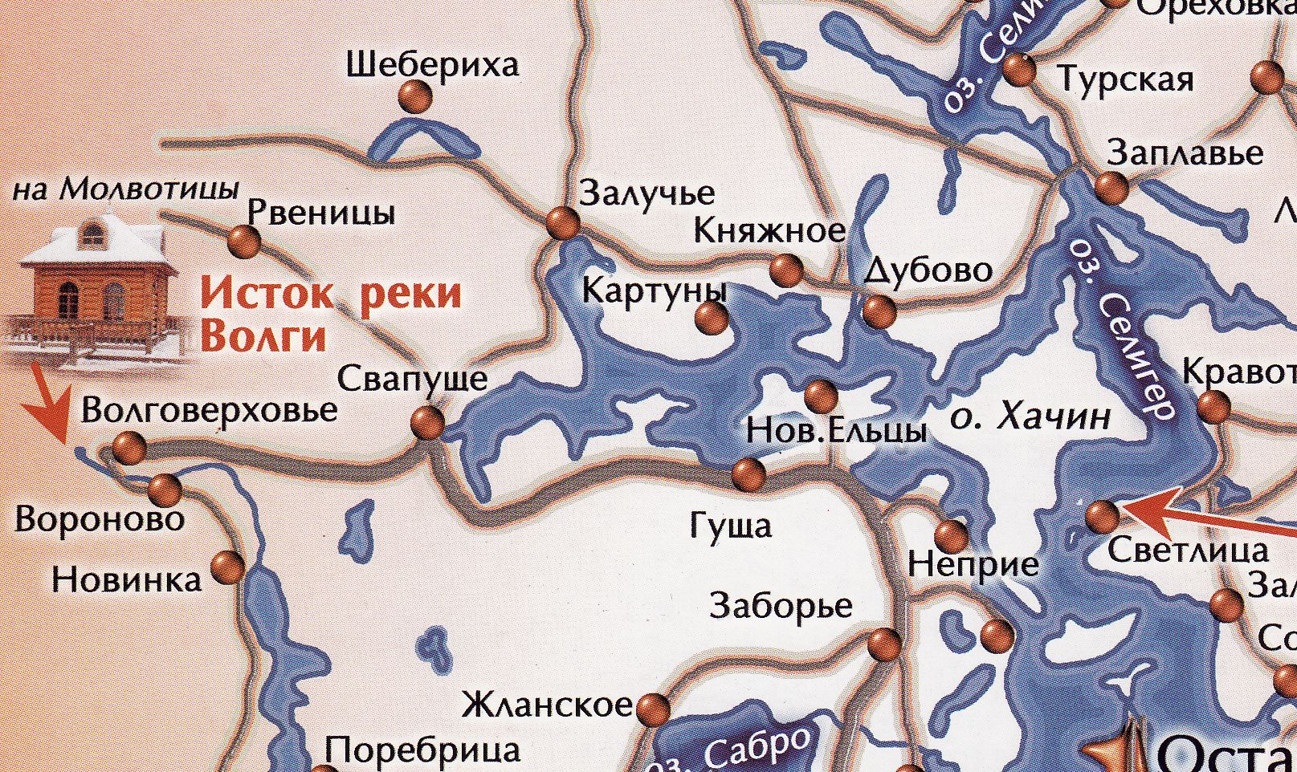
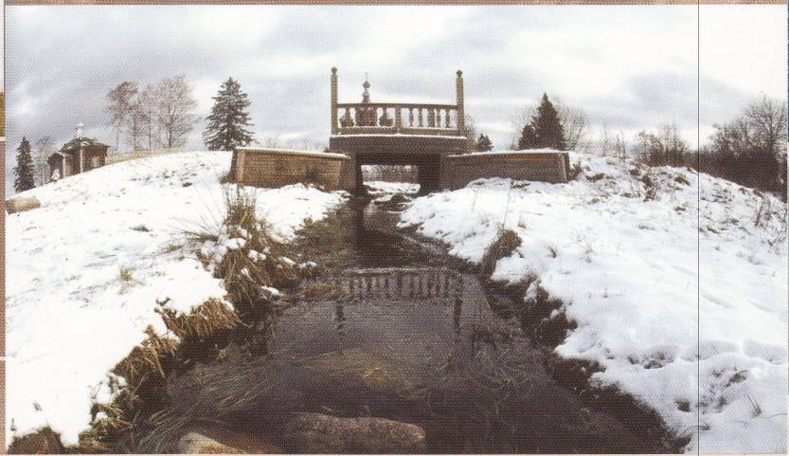

Slide 13
Homework
Do you want to go camping?
Why? Why not?
Write about it. Start with “Camping is fun” or “I hate camping.”

