Slide 1
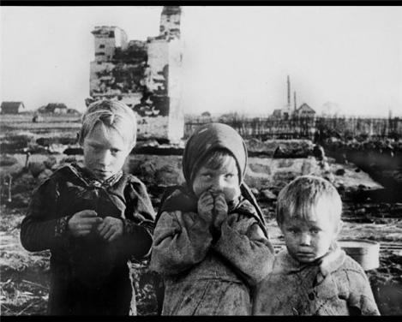
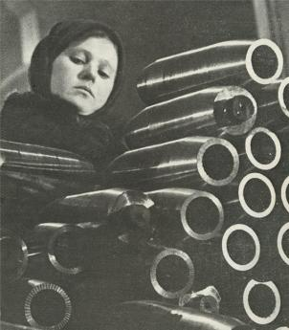

Slide 2
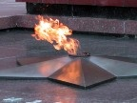
Young Heroes of the War
1941-1945

Slide 3
Zoya Kosmodemyanskaya’s story
Awards
Young heroes

Slide 4
Do you know…?
Do you know when the Great Patriotic War started?
What country attacked our Motherland?
Do you know how many people our country lost?
When did the Great Patriotic War end?

Slide 5
Do you know that many children became partisans?
Do you know any heroes of the war?
Did any of your relatives take part in the war?

Slide 6
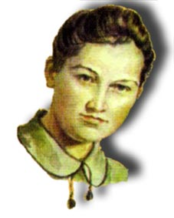
Zoya Kosmodemyanskaya 1923-1941
“Here, comrades! Why do you look so gloomy?
Be brave… Fight on… fight on!”
The Hero of the Soviet Union

Slide 7
Alexander Kosmodemyanskiy 1925-1945
The Hero of the Soviet Union

Slide 8
Active Words
Fascist
Soldier
Enemy
Battlefield
Destroy
village
Torture – пытать
Fear - страх
Pseudonym
Barefoot - босиком
Unclad – раздетый
Scaffold - виселица

Slide 9
"Tanya" by Kukrynikses (Mikhail Kupriyanov, Porfiriy Krylov and Nikolay Sokolov), 1942-1947. This painting is currently held by the Tretyakov Gallery in Moscow.

Slide 10
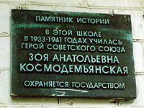
Zoya’s school

Slide 11
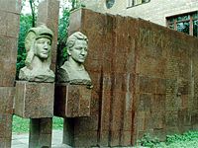
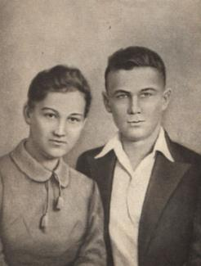
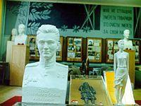
School museum

Slide 12
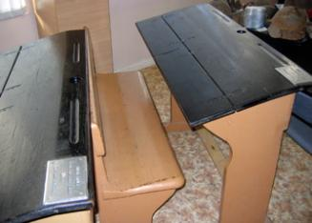
Some exhibits
Class register from School # 201 in Moscow
Zoya and Shura's school desk from School # 201 in Moscow

Slide 13
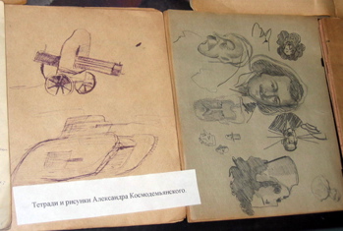
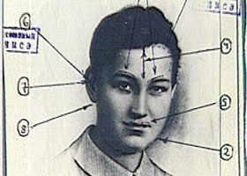
Pictures made by Alexader Kosmodemyanskiy (Shura)
Zoya's portrait featuring markings made by the experts who proved that the young heroine "Tanya" was actually Zoya Kosmodemyanskaya

Slide 14
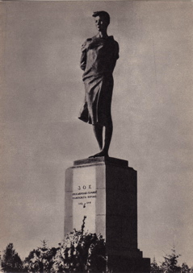
Petrishchevo

Slide 15
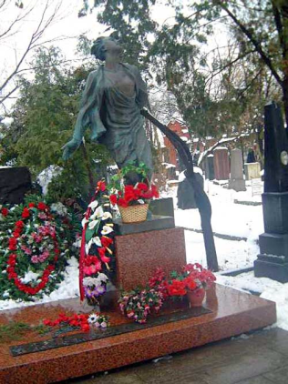
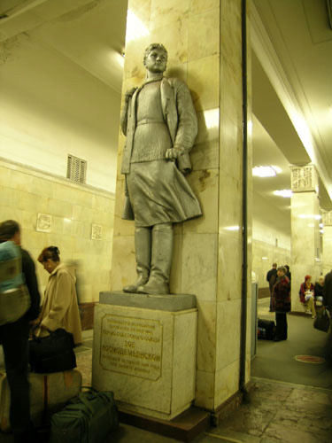
Statue at Partizanskaya
Metro Station in Moscow
Statue at grave site at Novodevichy Cemetery in Moscow

Slide 16
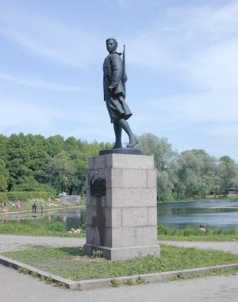
Statue in St. Petersburg (Leningrad), by M. Manizer

Slide 17
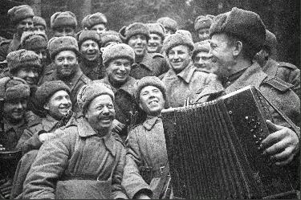

Slide 18
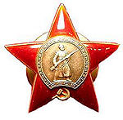
Awards
Medal "Golden Star“ of
The Hero of the Soviet Union
Медаль "Золотая звезда"
Order Of The Red Star
Орден "Красная Звезда"
Order Of The Red Banner
Орден "Крaсного Знамени"
Order Of The Patriotic War (1st Class)
Орден Отечественной войны (первой степени)

Slide 19
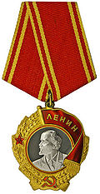
Order Of Lenin
Орден Ленина
For The Defence Of Moscow
За оборону Москвы
For The Defence Of Leningrad
За оборону Ленинграда

Slide 20
To award – награждать
The General awarded the soldier the medal For the Defence of Moscow.

Slide 21
To award – награждать
To be awarded – быть награжденным

Slide 22
To be awarded

Slide 28
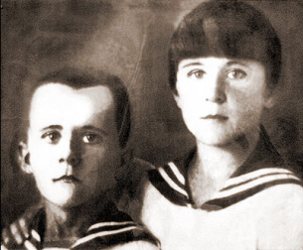
Young Heroes Marat Kazey
Wounded – раненый
Cure – лечить
Courage – мужество
Sabotage – диверсия
Posthumously- посмертно
Сombat merits- боевые заслуги
For Valour – за отвагу

Slide 29
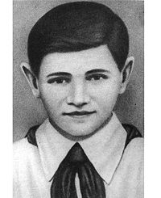
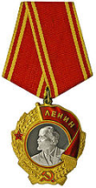
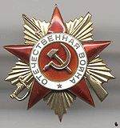
Valentin Kotik
Scout – разведчик
Participate – участвовать
Wounded – раненый
Posthumously - посмертно

Slide 30
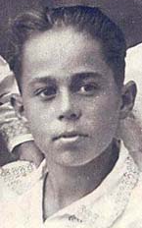
Volodya Dubinin
Abandoned quarry- заброшенная каменоломня
Trod on – наступил на
Mine - мина
Posthumously - посмертно

Slide 31
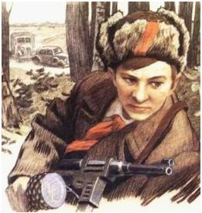
Lyonya Golikov
Scout – разведчик
Railway – железная дорога
Store - склад
Lorries of amunition – грузовики с боеприпасами
Posthumously - посмертно

Slide 32
Zinaida Portnova
Distribute leaflets – распространять листовки
Sabotage – диверсия
Interrogation – допрос
Execute – казнить
Jail - тюрьма

Slide 33
Listening
Machine-gun – пулемет
Appear – появиться
Crawl – ползти
Reach – добраться
Enemy - враг

Slide 34
What helped our people to win?
Courageous -храбрый, мужественный
Brave – смелый, храбрый
Motherland – Родина
Under the yoke of – под игом
What did the victory give us?
To be glad/happy, full of joy
Careless, carefree – беззаботный
Honour the memory of fallen heroes – чтить память погибших героев
Peace – мир
Defend - защищать

Slide 35
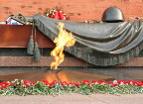

Slide 36
Thank you for the lesson

