Slide 1
“School” level: 8th form teacher: I. P. Polyatykina 2009-2010

Slide 2
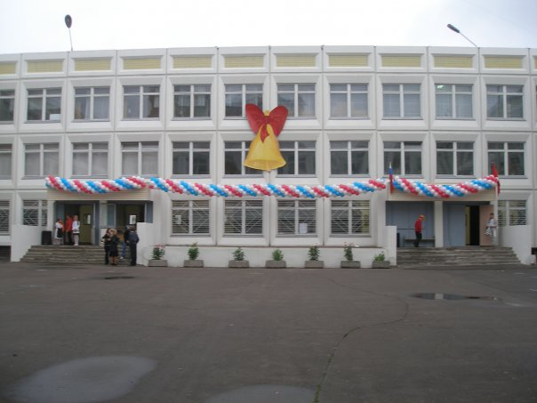
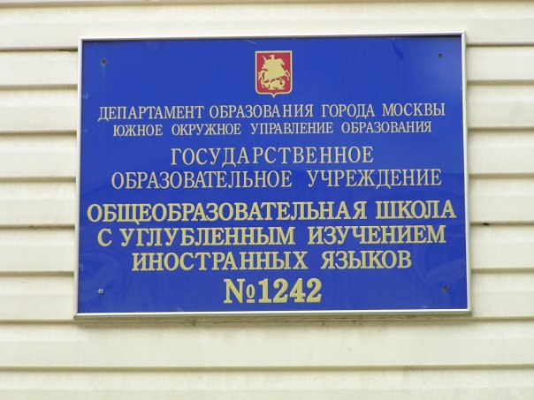
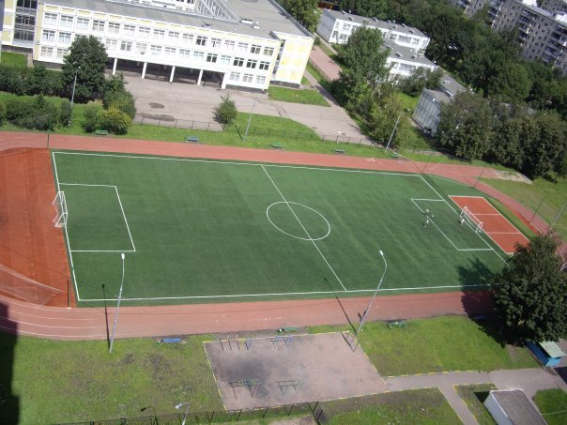
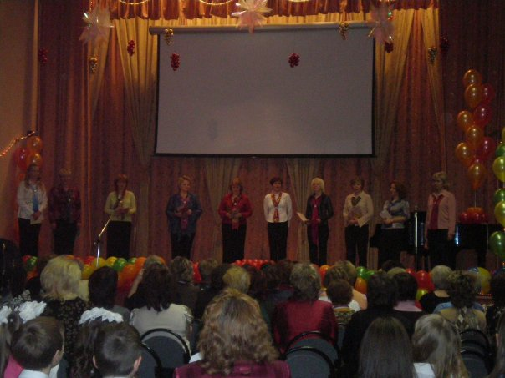
Our school

Slide 3
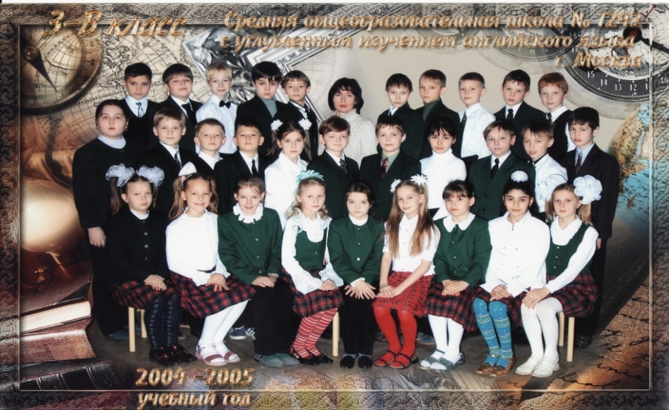
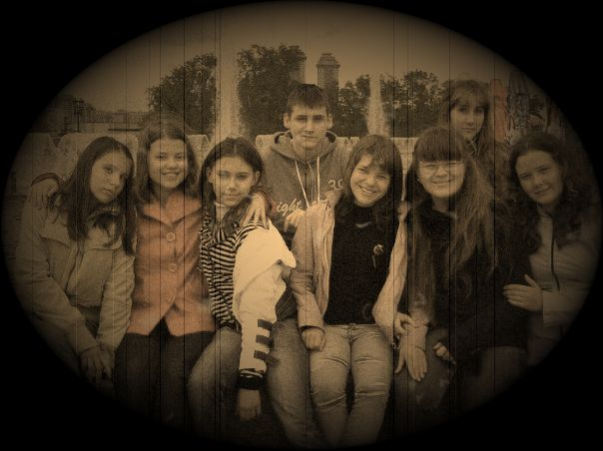
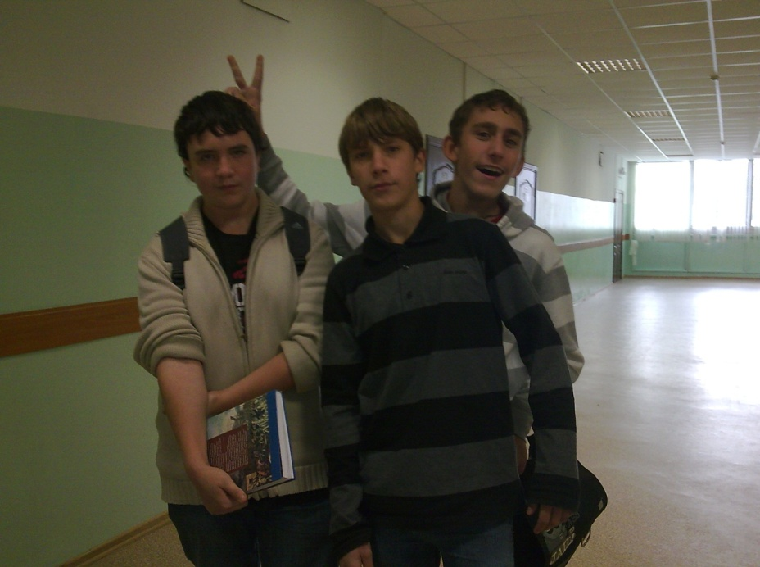
“The happiest years…” There is a saying in English, “Schooldays are the happiest days of your life”. Can you say that you are happy at school?

Slide 4
Our problems

Slide 5
What are the reasons of the problems? What are the consequences?
reasons | problems | solutions

Slide 7
Survey on school subjects: Maths and Sciences (25 students were questioned)

Slide 8
Survey on school subjects: social studies (25 students were questioned)

Slide 9
DRAWING A CONCLUSION

