Slide 1
Same or different?
Some people feel jealous
Other people feel afraid
Some people feel sadness
That’s the choice that they have made
Your mood is your decision
And it’s always up to you
So I choose to find happiness
In everything I do

Slide 2
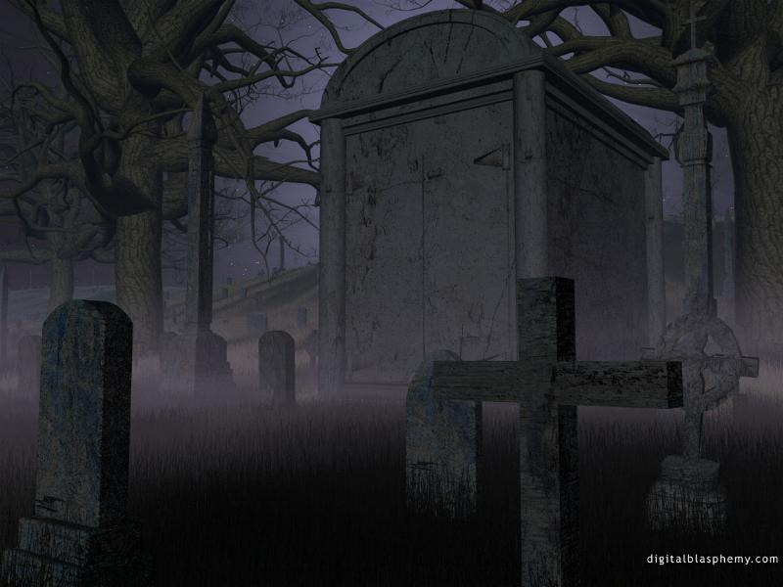
Goths

Slide 3
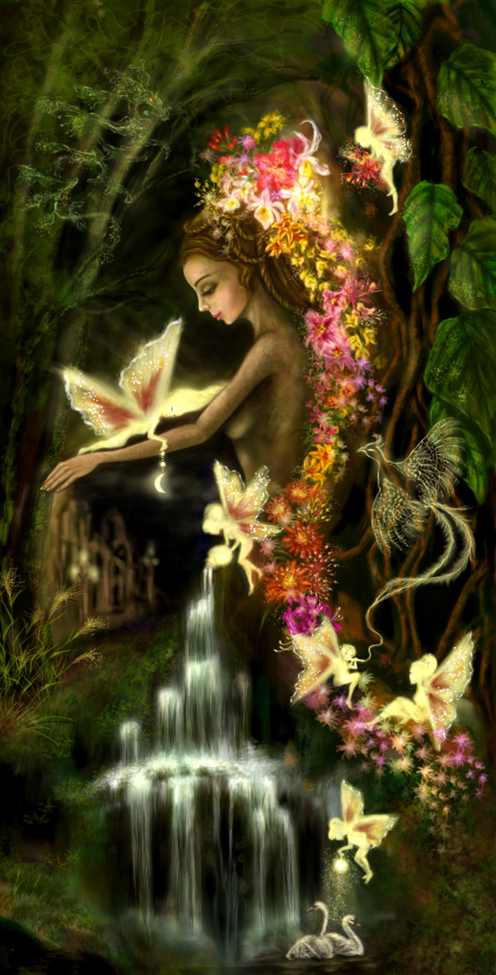
Hippies

Slide 4
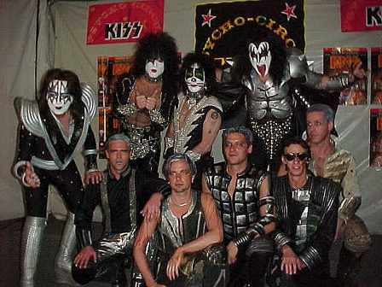
Rockers

Slide 5
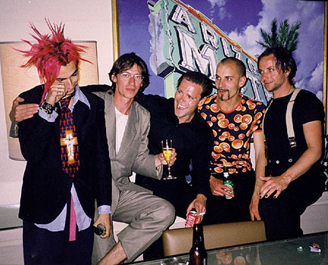
Punks

