Slide 1
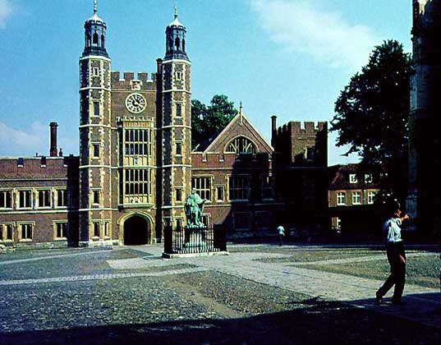
Eton College

Slide 2
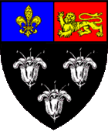
Eton College
Motto
Floreat Etona (Let Eton Flourish)

Slide 3
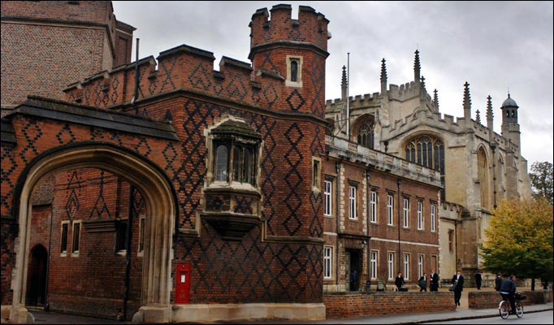
Eton College, often referred to simply as Eton, is a British independent school for boys aged 13 to 18. It was founded in 1440 by King Henry VI

Slide 4
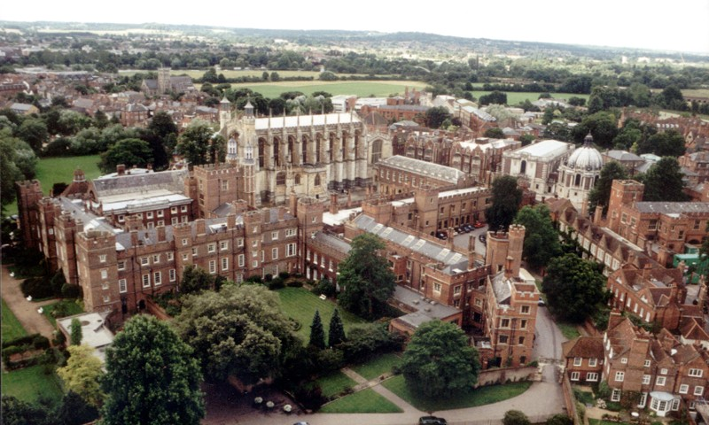
It is located in Eton, near Windsor in England, north of Windsor Castle, and is one of the original nine English public schools as defined by the Public Schools Act 1868.

Slide 5
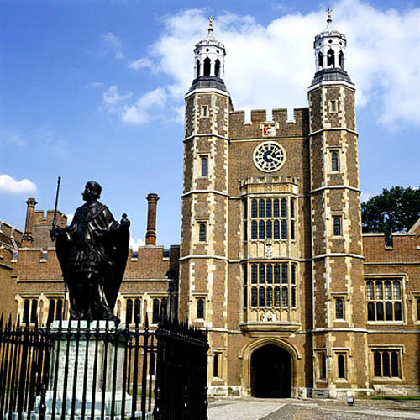
Students
1,300
Gender
Boys
Ages
13–18
Houses
25
Colours
Eton blue

Slide 6
Eton has traditionally been referred to as "the chief nurse of England's statesmen", and has been described as the most famous public school in the world. Early in the 20th century, a historian of Eton wrote, "No other school can claim to have sent forth such a cohort of distinguished figures to make their mark on the world".
The Good Schools Guide called the school "the number one boys' public school," adding, "The teaching and facilities are second to none." The school is a member of the G20 Schools Group.

Slide 7
The school is headed by a Provost and Fellows (Board of Governors), who appoint the Head Master. It contains 25 boys' houses, each headed by a housemaster, selected from the more senior members of the teaching staff, who number some 160.
Almost all the school's pupils go on to universities, about a third of them to Oxford or Cambridge.

Slide 8
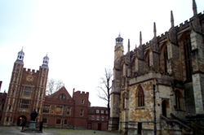
School yard, Eton College

Slide 9
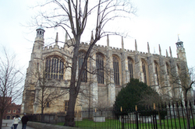
Eton College Chapel

Slide 10
School terms
There are three academic terms (known as halves) in the year,
The Michaelmas Half, from early September to mid December. New boys are now admitted only at the start of the Michaelmas Half, unless in exceptional circumstances.
The Lent Half, from mid-January to late March.
The Summer Half, from late April to late June or early July.
They are called halves because the school year was once split into two halves, between which the boys went home

Slide 11
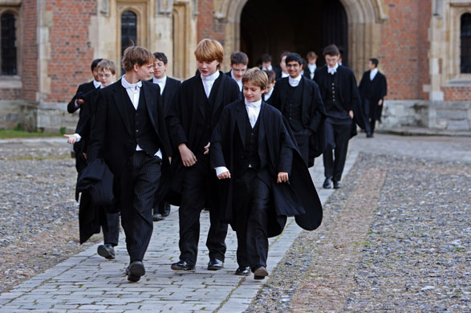
Uniform
The school is famous for its traditions, including a uniform of black tailcoat (or morning coat) and waistcoat, false-collar and pinstriped trousers. All pupils wear a white tie that is effectively a strip of cloth folded over into the collar.

Slide 12
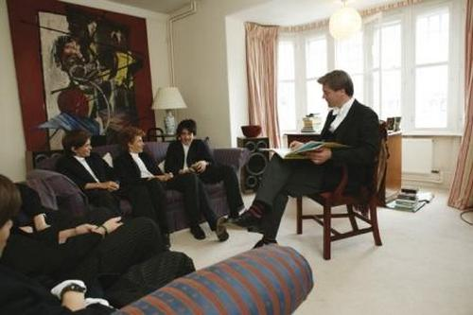
Tutors and teaching
The pupil to teacher ratio is 10:1, which is low by general school standards. Class sizes start at around twenty to twenty-five in the first year and are often below ten by the final year.

Slide 13
Societies
At Eton, there are dozens of organisations known as 'societies', in many of which pupils come together to discuss a particular topic, presided over by a master, and often including a guest speaker. Some societies are dedicated solely to music, some to religion, some to languages, and so on. Among past guest speakers are Andrew Lloyd Webber, J. K. Rowling, Boris Johnson, and King Constantine II of Greece.

Slide 14
Sports
Sports are a major feature of life at Eton. There is an extensive network of playing fields. Their names include Agar's Plough, Dutchman's, Upper Club, Lower Club, Sixpenny/The Field, and Mesopotamia (situated between two streams and often shortened to "Mespots").

Slide 15
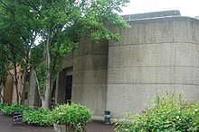
Drama
The exterior of Eton's main theatre, the Farrer.

Slide 16
Partially filmed at Eton
Here follows a list of films partially filmed at Eton.
Shakespeare in Love (1998)
The Secret Garden (1993)
Mansfield Park (1999)
Chariots of Fire (1981)
The Madness of King George (1994)
Young Sherlock Holmes (1985)
Aces High (1976)
The Fourth Protocol(1987)

