Slide 1
19 March
Friday

Slide 2
to get knowledge
to be clever
I study
to know a lot
to be with my friends

Slide 3
polite
strong
friendly
Professions
noisy
stupid
known
sociable

Slide 4
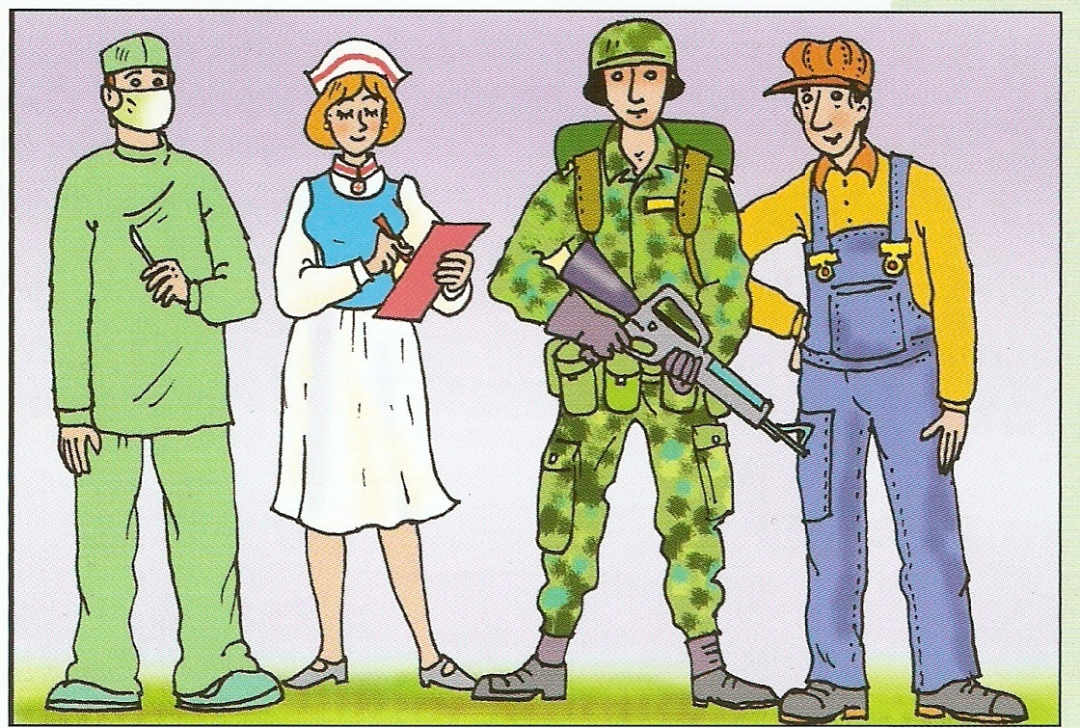
Professions

Slide 5
[kaɪnd] | [ˊfrendlɪ] | [ˊnͻ:tɪ]
[ˊdraɪvə] | [laɪˊbreərɪən] | [nɜ:s]
[ˊf˄nɪ] | [ˊdentɪst] | [ˊkru:əl]

Slide 6
Doctor

Slide 7
Postman

Slide 8
Teacher

Slide 9
Fireman
Policeman

Slide 10
Cook

Slide 11
Nurse

Slide 12
Listening
From … till … - с … по …
Bath – г. Бат
At my workplace – на моем рабочем месте
Both with … and … - как с … так и с …

Slide 13
Answer the questions
Where does Sara live?
When does she work?
What are her main characteristics?
Does Sara like her job?

Slide 14
Homework
WB ex.29 p.27

