Slide 1
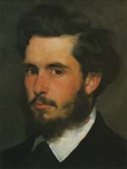
Claude Monet
(1840-1926)
a French landscape painter, born in Paris;
a founder of Impressionism;
His works are represented in the Louvre, the Mormottan ( Paris);
The National Gallery (London);
The Metropolitan Museum of Art
( New York);
The Art Institute of Chicago
Komsomolsk-na-Amure, Nekrasova Tatyana

Slide 2
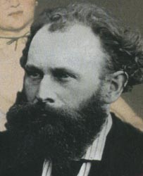
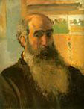
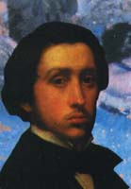
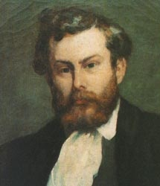
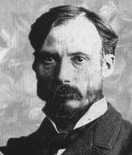
Impressionism
as an art movement started in France, Paris, in1870 thanks to Claude Monet ‘s friendship with the great artists
While studying in Paris Monet formed lasting friendships with the artists who would become the major impressionists, including Pissarro, Degas, Renuar, Sisley and
Eduard Manet …
Manet, Eduard
1832-1883
Pissarro, Camille
1830-1903
Degas, Edgar
1834-1917
Sisley, Alfred
1839-1899
Renuar, Pierre
Auguste
1841-1919

Slide 3
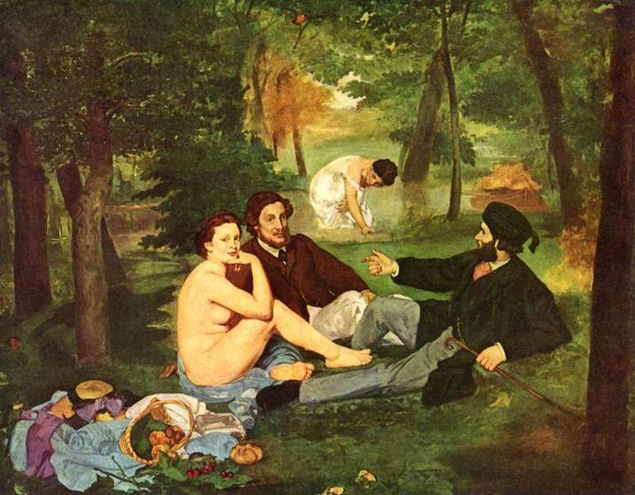
“Breakfast on the grass” by Eduard Manet
evoked a scandal of public. Nevertheless it was exhibited illegally in Paris and gave start to the new art movement called later Impressionism.
Olympia
Komsomolsk-na-Amure, Nekrasova Tatyana

Slide 4
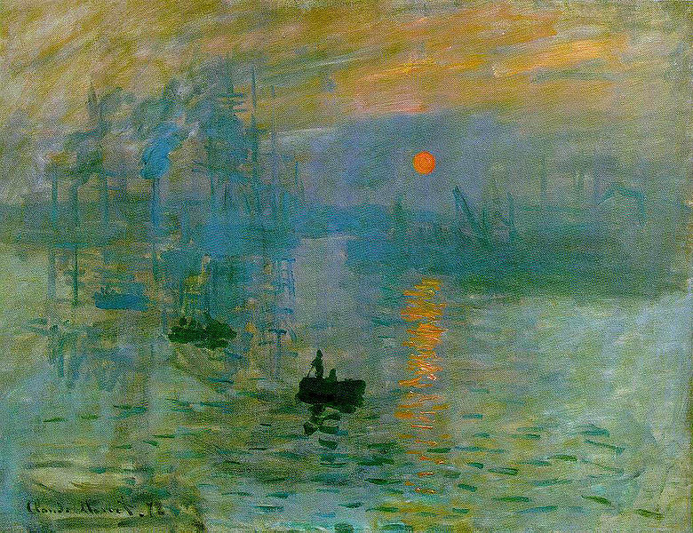
Impressionism is a light, spontaneous manner of painting which began in France as a reaction against the restrictions and conventions of the dominant Academic Art.
The movement's name was derived from Monet's early work, Impression: Sunrise.

Slide 5

Claude Monet (1840-1926) gave the Impressionist movement its name and was one of its most successful and best-known artists. Before Impressionism was fashionable or accepted by the artistic elite, Monet was on the forefront of this revolutionary style.
Paintings such as Impression Sunrise exemplify the Impressionist style, with their hazy portrayals of light, air, and motion, allowing the essential elements of the work to shine through.
Impressionists broke with the traditions. They didn’t follow proportions, the composition and the laws of painting. His works drew harsh criticism from many of Monet's contemporaries, but some realized that Monet was exploring a whole new way to paint.
Komsomolsk-na-Amure, Nekrasova Tatyana

Slide 6
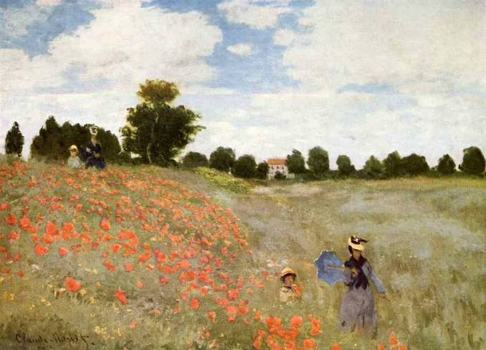
The artists of the new movement were the first to draw
in the open air (Fr. plein air – вольный воздух)
“ Poplars” by Claude Monet

Slide 7
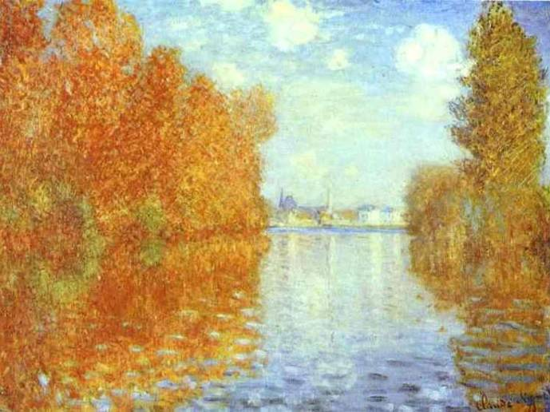
Monet and his friends developed a “sketchy”, “impressionistic "style, trying to capture the changing effect of natural light.
Claude Monet. Autumn.

Slide 8
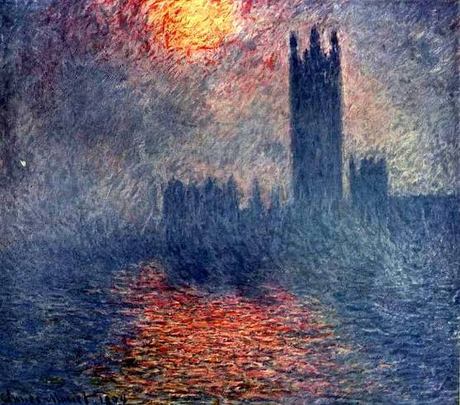
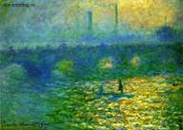
The effects of light had always interested Monet, and he explored those effects on haystacks in an extensive series of paintings. “His pictures are like impressions”- wrote critics and called this style
Impressionism
Claude Monet. The Parliament Building. London.
Claude Monet. Waterloo Bridge

Slide 9
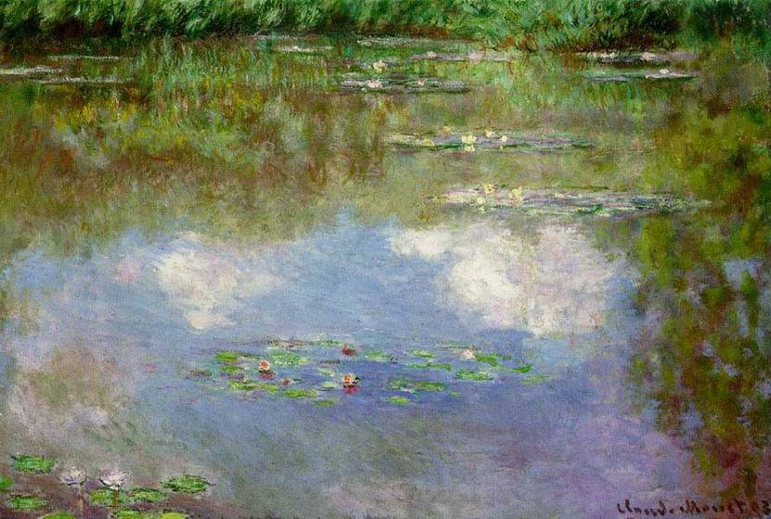
The usage of soft crayons or coloured powder made possible to show us
the sparkling light , the play of light and shadows on the water surface,
the velvet leaves of the delicate lilies in the pond.
The new technique of pastel was developed.
Claude Monet. Lilies. (Clouds)
Throughout Monet's life, his paintings focused on outdoor scenes, be they landscapes featuring the Seine river, haystacks in the fading sun, close-ups of blue-green water lilies, or even a portrayal of turkeys in a field. Many themes captured Monet's artistic attention, but nature was always his primary inspiration.
Komsomolsk-na-Amure, Nekrasova Tatyana

Slide 10
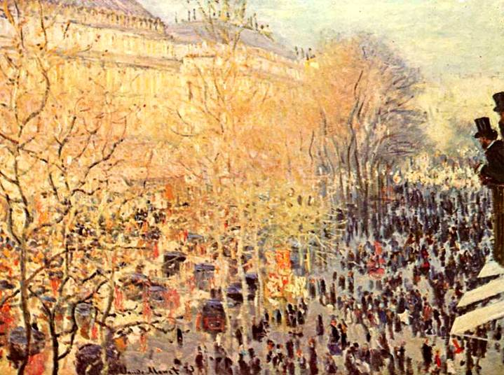
Monet painted boulevard of Caputsini many times in different parts of the day and managed to catch the light. Nobody could find a clue to his manner of painting as he changed it, making experiments.
Claude Monet. Boulevard of Caputsini in Shrovetide.

Slide 11
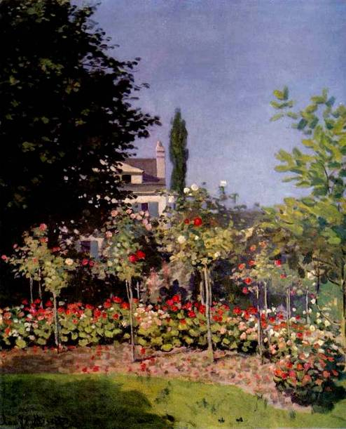
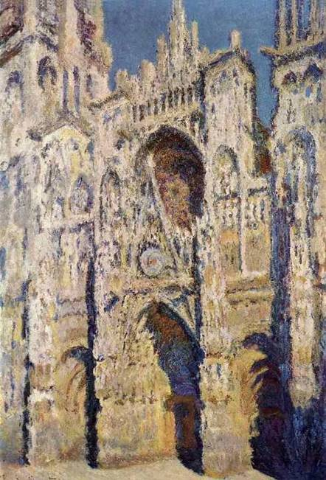
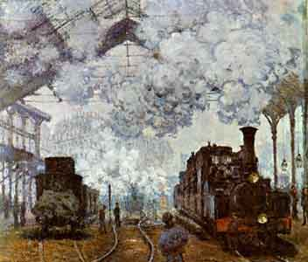
Urban settings and contemporary technology figured prominently in many of Monet's paintings. Modern bridges, train stations, and the hustle and bustle of city life all inspired his brush.
Claude Monet. The Garden in Blossom.
Transparent painting.
Claude Monet. Roan.
Pastel.
Claude Monet.Railway. Oil.

Slide 12
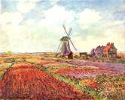
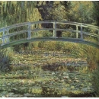
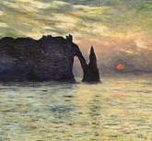
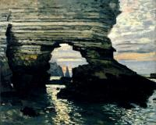
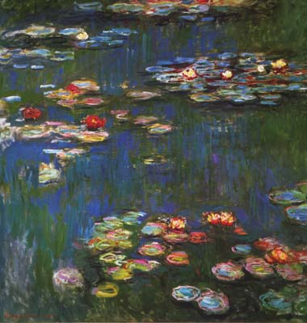
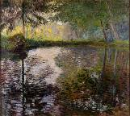
Monet's famous love of water lilies began, resulting in painting after painting of the aquatic plants. Monet continued to explore nature scenes during this time of his life, finding inspiration in the world around him.
Claude Momey.
The tulips of Holland.
Claude Monet. The Sunset
Claude Monet. The Bridge.
Claude Monet. The Pond.
Claude Monet. Stony Gates
Claude Monet. Lilies.

Slide 13
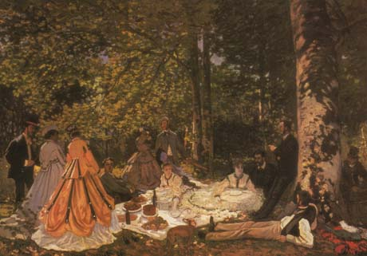
As his life drew to a close, Monet tackled large-scale works, but he stayed true to his nature and focused primarily on landscapes and outdoor scenes.
Komsomolsk-na-Amure, Nekrasova Tatyana

Slide 14
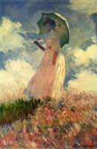
Read the short review and give your attitude to the picture of Claude Monet :
“The Walk. The woman with a Parasol”, oil on canvas.
"I'm working like never and at new attempts, figures in the open air as I understand them, made like landscapes. It is an old ream that still worries me and that I want to fulfill once and for all; but it is hard !"
Claude Monet
In this painting Monet ignores the growing industrialization of the towns to devote himself to the charm of a walk in the country.
This woman with an umbrella painted against the light and from below is Camille, Monet's wife.
The figure is turned right, the woman is holding an umbrella, walking without any goal. The background is subdued. The gaudy colours of the field and sky add the atmosphere of delicate loneliness of the figure.
Komsomolsk-na-Amure, Nekrasova Tatyana

Slide 15
Conclusion :
The Impressionist style was probably the single most successful and identifiable "movement" ever, and is still widely practiced today. But as an intellectual school it faded towards the end of the 19th century, branching out into a variety of successive movements which are generally grouped under the term Post-Impressionism.
References:
http://www.intermonet.com/.
htmhttp://entertainment.howstuffworks.com/arts/artwork/
http://www.artscroll.ru/Images/
http://www.artcyclopedia.com/history/impressionism.html
This lesson was created by the teacher of sch.1 Komsomolsk-na-Amure, Nekrasova Tatyana

