Slide 1
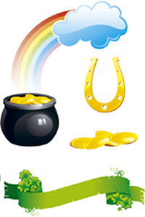
Do You Have Any Superstitions? What British Superstitions Do You Know? What Russian Superstitions Do You Know? What Superstitions Do You Believe in?

Slide 2
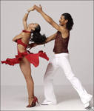
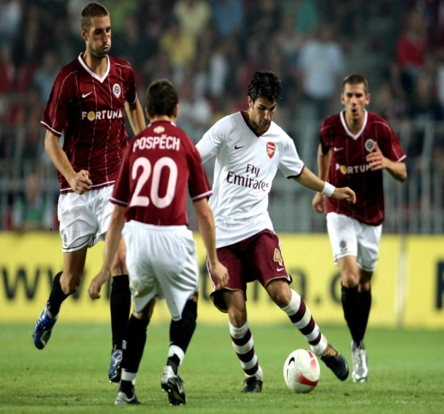
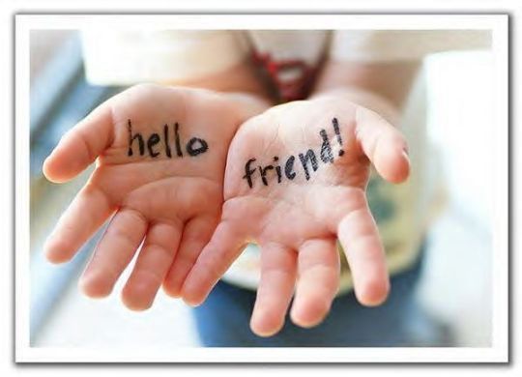
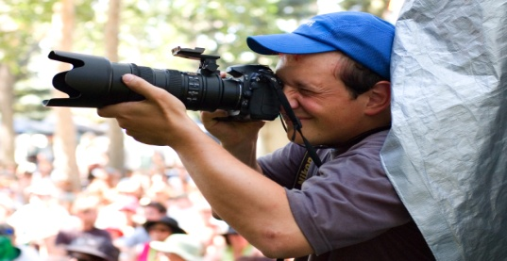
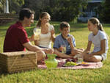
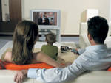
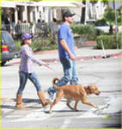
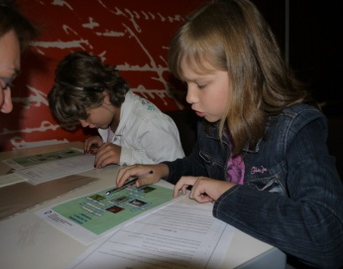
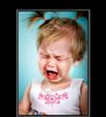
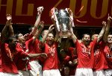
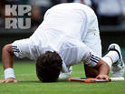
What do you like (enjoy, love) doing?
What do you hate (give up) doing?

Slide 3
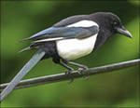
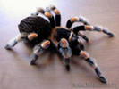
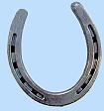
New Words.
Superstition [ˌs(j)uːpə'stɪʃ(ə)n] суеверие
Fourleaf clover ['kləuvə ] клевер
A magpie
A spider
Horseshoe ['hɔːsʃuː]
A ladder

Slide 4
Make up word combinations. Hate clover cross a charm black fingers good magpies have a spider under horseshoe kill the number 13 two a ladder wear luck fourleaf cat

Slide 5
British superstitions.
Good Luck.
Lucky to meet a black cat.
Lucky to touch wood.
Lucky to find a clover plant with four leaves.
A horseshoe over the door brings good luck.
On the first day of the month it is lucky to say “white rabbit, white rabbit, white rabbit”, before saying your first word of the day.
Catch falling leaves in autumn and you`ll have good luck. Every leaf means a lucky month next year.
Bad Luck.
Seven years bad luck to break a mirror.
Unlucky to spill salt. If you do, you must throw it over your shoulder.
Unlucky to open an umbrella in doors.
Unlucky to put new shoes on the table.
Тhe number thirteen is unlucky. Friday the thirteenth is a very unlucky day. Friday is considered to be an unlucky day because Jesus was crucified on Friday.
Unlucky to walk underneath a ladder.

Slide 6
Russian superstitions.
1. If you feel that something bad may happen, knock three (or more) times on a piece of wood to prevent it occurring; this goes back to times when people believed that powerful spirits inhabited the wood.
2. Do not whistle indoors: it will blow your money away.
3. Never shake hands over threshold (порог) – it will lead to a quarrel. It is better to invite someone into your room or flat before you shake hands.
4. If you are going on a long journey, sit down for a few moments before you leave, and your trip will be lucky.
5. Don`t spill salt. It is bad luck.

Slide 7
How to give and to accept warning.
Watch out!
Be careful!
Don`t forget to …
Don`t worry, I won`t.
Don`t break the mirror.
OK. I`ll be careful.

Slide 8
Do You Have Any Superstations? What Superstitions Do You Believe in? I believe in … It is lucky to … It is bad luck if you … I always … when…

Slide 9
Fill in the table.
Good luck. | Bad luck.
To meet a black cat.(Britain) | To meet a black cat. (Russia)
……. | ……..

Slide 10
Your homework.
Exercise 32 page 30
Exercise 33 page 31
What British Superstitions Do You Know?
What Russian Superstitions Do You Know?

Slide 11
Thank you for your work!

