Slide 1
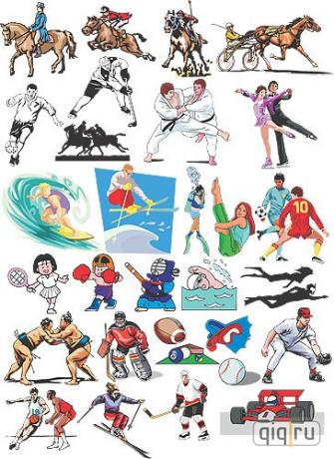
To have a healthy mind you must have a healthy body

Slide 2
My classmate’s sport activities
1. Do you do any sports?
2. What sport do you go in for?
3. How often do you do it?
4. Do you think it is a good sport?
5. Why do you like it?

Slide 3
Sport for everybody

Slide 4
Sports that make you strong and flexible
V – a little energy
VV – a lot of energy
V – strong, flexible
VV – very strong, very flexible
sport | How much energy do you need? | Does it make you: strong? flexible?
cycling
football
running
tennis
swimming
walking

Slide 5
As for me I think…
I should add…
Sport is very useful but …
On the one hand it …
In my opinion…
On the other hand it…

Slide 6
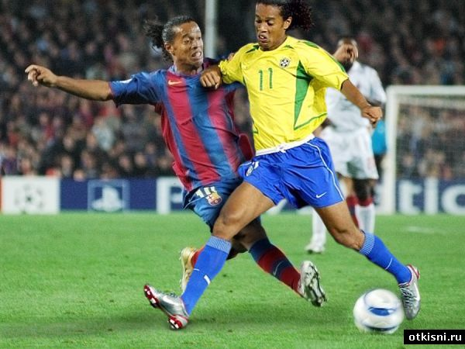
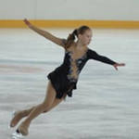
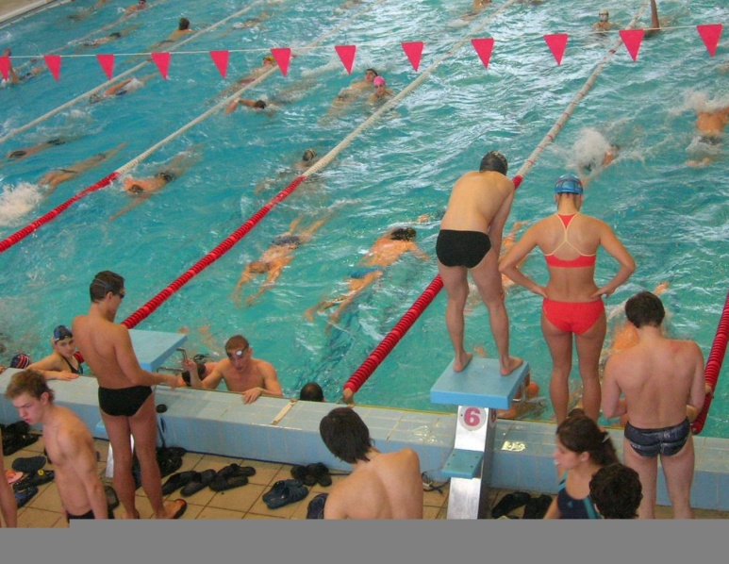
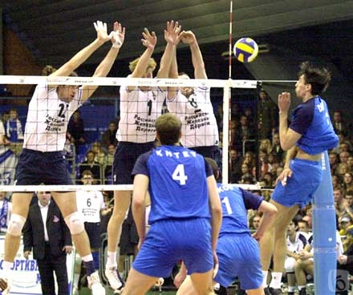
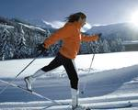
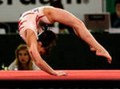

Slide 7
ports for everybody
I go out cycling every day,
I get strong and ½t that way,
And I play football at weekends,
With all my other healthy friends.
We like to run and swim and walk
Let’s move around, no time to talk!
So we enjoy sport anyway,
We love to do sport every day.
Yes there are sports for everybody.

