Slide 1
THE SIBERIAN TIGER

Slide 2
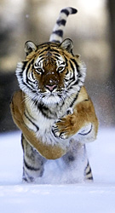
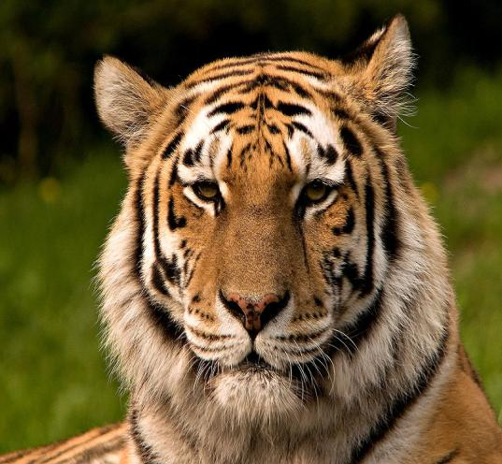
The Siberian tiger is also known as the Amour tiger, Manchurian tiger. It is written in the Red book.

Slide 3
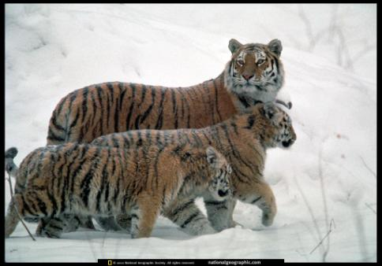
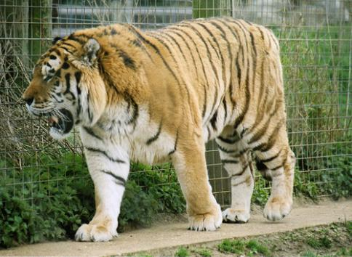
In 1996 there were about 450 tigers.

Slide 4
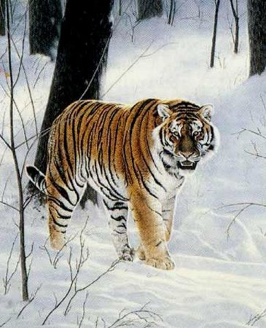
The Siberian tiger is a big animal, it has exotic color, it is one of the biggest beasts of prey of our planet.
It’s length is about 2m
It’s mass is about 350 kg
It runs at a speed of 50 km/h

Slide 5
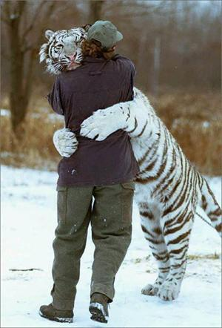
The Siberian tiger doesn’t attack people.

Slide 6
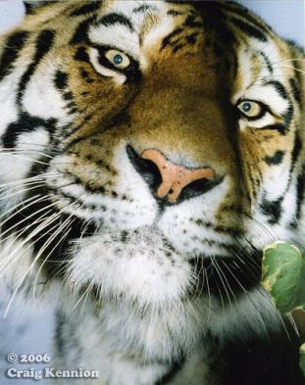
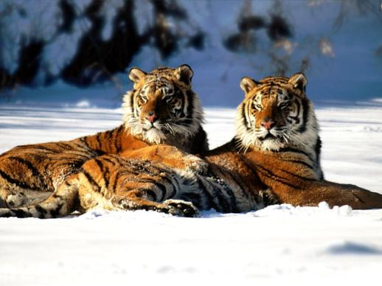
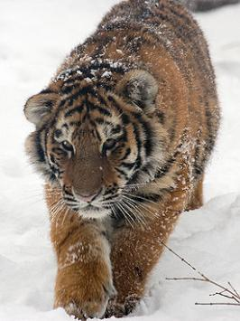
It is a very beautiful and dangerous animal.

