Slide 1
Конспект урока по английскому языку
«Здоровый образ жизни»
Учитель: Антипова Ольга Алексеевна

Slide 2
BYCICLE
YOGHURT
DOCTOR
ECOLOGY
CHEMIST
VITAMIN
TEMPERATURE
HEALTH

Slide 3
“Health or Body Care”

Slide 4
Healthy or Unhealthy

Slide 5
Healthy or Unhealthy

Slide 6
Healthy or Unhealthy

Slide 7
Healthy or Unhealthy

Slide 8
Healthy or Unhealthy

Slide 9
Healthy or Unhealthy

Slide 10
Healthy or Unhealthy

Slide 11
Healthy or Unhealthy

Slide 12
Healthy or Unhealthy

Slide 13
Healthy or Unhealthy

Slide 14
Healthy or Unhealthy

Slide 15
Healthy or Unhealthy

Slide 16
Healthy or Unhealthy

Slide 17
Healthy or Unhealthy

Slide 18
Healthy or Unhealthy

Slide 19
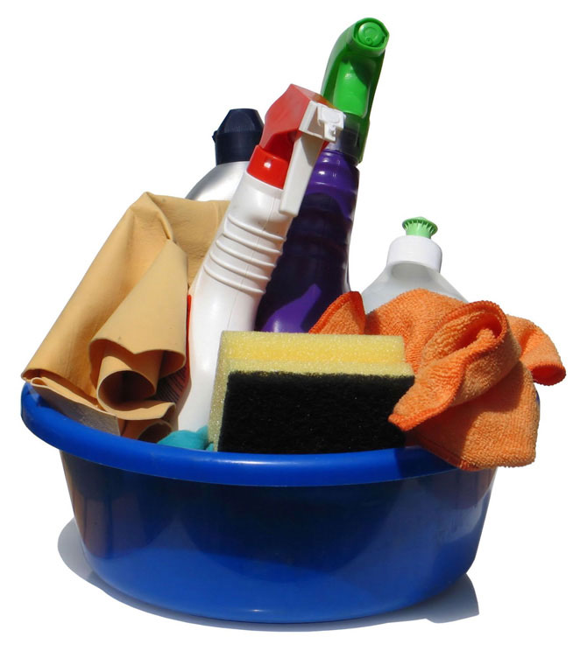
How to Be Healthy?

Slide 20
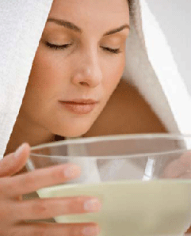
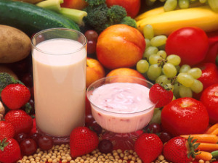
At the Doctor
Illnesses
Remedies

