Slide 1
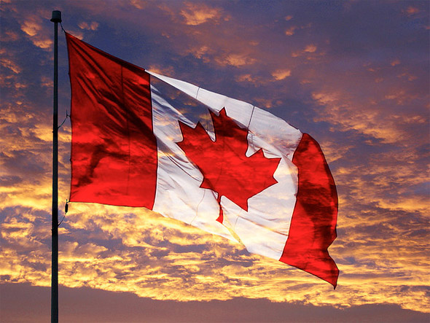
Welcome to Canada!

Slide 2
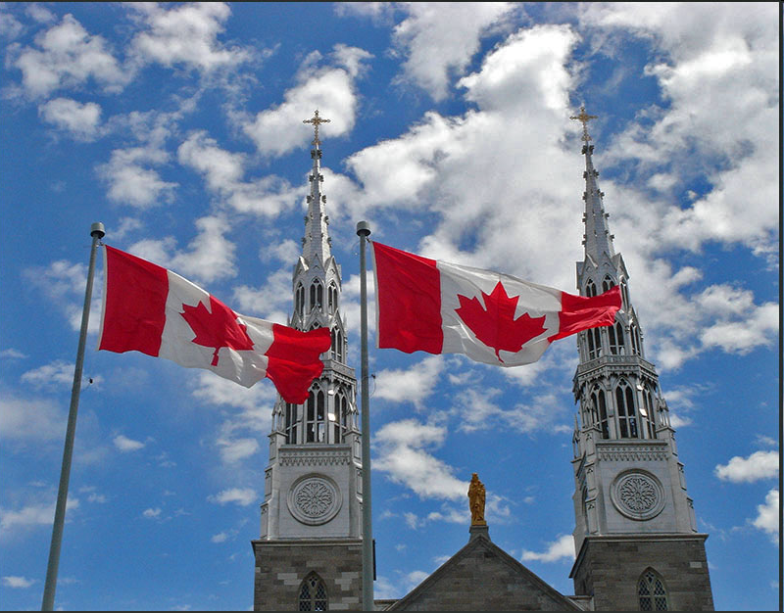

Slide 3
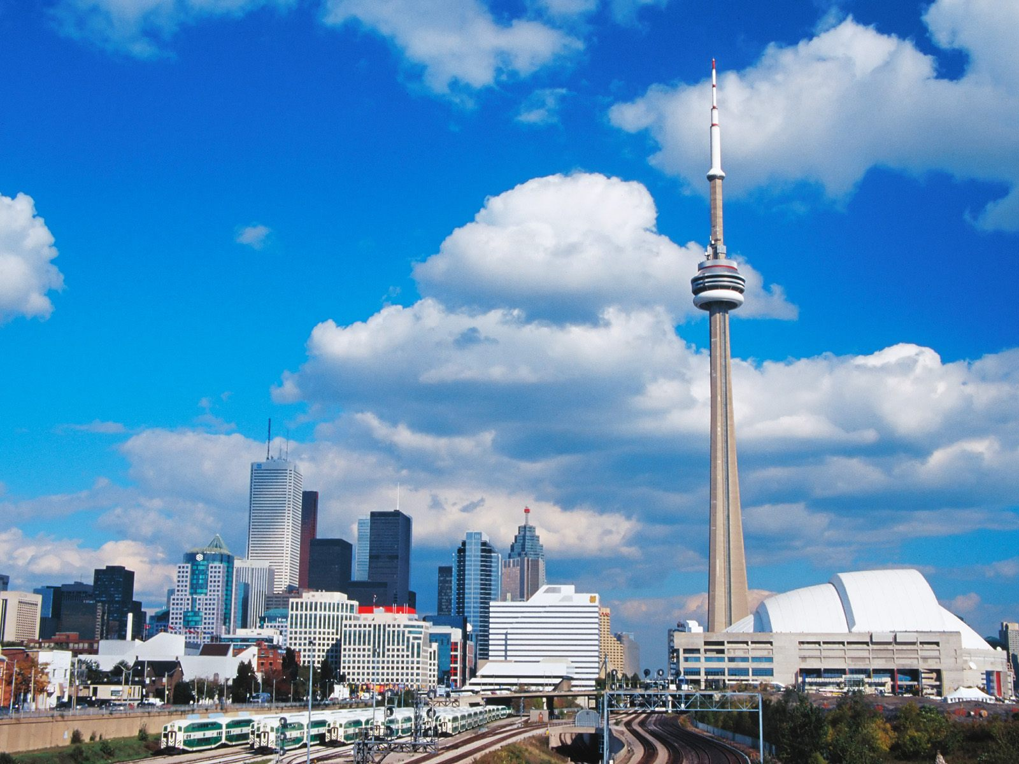
Capital city - Ottawa
Total area— 9,985,000 sq. km.
Official language – English, French
Population — 34 mln. Of people.
Official language: English, French

Slide 4
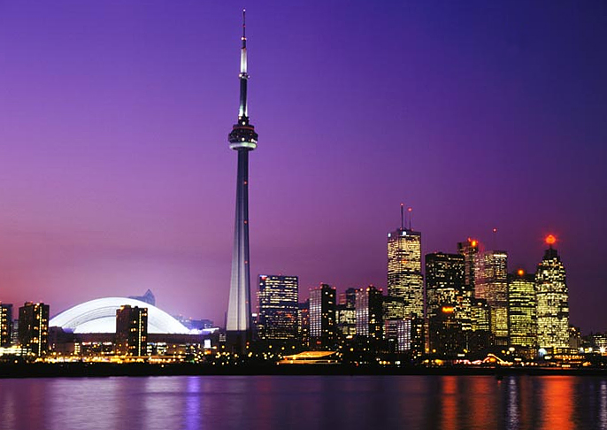

Slide 5
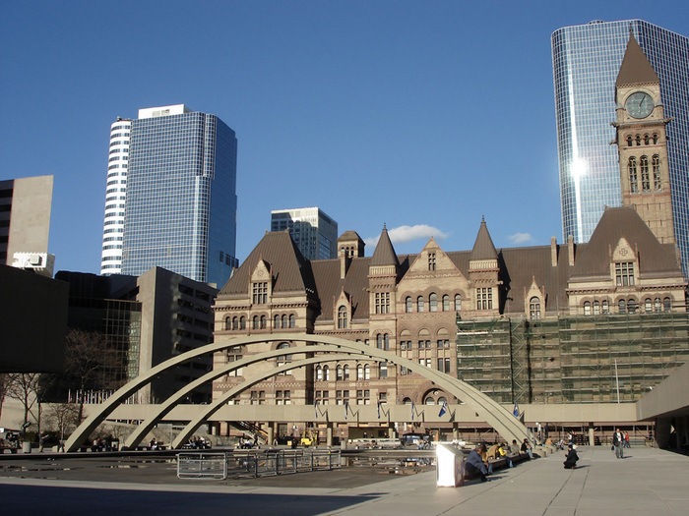
Canada is a country with a very high standard of living. This country is particularly advanced in the areas of health, education, social protection and human rights.

Slide 6
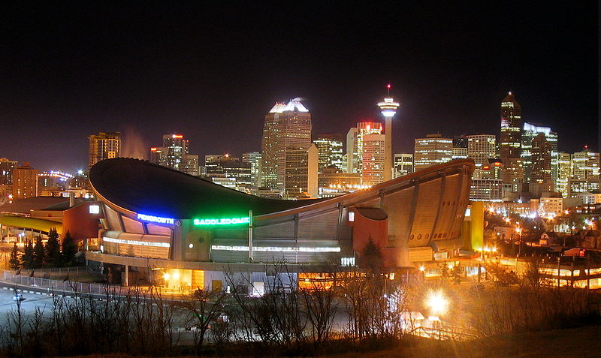

Slide 7
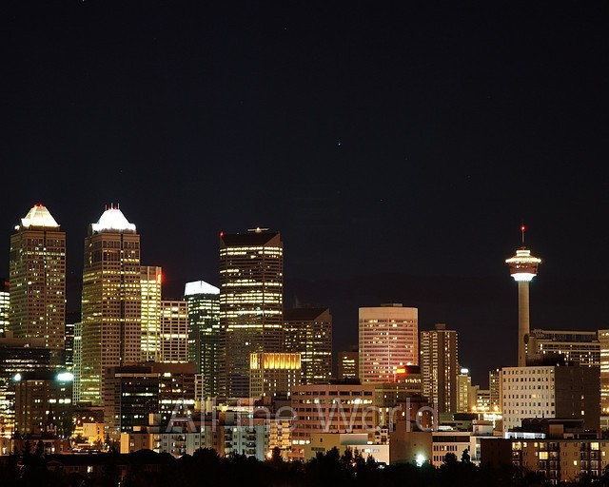

Slide 8
