Slide 1
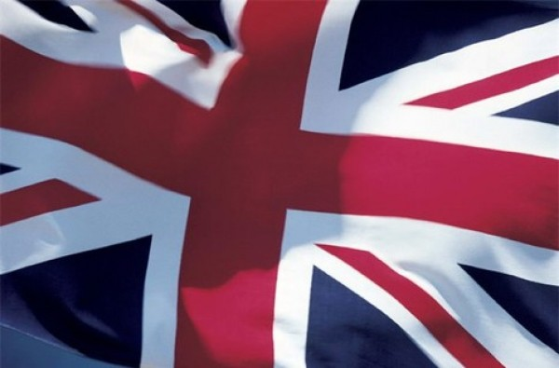
Travel around Britain.

Slide 2
The United Kingdom of Great Britain
The full name of the country the United Kingdom of Great Britain and Northern Ireland. The United Kingdom is situated on the British Isles. The British Isles consist of two large islands, Great Britain and Ireland, and a great number of small islands.
The UK is one of the world's smallest countries. Its population is over 57 million. About 80 % of the population is urban.
The UK is a highly developed industrial country. It is known as one of the world's largest producers and exporters of machinery electronics, textile, aircraft, and navigation equipment.

Slide 3
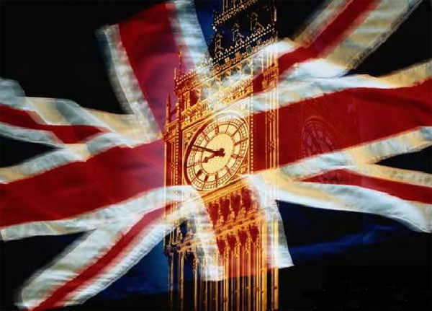
The flag of the United Kingdom, known as the Union Jack, is made up of three crosses. The big red cross is the cross of Saint George, the patron saint of England. The white cross is the cross of Saint Andrew, the patron saint of Scotland. The red diagonal cross is the cross of Saint Patrick, the patron saint of Ireland.

Slide 4
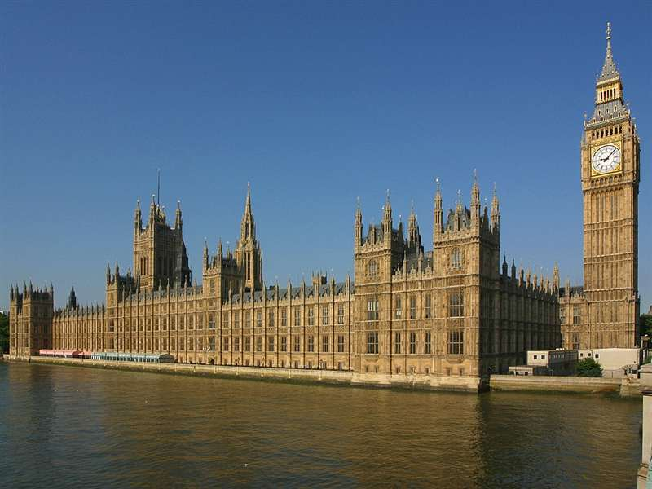

Slide 5
Places of Interest in Great Britain
Great Britain is rich in world-famous places. Hide Park is the London's largest and most fashionable park. It was once a royal hunting forest. There are restaurants and bars at each end of the Serpentine lake. You can hire a boat there.
The official name of the Houses of Parliament is the Palace of Westminster. Most of the building was built in 1840 after the fire of 1834 destroyed the old palace. At the north end of the building, by Westminster Bridge, there is the famous clock tower, Big Ben. In fact Big Ben is really the name of the bell in the tower, not of the clock.
The Tower of London is the London's oldest building. Since William the Conqueror built it in the 11th century, this castle has been a Royal palace, a prison, a place of execution, a zoo, the Royal Mint, and an observatory. Today it's a museum and houses the Crown Jewels. There is a gift shop.
The British Museum is the largest and richest museum in the world. It was founded in 1753 and contains one of the world's richest collections of antiquities. The Egyptian Galleries contain human and animal mummies.
Madam Tussaud's Museum is an exhibition of hundreds of life-size wax models of famous people of yesterday and today. The collection was started by Madam Tussaud, a French modeller in wax, in the 18th century. Here you can meet Marilyn Monroe, Elton John, Picasso, the Royal Family, the Beatles and many others: writers, movie stars, singers, politicians, sportsmen, etc.

Slide 6
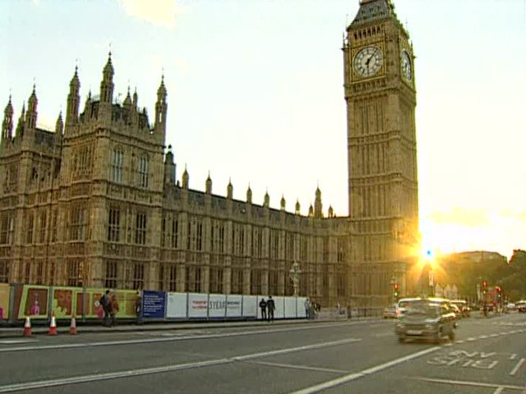

Slide 7
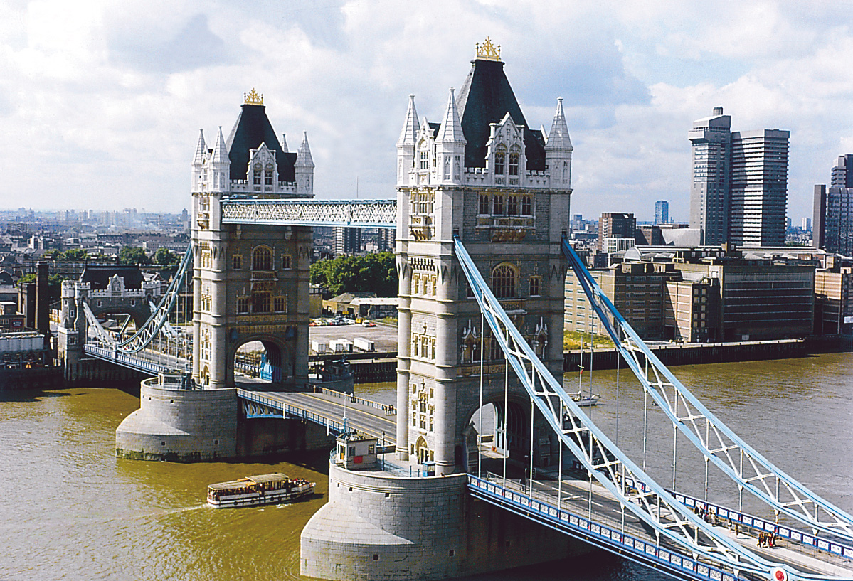
London Bridge

Slide 8
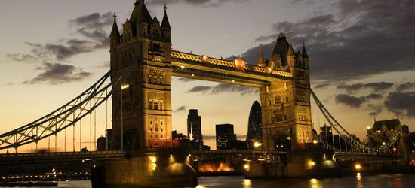

Slide 9
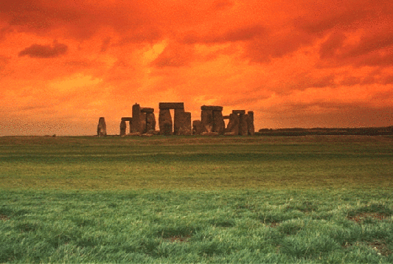
There is a prehistoric monument in Great Britain which is as interesting to the tourists as the Egyptian pyramids. This is Stonehenge. Stones stand here in circles or are arranged into a horseshoe shape. A great many theories have been advanced but exactly why it was built remains a mystery. Though the scientists consider that Stonehenge was built in order to calculate the annual calendar and seasons.

Slide 10
London
London is the capital of Great Britain, its political, economic and cultural center. It's one of the largest cities in the world. Its population is more than million people. London is situated on the river Thames. The city is very old and beautiful. It was founded more than two thousand years ago. Traditionally London is divided into several parts: the City, the West End, the East End and Westminster. The City.
The heart of London is the City, its financial and business center. Numerous banks, offices, and firms are situated there, including the Bank of England, the Stock Exchange
Westminster is the governmental part of London.
Nearly all English kings and queens have been crowned in Westminster Abbey.
Across the road from Westminster Abbey is Westminster Palace, the seat of the British Parliament. The Clock Tower of the Houses of Parliament is famous for its big bell, known as "Big Ben". Buckingham Palace is the official residence of the Queen.
The West End is the richest and most beautiful part of London. It is the symbol of wealth and luxury. The best hotels, shops, restaurants, clubs, and theatres are situated there.
The Trafalgar Square is the geographical center of London. It was named in memory of Admiral Nelson's victory in the battle of Trafalgar in 1805. The tall Nelson's Column stands in the middle of the square.
On the north side of the Trafalgar Square is the National Portrait Gallery. Not far away is the British Museum — the biggest museum in London. It contains a priceless collection of ancient manuscripts, coins, sculptures and is also famous for its library.

Slide 11
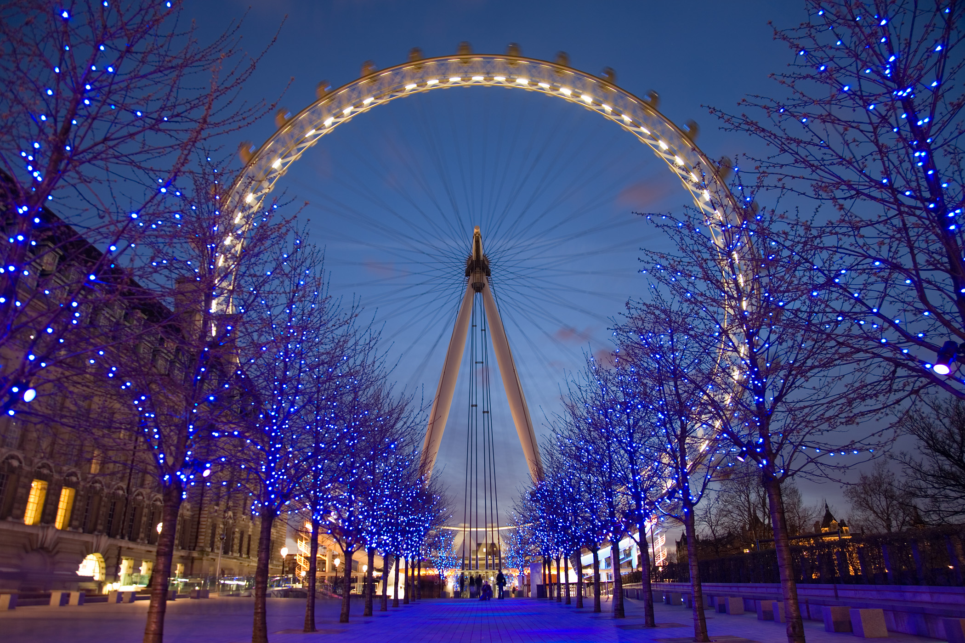

Slide 12
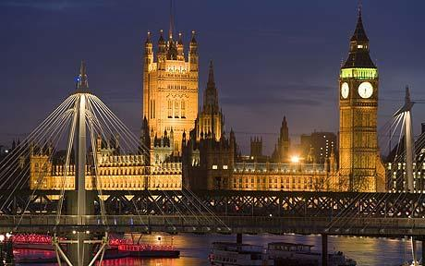

Slide 13
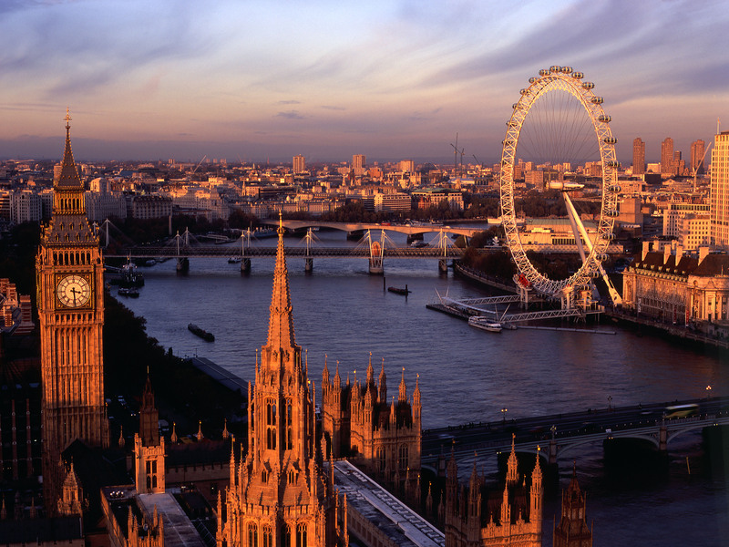

Slide 14
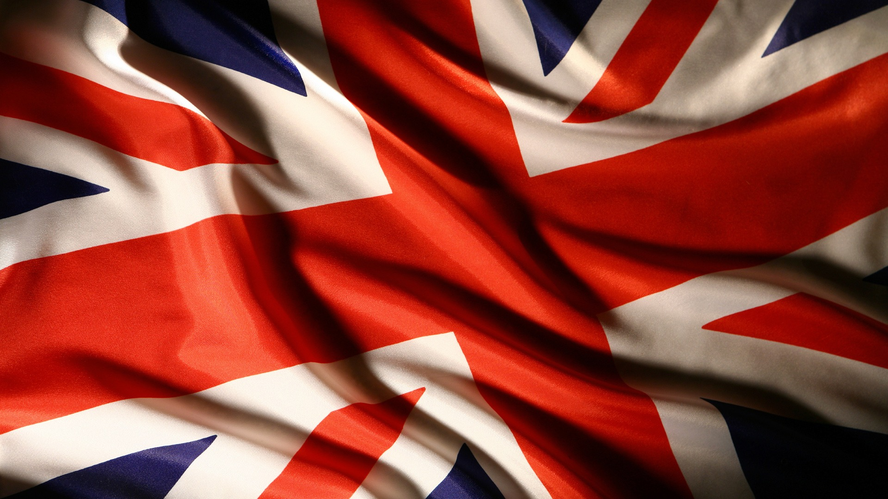
If you want to relax and see the interesting and memorable places I recommend you to visit The United Kingdom of Great Britain!

Slide 15
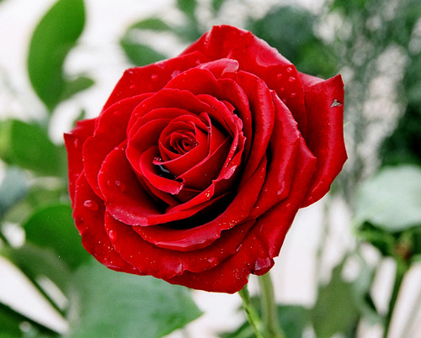

Slide 16


Slide 17
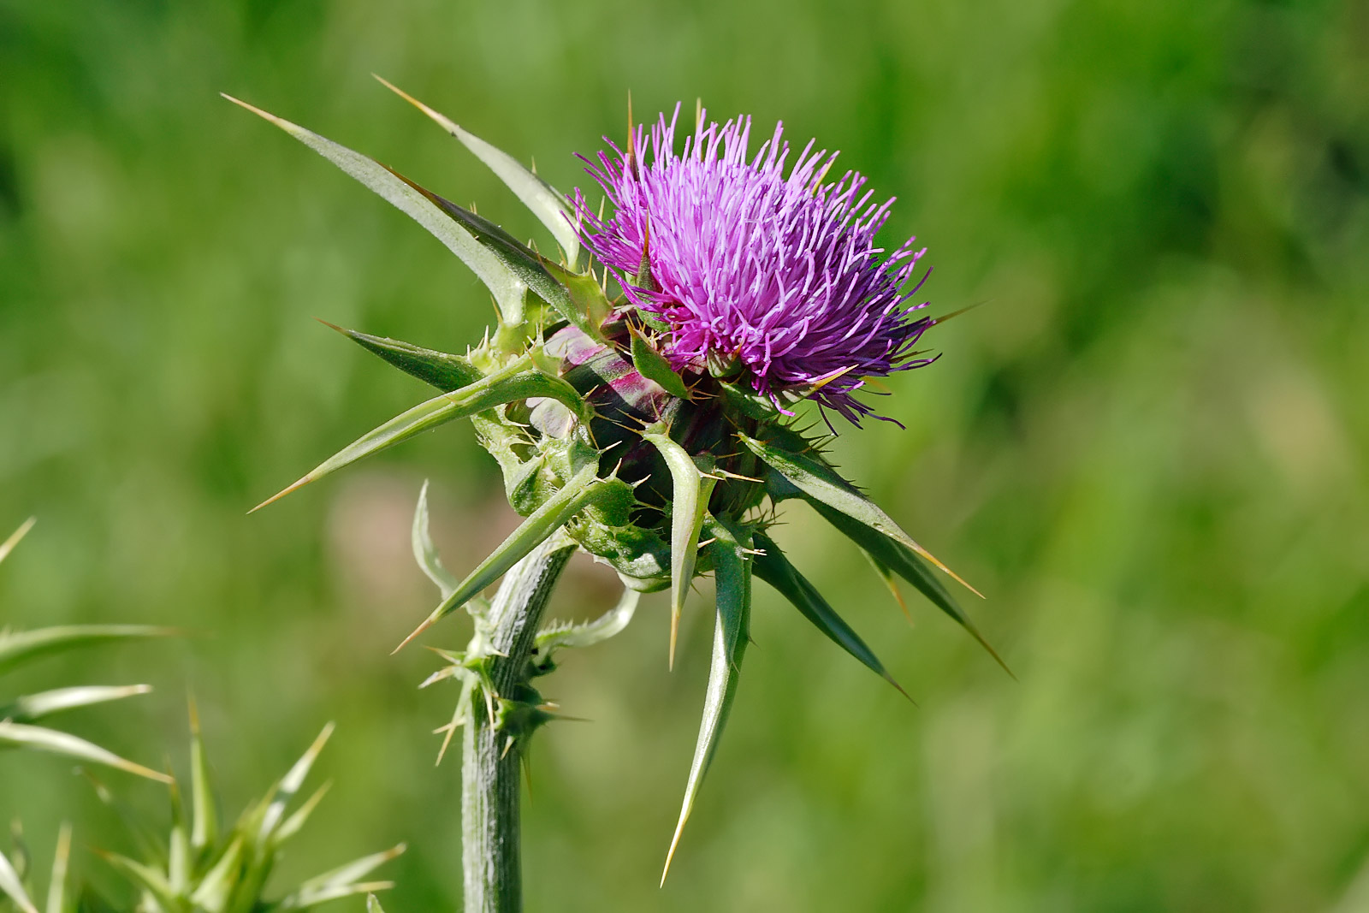

Slide 18


