Slide 1


Slide 2




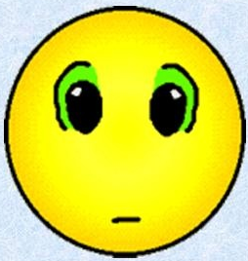

How are you?

Slide 3




Slide 4

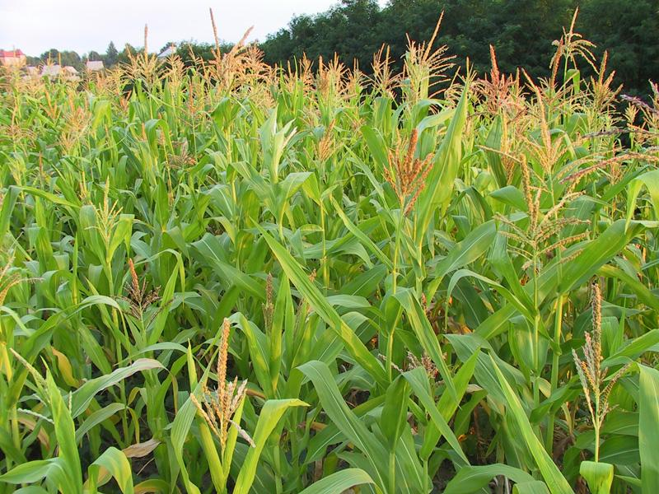
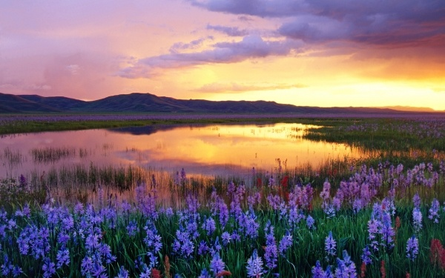
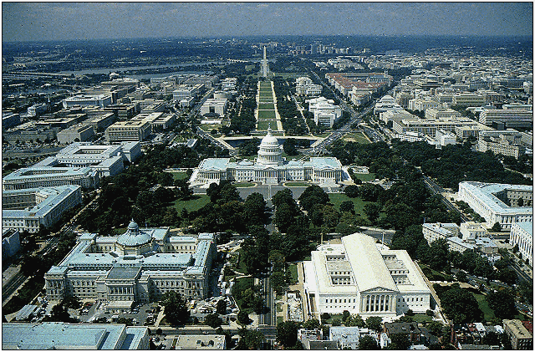
AMERICA, THE BEAUTIFUL

Slide 5
The plan of the lesson
The US geographical outlook
The US scenery and its wild beauty
The US as a melting pot
The article ‘the’ with the geographical names

Slide 6
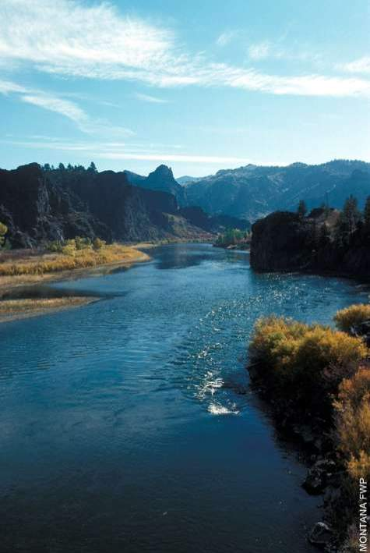
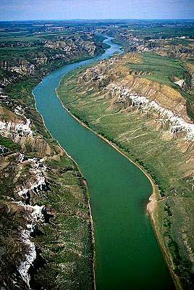
The Colorado
The Missouri

Slide 7
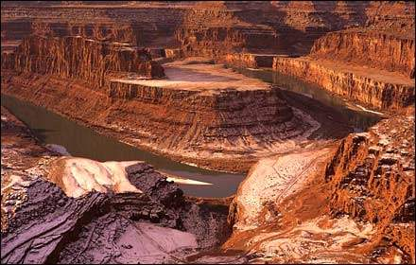
The Grand Canyon

Slide 8
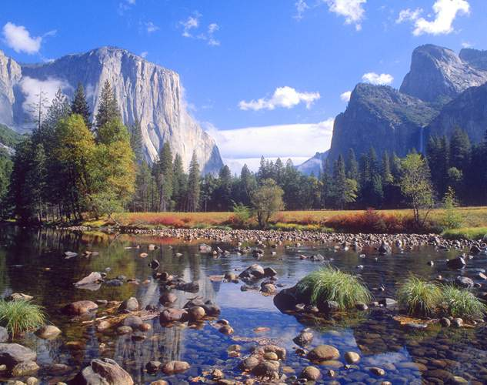
Yosemite Valley

Slide 9
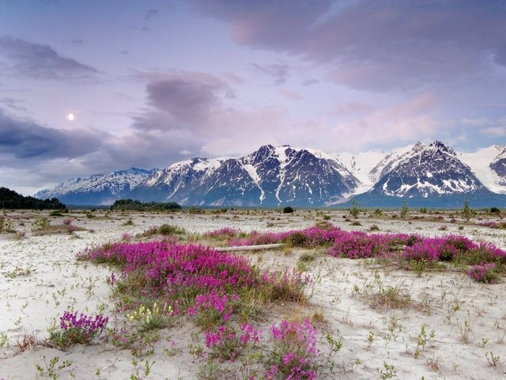
Alaska

Slide 10
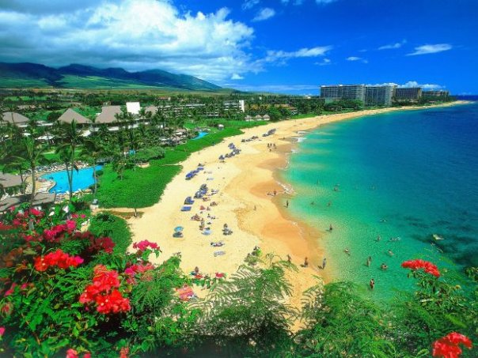
Hawaii

Slide 11
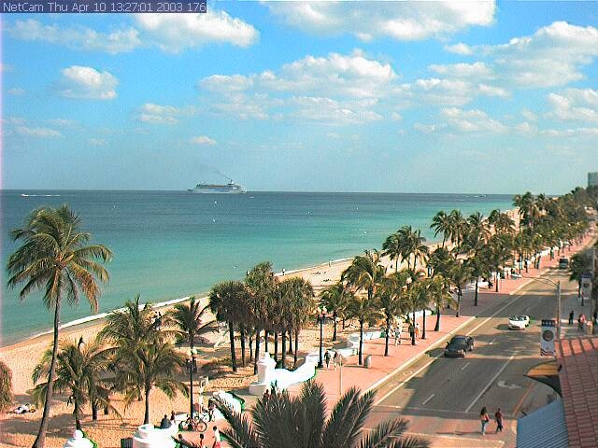
Florida

Slide 12
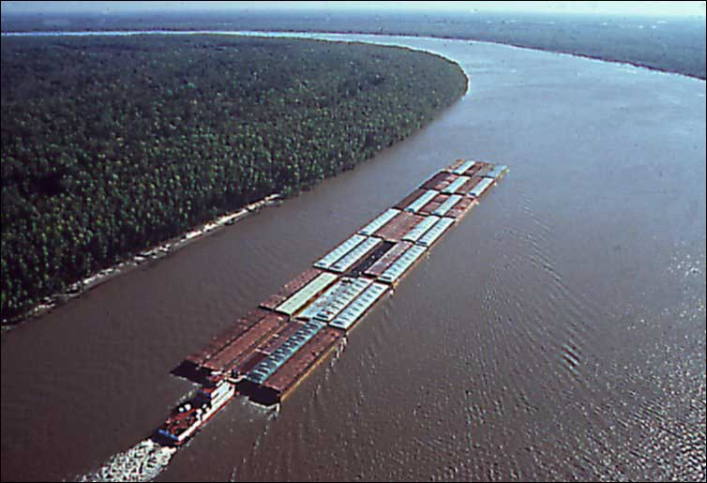
The Mississippi

Slide 13
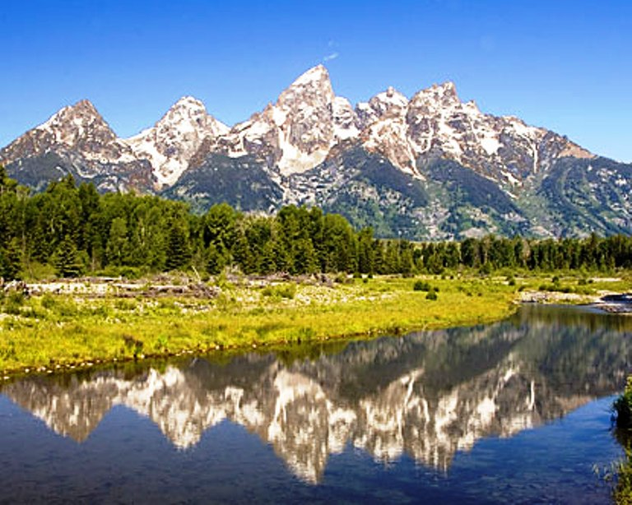
The Rocky Mountains

Slide 14
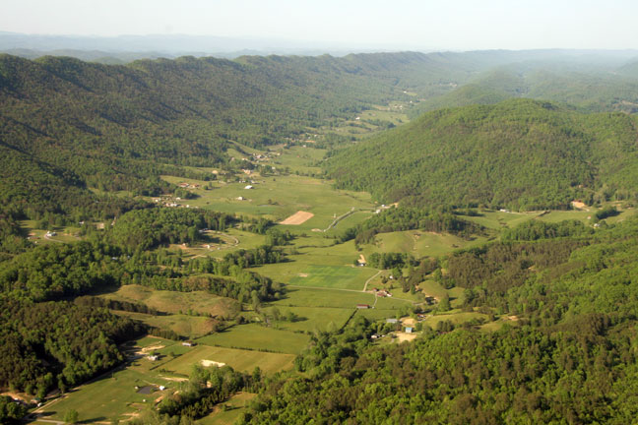
The Appalachians

Slide 15
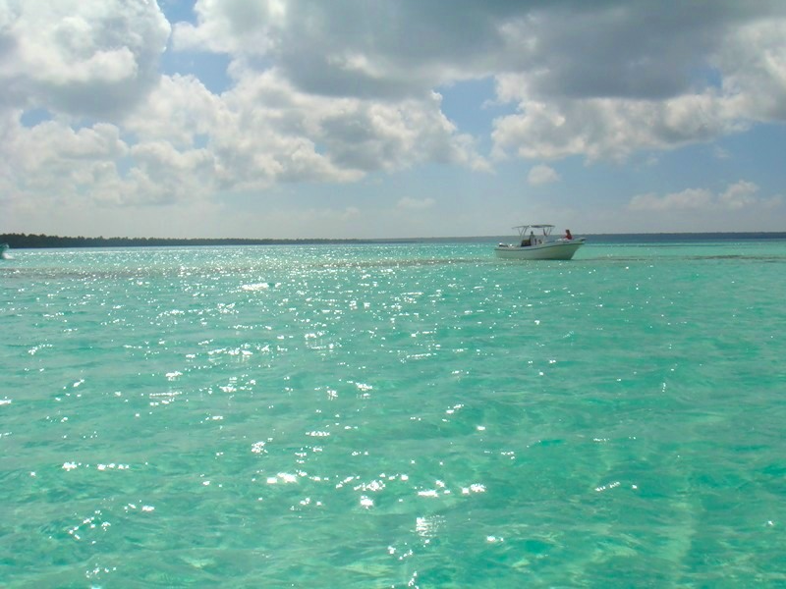
The Caribbean Sea

Slide 16
The definite article “THE” with the geographical names.
Check yourself 1.____Alaska 2.The Colorado 3.___Florida 4.The Missouri 5.The Grand Canyon 6.___Yosemite Valley 7.The Appalachians 8.The Mississippi 9.___Hawaii 10.The Caribbean Sea 11.The Rocky Mountains
THE RIVERS SEAS MOUNTAINS
11 | 10-9 | 8 | 7…
5 | 4 | 3 | Try again!

Slide 17
Text “COUNTRY AND PEOPLE”
Part I
The geographical position
Part II
The beauty and nature of the US
Part III
People of the US

Slide 19
True or False
Keys:
False
True
False
False
True
True
False
True
8 | 7 | 6 | 5
5 | 4 | 3 | Try again!

Slide 20
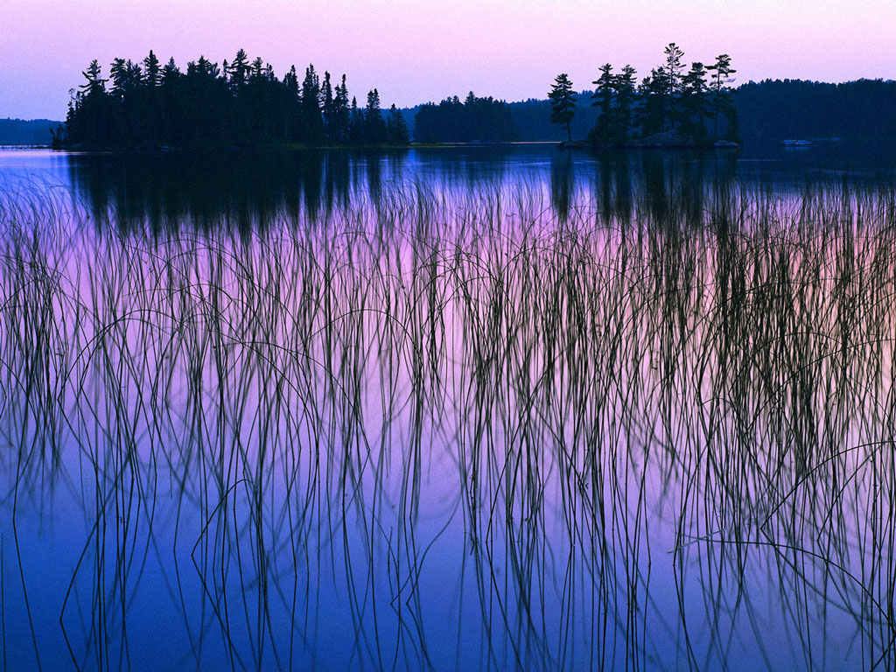
G R E A T L A K E S
&
Niagara Falls

Slide 21
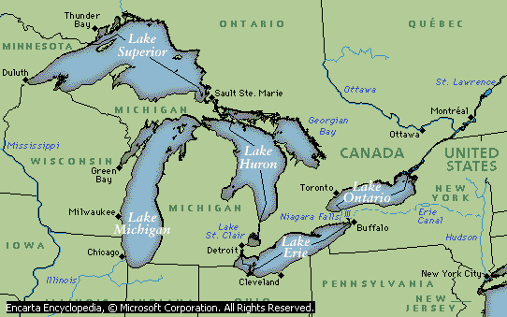

Slide 22
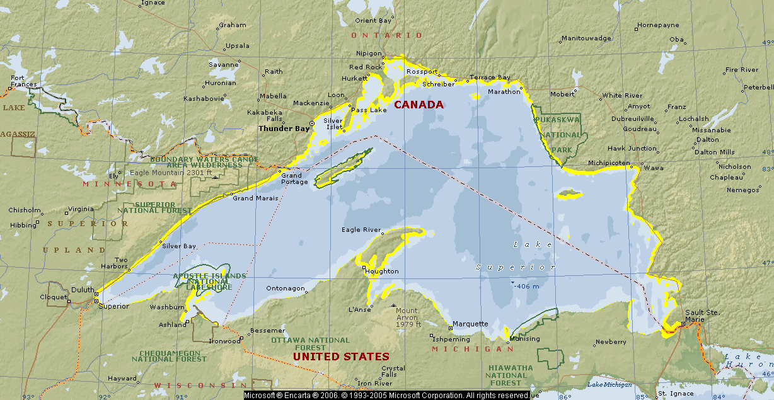
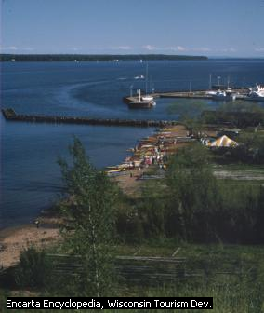
Lake Superior

Slide 23
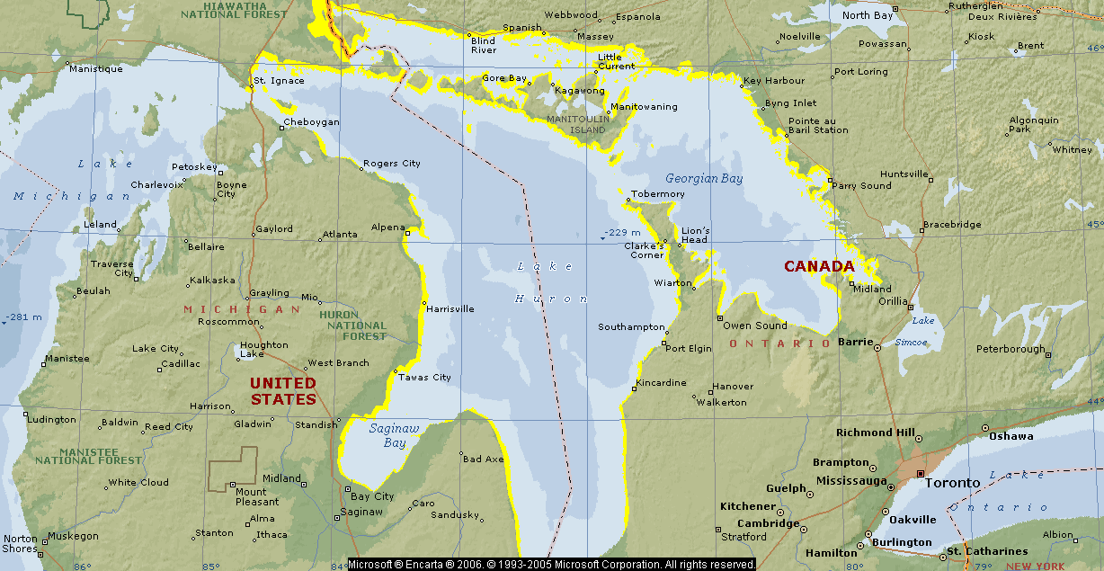
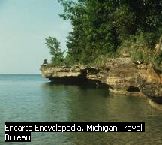
Lake Huron

Slide 24
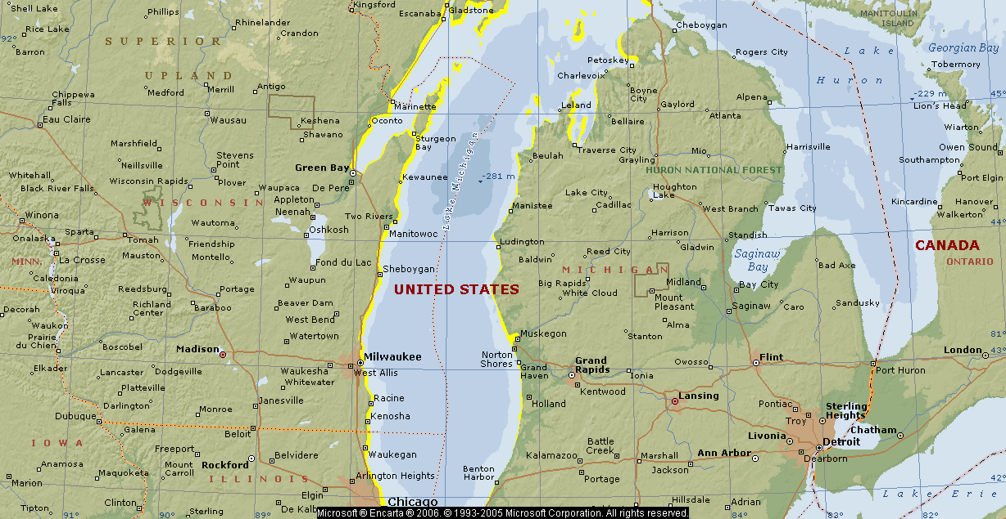
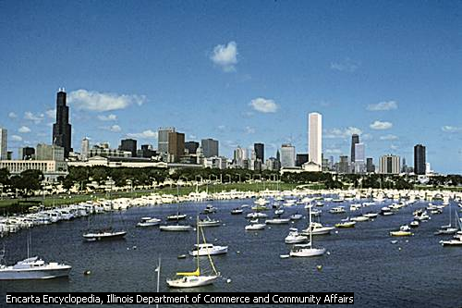
Lake Michigan

Slide 25
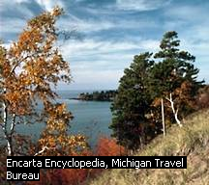
Lake Michigan

Slide 26
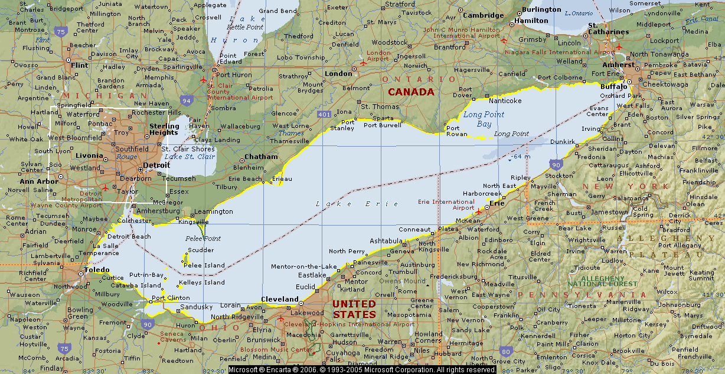
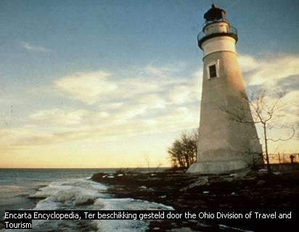
Lake Erie

Slide 27
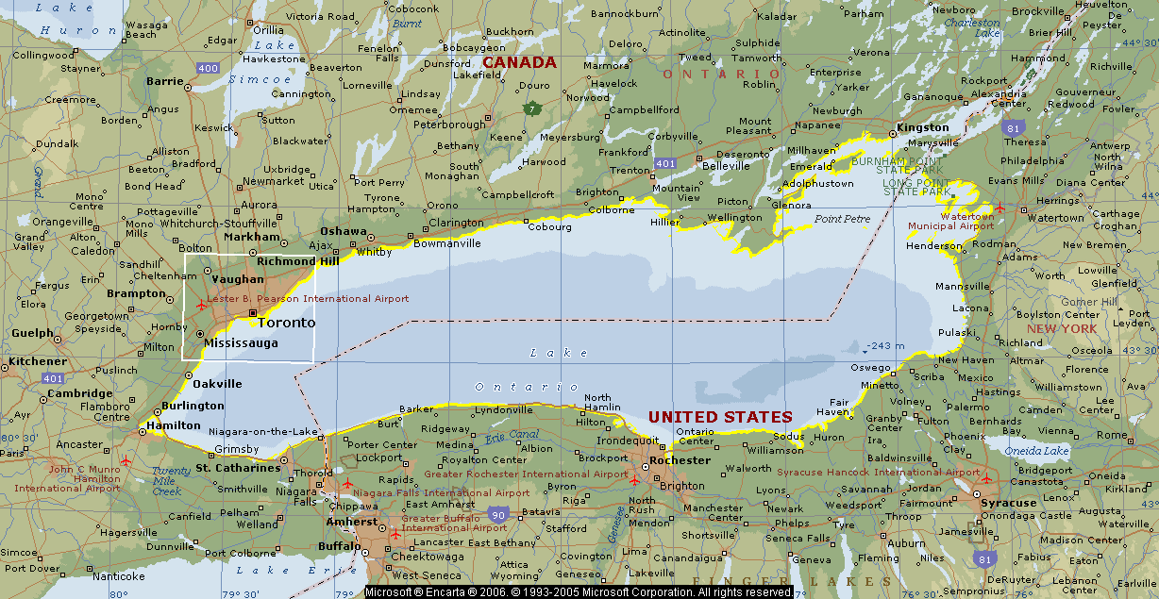
Lake Ontario

Slide 28
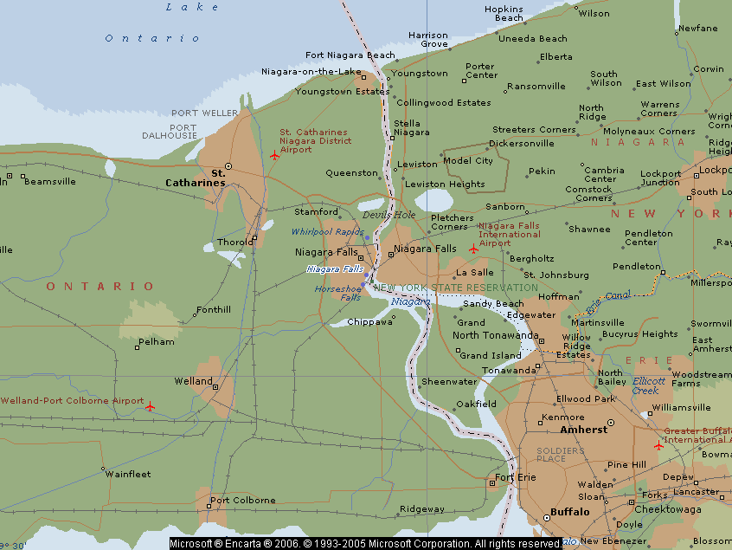
Niagara Falls

Slide 29
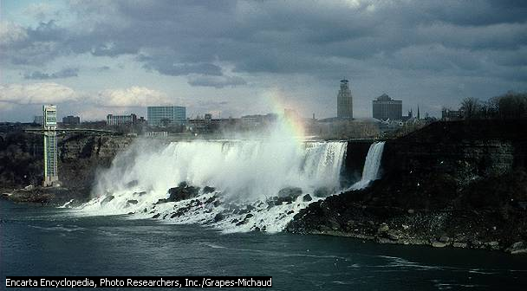
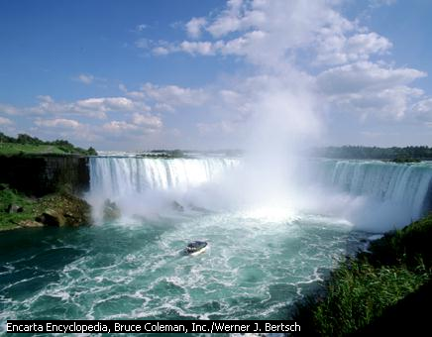
Niagara Falls

Slide 30
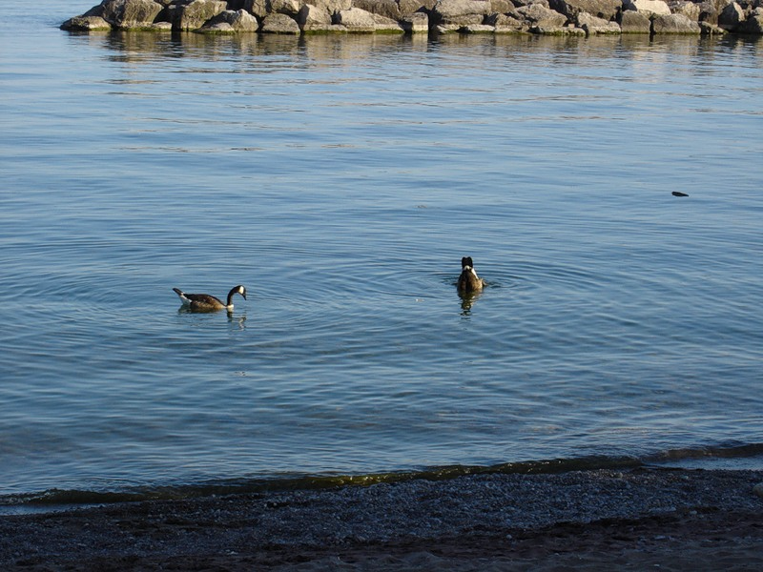

Slide 31
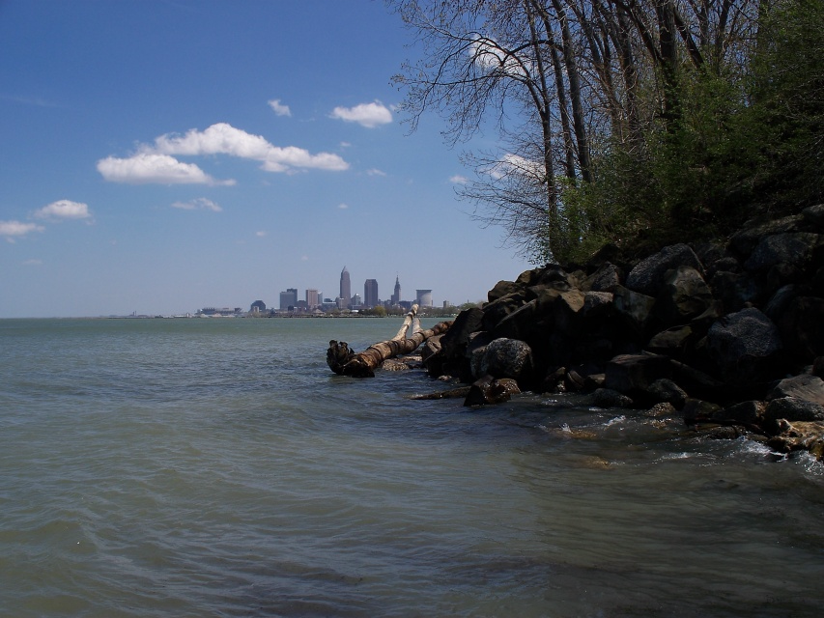

Slide 32
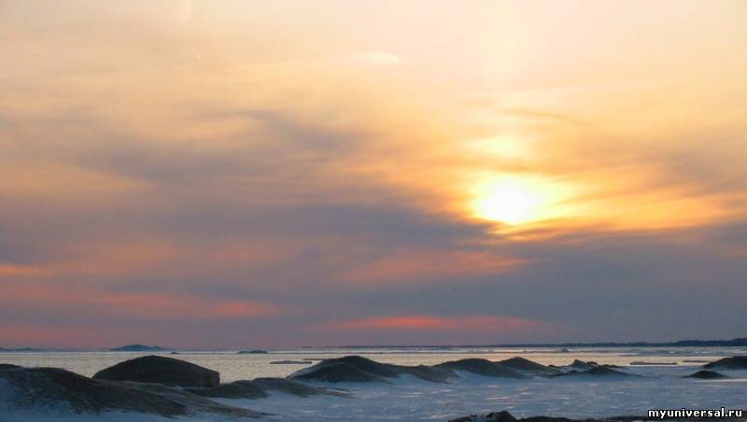

Slide 33
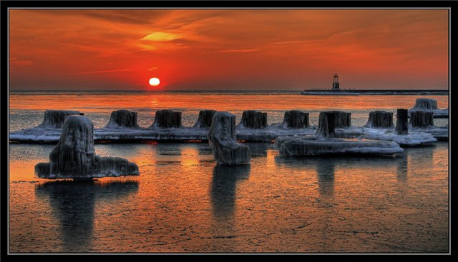

Slide 34
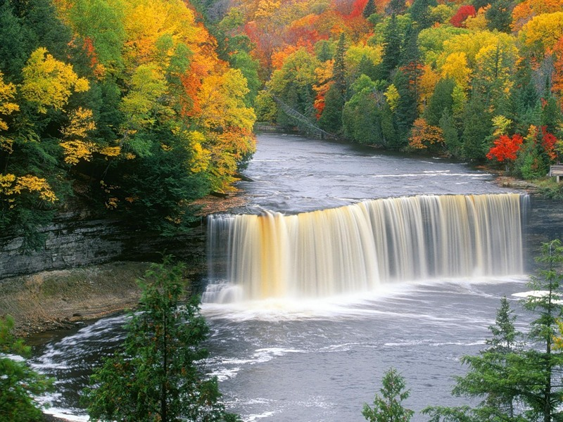

Slide 35
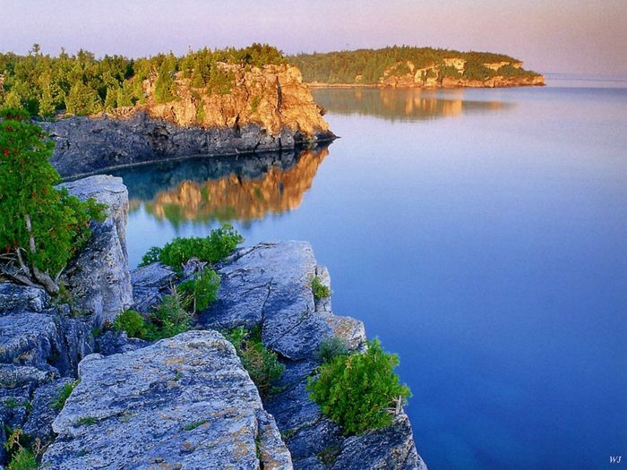

Slide 36
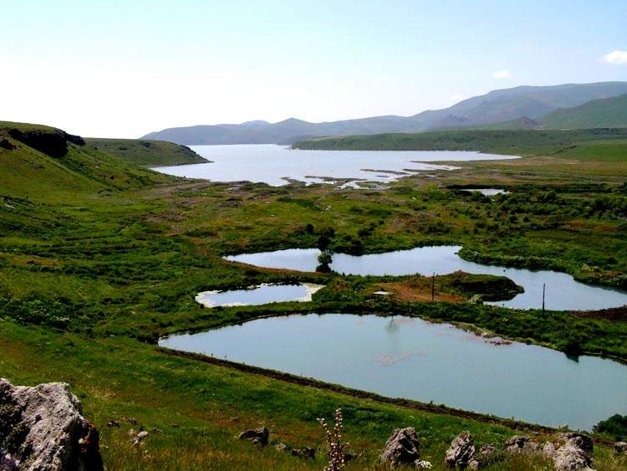

Slide 37
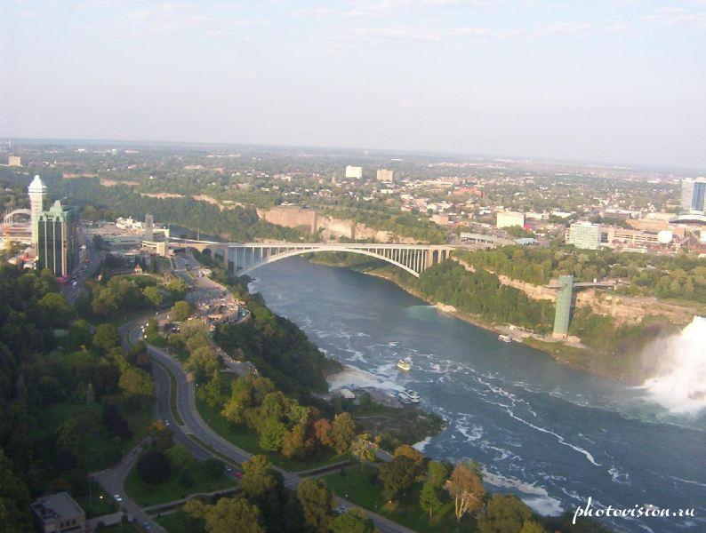

Slide 38
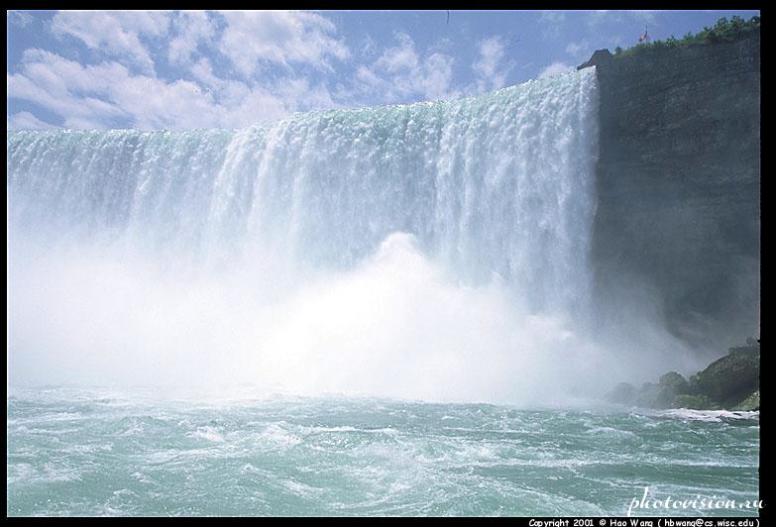
WELCOME TO AMERICA!

Slide 39

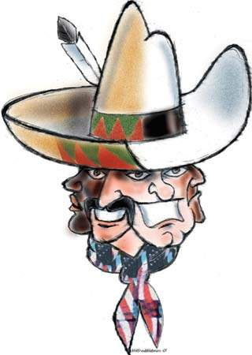
The people of the United States are a mixture of different nationalities.

Slide 40
The USA.
1.____is situated_____. 2. It is washed by _____ in the west, by _____ in the east, _____ and ______ in the south. 3. There are five _____between ____ and ____. 4. The USA _____ almost every kind of _______. 5. Snowy ______ is the biggest state. 6. There _____ a lot of mighty, powerful ________ , wild______, high____. 7.____ and ____ are two big mountain chain in the USA. 8. _______ is really big and very beautiful. 9. The USA is like _____ pot for people. 10. More than _______ million people ______ in the USA.

Slide 41

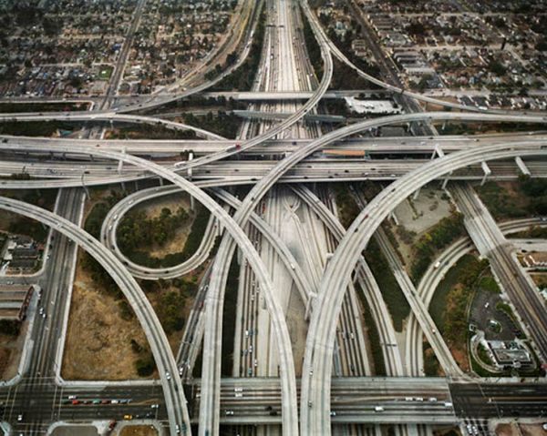
This land is your land
ribbon of highway – лента шоссе (дороги)
the Gulf Stream – Гольфстрим

Slide 42
CHECK YOURSELF
As I was walking that ribbon of highway
I saw above me that sky-way,
I saw below me that golden
This was made for you and me.
This is your , this is my
From to the island,
From the red-wood to the Gulf Stream water,
This was made for you and me.
endless
valley,
land
land
land
land,
California
New York
forest
land

Slide 43
Let’s have fun!

Slide 44
Try to name the reasons for travelling to America
Why travel to America?
To visit Yellowstone
to rest and swim in the Caribbean sea
To walk in the Appalachians
to practice speaking English
To meet people
To see the Grand Canyon
To visit American
city
to learn more about America

Slide 45
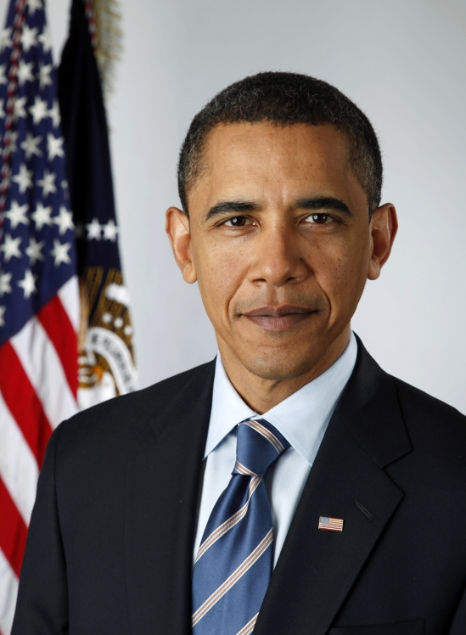
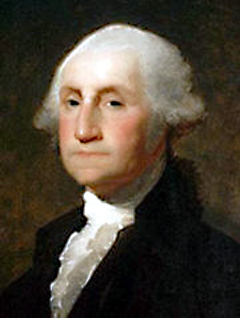
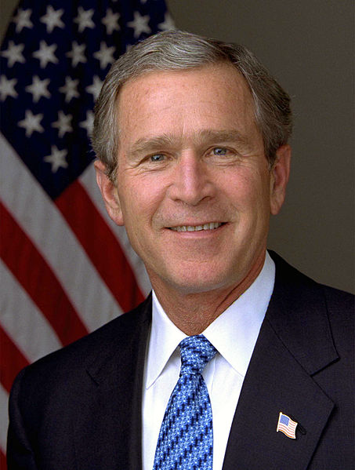
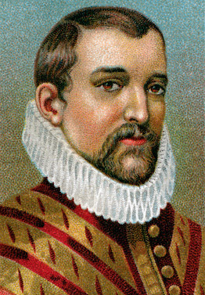
FAMOUS PEOPLE

Slide 46
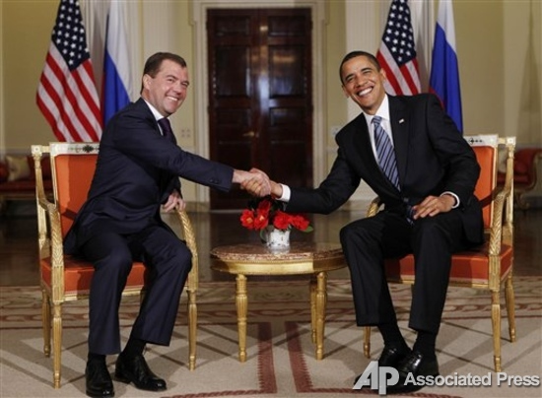
Russia and America are friends!

Slide 47
THE USA

