Slide 1
English Quiz

Slide 3
Question №1:
Название какой спортивной игры переводится как НОГА и МЯЧ?
FOOTBALL

Slide 4
Question №2:
Как в слове Basketball переводится basket?
Корзина

Slide 5
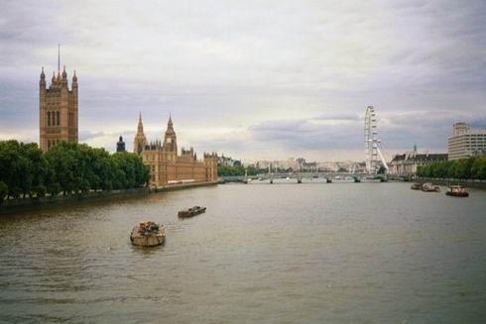
Question №3:
What is the name of the main river in London?
Thames

Slide 6
Question №4:
What’s the name of the author who wrote “Alice in Wonderland”?
L. Carroll

Slide 7
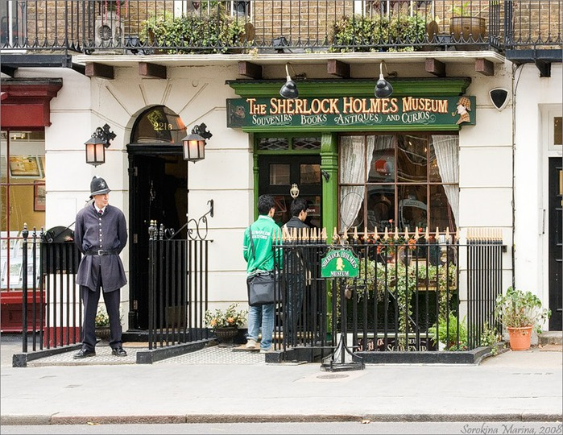
Question №5:
Who lived in Baker Street?
Sh.Holmes

Slide 8
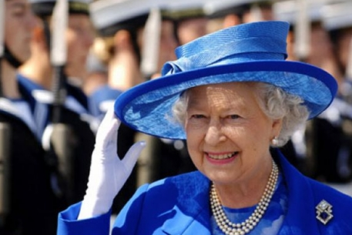
Question №6:
What is the name of the English Queen?
Elizabeth II

Slide 9
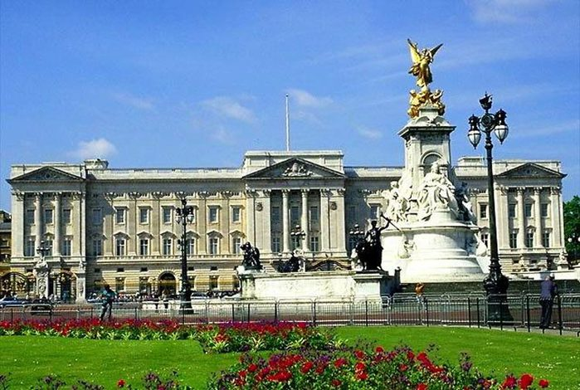
Question №7:
Where does Queen Elizabeth II live?
Buckingham palace

Slide 10
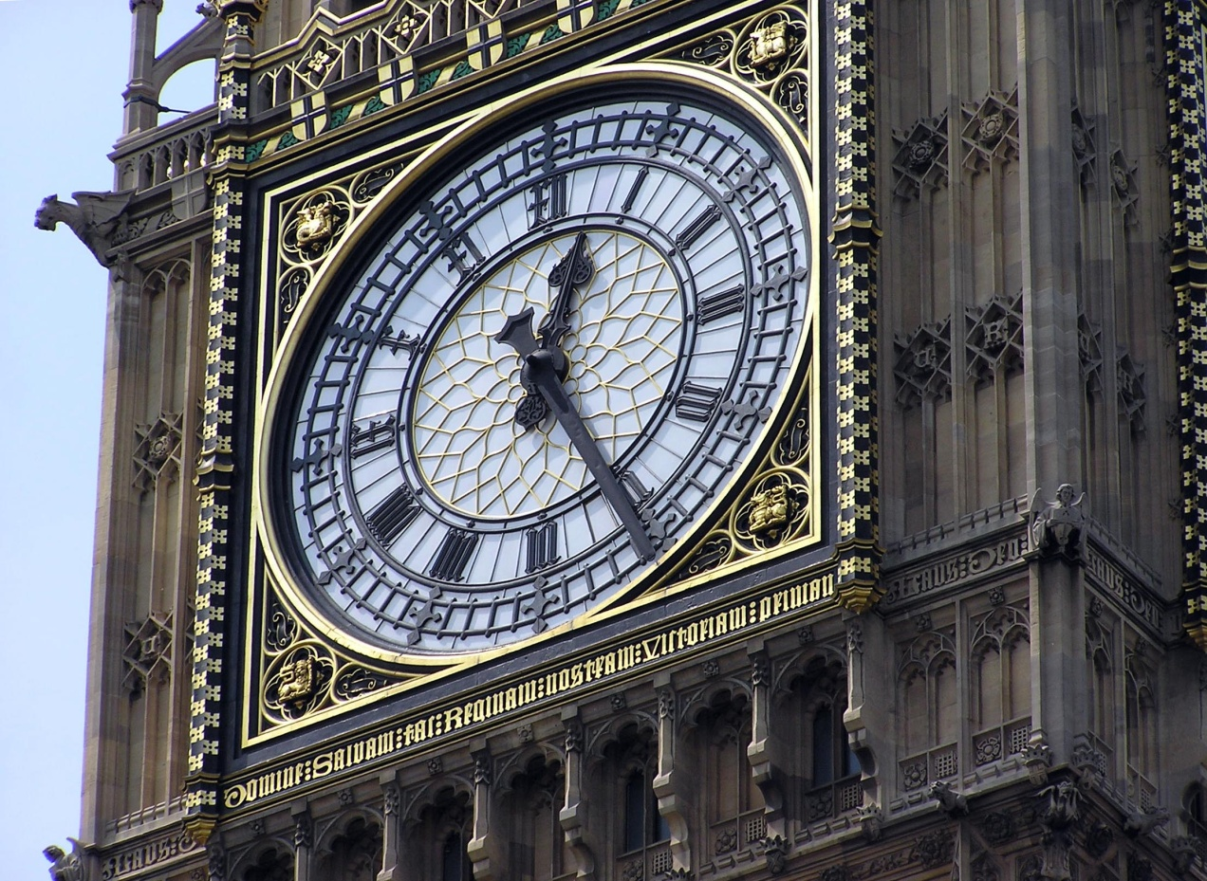
Question №8:
What is the famous clock in the UK?
Big Ben

Slide 11
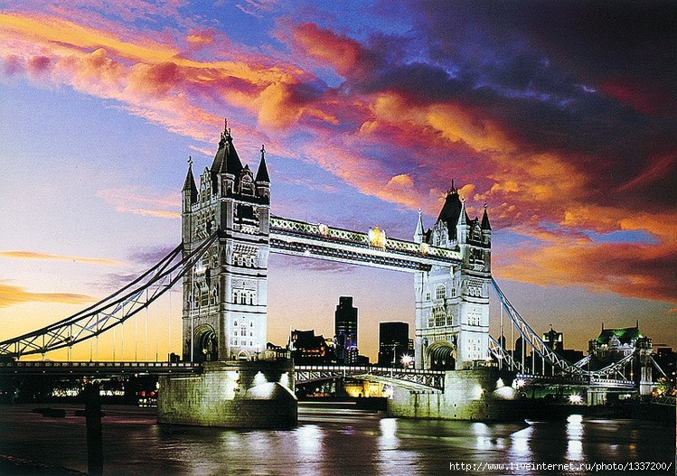
Question №9:
What is the most famous bridge in London over the river Thames?
Tower Bridge

Slide 12
Question №10:
Where can you see many wild animals in London?
London Zoo

Slide 13
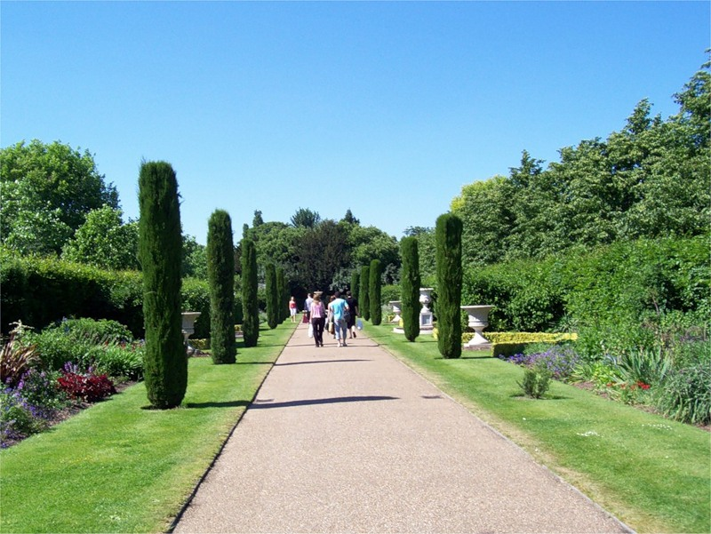
Question №11:
In what park is there London Zoo?
In Regent’s Park

Slide 14
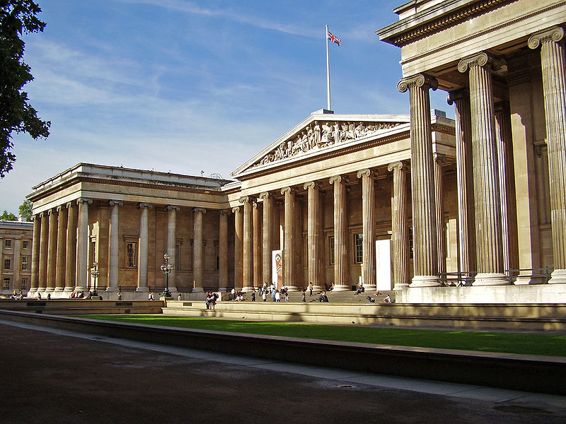
Question №12:
What is one of the world famous museums in the UK?
The British Museum

Slide 15
Question №13:
Where are many banks and offices in London?
The city

Slide 16
Question №14:
Where is a monument to Admiral Nelson?
In Trafalgar Square

Slide 17
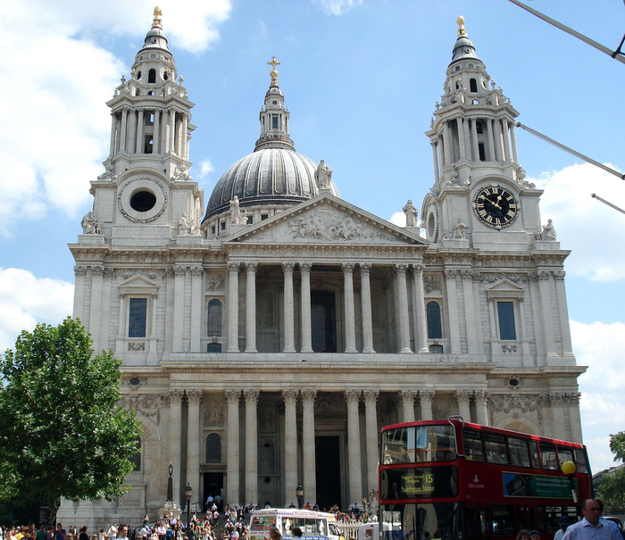
Question №15:
What was built by architect Christopher Wren?
St. Paul’s Cathedral

Slide 18
Question №16:
Which country is not a part of the UK?
Ireland

Slide 19
Question №17:
When was the Great Fire of London?
1666

Slide 20
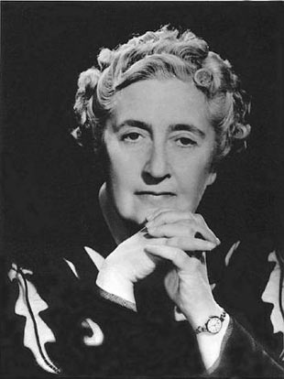
Question №18:
A.Christie has written lots of …stories.
Detective

Slide 21
Question №19:
The Boat Race in England is between … Universities.
Oxford and Cambridge

Slide 22
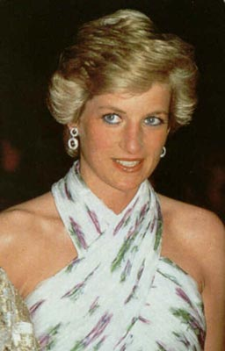
Question №20:
Who is this woman?
Princess Diana

Slide 23
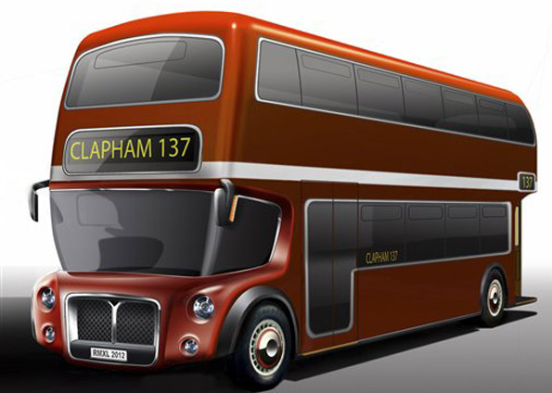
Question №21:
What is the name of this bus?
Double-decker bus

Slide 24
Find the odd word.
В предложенных карточках участники должны найти лишнее слово.
Spring, autumn, cold, winter, summer
Hot, frog, foggy, frosty, rainy, warm
Interesting, walking, cycling, swimming, jumping,running
Sweater, dress, skirt, sweet, trousers
Bread, fruit, porridge, head, butter

Slide 25
Thank you ☺

