Slide 1
Theme: Our plans for the Weekend

Slide 2
See a pin and pick it up All that day you will have luck See a pin and let it lay You`ll have bad luck all that day.

Slide 3
Translate From Russian Into English:

Slide 4
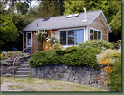
1.ездить на дачу 2.гулять с друзьями 3.приглашать 4.ходить за покупками 5.вовремя

Slide 5
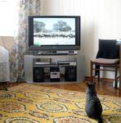
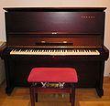
1.Смотреть телевизор 2.это - плохая идея 3.убрать квартиру 4.хорошо провести время 5.играть на пианино

Slide 6
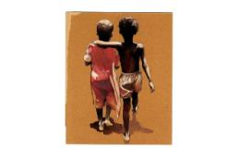
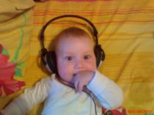
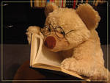
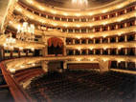
1.посещать друзей 2.слушать музыку 3.играть в компьютерные игры 4.читать книги 5.ходить в театр

Slide 7
1.вовремя 2.ходить в кино 3.сколько раз 4.это хорошая идея 5.читать журналы

Slide 8
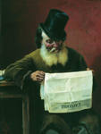
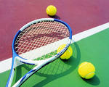
1.читать газеты 2.играть в теннис 3.сходить за покупками 4.время 5.играть на гитаре

Slide 9
We can read we can write We can speak English too We like learning Grammar And what about you?

Slide 10
To be going to+Infinitive

Slide 11
+ I am going to read. He/She/It is going to read. We/You/They are going to read.

Slide 12
? Am I going to read? Is she/he/it going to read? Are we/you/they going to read?

Slide 13
_ I`m not going to read. She/he/it isn`t going to read. We/you/they aren`t going to read.

Slide 14
Student`s book: ex.11 p.29 Workbook: ex.13 p.15

Slide 15
Tag- questions 1. They are going to study Literature,…? 2. We shall spend our holidays in Great Britain,…? 3. His friend can speak English very well, …? 4. I never play tennis in winter,………...? 5. You are not a doctor,………….………..? 6. The girl helped her granny about the house last week,…?

Slide 16
Work in pairs and Act out: 1. Making a picnic 2. Going to the theatre 3. Visiting granny on her Birthday

Slide 17
Hands up! Hands down! Hands to the sides! Hands on hips! Bend left! Bend right! Hands up! Hands down! And sit down!

Slide 18
I am going to London! Author: Virskaya Liza, 5-1th form, school 17. Tver, 2012

Slide 19
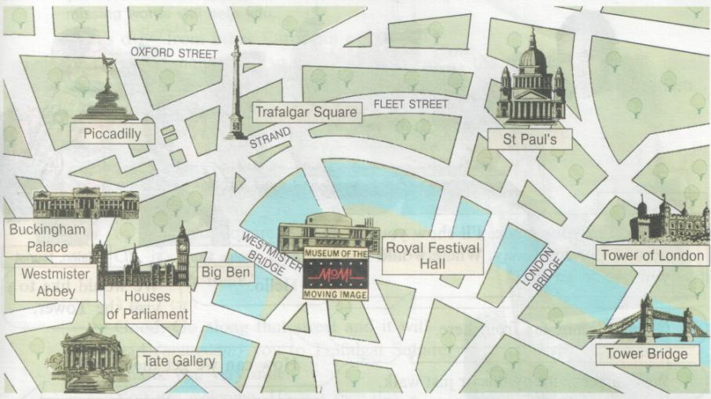
The Map of LONDON jj

Slide 20
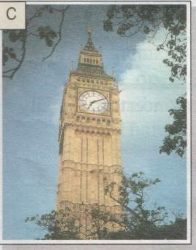
Places of Interest in London Big Ben Big Ben is really a big bell. You hear it every hour.

Slide 21
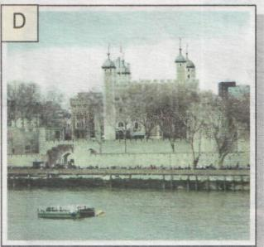
The Tower of London You can see the Tower of London from the river Thames. The Tower is very old. The tall building is the White Tower, the oldest part of the Tower of London. The Bloody Tower is near the river.

Slide 22
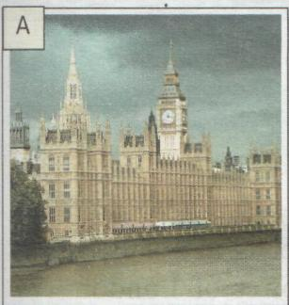
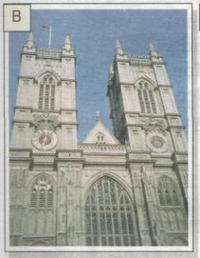
The Houses of Parliament The country’s leaders speak in the Houses of Parliament. Westminster Abbey It is a symbol of England. W Westminster Abbey was u founded by St Peter himself. The coronation of all British Kings and Queens takes place there.

Slide 23
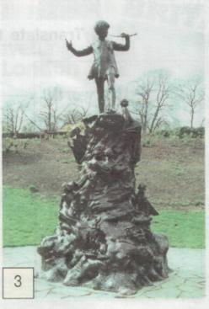
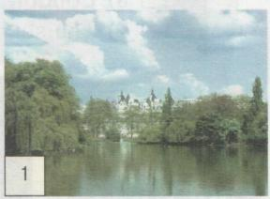
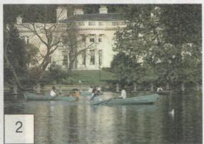
Parks and Gardens of London The Royal Parks are the property of the Royal family. They are Hyde Park, Green Park, St James’s Park, Regent’s Park and Kensington Gardens.

Slide 24
Have a good time in London!!!

Slide 25
My last weekend Author: Gorodnow Daniil, 5-1th form, school 17. Tver,2012

Slide 26
I spent my last Weekend at the cinema, at the cafe, and in the park near the river!

Slide 27
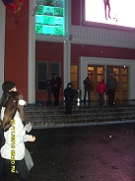
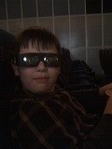
I enjoyed a new film, called ‘‘Harry Porter’’. It was fantastic!

Slide 28
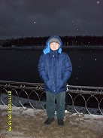
After the cinema we walked near the river Volga!

Slide 29
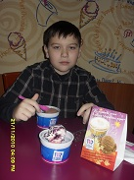
My favourite tasty food!!!

Slide 30
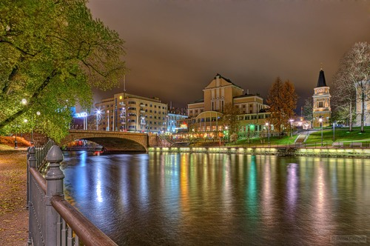
The weekend was over. I had a good time!

Slide 31
Mary Poppin`s Day Out Mary Poppin`s is a nanny for babies in one of London`s families. She is strict, but kind. Children like her and don`t want to leave her. The first book about Mary was published in 1934. Children of different countries dreamt, that Mary would fly to them and would be their nanny.

Slide 32
H/W: ex.21 p. 32 Make up your own ending to the story “ Mary Poppins` Day Out”. The lesson is over. Goodbye!

