Slide 1
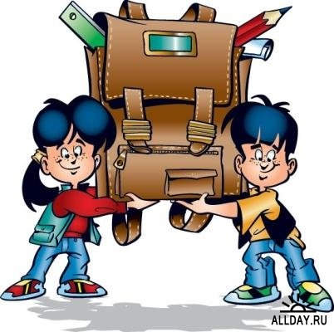
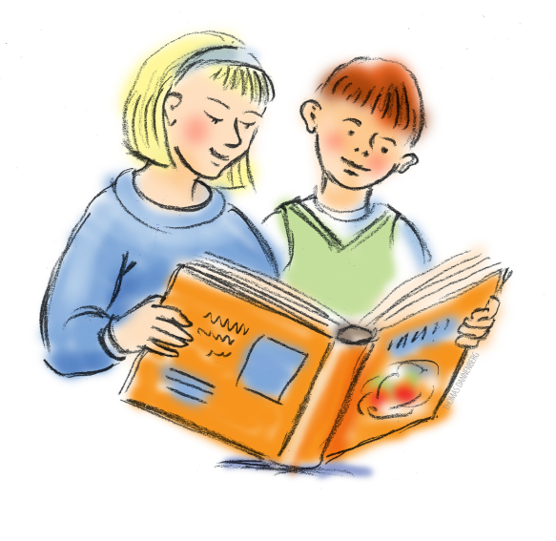
You learn a lot of things at school, And new ones every day; I think the names of some of them Are very hard to say. Writing is an easy thing. But if you use your ink, Remember not to make a blot, Dictation can be bad, I think. Geography’s about the world, It’s interesting for me, Because I like to hear about The lands across the sea. But Reading is the best of all, Reading’s like a key That opens many, many doors; It opens books for me.

Slide 2
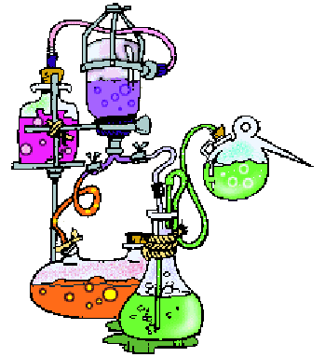
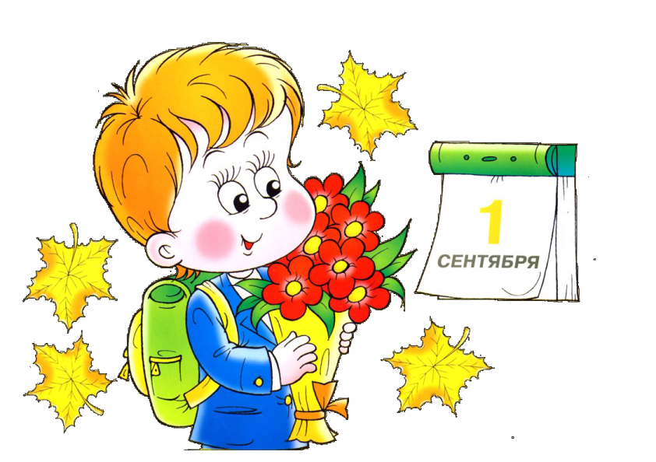
School life

Slide 3
[ ju: ]
Tuesday
Uniform
Education
Museum
Music
[ a: ]
Laugh
Class
classroom
Half
Past
Art
[ Λ ]
Sunday
Monday
Comfortable
Study
Good luck
Rubber
[ ei ]
Late
Age
Timetable
Famous
Bookcase
[ o: ]
Corner
Door
Floor
Wall
Important
[ æ ]
Handicraft
Maths
Blackboard
Stand
Back

Slide 4
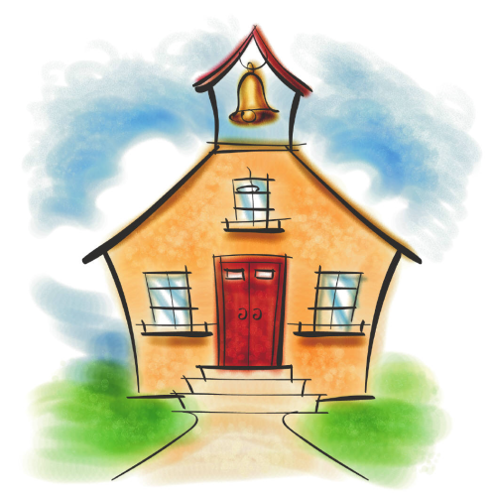
English proverbs
a). Сначала научись говорить, а петь потом будешь. (Азбуки не знает, а читать садится.)
b). Каков учитель, таков и ученик.
c). Век живи - век учись.
d). Ни один человек не умеет всего.
e). Никогда не откладывай на завтра то, что можешь сделать сегодня.
f). Учиться никогда не поздно.
1. Like teacher, like pupil.
2. Live and learn.
3. Never put off till tomorrow what you can do today.
4. Learn to say before you sing.
5. It’s never too late to learn.
6. No living man all things can.

Slide 5
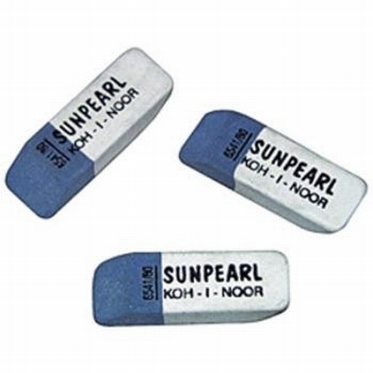
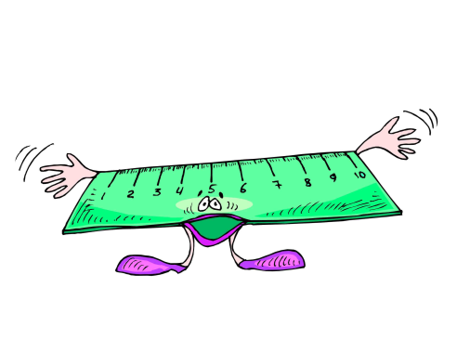
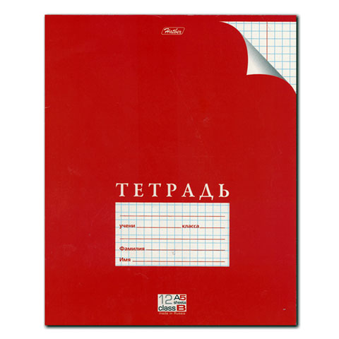
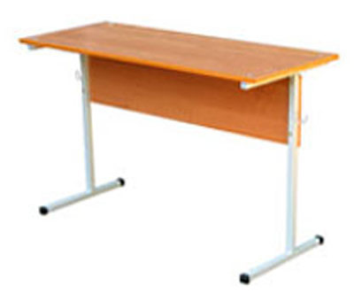
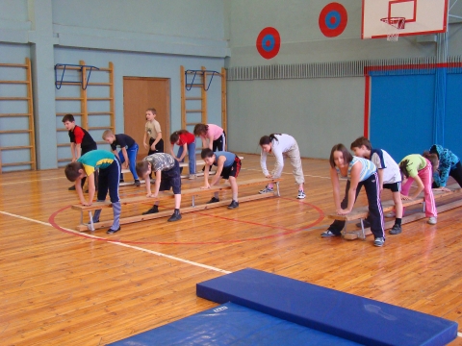
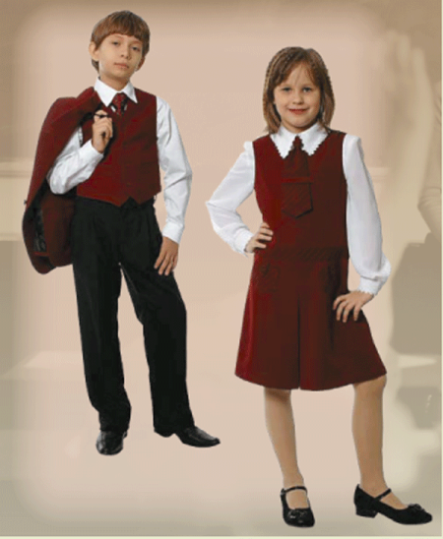
“SCHOOL” WORDS
1
2
8
5
6
9
3
4
7
10

Slide 6
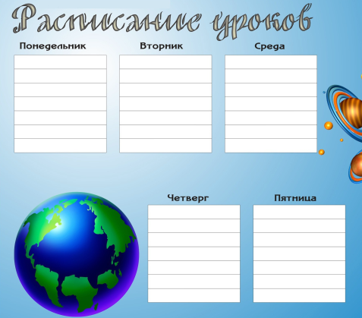
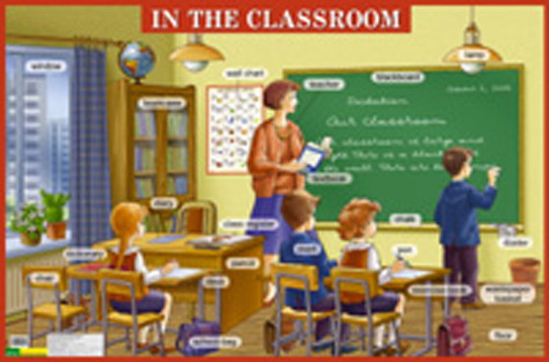
COMPLETE THE SENTENCES Study, sing, Sundays, age, Maths, Good luck, classroom, timetable.
We don’t have classes on _________________.
I like our ___________. It is big and light.
We have English and PE on the ____________ today.
In our Nature ______________ we usually speak about different flowers, trees and plants.
We usually count and do sums at _______________ lesson .
We ___________ nice songs at music lesson.
I am going to have a test on Monday. - ___________________!
At what __________ do English pupils go to school?

Slide 7
I meet
I learn
I wear
I draw
I am never
I leave
I work
I visit
I spend
uniform
friends before classes
late for school
poems by heart
a lot
nice pictures
much time outdoors
my house at 8 am
different museums

Slide 8
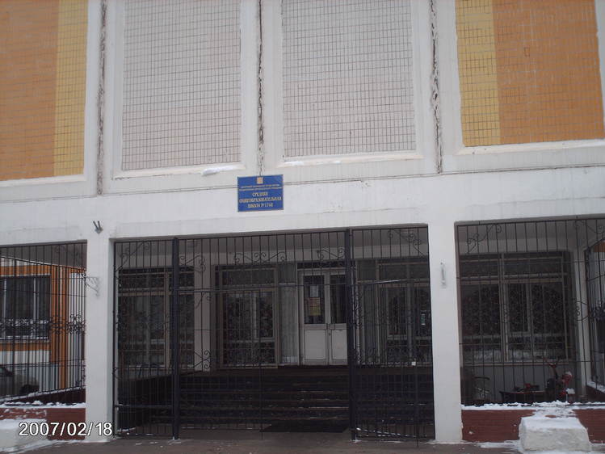
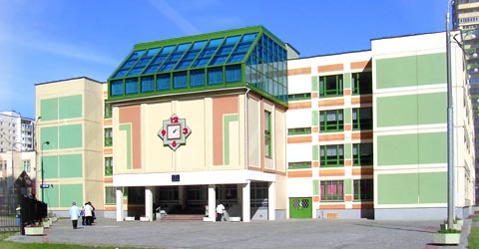
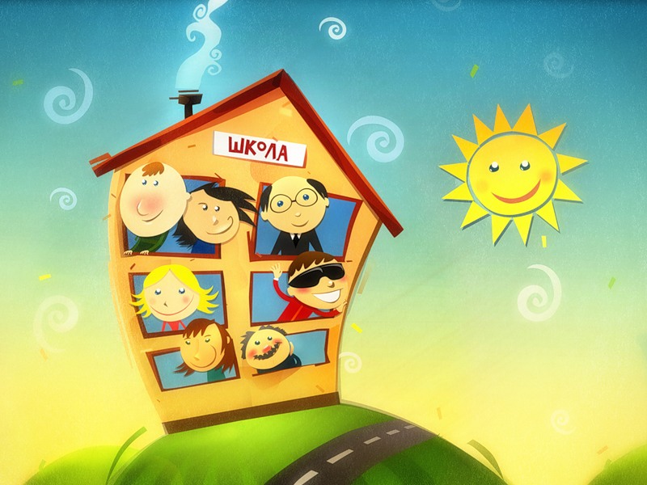
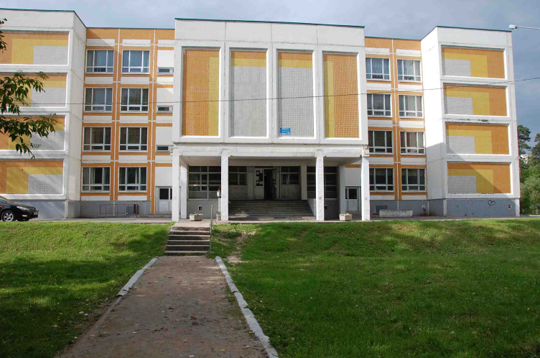
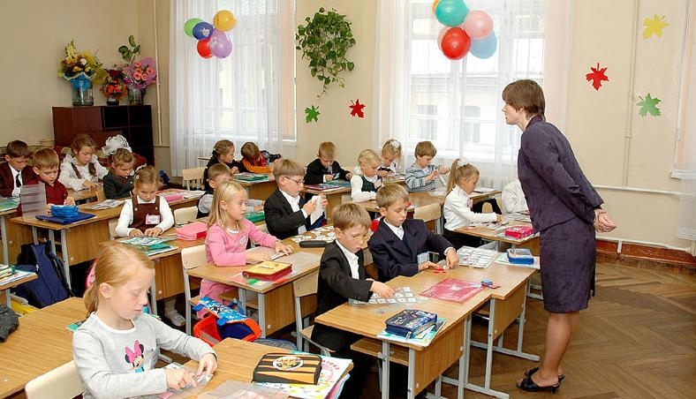
RUSSIAN SCHOOLS

Slide 9
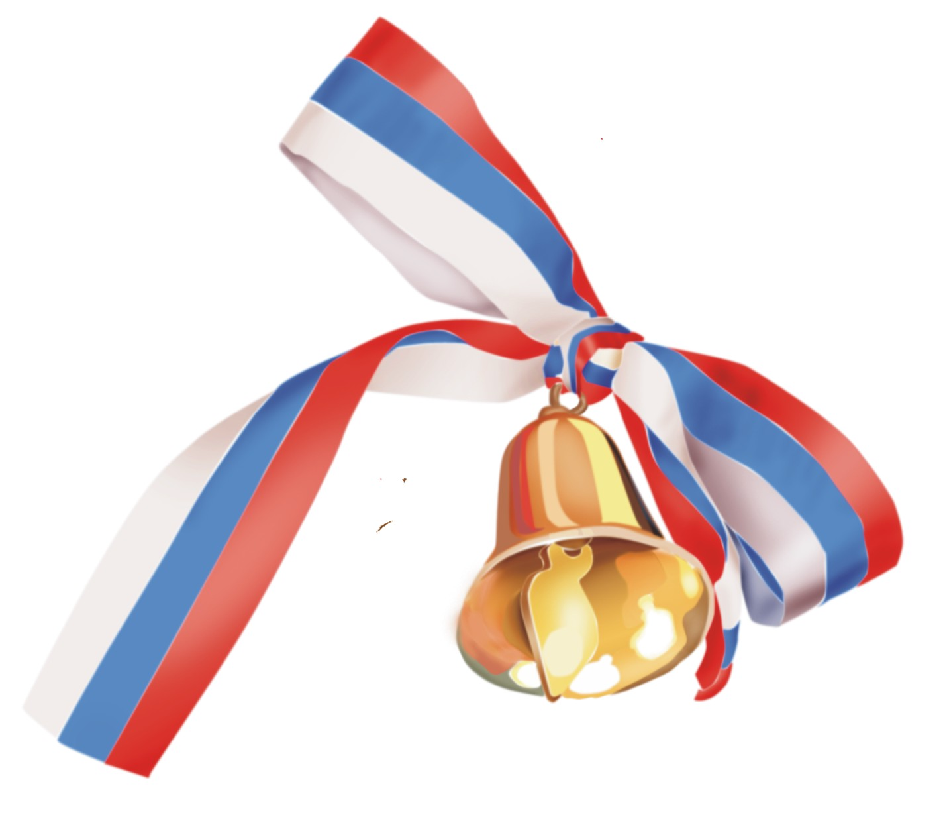
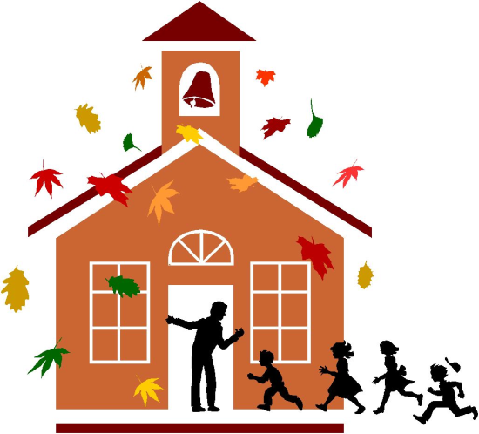
What do we know about Russian schools?
In Russia school begins at the age of or . Pupils go to the primary school where they spend years. In Russia school year begins on the of September. Pupils usually have for their teachers. Russian children have lessons or days a week. They never have lessons on
Children learn how to write, read and count. They have many lessons on their timetable: _____________________.
Children leave school at the age of or .
Schools in Russia often have not .
6
7
4
1st
flowers
5
6
Sundays.
17
18
numbers
names

Slide 10
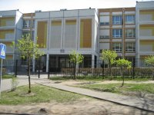
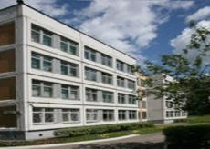
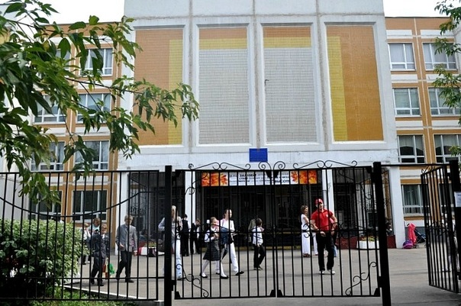
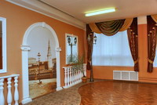
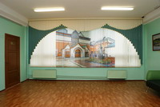
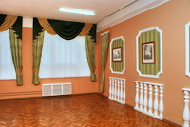
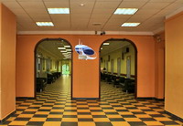
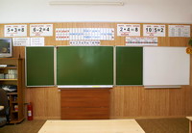
MY SCHOOL

Slide 11
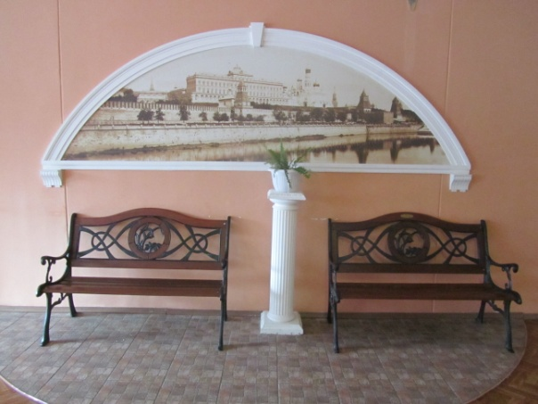
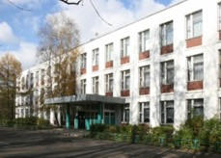
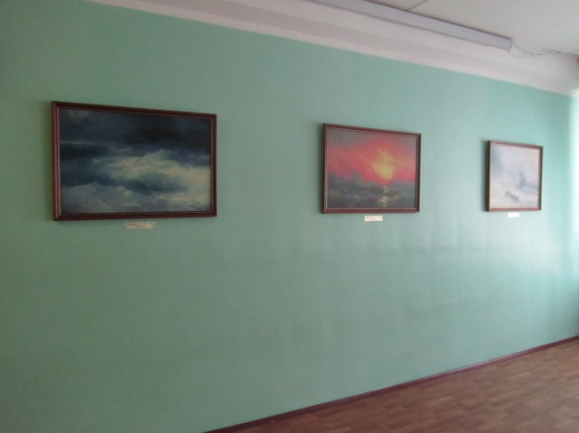
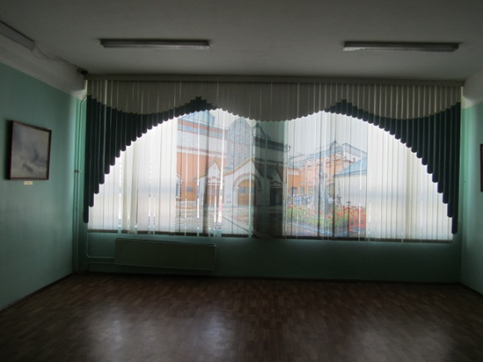
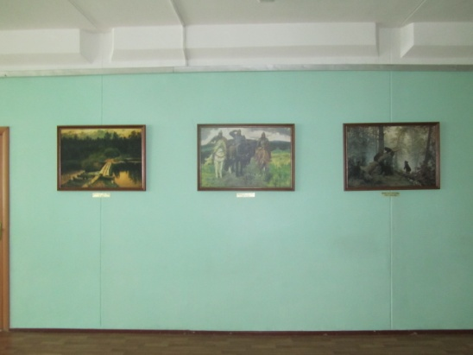
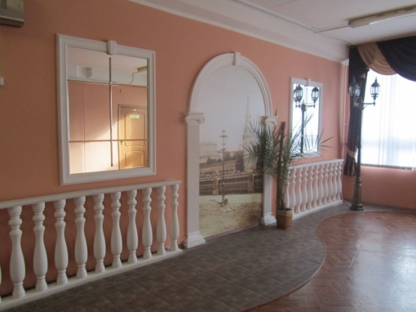
I go to the forth form of the best school in Moscow. Our school has a number and a name. Its number is 1748; its name is “Vertical”. It was built in 1993 and the next year our school will be 20 years old. There are 2 buildings with 36 classes and about 1000 (one thousand) pupils in our school.

Slide 12
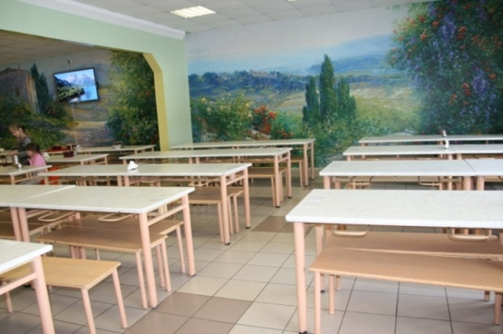
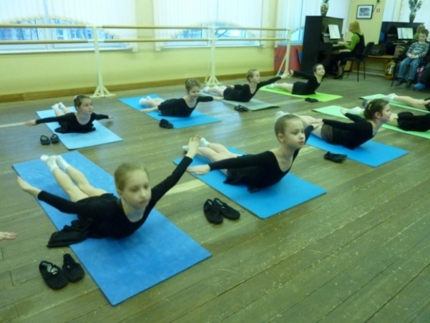
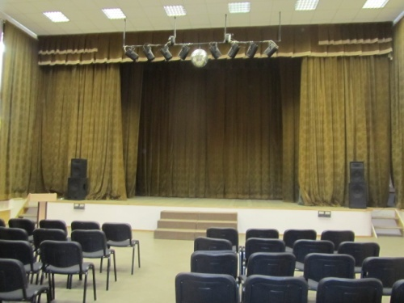
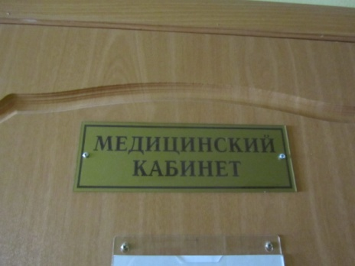
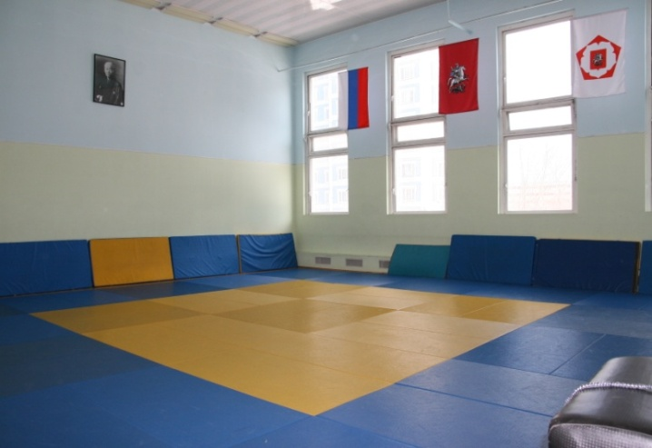
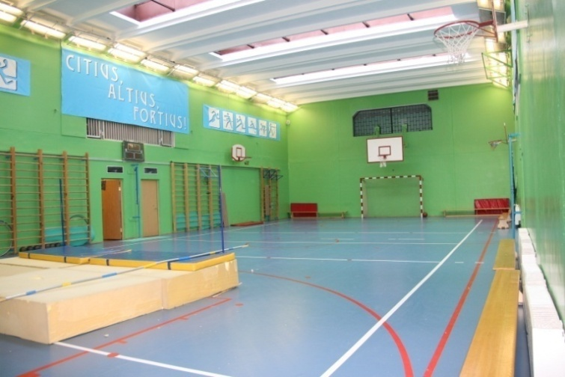
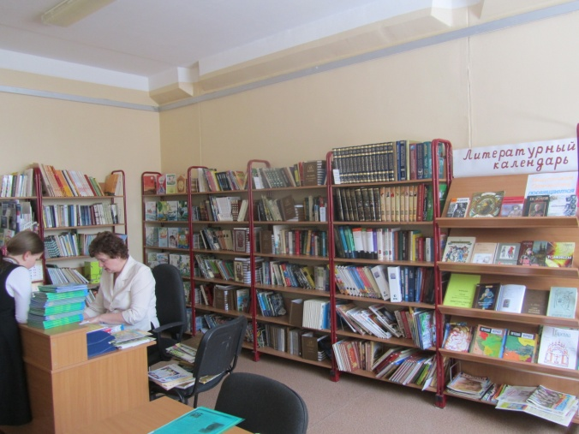
Inside “Vertical”
I go to the first building of our school. There are 4 floors and 30 classrooms, two gyms, a dancing room, a library, a museum and
a school canteen in it. It’s a modern, beautiful and a clean building. It’s very nice to study here.

Slide 13
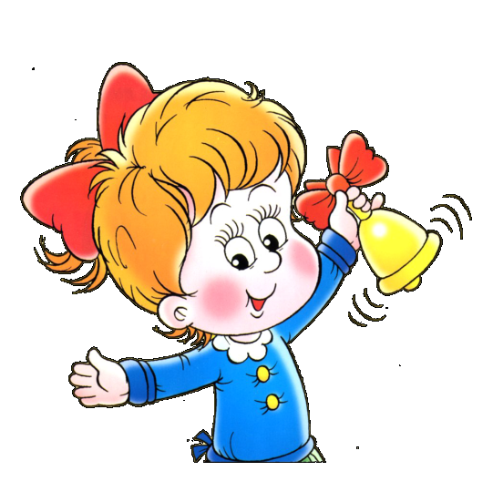
Complete the sentences
Our school has a n and a n
It was built in 19 .
There are buildings in our school.
About one th pupils study in our school.
There are floors in our first building.
There are 30 classrooms, two g , a d room, a l , a m and a school c in our school.
ame
umber.
93
two
ousand
four
yms
ancing
ibrary
useum
anteen

Slide 14
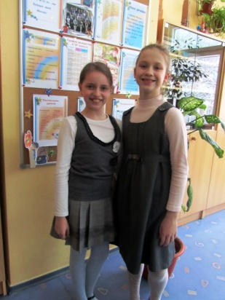
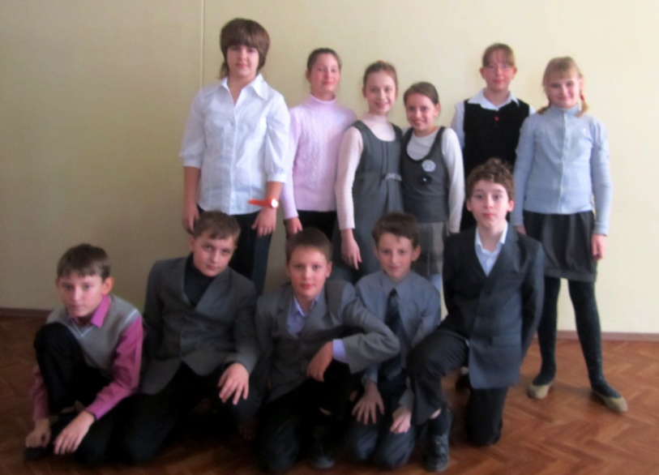
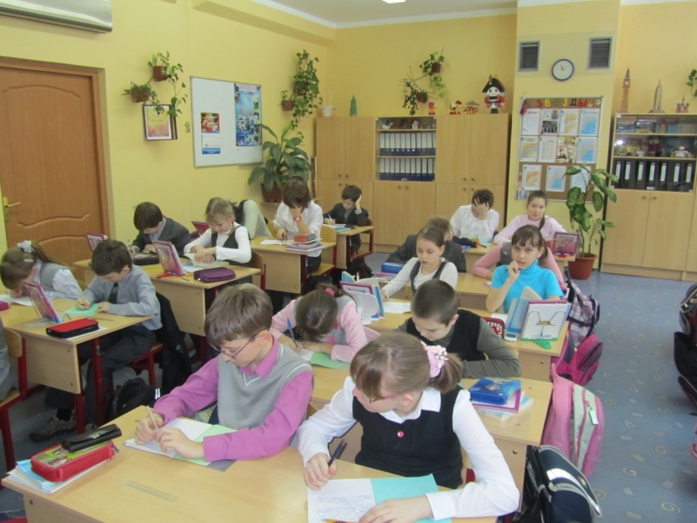
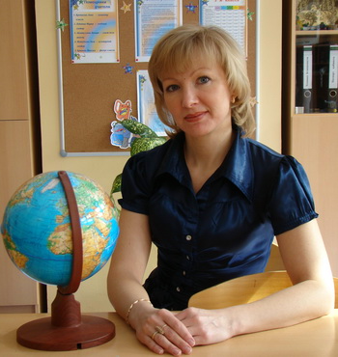
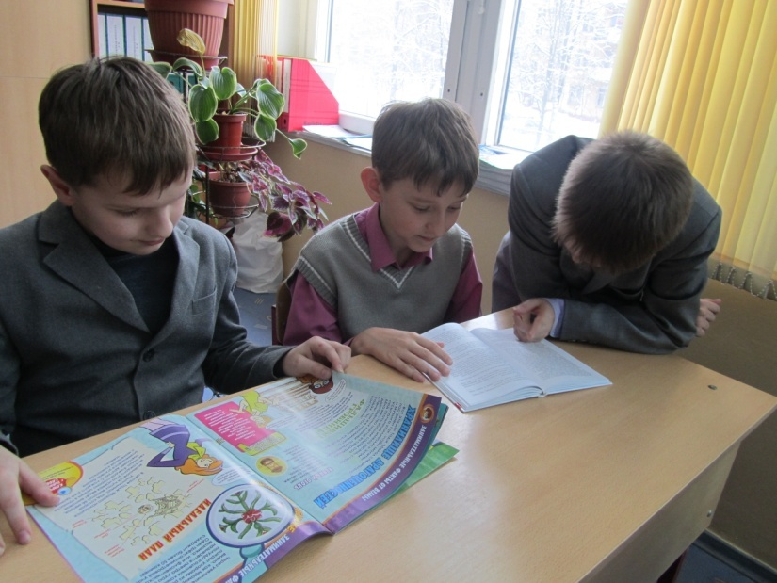
We study in “Vertical”
Pupils go to our school 6 days a week: on Monday, Tuesday, Wednesday, Thursday, Friday and Saturday.
Some pupils don’t go to school on Saturdays. Classes begin at 8.30. and last 45 minutes. The shortest break lasts 10 minutes, the longest one is
20 minutes long.

Slide 15
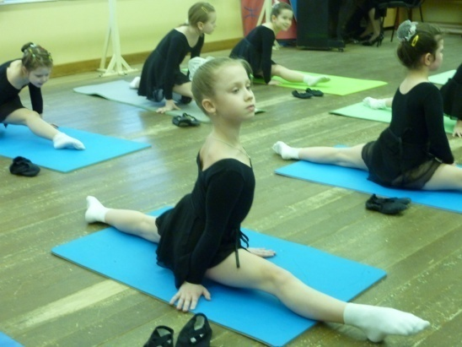
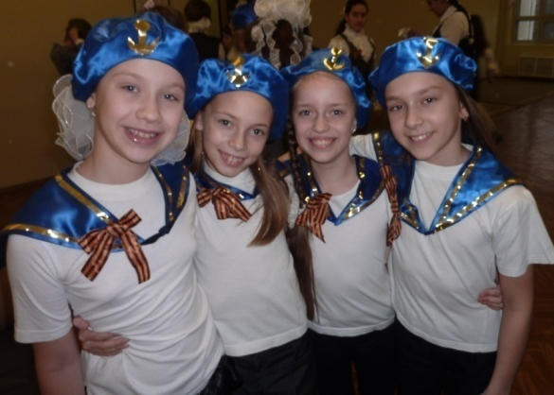
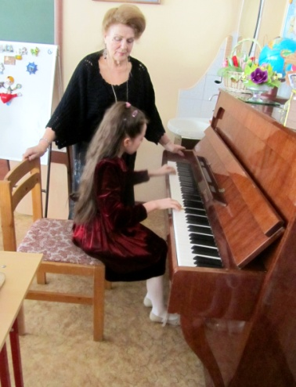
Indoor activities
You can spend a lot of time in our school after lessons. You can dance and sing, play different musical instruments and sports games, do taekwondo and judo, paint and knit. You are never tired in “Vertical”.

Slide 16
MATCH
Pupils go to school
Some pupils don’t go to school
Classes begin
Lessons last
The longest break lasts
After lessons you can
You are never
forty-five minutes.
on Saturdays.
tired in “Vertical”.
6 days a week.
dance, sing, play different musical instruments and sports games, knit, paint.
at half past eight.
20 minutes.

Slide 17
Pupils wear uniform in our school: light blouses with vests and dark trousers or skirts.
Pupils come to our school at the age of 6 or seven and finish it at the age of 17 or 18. Pupils go to primary school from the first to the forth form, to secondary school – from the fifth to the ninth form and to the high school - from the 10th to the 11th form.

Slide 18
SUBJECTS

Slide 19
Find the correct variant
b)
1. Pupils come to our school at the age of .
7 or 8 b) 6 or 7 c) 5 or 6
2. Pupils finish our school at the age of .
a) 17 or 18 b) 16 or 17 c) 15 or 16
3. Our school consists of .
1 step b) 2 steps c)3 steps
4. Pupils go to the primary school form.
from the first to the forth b) from the first to the third
c) from the first to the fifth
5. Pupils go to the secondary school form.
from the forth to the ninth b) from the fifth to the eleventh
c) from the fifth to the ninth
6. Pupils go to the high school form.
from the 9th to the 11th b) from the 8th to the 11th
c) from the 10th to the 11th
7. Pupils wear as their uniform in school.
dark blouses and dark trousers b) light blouses and light trousers or skirts
c) light blouses and dark trousers or skirts
8. Pupils sit in our primary school.
a) On the carpet b) at the desks c) on the desks
a)
c)
a)
c)
c)
c)
b)

Slide 20
OUR TIMETABLE
8.30.-9.15.
9.25.-10.10.
10.30.-11.15.
11.30.-12.15.
Nature Study
8.30.-9.15.
9.25.-10.10.
10.30.-11.15.
11.30.-12.15.
Reading
8.30.-9.15.
9.25.10.10.
10.30.-11.15.
11.30.-12.15.
12.25.-13.10.
Maths
English
Russian
Russian
Russian
Maths
P. E.
Music
Art
Reading
P. E.
Nature Study
8.30.-9.15.
9.25.-10.10.
10.30.-11.15.
11.30.-12.15.
Reading
8.30.-9.15.
9.25.-10.10.
10.30.-11.15.
11.30.-12.15.
12.25.-13.10.
Dancing
Singing
Oxford Quality
Taekwondo
Judo
Football
Playing the piano
Playing the guitar
Painting
Knitting
Basketball
Gymnastics
Museum
Russian
Russian
Maths
Art
P. E.
English
I. T.

Slide 21
Walk, walk I can walk Walk, walk I can walk Walk, walk I can walk Like a dog.
Jump, jump I can jump Jump, jump I can jump Jump, jump I can jump Like a frog.
Mommy, Mommy watch me, Daddy, Daddy watch me.
Swim, swim I can swim Swim, swim I can swim Swim, swim I can swim Like a fish.
Fly, fly I can fly Fly, fly I can fly Fly, fly I can fly Like a bird.
Mommy, Mommy watch me, Daddy, Daddy watch me.

Slide 22
LISTEN TO THE DIALOGUE
ANSWER THE QUESTIONS
1. What new subjects does the girl have this year?
2. What does the girl do at Drama lesson?
3. Are the girls from English or Russian school?

Slide 23
ENGLISH SCHOOLS

Slide 24
British boys and girls begin to go to school at the age of 5.
They draw pictures, sing songs and play games.
British children begin to read and write when they enter infant school.
They leave infant school at the age of 7 and began to study at junior school.
Pupils learn to write, to read and to do sums.
Boys and girls have many interesting subjects such as:
History, Geography, Art, Music, Cooking and others.
Pupils study at junior school for four years. Then they take their examinations.
Boys and girls have school uniforms. It is an old tradition in England.

Slide 25
CHECK YOURSELF

Slide 26
PROJECT TIME

Slide 27
Thank you for your active work!!! Good bye!!!

