Slide 1
Great people of Great Britain
To create or not to create

Slide 2
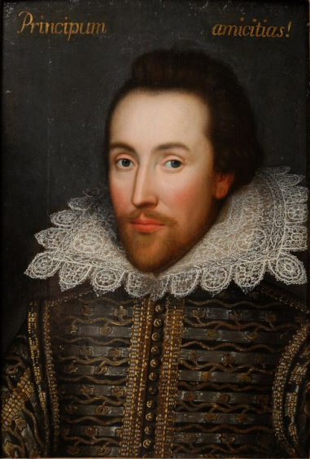
William Shakespeare
William Shakespeare was born in April 1564.
In 1587 Shakespeare went to work in London. Some years later Shakespeare began to write plays.
By 1592 Shakespeare was an important member of well-known company.
In 1599 the famous Globe Theatre was built on the south bank of the river Thames. In that theatre most of his plays were performed.
By 1603 Shakespeare was the leading poet and dramatist of his time. He continued to write for the next ten years.
In 1613 he finally stopped writing and went to live in Stratford where he died in 1616. He is buried in Stratford-on-Avon.

Slide 3


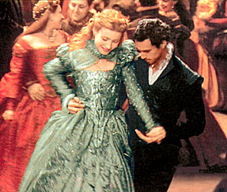

William Shakespeare wrote 37 plays. Romeo and Juliet Hamlet King Lear Much ado about nothing Othello Henry 4th Macbeth
His house in Stratford –on- Avon
His theatre GLOBE

Slide 4
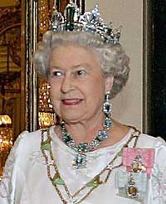
Elizabeth the Second
Elizabeth the Second was born on 21 April 1926. She is Queen of 16 states and 128 million people. Elizabeth`s coronation took place in Westminster Abbey on 2 June 1953.

Slide 5
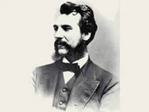
Alexander Bell
Born | March 3, 1847 Edinburgh, Scotland, UK
Died | August 2, 1922 (aged 75) Beinn Bhreagh, Nova Scotia, Canada
Cause of death | Complications from diabetes
Education | University of Edinburgh University College London
Occupation | Inventor Scientist Engineer Professor (Boston University) Teacher of the deaf
Known for | Inventing the Telephone

Slide 6
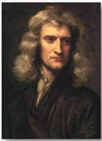
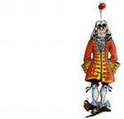
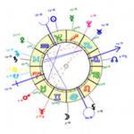
Isaac Newton
Isaac Newton was born in 1642 in England. He studied Maths at Cambridge university. He made 3 discoveries: - differential calculations - the nature of white light - the Law of gravitation. He died at the age of 84. His monument is at Westminster Abbey.

Slide 7
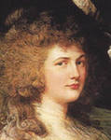
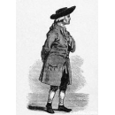
Henry Cavendish
He was born in 1731 in Great Britain. He was a great chemist and a natural philosopher. He graduated from Cambridge university. He was a member of London Royal Society. He died in 1810.

Slide 8
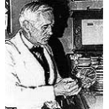
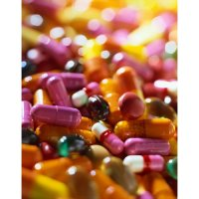
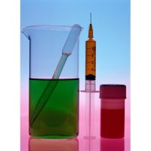
Alexander Fleming
Fleming was born in Scotland in the family of a farmer in 1881. He is an outstanding scientist in microbiology. Fleming invented penicillin. And got a Nobel prize for it in 1945. He died in 1955.

Slide 9
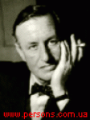
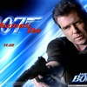
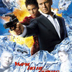

Ian Lancaster Fleming
Fleming was born in a rich aristocratic family in 1908. He is a famous English writer. He studied in Eton, in Military Academy and in Europe. He wrote 14 novels about the agent 007 James Bond.

Slide 10
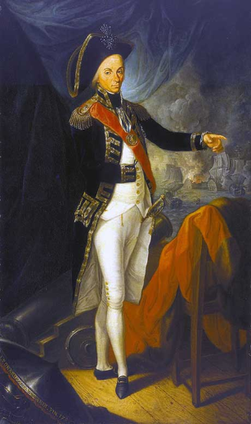
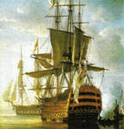
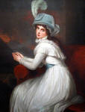
Admiral Nelson
Horatio Nelson was an English admiral, a national hero. He won several victories at sea. The most famous was the battle of Trafalgar in 1805. He was brave, skilled and confident. 1758-1805.

Slide 11
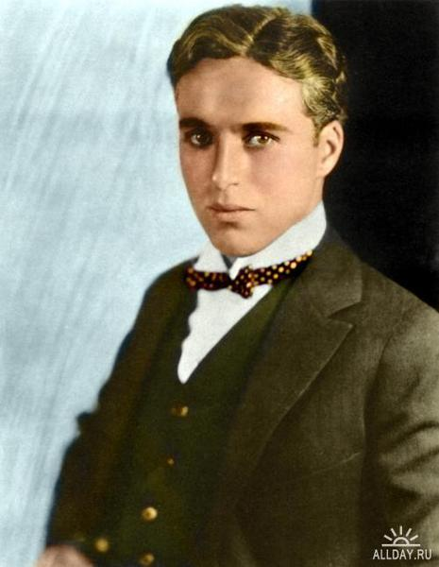
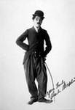
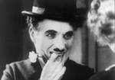
Charlie Chaplin 1889-1977
Chaplin was a comedian and movie star of the earlier 1900s. The most favourite character was the Little Trump. He played in silent black and white comedy films. He was a director of many films. 1954- a World Peace Prize 1972- the second Oscar

Slide 12
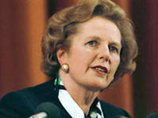
Margaret Thatcher 1925-
Margaret Thatcher was the first woman prime-minister. She was called “ the iron lady” for criticizing Russia. She did much to rise the economy of the country. She is the member of the House of Lords.

Slide 13
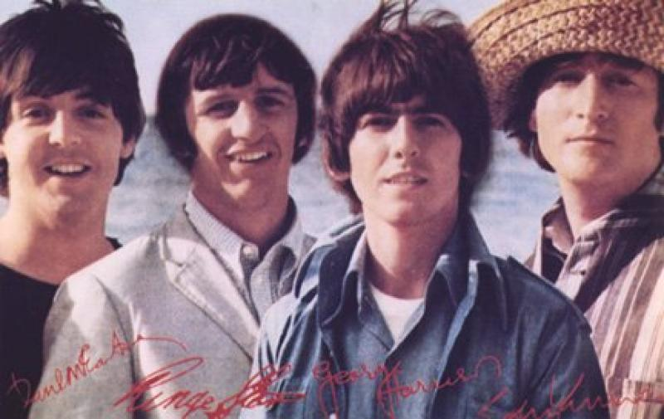

The Beatles

Slide 14
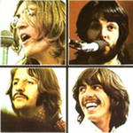

The Beatles are the most influenced group un Britain. Fist performed in 1959 in Liverpool. Their records were Top of the pop music In the mid of 1960s. The most popular songs: Yesterday. Girls. Hey Jude. Let it be. Rock and roll music. Yellow submarine. Pretty woman. The Beatles broke up in 1971.
Paul McCartney 1942 John Lennon 1940-1980 ( was murdered in N.Y.) George Harrison 1943 Ringo Starr 1940

Slide 15
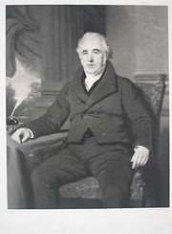
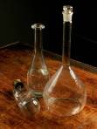

Charles Mackintosh
Mackintosh was a Manchester textile chemist, who in 1823 developed a rubber solution for coating fabrics. A waterproof raincoat was made and it was named mackintosh. 1766-1823

Slide 16
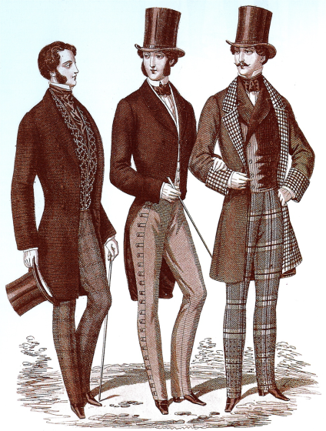
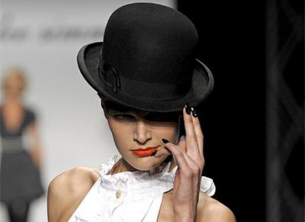
John Bowler

Slide 17
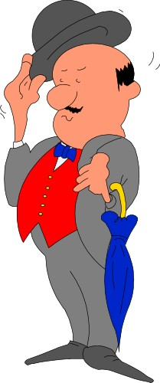
John Bowler was a London hatter. He designed the hard round hat known as a bowler in about 1850. This hat is the symbol of the British male respectability. The businessmen wear bowlers in the City now, the center of London`s commerce.

Slide 18
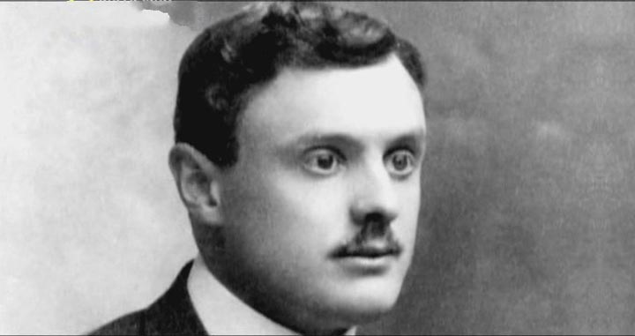
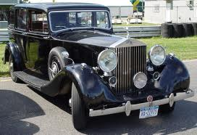
Charles Rolls
Rolls was a car salesman. Together with the engineer Henry Royce he created the world – famous Rolls-Royce car. Since 1904 7 thousand of these cars were produced. They are cars for the Rich.

Slide 19
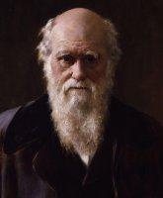
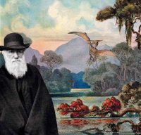
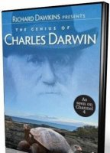
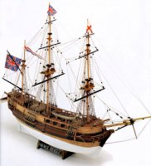
Charles Darwin
Charles was born in the family of a doctor in 1809. As a boy he collected insects and minerals. He studied in Edinburgh University medicine. He sailed to South America to make maps. He wrote the book “ The origin of species”. His idea of evolution was right.

Slide 20
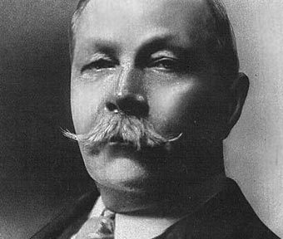
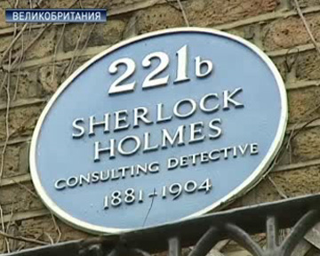
Arthur Conan Doyle

Slide 21
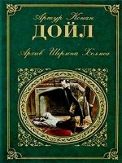
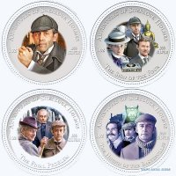
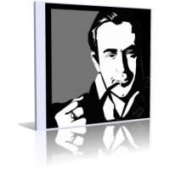
Elementary , my dear Watson…
Arthur was born in Scotland in 1859. He was a doctor. He wrote detective stories. He created his famous character Sherlock Holmes in 1885. And became a popular writer. He enjoyed sport: tennis, golf.

Slide 22
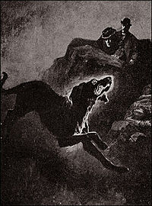
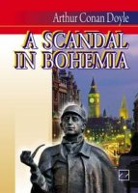

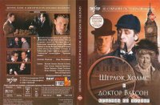
The most popular books: The hound of the Baskervilles. The adventures of Sherlock Holmes and Doctor Watson The lost world The poisoned belt

Slide 23
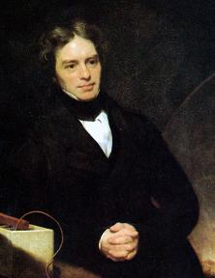
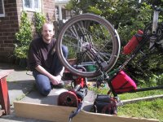
Michael Faraday
Faraday is a great English scientist in electricity. He invented a machine producing it. He made a new kind of glass, a new kind of steel. He made 2000 difficult experiments. He was a creator of the electrical motor.

Slide 24
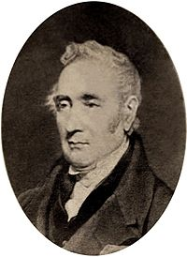

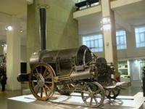
George Stephenson 1781-1848
Stephenson was a great English constructor and inventor. He made a revolution in steam transport. He invented the first steam. His steam ROCKET is in London museum now. He built steel rails. The fist railroad was from Manchester to Liverpool. It was 40 kms.

Slide 25
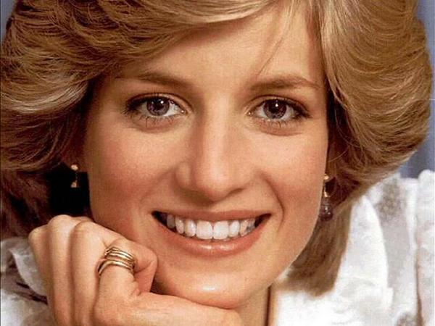
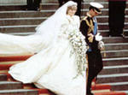
Lady Diana

Slide 26
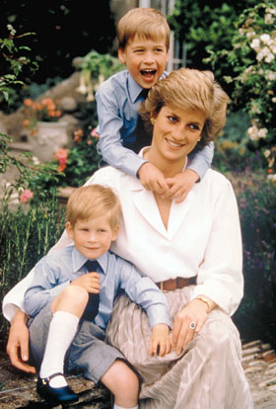


Diana was the first wife of Charles, Prince of Wales. She had two sons: Prince William and Henry. She was People Princes. She could talk to any person and they loved her. Her mission was charity. She died in 1997 in a car accident. 1961-1997

Slide 27


The king Henry 4th The Queen Jane Semmur

Slide 28


The queen Elizabeth the First The poet Oscar Wild

Slide 29


Winston Churchill a political leader | James Cook A traveller

Slide 30


David Livingstone 1813-1873 A great Scottish missioner. Explored Africa.
George Gordon Byron 1788-1824 A great English romantic poet

Slide 31


Charlotte Bronte 1816-1855 A great English poet and novelist. She wrote a popular novel “ Jane Eyre”
Charles Dickens 1812-1870 A great English novelist writer. He wrote “ Oliver Twist” , “ David Copperfield”

Slide 32


Vivien Leigh 1913-1967 A popular actress. Played in “ Gone with the wind” “ Cleopatra”
Timothy Dalton 1946--- A very popular actor, born in Wales. Acted in films as the agent 007, Scarlet , Jane Eyre.

Slide 33


Sean Connery 1930--- A Scottish actor and producer. Was awarded the Gold Globe and Some Oscars. Got the Knight Title In 2000 from the Queen.
Jayne Torvill and Christopher Dean Famous British Ice-dancers. Won the European and World Championships in 1983-1984. Winners of the Olympic Games In Sarajevo in 1984 .

Slide 34


