Slide 1
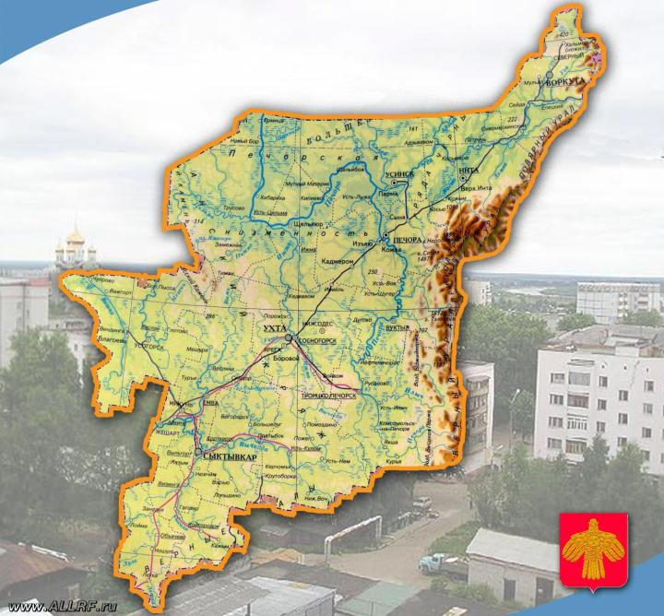
Achievements of Komi Republic

Slide 2
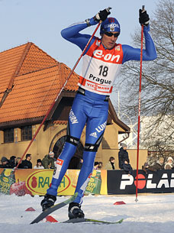
Rochev
Vasily
Vasilyevich
He was born on October, 23rd,
1980 in Syktyvkar, the USSR.
The Russian skier, a member
of a national team of Russia
on cross-countries.

Slide 3
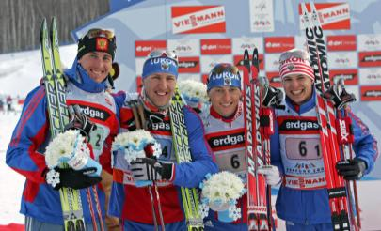
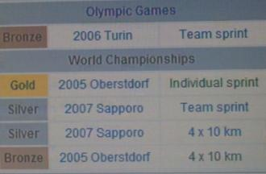
The participant of two winter Olympic Games: 2002 in Solt-Lake-city and 2006 in Turin. The world champion of 2005 . Several years he was the captain of a man's Russian national team.

Slide 4
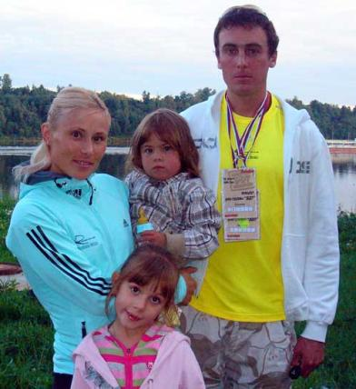
He is married to Olympic
champion Julia Chepalova.

Slide 5
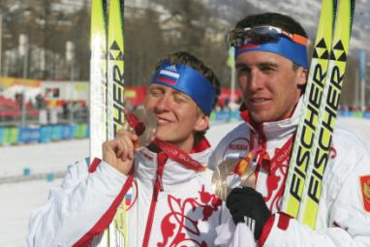
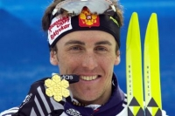
He is in a Russian national team since 1999. The winner and the silver prize-winner of superiority of the world among juniors in 2000. The participant of the Olympic games of 2002 in Solt-Lake-city.
He is the world champion of 2005 in sprint,the bronze prize-winner of the Olympic games 2006 in command sprint together with Ivan Alypov, the owner of two silver medals of the World championship 2007.

Slide 6
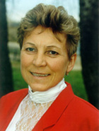
Smetanina
Raisa
Petrovna
She was born on February, 29th 1952,in a village Mokhcha, Komi АSSR. The glorified Soviet skier, a champion of the USSR.

Slide 7
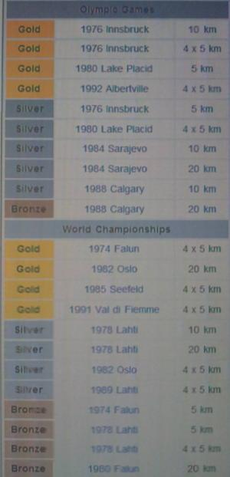
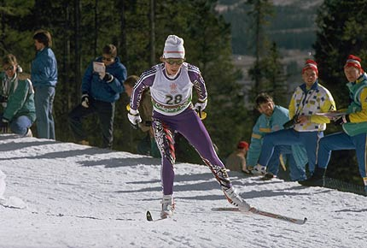
She took part in five winter Olympic Games, and the last award she won in Games in Albervile some days before the 40 anniversary that is an original record at skiers.

Slide 8
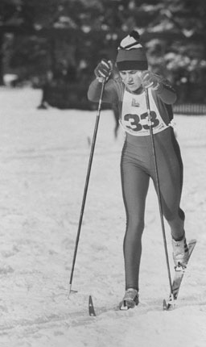
In total she has 26
medals of the world championships and the Olympic Games. Raisa Smetanina was awarded the international prize of Kuberten.

Slide 9
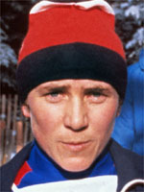
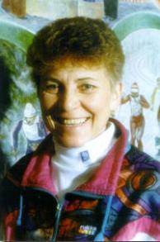
Raisa Smetana`s
Olympic records
She has the greatest number of awards among women in winter Olympic Games.
2) The First sportswoman (as among women, and men) which has won medals in 5 winter Olympic Games .

Slide 10
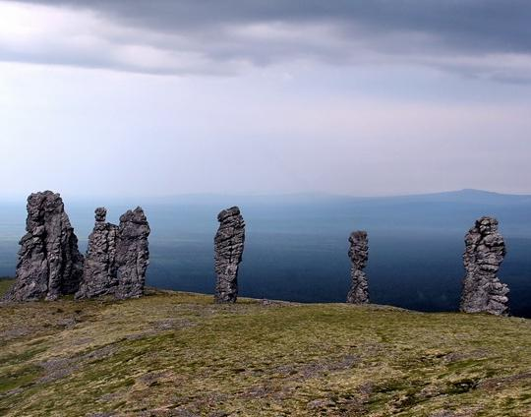
The Manpupuner
stones

Slide 11
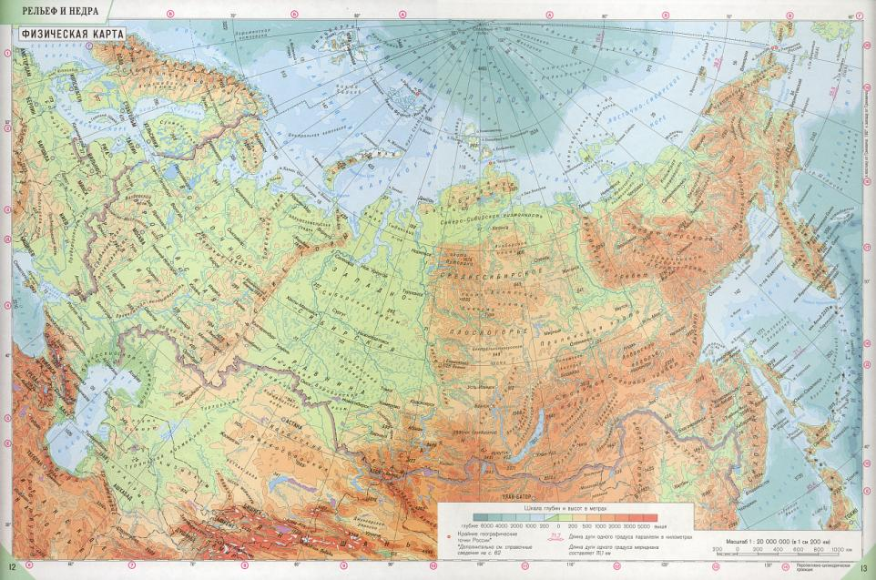
Geological monument in the Troitsko-Pechorskiy region in Republic Komi
Manpupuner

Slide 12
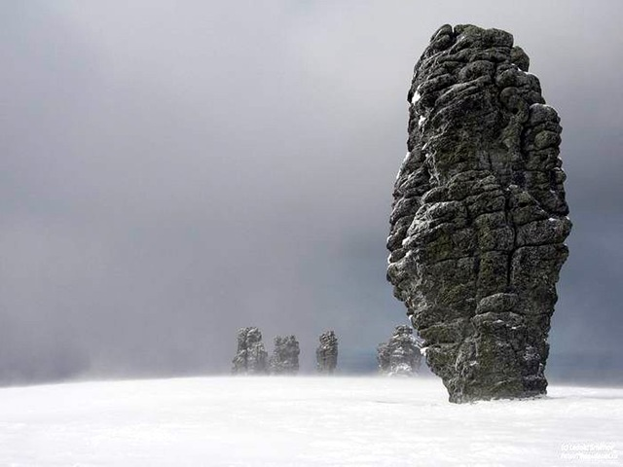
There are 7 columns. They are far enough from populated places. R The columns are considered to be one of seven miracles of Russia.

Slide 13
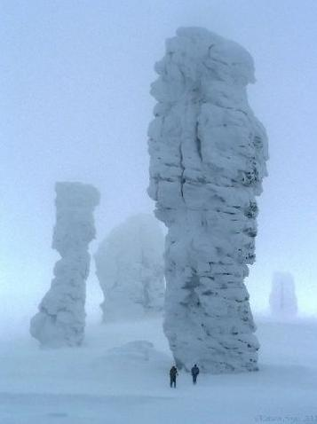
They are absolutely white during a winter period, as if they are crystals.

Slide 14
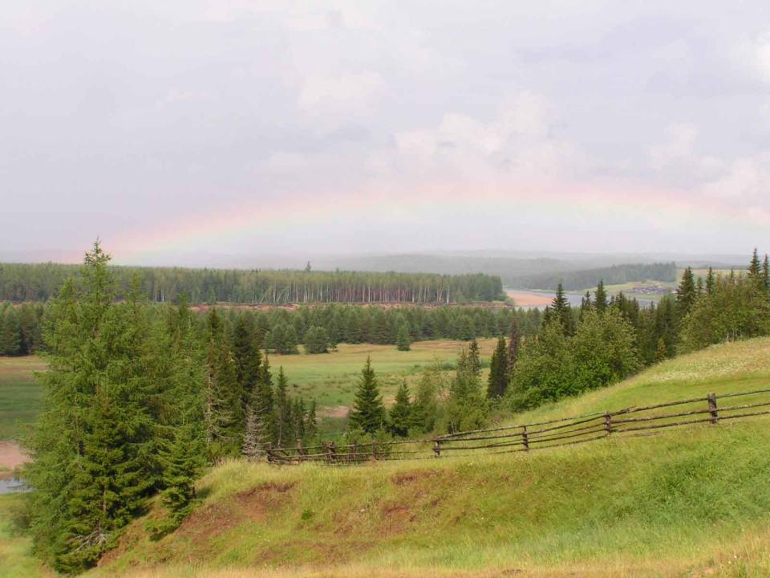
Our republic is proud of achievements in sport culture, science, art... Our republic is rich in minerals, has beautiful landscapes. I love the place where I live.

