Slide 1
LITERATURE ENGLISH CHANNEL
LA MANCHE LITTERAIRE
ЛИТЕРАТУРНЫЙ ЛАМАНШ

Slide 2
WRITER – COUNTRY ECRIVAIN - PAYS

Slide 3
Charles Dickens

Slide 4
England

Slide 5
O’Henry

Slide 6
The USA

Slide 7
Albert Camus

Slide 8
La France

Slide 9
Prosper
Merimee

Slide 10
La France

Slide 11
JACK LONDON

Slide 12
The USA

Slide 13
Emile Zola

Slide 14
La France

Slide 15
THEODOR DREISER

Slide 16
The USA

Slide 17
Gustave
Flaubert

Slide 18
La France

Slide 19
Charles Perrault

Slide 20
La France

Slide 21
ETHELE LILIAN VOYNICH

Slide 22
ENGLAND

Slide 23
Redyard Kipling

Slide 24
ENGLAND

Slide 25
Anatole France

Slide 26
La France

Slide 27
WHO IS HE? QUI EST-CE?

Slide 28
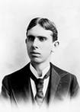

Slide 29
THEODOR DREISER

Slide 30
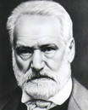

Slide 31
Victor Hugo

Slide 32
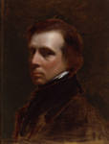

Slide 33
WILLIAM THACKEREY

Slide 34
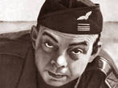

Slide 35
Antoine de Saint-Exupery

Slide 36
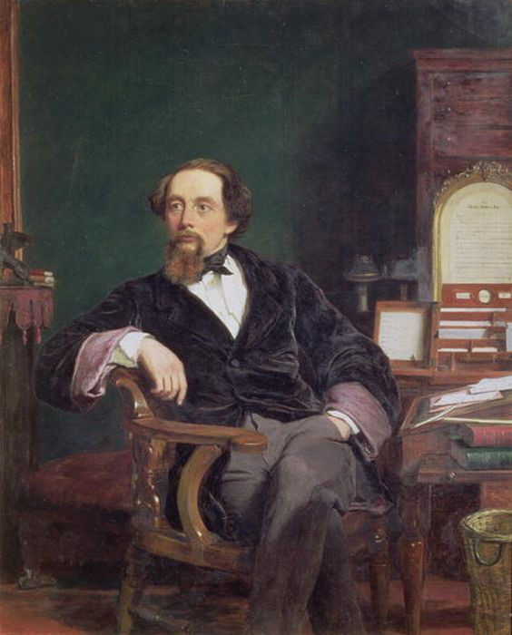

Slide 37
CHARLES DICKENS

Slide 38
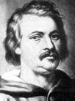

Slide 39
Honore de Balzac

Slide 40
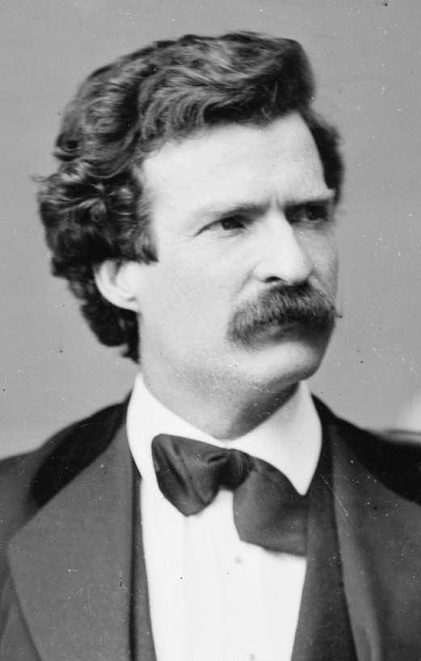

Slide 41
MARK TWAIN

Slide 42
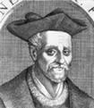

Slide 43
FrancoisRabelais

Slide 44
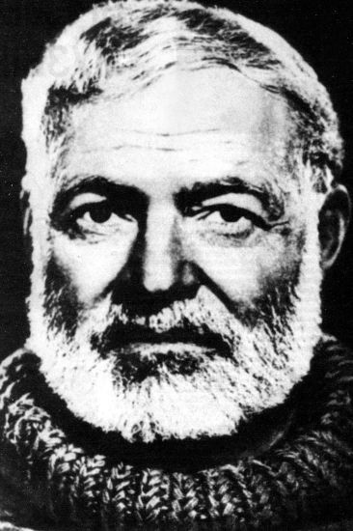

Slide 45
ERNEST HEMINGWAY

Slide 46
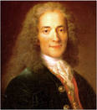

Slide 47
Jean-Baptiste
Moliere

Slide 48
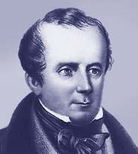

Slide 49
FENIMOR COOPER

Slide 51
Guy de Maupassant

Slide 52
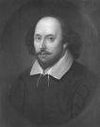

Slide 53
WILLIAM SHAKESPEARE

Slide 54
NOVEL – WRITER ROMAN - ECRIVAIN

Slide 55
“Le Pere Goriot”

Slide 56
Honore de Balzac

Slide 57
“KING LEAR”

Slide 58
William Shakespeare

Slide 59
“Le petit Prince”

Slide 60
Antoine de Saint-Exupery

Slide 61
“David Copperfield”

Slide 62
Charles Dickens

Slide 63
“Rouge et Noir”

Slide 64
Stendhal

Slide 65
“Bel ami”

Slide 66
Guy de Maupassant

Slide 67
“THE PRINCE AND THE PAUPER”

Slide 68
MARK TWAIN

Slide 69
“THE OLD MAN AND THE SEA”

Slide 70
ERNEST HEMINGWAY

Slide 71
“Les enfants du capitaine Grant”

Slide 72
Jules Verne

Slide 73
“HARRY POTTER”

Slide 74
JOANNE ROWLING

Slide 75
“L’homme qui rit”

Slide 76
Victor Hugo

Slide 77
“JANE EYRE”

Slide 78
Charlotte Bronte

Slide 79
CHARACTER – NOVEL HEROS - ROMAN

Slide 80
Gavroche

Slide 81
“Les miserables”

Slide 82
Winnie – the - Pooh

Slide 83
Alan Milne

Slide 84
M. de Treville

Slide 85
“Les trois mousquetaires”

Slide 86
Rhet Butler

Slide 87
“GONE WITH THE WIND”

Slide 88
Gargantuat

Slide 89
“Gargantuat et Pantagruel”

Slide 90
OPHELIA

Slide 91
“HAMLET”

Slide 92
Quasimodo

Slide 93
“Notre-Dame de Paris”

Slide 94
Huckleberry Finn

Slide 95
“The Adventures of Tom Sawyer and Huckleberry Finn”

Slide 96
Capitaine Nemo

Slide 97
“80 milles lieus sous l’eau”

Slide 98
Jim Hawkins

Slide 99
“TREASURE ISLAND”

Slide 100
M. Jourdin

Slide 101
“Le bourgeois gentilhomme”

Slide 102
Dorian Gray

Slide 103
“The Picture of Dorian Gray”

Slide 104
THANK YOU
FOR THE TRIP!
WELL DONE!
MERCI POUR
CE VOYAGE!
BRAVO!

