Slide 1
Do you
recognize
these views of
Khanty-Mansiysk?

Slide 3
Airport

Slide 4
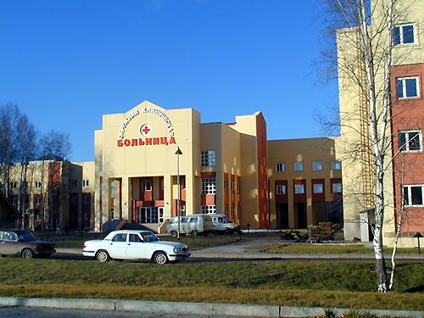

Slide 5
Hospital

Slide 6
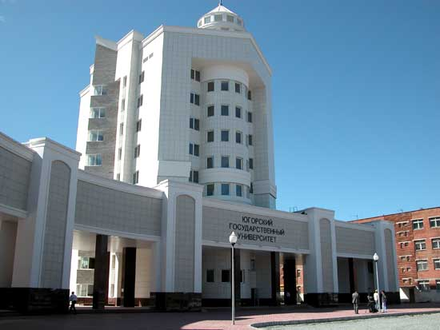

Slide 7
Ugra State University

Slide 8
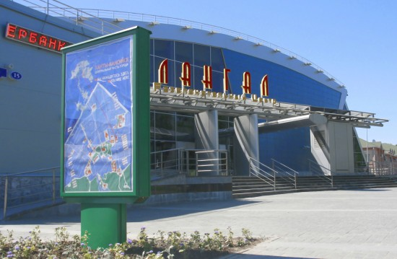

Slide 9
Cinema House ’Langal’

Slide 10
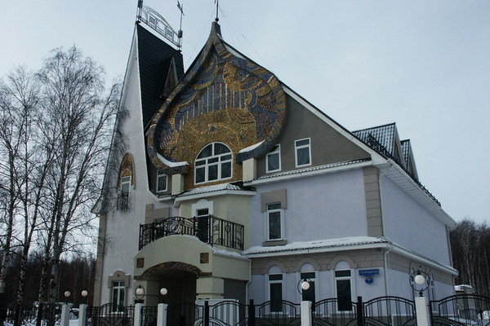

Slide 11
House-Museum of A. Igoshev

Slide 12
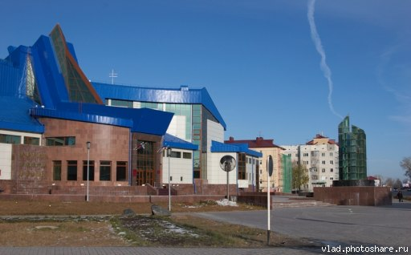

Slide 13
Museum of Geology, Oil and Gas

Slide 14
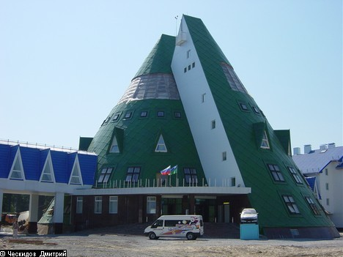

Slide 15
Hotel ‘Yugorskaya Dolina’

Slide 16
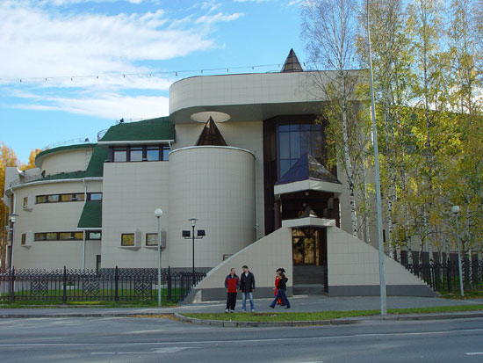

Slide 17
Museum of Nature and Man

Slide 18
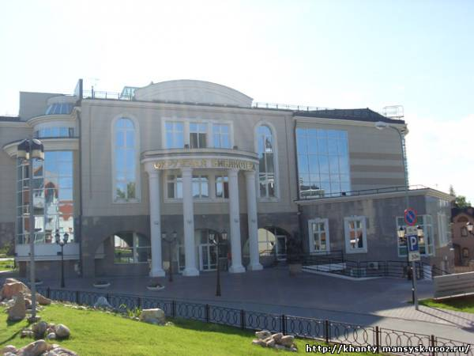

Slide 19
Library

Slide 20
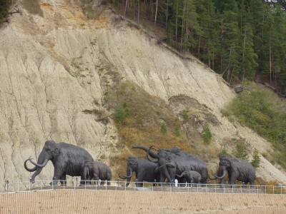

Slide 21
Archeological Park

Slide 22
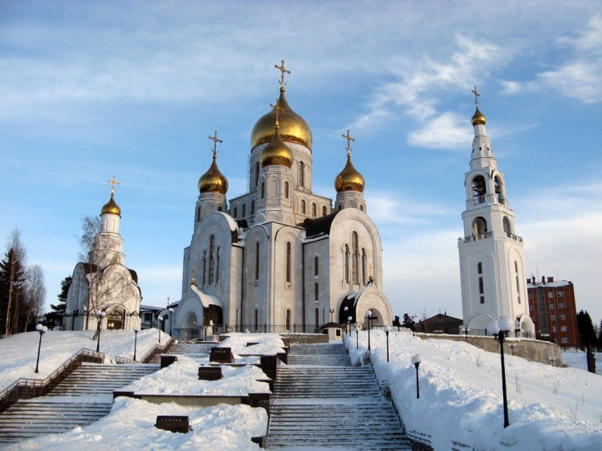

Slide 23
Orthodox Church

Slide 24
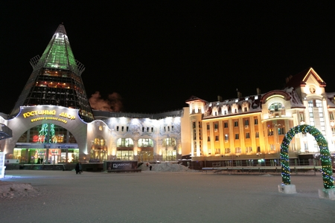

Slide 25
Shopping center ‘Gostiny Dvor’

Slide 26
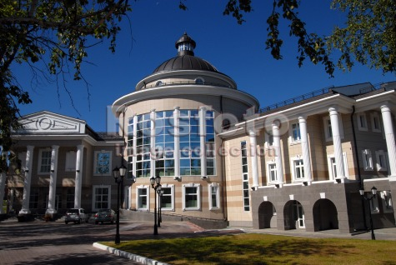

Slide 27
Art Museum

Slide 28
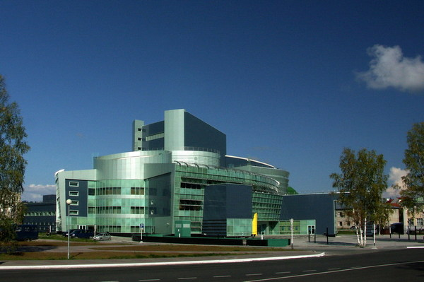

Slide 29
Concert Complex
‘Ugra Classic’

Slide 30
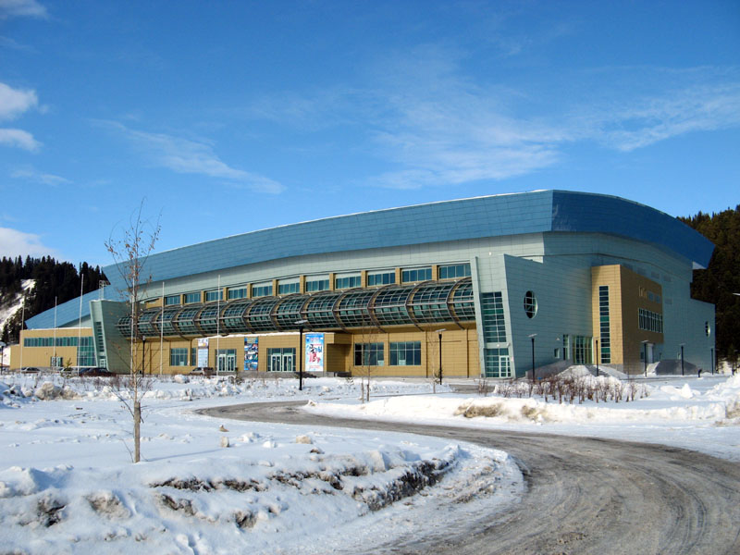

Slide 31
Ice-rink

Slide 32
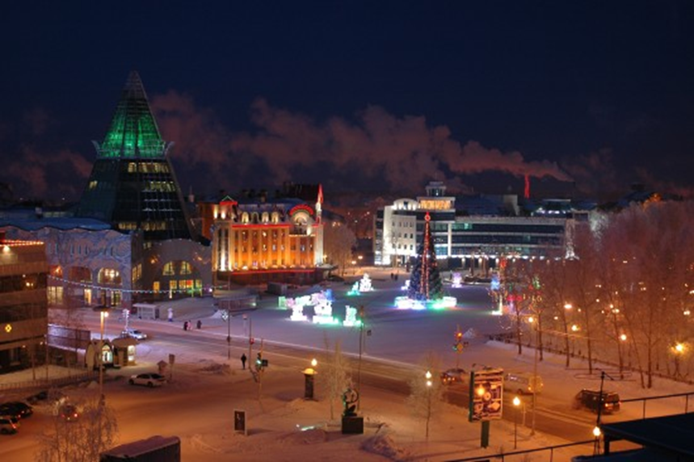

Slide 33
The Central Square

Slide 34
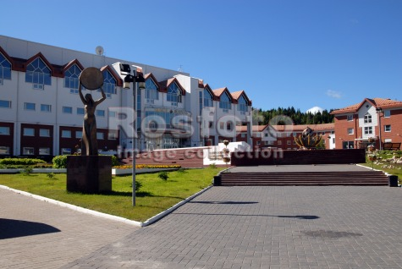

Slide 35
Center of Arts

