Slide 1
Elvis Presley
By
Pyatkin Nikita,
Baharev Nikita,
Shiryaev Maxim,
Nasibov Elnur

Slide 2
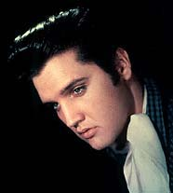
Factfile
Full name: Presley, Elvis
Nickname: Aaron
Date of birth: Jan. 8, 1935
Place of birth: Tupelo, Miss., U.S.
Began his musical career: in 1954

Slide 3
Factfile
His first producer: Sam Phillips
His first musical success: "Heartbreak Hotel"
Songs: "Hound Dog“ ,"All Shook Up"
Films: Love Me Tender
TV shows: Ed Sullivan Show
Died: Aug. 16, 1977

