Slide 2
“Unlearned Lessons”
Автор:
Учитель английского языка
МБОУ СОШ №33
п. Верхнегрушевский
Магдалинова Ирина Александровна

Slide 3
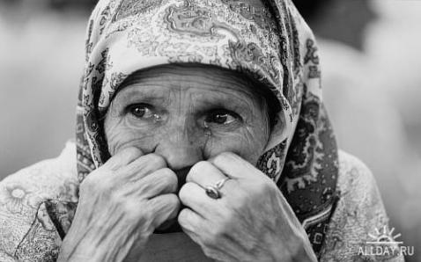
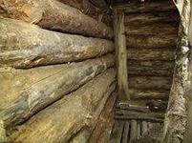
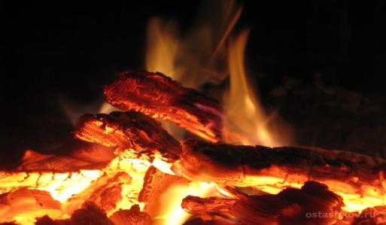
1.
Restless flames twist and toss in the stove.
Resin shines on the wood like a tear.
An accordion sings about love,
And your eyes and your smile reappear.

Slide 4
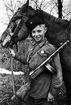
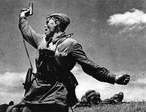
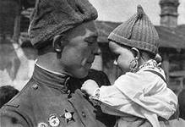
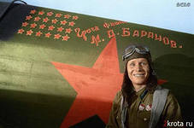
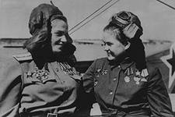
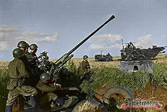
The topic of our lesson is War. Today we are going to speak about the Great Patriotic War.

Slide 5
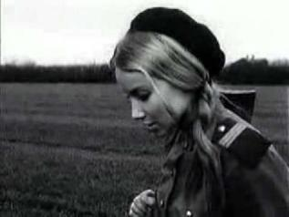
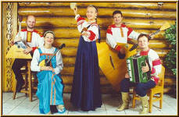
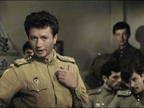
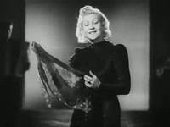
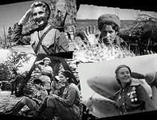
“Ogonek” “Smuglyanka-Moldavanka” “Katusha” “Kalinka”

Slide 6
III. Речевая зарядка I’d like you to revise the lexical material on the topic “The Great Patriotic War”. Let’s read the words about the War one by one. Look at the screen, read and translate the words. the Great Patriotic War, Patriot, officer, hero of the Soviet Union, brave, forces, terror, weapon, hunger, risk, victory, flag, patriotism, Nazi, death, declaration of war, the attack of fascist Germany, a sudden powerful offensive.

Slide 7
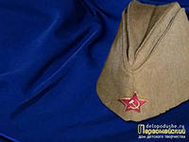
Let’s check your work Patriot, officer, terror, weapon, hunger, hero of the Soviet Union, risk, Nazi, death brave, forces, victory, declaration of war, patriotism, the attack of fascist Germany a sudden powerful offensive.
IV. Систематизация и обобщение
Let’s division words and word combinations into 2 categories: positive and negative.

Slide 8
Find the antonyms in the text to the words that are written on the board. weak offensive слабое наступление personal communication личное сообщение step back отступать назад were released были освобождены a small part of the country малая часть страны succeed удаваться, преуспеть
VI. Применение учебного материала в знакомой и новой учебных ситуациях

Slide 9
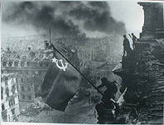
And now we’ll try to sum up our knowledge concerning the text. There are some questions: 1. When did the Great Patriotic War begin? 2. What cities had suffered the bombardments? 3. When did all the radio stations of the Soviet Union broadcast the official communication about the attack of fascist Germany against our country? 4. Who made a declaration of war to USSR?
VII. Практика устной речи

Slide 10
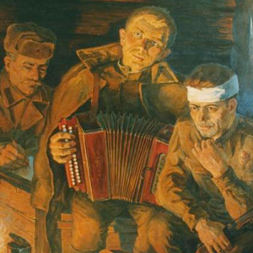
Apple trees and pear trees were a flower, River mist was rising all around. Young Katusha went strolling by the hour On the steep banks, O'er the rocky ground. By the river's bank she sang a love song Of her hero in a distant land. Of the one she'd dearly loved for so long, Holding tight his letters in her hand. Oh, my song, song of a maiden's true love, To my dear one travel with the sun. To the one with whom Katusha knew love, Bring my greetings to him, one by one. Let him know that I am true and faithful, Let him hear the love song that I send. Tell him as he defends our home that grateful, True Katusha our love will defend.
VIII. Релаксация: прослушивание песни, выделение основной идеи песни “Katusha”

Slide 11
схема - ассоциация
IX. Проверка уровня обученности (Работа со схемой - ассоциацией)
BRAVE
BLOOD
DEATH
WAR
ENEMY
FORCES
PATRIOT

Slide 12
You must write the essay “To defend the homeland, is it patriotism?” What is love to the homeland for you…..?
XI. Запись и объяснение домашнего задания

