Slide 1
FUTURE
Тетерина Ольга Афанасьевна

Slide 2
What will you be
when you are 35?

Slide 3
a businessman

Slide 4
a teacher

Slide 5
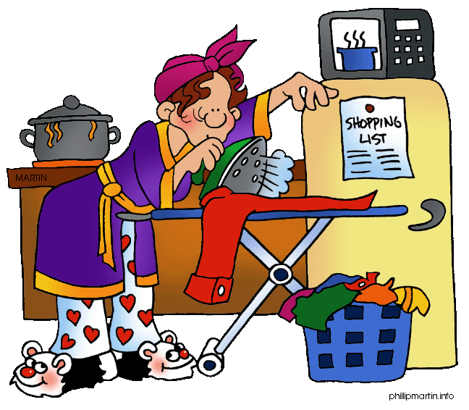
a housewife

Slide 6
a millionaire

Slide 7
a journalist

Slide 8
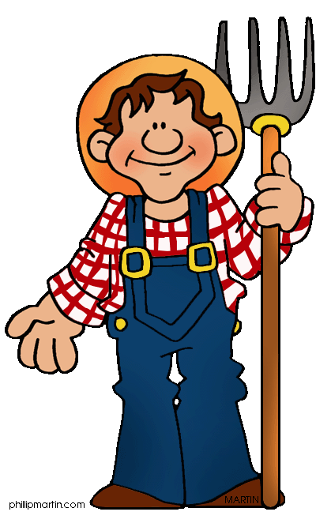
a farmer

Slide 9
What will you be doing at this time when you are 35?

Slide 10
will be working at an office

Slide 11
will be treating a patient

Slide 12
will be lying on the sofa as usual

Slide 13
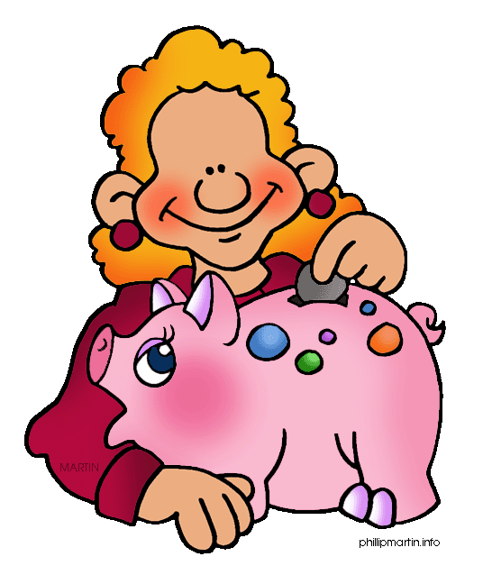
will be counting your money

Slide 14
will be travelling in Africa

Slide 15
will be making a presentation

Slide 16
What will you have done by the time you are 35?

Slide 17
will have graduated from university

Slide 18
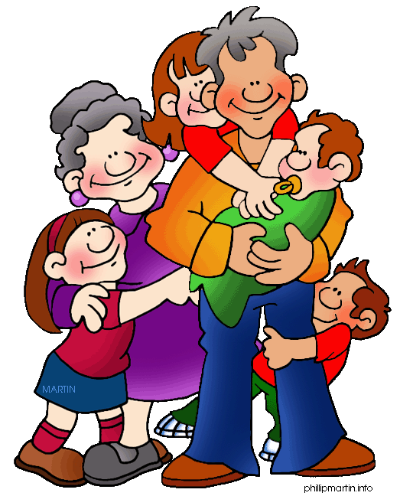
will have got married

Slide 19
will have made an important discovery

Slide 20
will have bought a large house and a yacht

Slide 21
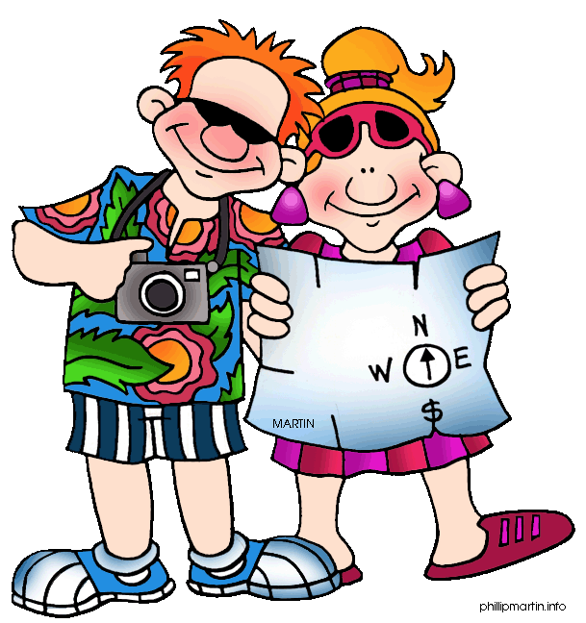
will have visited lots of countries

Slide 22
will have lost your job

Slide 23
How long will you have been working by the time you are 35?

Slide 24
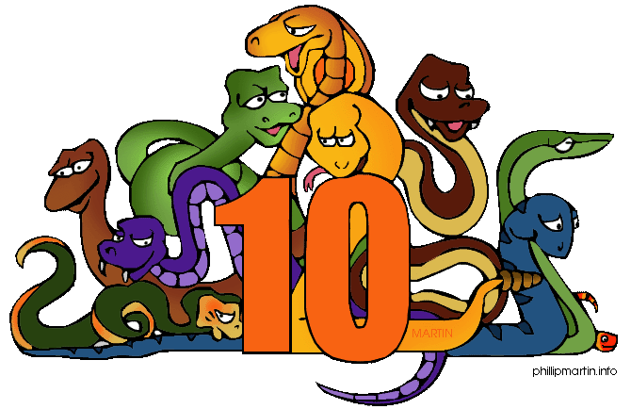
for 10 years

Slide 25
for 9 years

Slide 26
for 8 years

Slide 27
for 5 years

Slide 28
for 4 years

Slide 29
For 3 years

Slide 30
How much money will you have saved by the age of 35?

Slide 31
$1,000,000

Slide 32
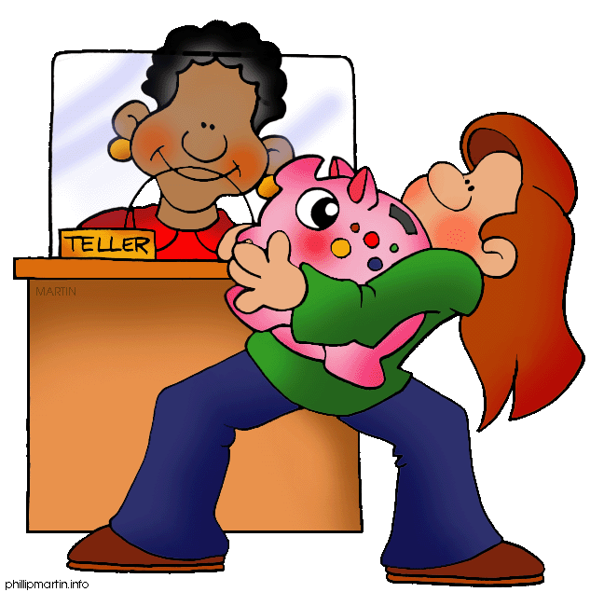
10, 000 roubles

Slide 33
a lot

Slide 34
Sometimes you’ll have a lot of money but you’ll always spend it very quickly.

Slide 35
Not much. Sorry.

Slide 36
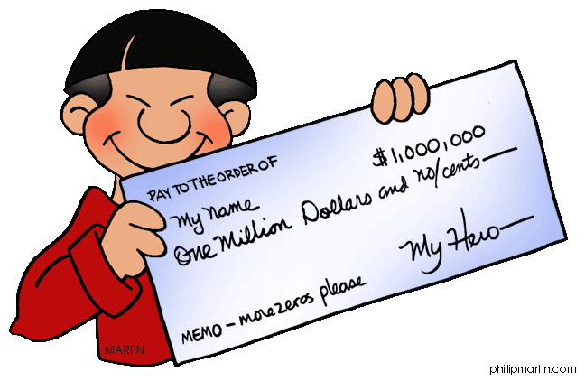
Enough for you.

Slide 37
What countries will you have visited by the age of 35?

Slide 38
almost all

Slide 39
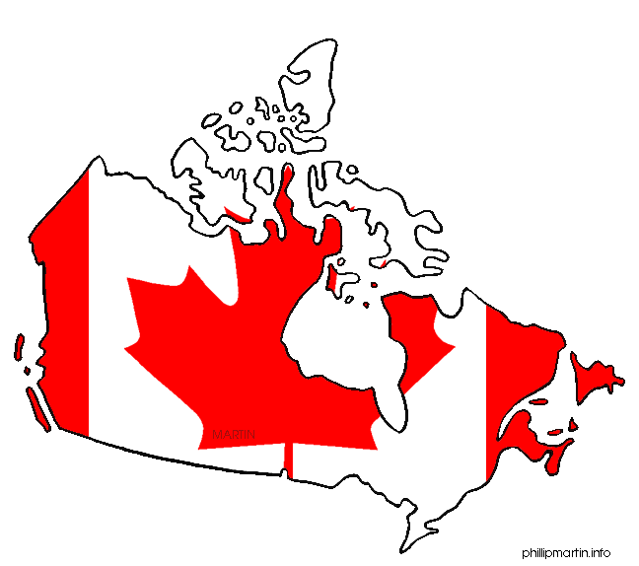
the USA and Canada

Slide 40
European

Slide 41
Asian

Slide 42
Australia

Slide 43
African

Slide 44
Where will you be living
when you are 35?

Slide 45
in a bungalow on the Canary Islands

Slide 46
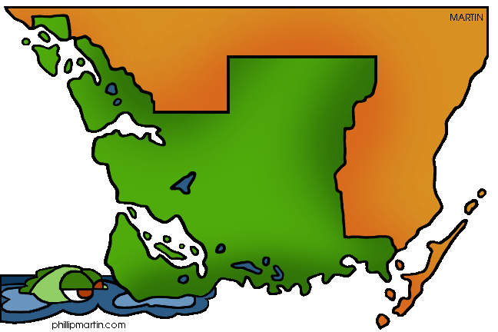
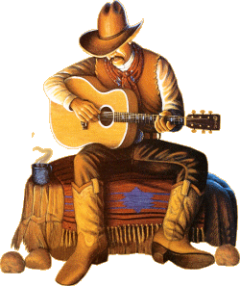
in a villa in Florida

Slide 47
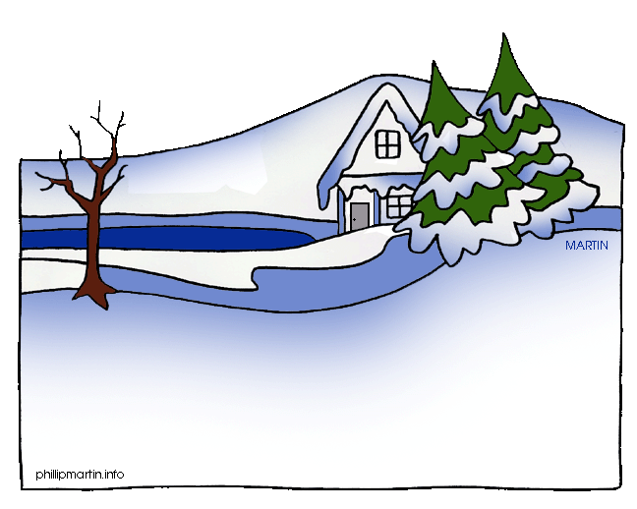
in a village cottage in Siberia

Slide 48
in a block of flats in Moscow

Slide 49
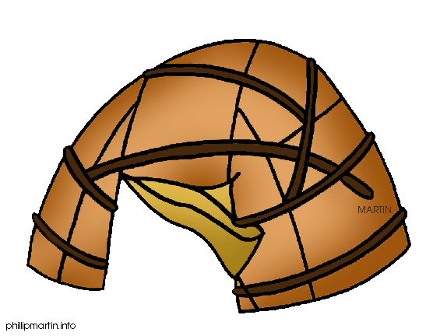
somewhere

Slide 50
in a castle

Slide 51
Whom will you have got married to by the age of 35?

Slide 52
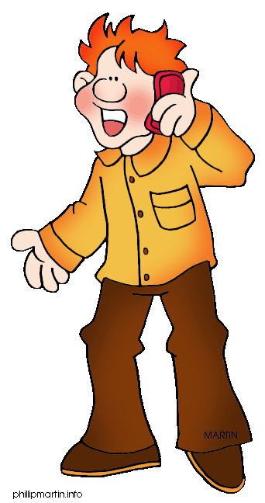
your classmate

Slide 53
a millionaire

Slide 54
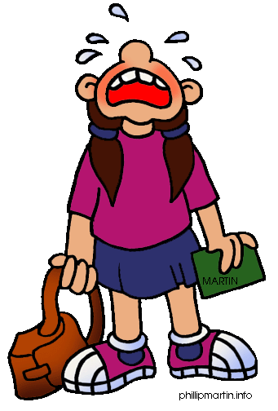
You will have a lot of lovers but you will never marry. Sorry.

Slide 55
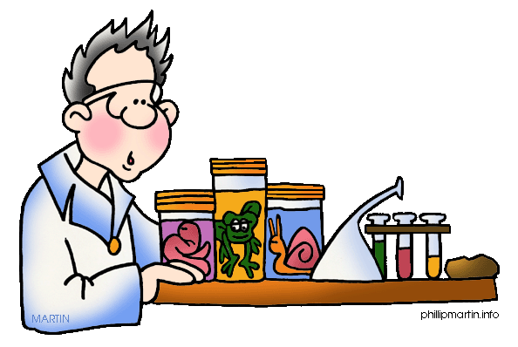
a professor

Slide 56
a very nice and handsome man/ beautiful woman

Slide 57
the President

Slide 58
How many children will you be raising at the age of 35?

Slide 59
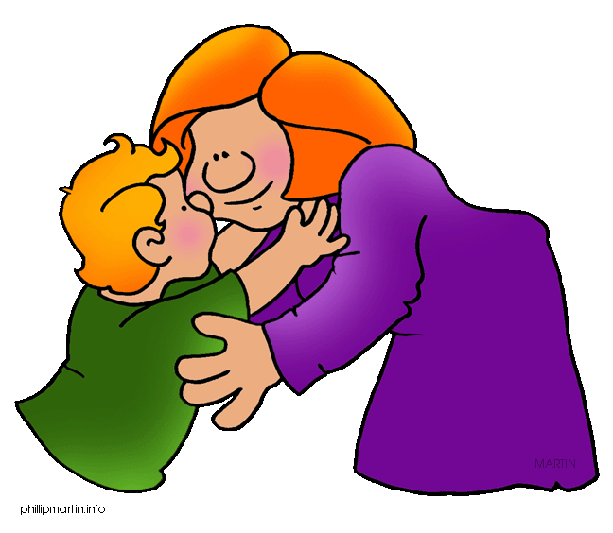
one but smart and nice

Slide 60
a lot

Slide 61
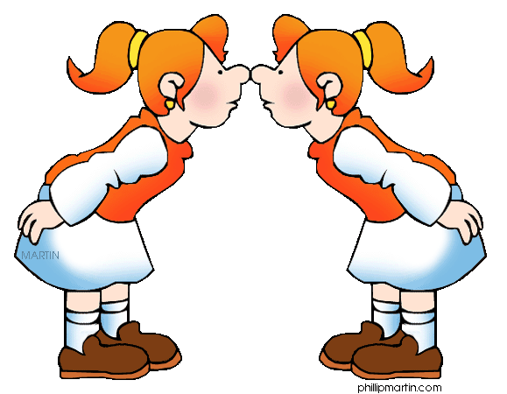
twins

Slide 62
three kids: one dark-haired, one fair-haired and one red-haired

Slide 63
as many as you will like

Slide 64
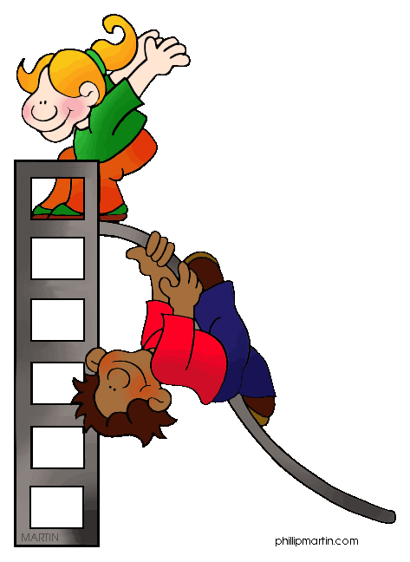
two but very noisy and naughty

Slide 65
What will you have learnt
by the age of 35?

Slide 66
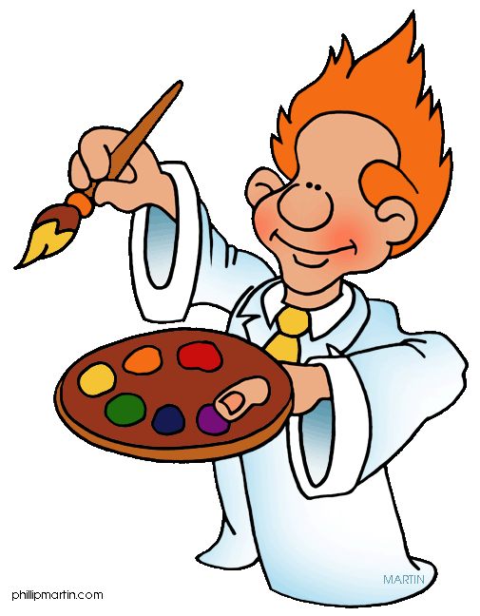
painting

Slide 67
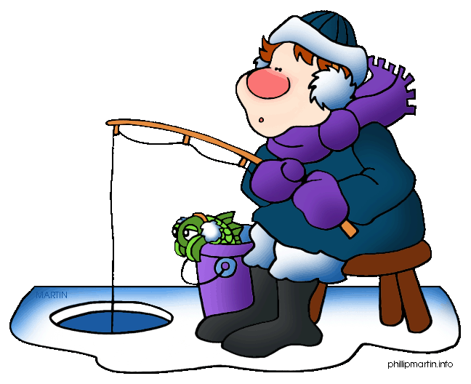
ice fishing

Slide 68
belly dancing

Slide 69
surfing

Slide 70
playing hockey

Slide 71
sky diving

Slide 72
What will you still be learning
at the age of 35?

Slide 73
how to do yoga

Slide 74
how to repair things

Slide 75
how to do business

Slide 76
laws

Slide 77
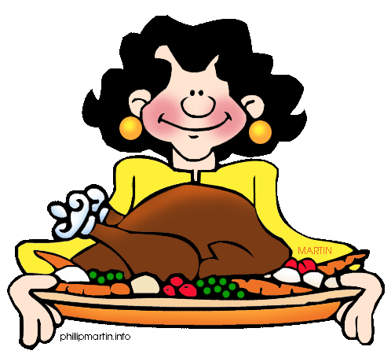
how to cook

Slide 78
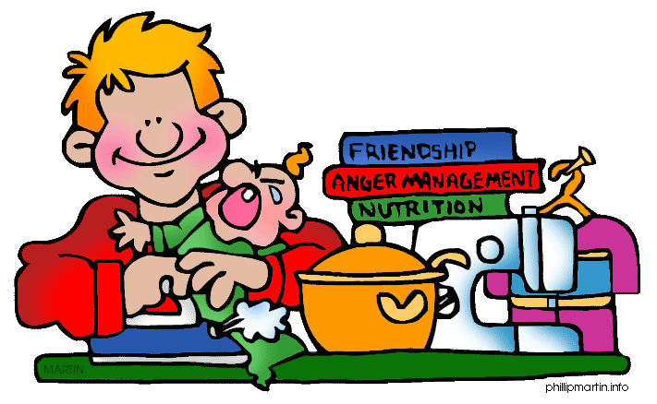
home economics

Slide 79
What pet will you be looking after at the age of 35?

Slide 80
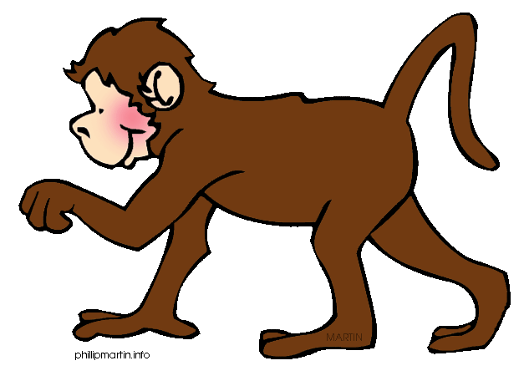
a monkey

Slide 81
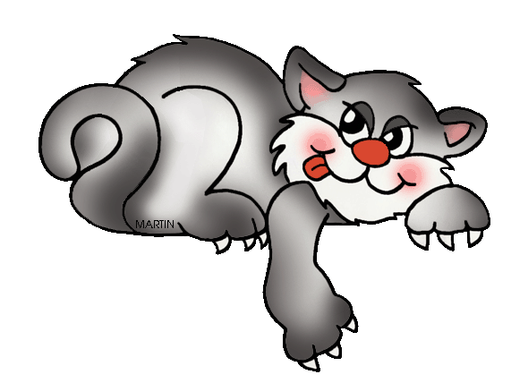
a cat

Slide 82
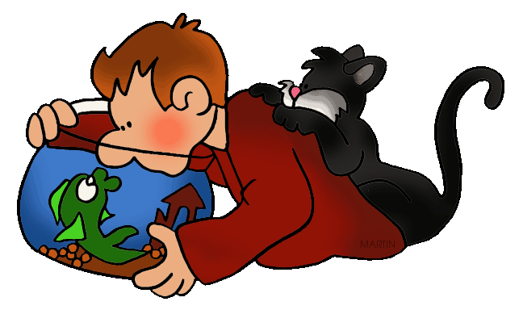
fish and a cat

Slide 83
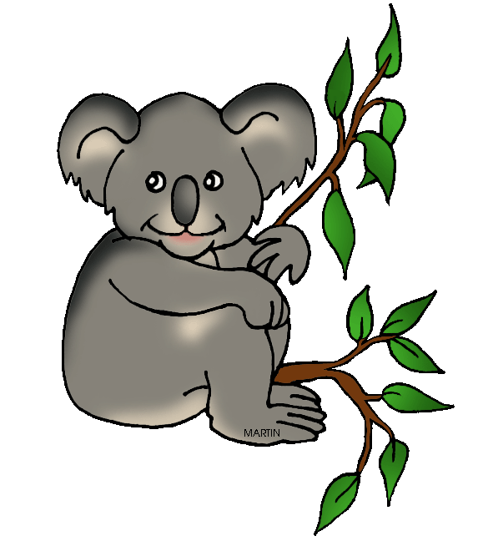
a koala

Slide 84
a dog

Slide 85
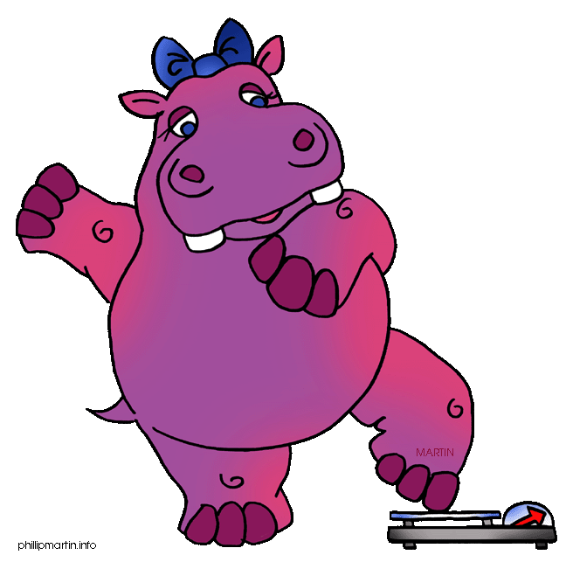
a hippo

Slide 86
How will you be travelling
when you are 35?

Slide 87
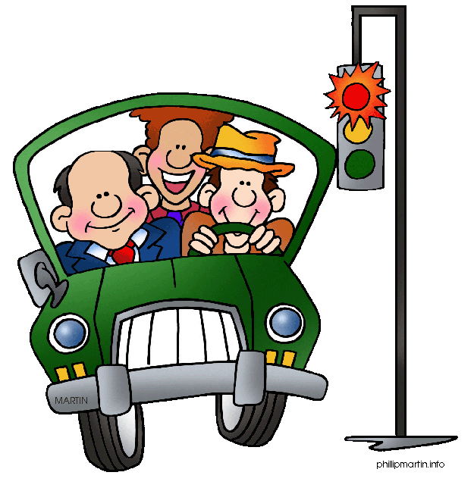
by car

Slide 88
by bike

Slide 89
by rocket

Slide 90
by UFO

Slide 91
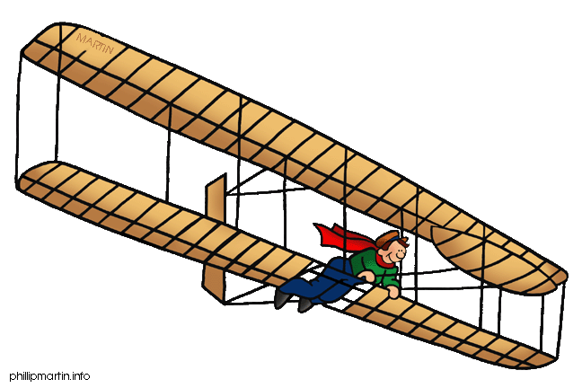
by plane

Slide 92
by ship

Slide 93
Thank you for attention!

Slide 94
Источник иллюстраций
http://pppst.com/
FREE Original Clipart for Kids, Teachers, Parents, Schools, Churches, WebPages, wherever you can find a non-profit use for it

Slide 95
Автор презентации:
Тетерина Ольга Афанасьевна

