Slide 1
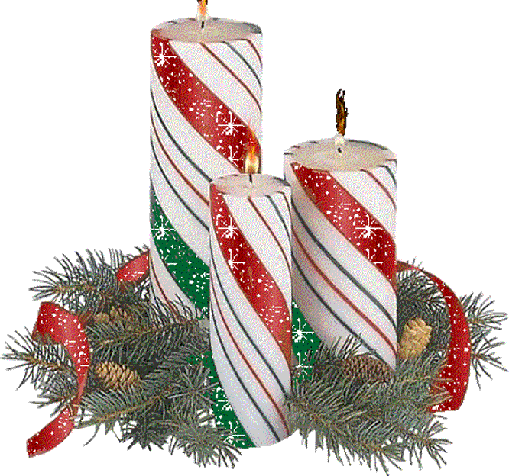
MERRY CHRISTMAS
Захарьина Ольга Валерьевна, 254-599-258

Slide 2
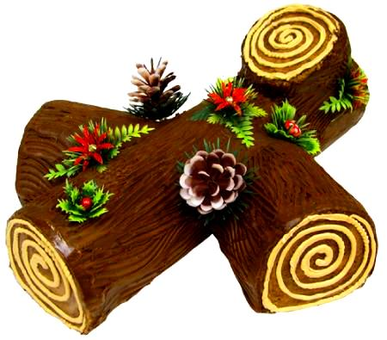
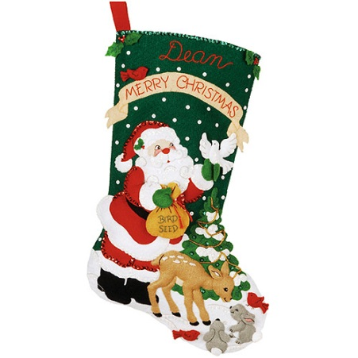
Candle
Yule log
Stocking

Slide 3
Wreath
Cracker
Holly

Slide 4
Presents
Fireplace
Carol singers

Slide 5
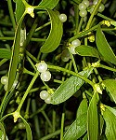
Candy Cane
Mistletoe
Sleigh

Slide 6
MERRY CHRISTMAS

Slide 7
Links:
Pictures
http://www.woodlands-junior.kent.sch.uk/customs/Xmas/facts.html
http://www.xmasangel.narod.ru/history/kollegi.html
http://radoden.com/novogodnie-animashki/
http://im1-tub-ru.yandex.net/i?id=96f1259b39dd7df00bf70d5ce13e4766-09-144&n=21
http://s011.radikal.ru/i318/1012/ea/3aa62932401a.gif
http://im0-tub-ru.yandex.net/i?id=f6d28f929d15f75aed7bf4c80c111e66-133-144&n=24
https://encrypted-tbn2.gstatic.com/images?q=tbn:ANd9GcQDGOFyDNttPRu6bj7czer59F0LOQdNlaDGoJlsLJZS4cyS3wzS
https://31.media.tumblr.com/7af3b3970776f16abc5047865cd10ab0/tumblr_inline_nfkyzvPCq41r750k7.gif
http://projectbritain.com/Xmas/images/santachim.gif
http://im0-tub-ru.yandex.net/i?id=4507e0c07f3362833459e38c9d42d494-63-144&n=21
http://im0-tub-ru.yandex.net/i?id=380dbcb78b5bb53bfc604c2644100f20-130-144&n=21
http://deti-online.com/img/pesni-elochka-elka-lesnoy-aromat.jpg
http://www.merrystockings.com/images/thumbnails/0//165/Christmas-Feast-Bucilla-Christmas-Stocking-kit.jpg
http://www.crowderconsult.com/wp-content/uploads/2012/12/christmas-holly.jpg

