Slide 1
Захарьина Ольга Валерьевна, учитель английского языка МБОУ "Общеобразовательный лицей №17"г. Северодвинск Архангельской области
2015

Slide 2
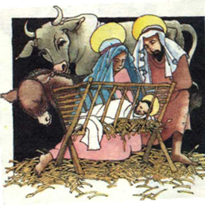

Slide 3
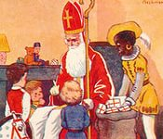
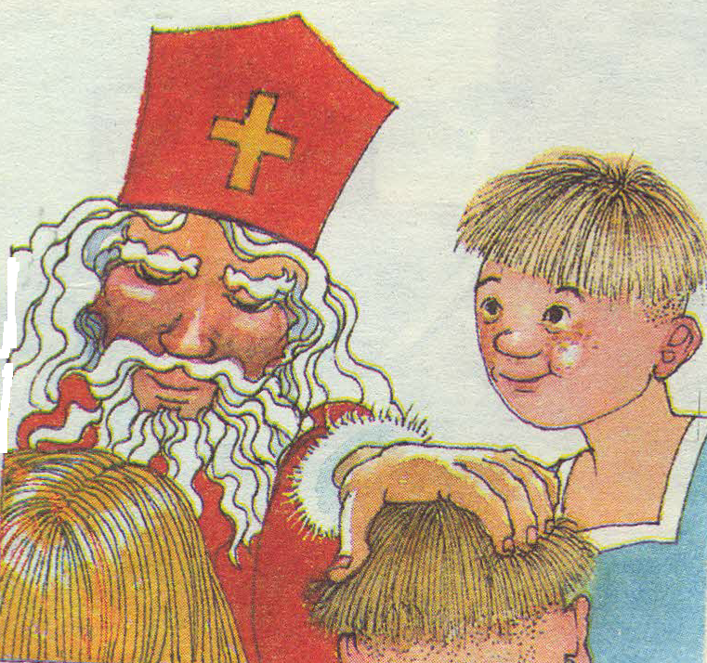
Bishop of Myra
St. Nicholas lived
in the
4th century
вishop - епископ
Sinterklaas
Santa Clause

Slide 4
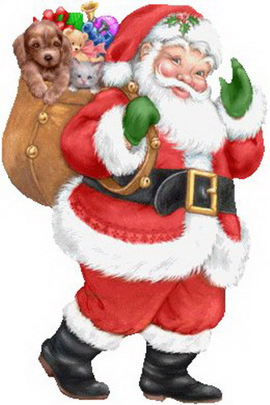
Santa Clause

Slide 5
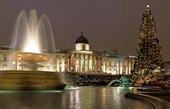
After Queen Victoria married Prince Albert the custom of decorating Christmas tree with candles and presents was introduced in Britain.

Slide 6
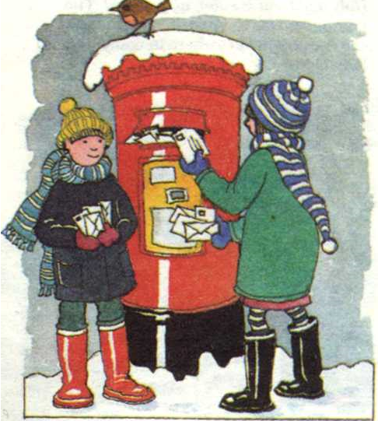
Christmas cards
The earliest
known
Christmas card
was sent by
Sir Henry Cole
in 1843.

Slide 7
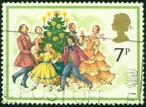
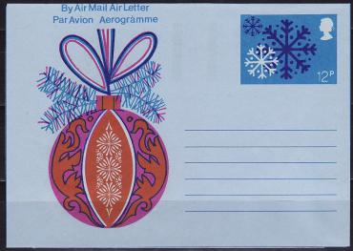
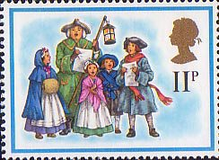
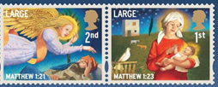
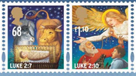
Christmas cards

Slide 8
Links:
1.Click №2 2000
2. Pictures:
http://cs623221.vk.me/v623221703/f9a3/YiW9256l8Wk.jpg
http://im1-tub-ru.yandex.net/i?id=4d05fa13f5b9f4e381435e4a8677aea1-01-144&n=21
http://im1-tub-ru.yandex.net/i?id=15011fbf6dda6946b41bc9193f2a4893-45-144&n=21
http://yandex.ru/images/search?pin=1&pin=1&text=pictures%20Saturnalia&img_url=http%3A%2F%2Fwww.westhamptonbeach.k12.ny.us%2Fcms%2Flib2%2FNY01001014%2FCentricity%2FDomain%2F331%2Fsaturnalia.gif&pos=1&rpt=simage&pin=1
http://im0-tub-ru.yandex.net/i?id=bd0789d3dba7319914b6f78af2ea7df3-29-144&n=21
https://encrypted-tbn2.gstatic.com/images?q=tbn:ANd9GcQDGOFyDNttPRu6bj7czer59F0LOQdNlaDGoJlsLJZS4cyS3wzS
https://31.media.tumblr.com/7af3b3970776f16abc5047865cd10ab0/tumblr_inline_nfkyzvPCq41r750k7.gif
http://s3-eu-west-1.amazonaws.com/lookandlearn-preview/A/A001/A001141.jpg
http://im1-tub-ru.yandex.net/i?id=44ffc148212abab0908d828b6f024d5d-17-144&n=21
http://im3-tub-ru.yandex.net/i?id=878a2ef5700c1e33d79838d264cd1059-135-144&n=21
http://im1-tub-ru.yandex.net/i?id=e8f734a05fcb3f235eafcbe064460112-95-144&n=21
http://im0-tub-ru.yandex.net/i?id=66d536d79777f818578079049fe743bb-87-144&n=21
http://im1-tub-ru.yandex.net/i?id=ce4e172fe39cc9749f0f54205be5aad7-19-144&n=21
http://caccioppoli.com/Animations/Navidad/155.gif
http://www.comprehensivepediatrics.com/animated_fireplace.GIF

