Slide 1
Christmas Quiz
Захарьина Ольга Валерьевна
учитель английского языка
МБОУ "Общеобразовательный
лицей №17"г. Северодвинск
Архангельской области
2015

Slide 2
When was the first Christmas tree introduced to Britain?
A. About 1920
B. About 1830
C. About 1850
D. About 1870

Slide 3
2. Who made the Christmas tree popular in Britain?
A. Father Christmas
B. Good King Wenceslas
C. Queen Victoria
D. Queen Elizabeth

Slide 4
3. What country gave Britain the tradition to celebrate and decorate Christmas tree?
A. Germany
B. Bohemia
C. Turkey
D. Russia

Slide 5
4. Which of these things would you decorate your house with at Christmas time?
A. Punch
B. Streamers
C. Mistletoe
D. Crackers

Slide 6
5. What would you expect to find at a Christmas stocking?
A. Plum pudding
B. Old clothes
C. Money
D. Small presents

Slide 7
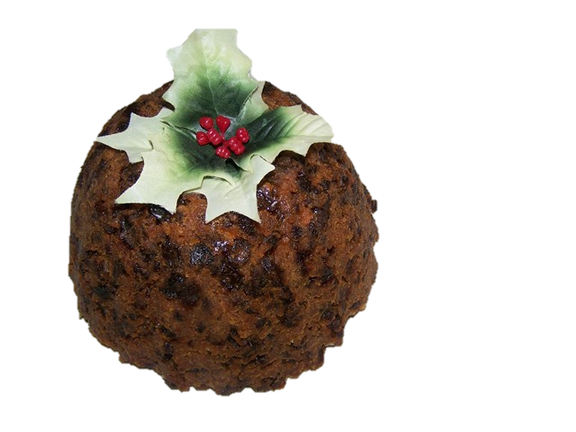
6. Which at these things would you not find on your plate at Christmas?
A. Plum pudding
B. Turkey
C. Ivy
D. Mince pies

Slide 8
7. Where does the tradition of decorating the house with mistletoe at Christmas come from?
A. Germany
B. Bohemia
C. The Druids
D. Russia

Slide 9
8. How does Santa get into the houses to deliver the toys?
A. Front door
B. Basement door
C. Back door
D. Down the chimney

Slide 10
9. Who brought Santa Claus to America?
A. The Germans
B. The French
C. The Dutch
D. The English

Slide 11
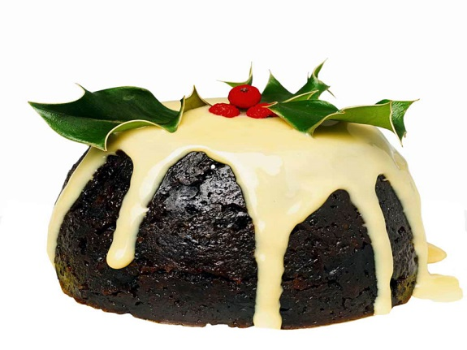
10. What are the traditional Christmas colours?
A. Red and white
B. Red and blue
C. Red and green
D. White and blue

Slide 12
MERRY CHRISTMAS!

Slide 13
Links
Wall
http://im2-tub-ru.yandex.net/i?id=687f6ca7bc58a6f28de1061e4ced0aea-12-144&n=21
Pictures:
https://encrypted-tbn3.gstatic.com/images?q=tbn:ANd9GcTMi2iPu1LFSJO6WW7-vxdDVSF2-TEH6vjrrM07Cd9THEL9MBBaiKCy
http://thetrainerstrainingcompany.co.uk/wp-content/uploads/2011/12/MP9004312771.jpg
https://lh5.ggpht.com/GufFqTVeqF8AIo5SYvk4zXzUF3MzFTgz92GPGPRxWc3SgiYhSBlm3GR2vg2e40ulwPR57Q=s99
https://lh5.ggpht.com/soiUGTkuGQZy0sNdEyhTZe-lRC0-7wpMmA5F-D5JkwsKdgjZZUKWKvl1o6MN6dckjxNGRI0=s85
https://lh4.ggpht.com/dd7KmDoN-97Kloi4KvCBMfh2wqB6ywGgi8FX9GLqLhwZNDmof9_-M7kKaINHaytydJ_6=s85
https://lh3.ggpht.com/fz940WF2tmAK-sXa5S9yVhnZG4ql-fXWHrvFwU82wlbYJZ0_wOEU02E9NL8FdjJlCje5UBY=s99
https://lh4.ggpht.com/_vrDXC25wKL_ejBHzH22s7_IZHnto-KETbrGfed_Q0aKk6W5RezMIHlB3nr2k0btalzWwQ=s85
http://boitedependore.com/fleurmois/gui2.jpg
https://lh6.ggpht.com/Zx1nYm4P9y-WX-Y2PWvM9zw4Xlsk-lEKyjHWmPbMPWnmqEPorXE5hf8sTGERCvuaWoQY=s85

