Slide 1
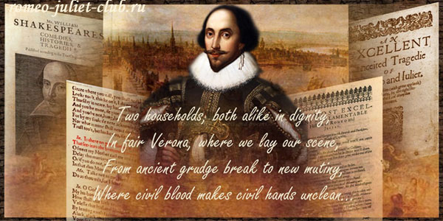
William Shakespeare
ROMEO and JULIET
Mirny Lyceum Students

Slide 2
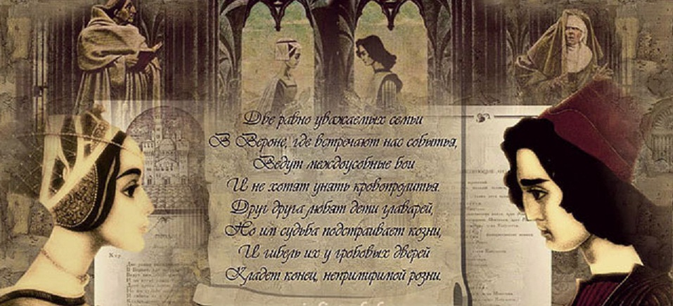
William Shakespeare
ROMEO and JULIET
Mirny Lyceum Students

Slide 3
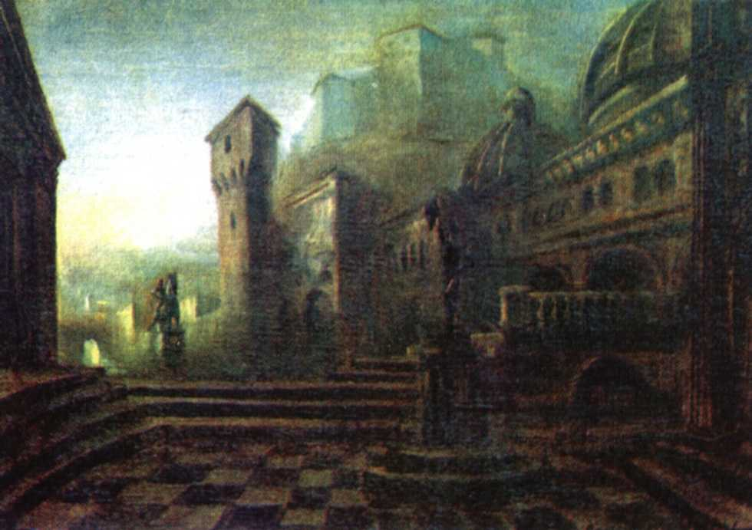
William Shakespeare
ROMEO and JULIET
Mirny Lyceum Students

Slide 4
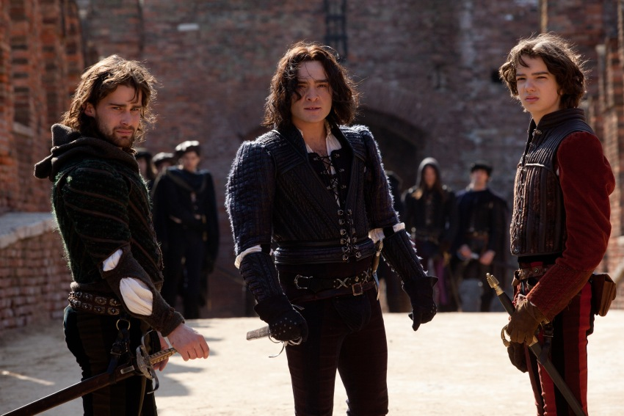
William Shakespeare
ROMEO and JULIET
Mirny Lyceum Students

Slide 5
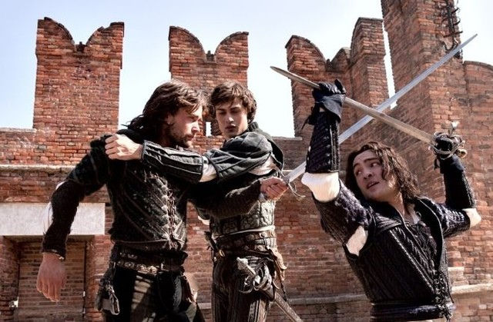
William Shakespeare
ROMEO and JULIET
Mirny Lyceum Students

Slide 6
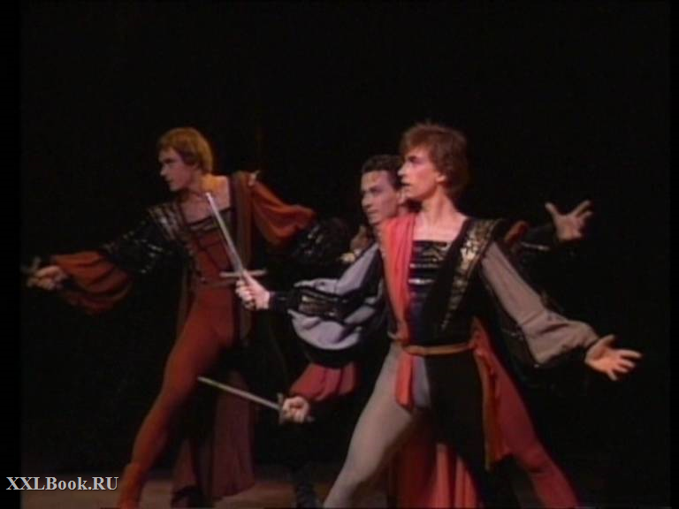
William Shakespeare
ROMEO and JULIET
Mirny Lyceum Students

Slide 7
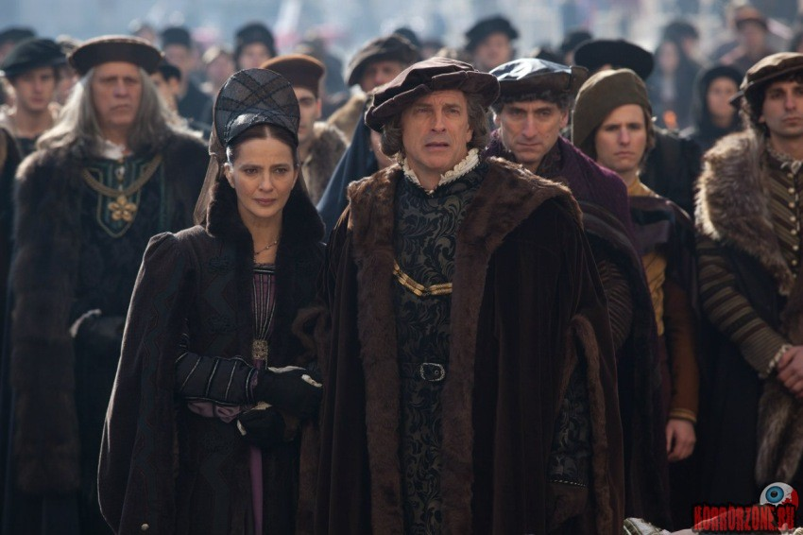
William Shakespeare
ROMEO and JULIET
Mirny Lyceum Students

Slide 8
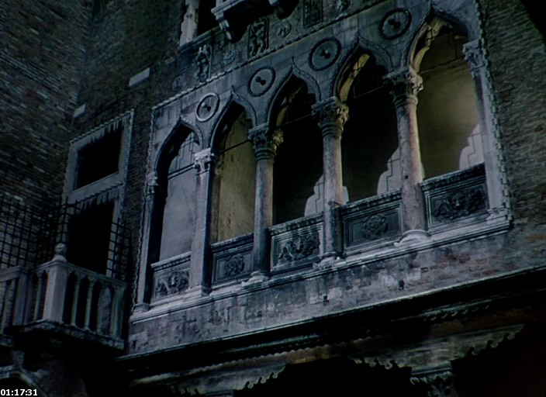
William Shakespeare
ROMEO and JULIET
Mirny Lyceum Students

Slide 9
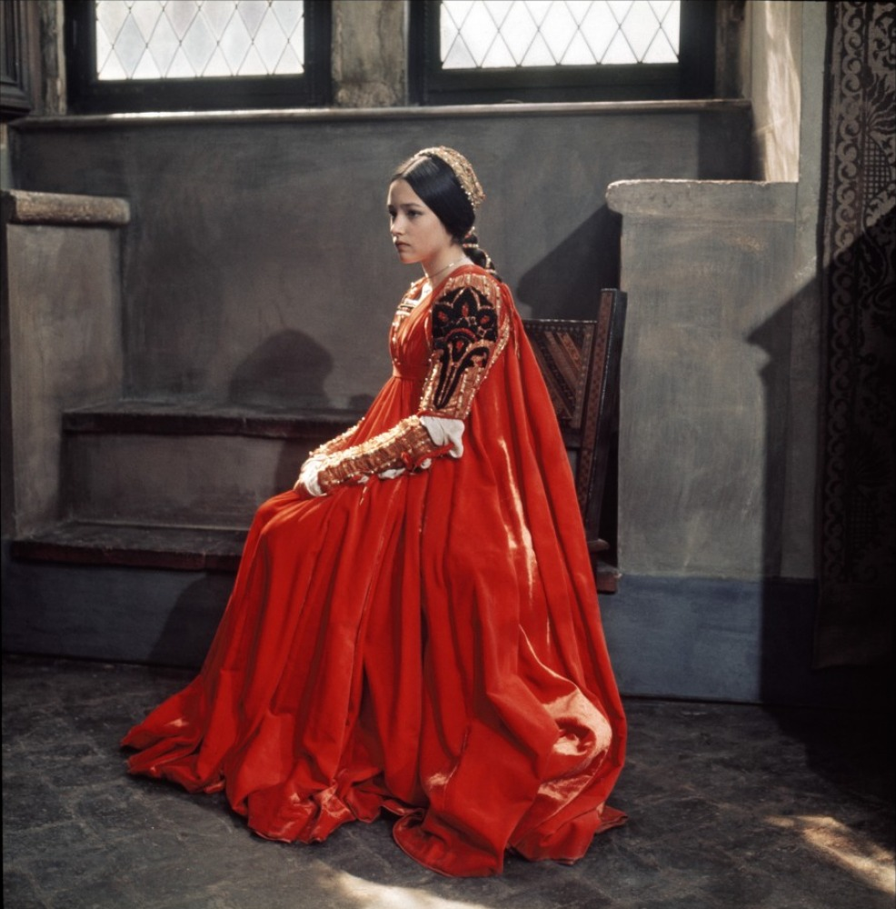
William Shakespeare
ROMEO and JULIET
Mirny Lyceum Students

Slide 10
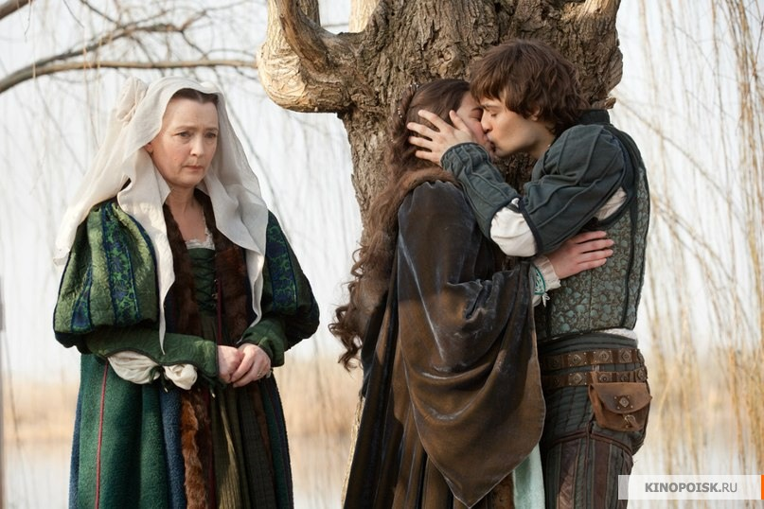
William Shakespeare
ROMEO and JULIET
Mirny Lyceum Students

Slide 11
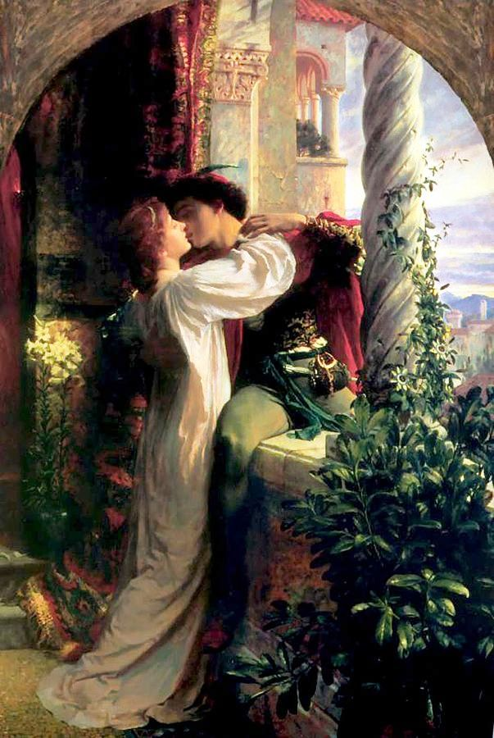
William Shakespeare
ROMEO and JULIET
Mirny Lyceum Students

Slide 12
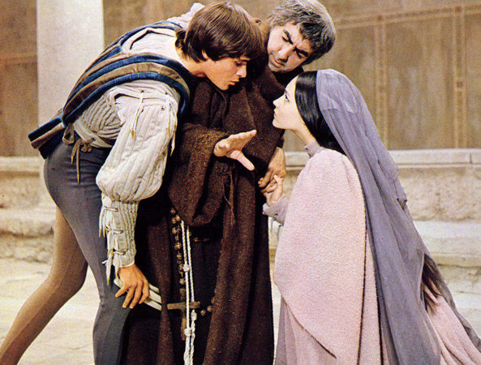
William Shakespeare
ROMEO and JULIET
Mirny Lyceum Students

Slide 13
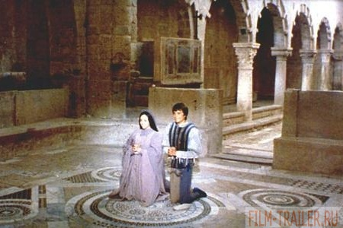
William Shakespeare
ROMEO and JULIET
Mirny Lyceum Students

Slide 14
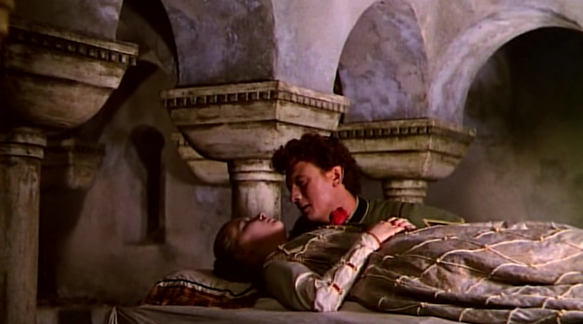
William Shakespeare
ROMEO and JULIET
Mirny Lyceum Students

Slide 15
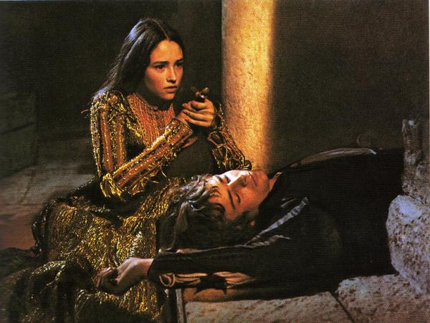
William Shakespeare
ROMEO and JULIET
Mirny Lyceum Students

Slide 16
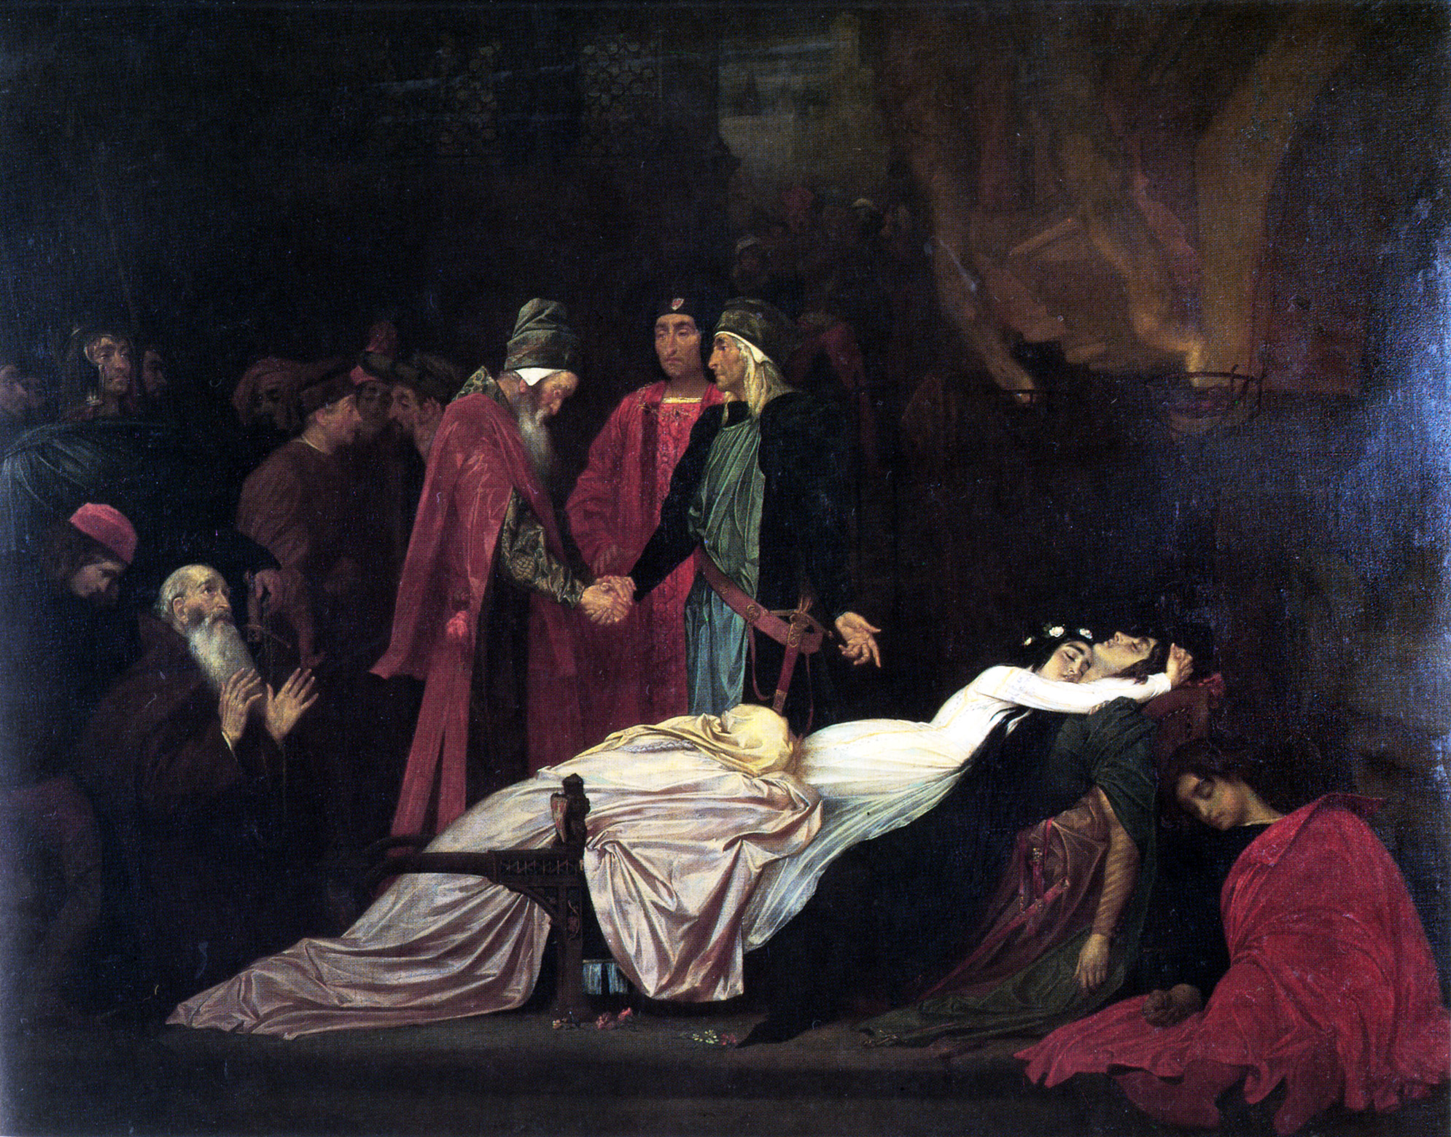
William Shakespeare
ROMEO and JULIET
Mirny Lyceum Students

Slide 17
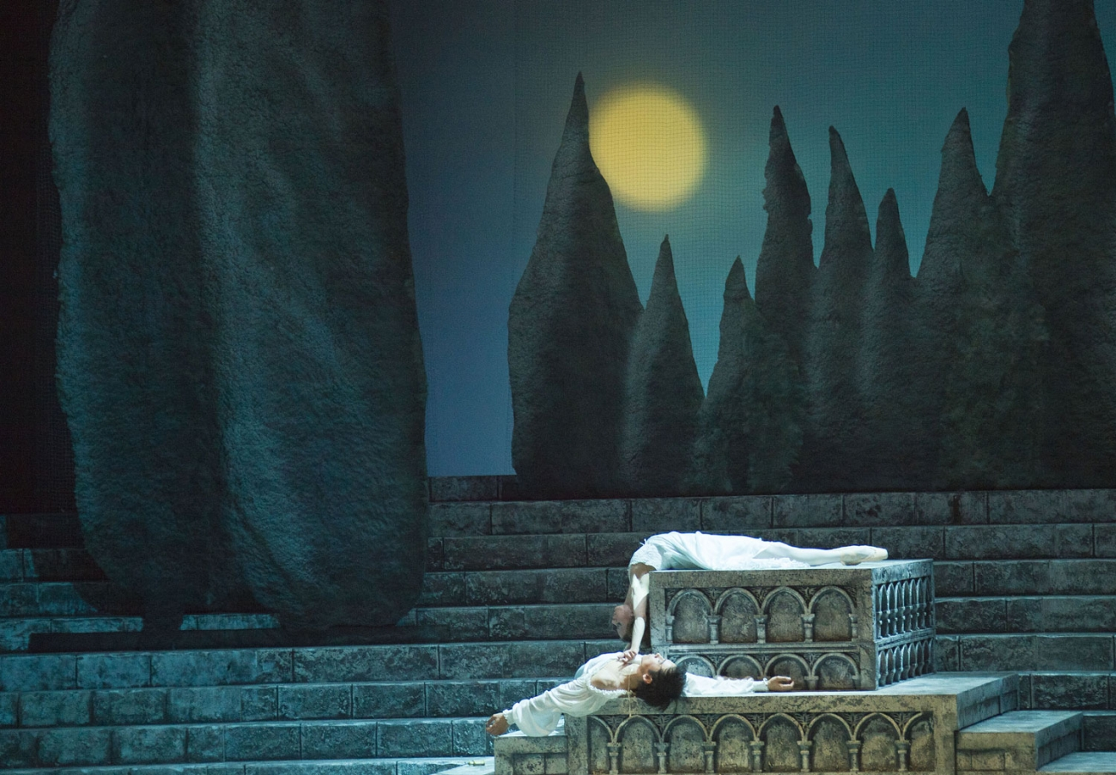
William Shakespeare
ROMEO and JULIET
Mirny Lyceum Students

