Slide 1
We are the champions!

Slide 2
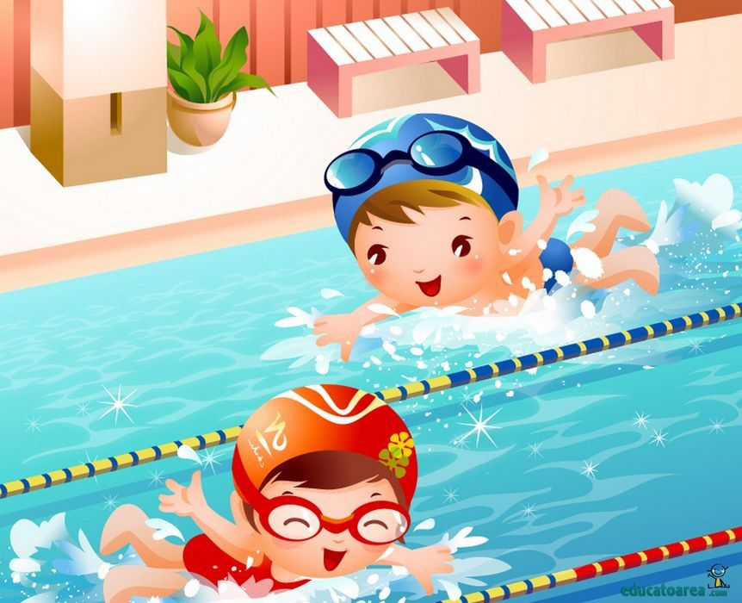
Go swimming

Slide 3
Play basketball

Slide 4
Play tennis

Slide 5
Do gymnastics

Slide 6
Play ice hockey

Slide 7
Do judo

