Slide 1
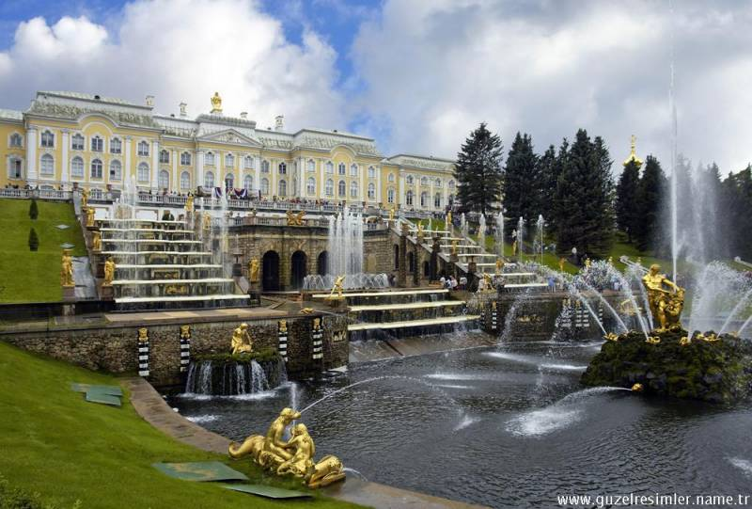
St. Petersburg

Slide 2
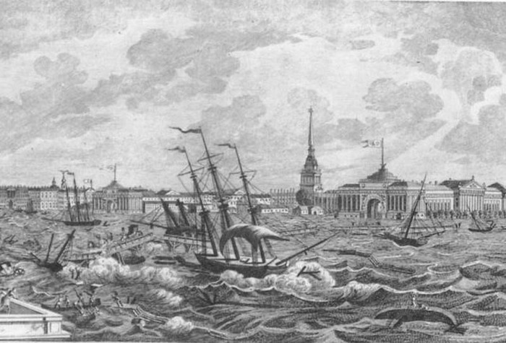
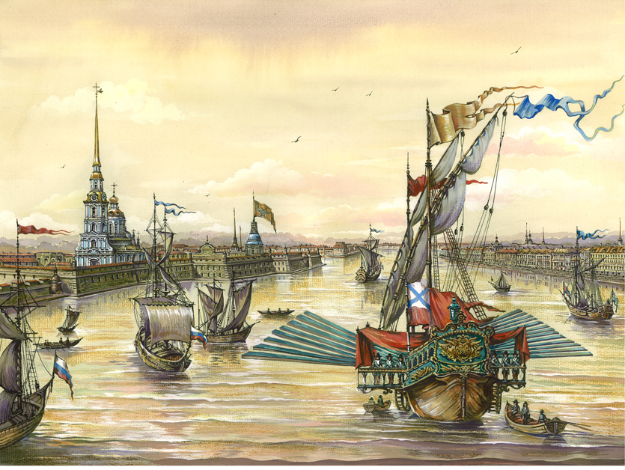
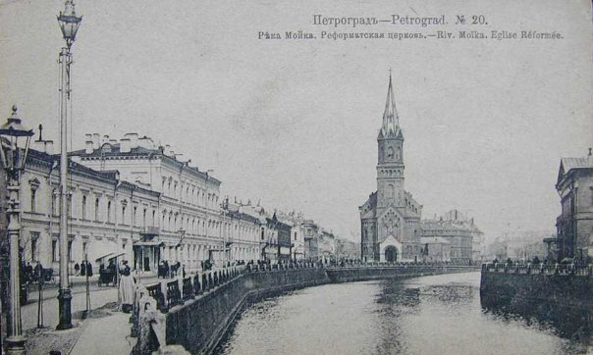
St Petersburg is the second largest city of Russia and one of the world’s major cities. It's a relatively young city, by both Russian and European standards, and was only founded in 1703 by Tsar Peter the Great. Despite its short life so far, Petersburg has a rich and exciting history. The city has always bustled with life and intrigue, revolution and mystery

Slide 3
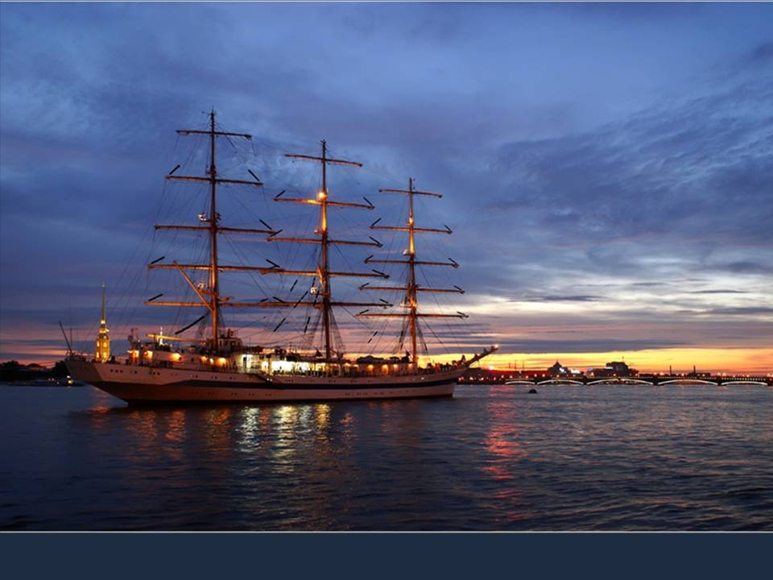
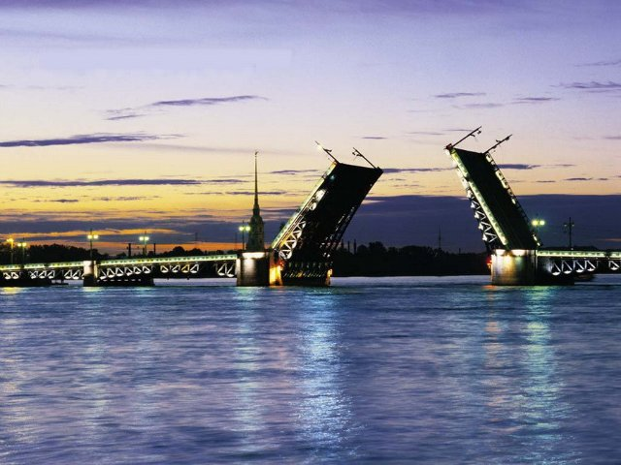
White Night starts in May, when the city finally succumbs to spring and the parks are filled with flowering trees, but mid-June is peak time, when the sun slumps lazily towards the horizon, but never fully sets. Technically speaking the so-called "White Nights" are not unique to St Petersburg, but only here have the northern nights received such a poetic acclaim. What could be more romantic than walking along rivers and canals when night is as bright as early evening? It is the world's only metropolis where such a phenomenon takes place every summer. Every year there are days when the downtown St Petersburg is full of people, even at night. It is a great time for those in love.

Slide 4
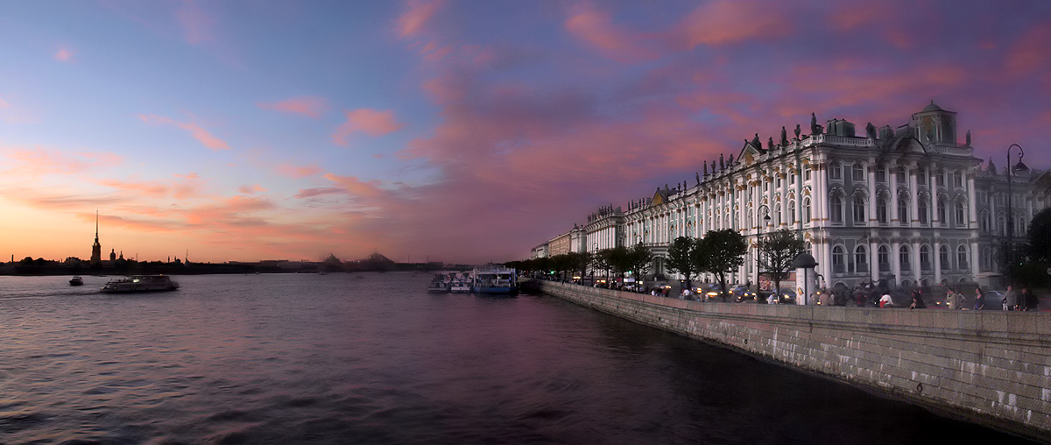
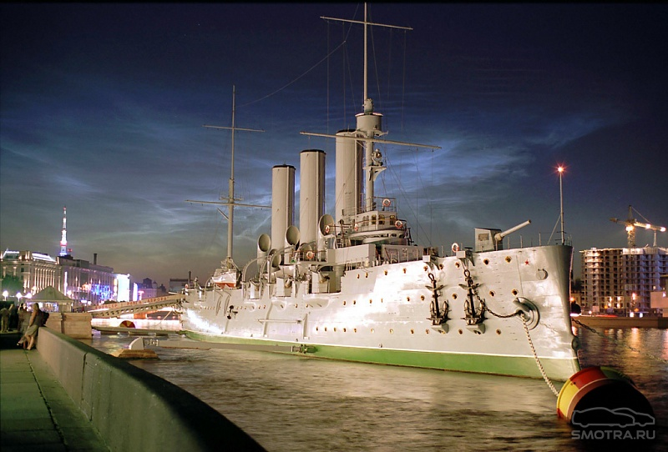

Slide 5
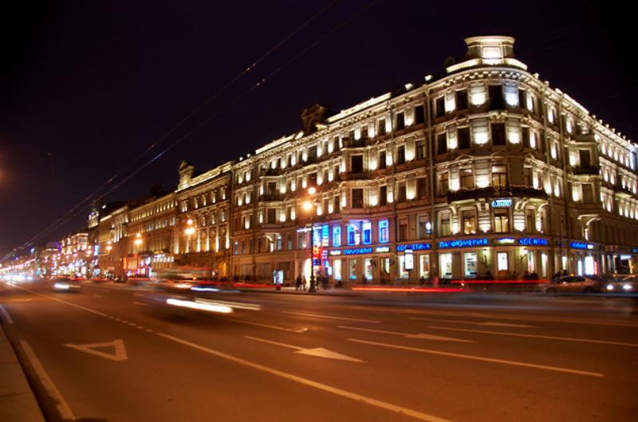
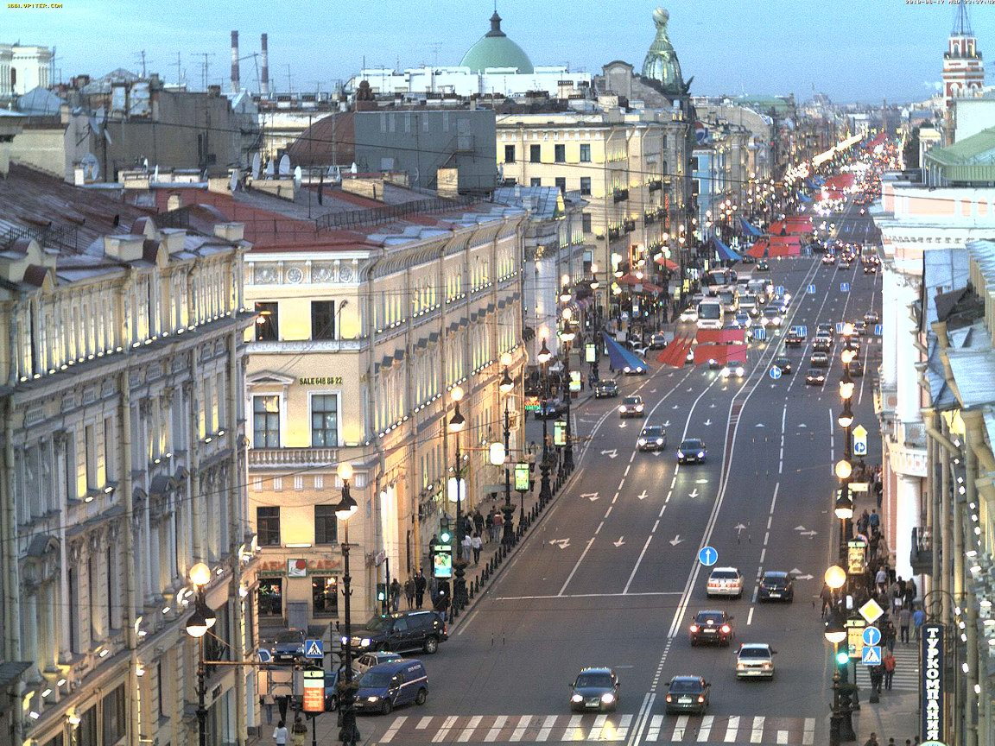
Nevsky Prospect is St. Petersburg’s main avenue and one of the best-known streets in Russia. Cutting through the historical center of the city, it runs from the Admiralty to the Moscow Railway Station and then, after a slight kink, to the Alexander Nevsky Monastery. In the very first days of St. Petersburg it was simply the beginning of the road to the ancient city of Novgorod, but it quickly became adorned with beautiful buildings, squares and bridges and became the very center of the bustling, rapidly growing city.

Slide 6
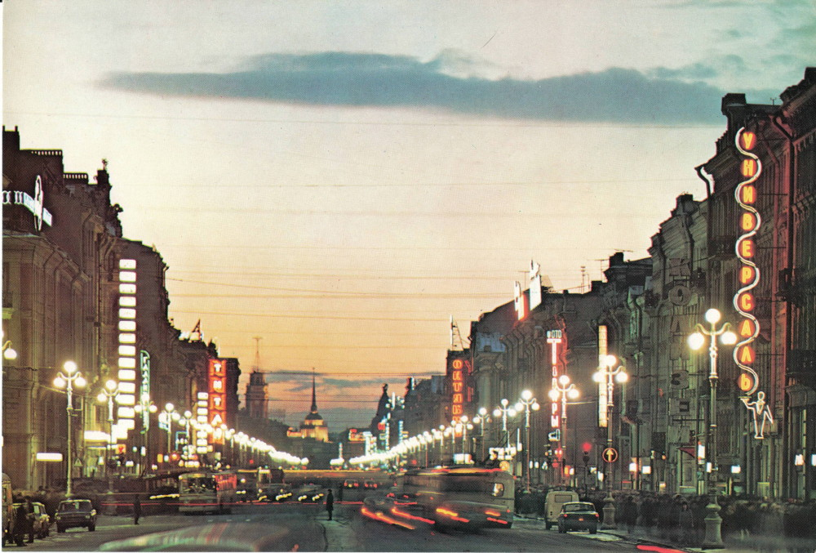
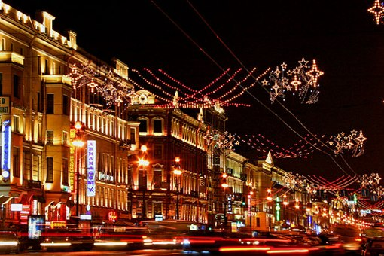
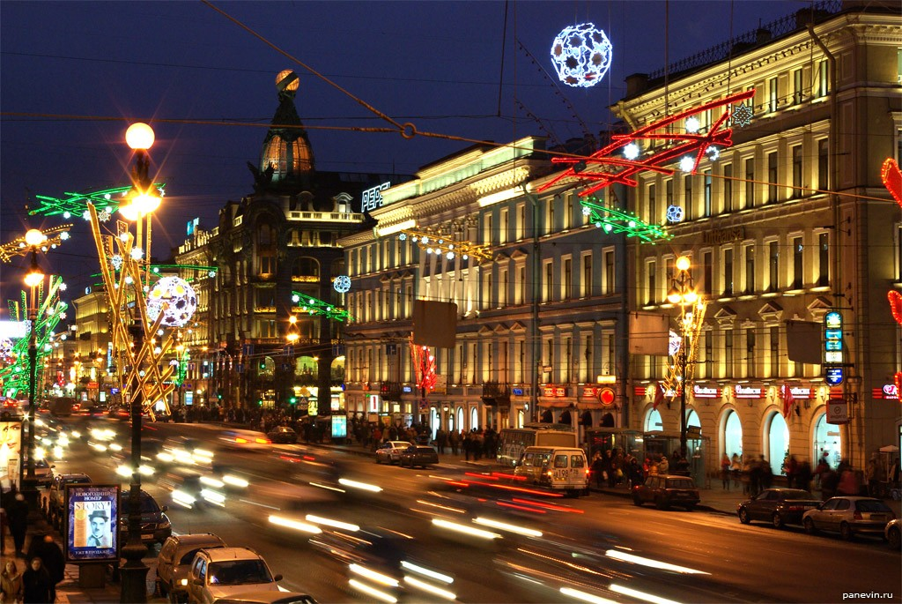
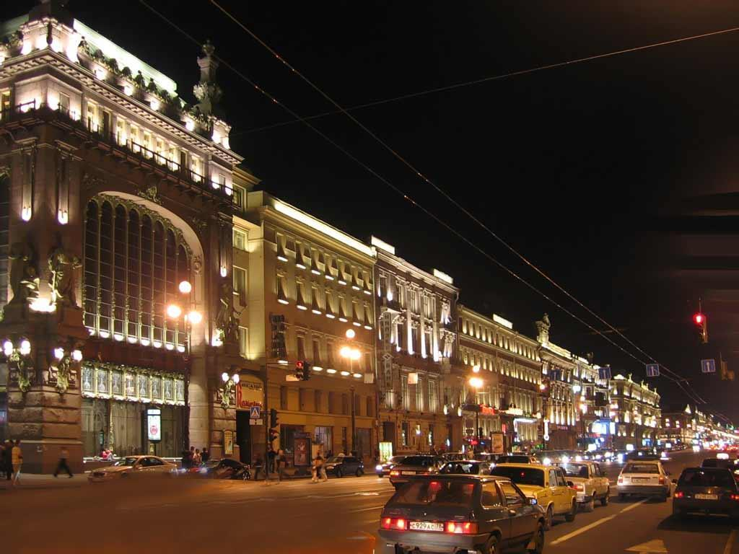

Slide 7
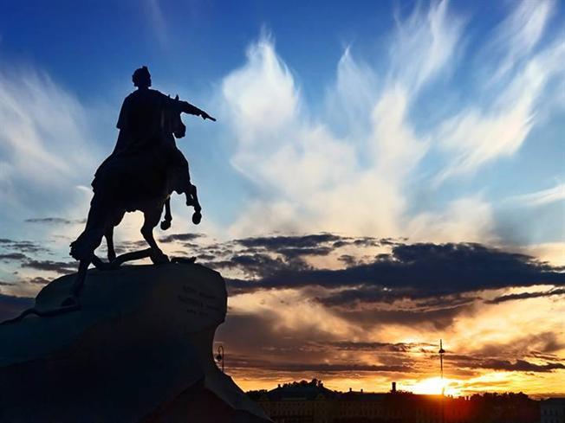
The Bronze Horseman, an impressive monument to the founder of St Petersburg, Peter the Great, stands on Senatskaia Ploschad' (Square), facing the Neva River. The monument was built by order of the Empress Catherine the Great as a tribute to her famous predecessor on the Russian throne, Peter the Great. This statue of Peter the Great was created by the famous French sculptor Etienne Maurice Falconet. The pedestal is made of a single piece of red granite molded into the shape of a cliff.

Slide 8
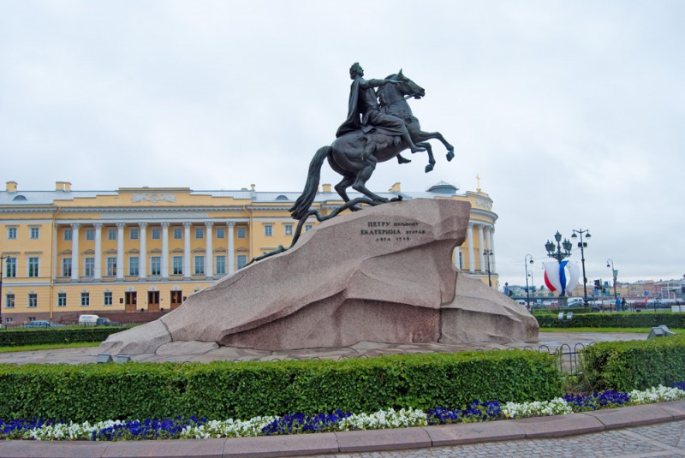
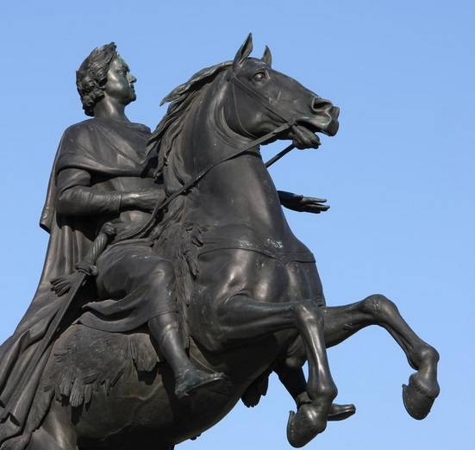
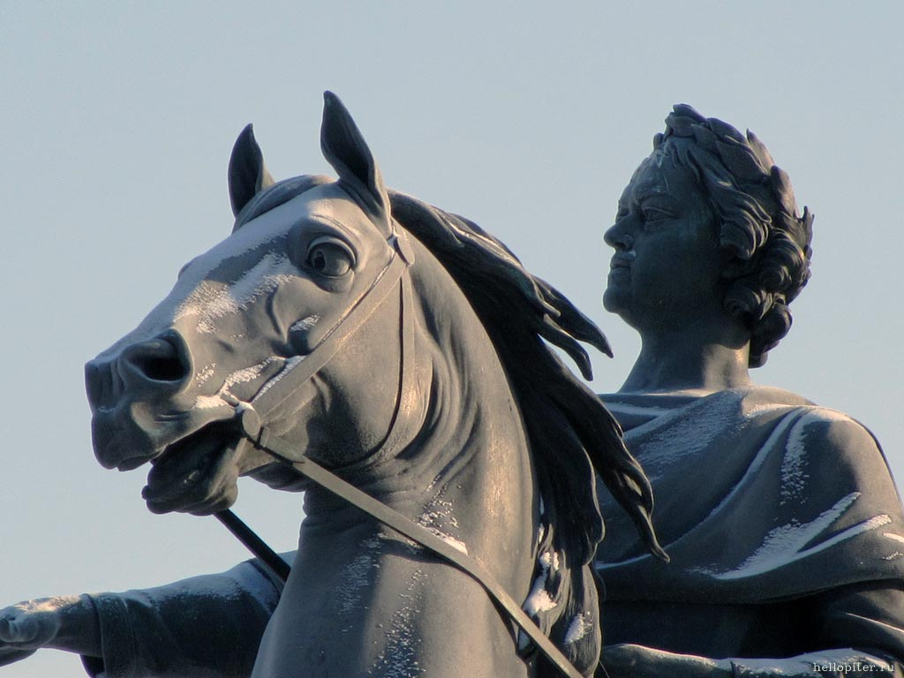
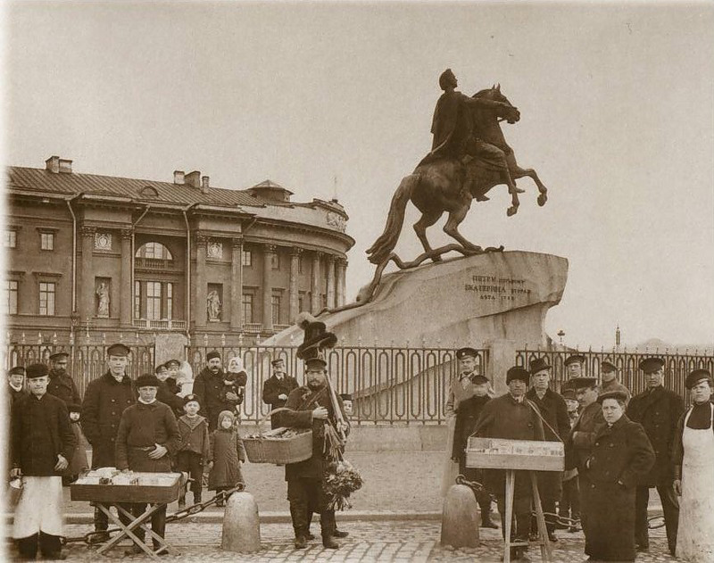

Slide 9
Санкт-Петербург - гранитный город, Взнесенный Словом над Невой, Где небосвод давно распорот Адмиралтейскою иглой!
Как явь, вплелись в твои туманы Виденья двухсотлетних снов, О, самый призрачный и странный Из всех российских городов!
Николай Агнивцев

