Slide 1
Winter Olympic Games Sochi-2014

Slide 2
Winter Olympic Games
Will be held in a beautiful place.
Sochi is waiting for us
And all the sportsmen will come here at last.

Slide 3
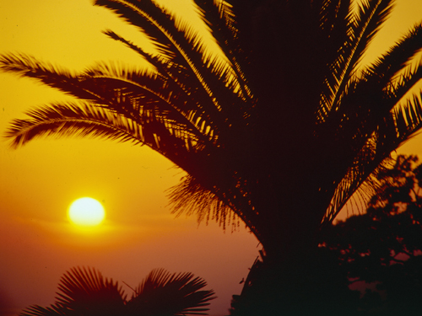
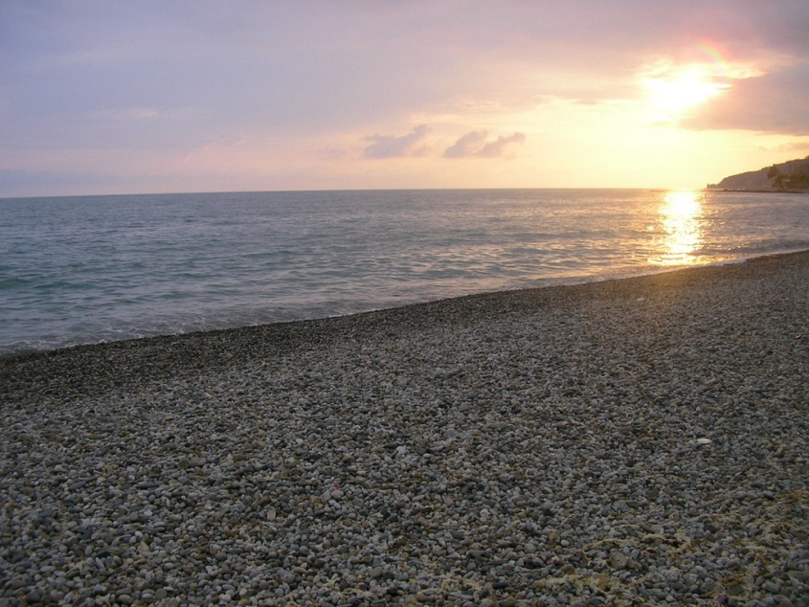
Mountains and valleys ,
The Black but blue sea.
Sunshine and snowy peaks
Here you can see.

Slide 4
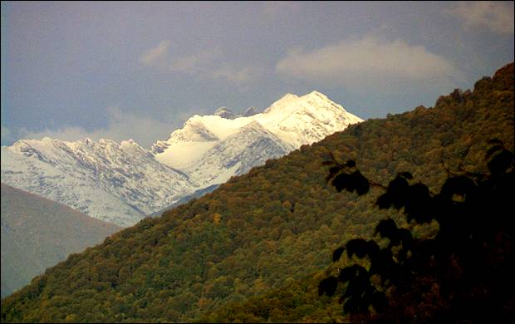
A beautiful climate ,
A marvelous land .
It is our motherland ,
We understand.

Slide 5
We open these Olympic Games
For me, and you, and you.
We wish you happiness and health,
We wish you much success.

Slide 6
Winter Olympic Games
Have got three talismans.
Leopard, Hare and Bear
Will meet you in Sochi everywhere.

Slide 7
Five colourful rings
And five beautiful lands.
Let’s match them together
And do it forever.

Slide 8
Blue is for Europe.
For America is red.
Yellow is for Asia.
For Africa is black.
And for Australia is green.

Slide 9
“Oh, sport – you are the peace!”
A Frenchman to the people said.
And all of us shouted: “Yes!”
Oh, sport! You are the peace indeed!

Slide 10
Citius! Altius! Fortius!
Faster! Higher! Stronger!

Slide 11
When you are running
Or you are jumping,
Or you are swimming
You feel – you live.

Slide 12
Your heart is trembling
Full of funny ,
Full of joyful ,
Exciting things.

Slide 13
You know how many ,
How many metres
For you are waiting
You know – you Live!

Slide 14
Sport is a force
And has a skill.
It has no boarders
But has a drill.

Slide 15
Olympic Games are a holiday.
Of beauty, health and strength
Keep your fit and train every day
Then you can win your victory yourself.

Slide 16
Thank you for your attention!!!

