Slide 1
Welcome to Australia!

Slide 2
Australia, a magic land
Far from us, but near the equator.
It has the golden sand
And volcanoes without any active crator.

Slide 3
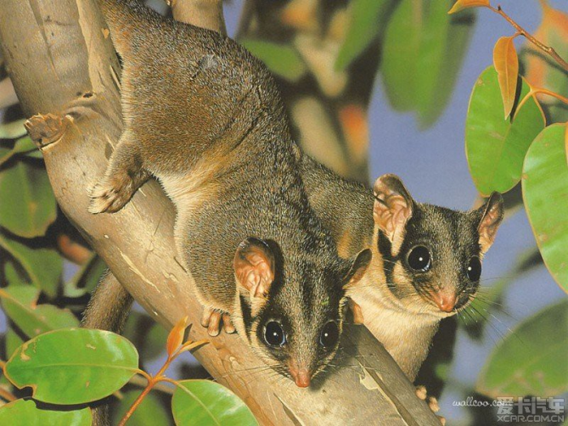
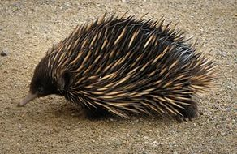
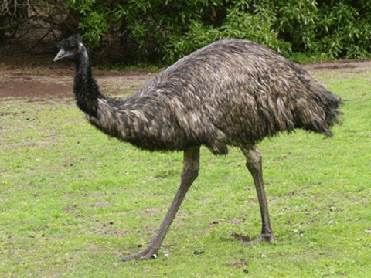
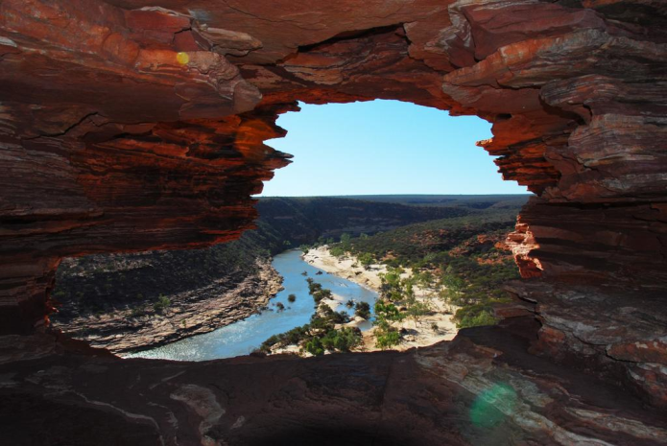
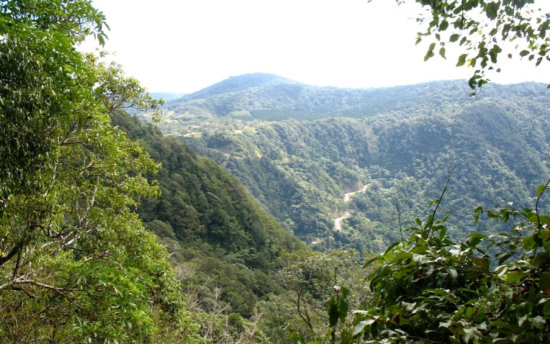
It has unforgettable nature
With so many creatures.
With dangerous snakes
And beautiful lakes.

Slide 4
Australia is calling Australia is attracting Aborigines live there, They are to this land so dear.

Slide 5
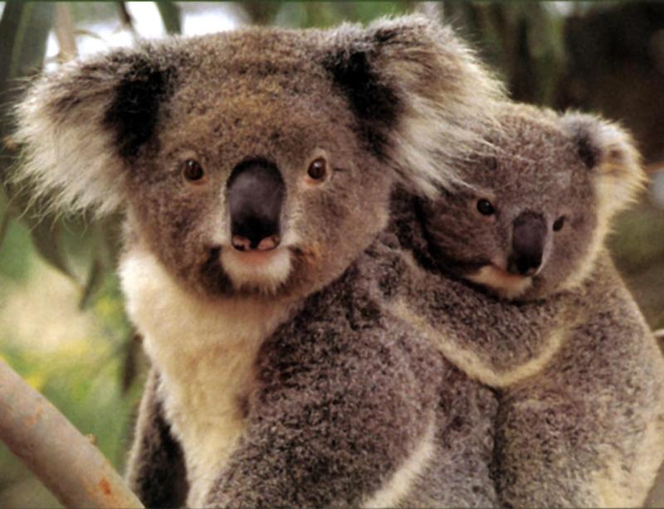
Kangaroos jump with their babies. Pandas live there with no troubles. Ocean is there, Ocean is everywhere.

Slide 6
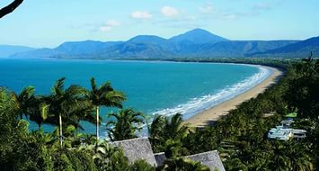
Marvelous beaches
For you and me.
Beautiful towns
There you can see.

Slide 7
The Queen of England Is its head. You can’t imagine But it’s true.

Slide 8
flag of Australia
Its flag consists
Of six stars.
All this
Is interesting for us.

Slide 9
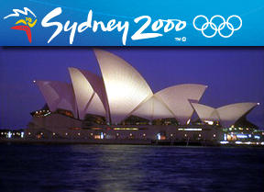
Olympic games
In Sydney took place.
Australia has
A magnificent face.

Slide 10
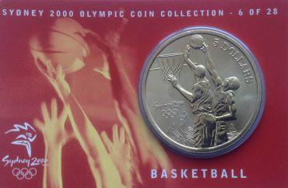
Basketball, swimming,
Archery, rowing
All sports were there, in Sydney.

