Slide 1
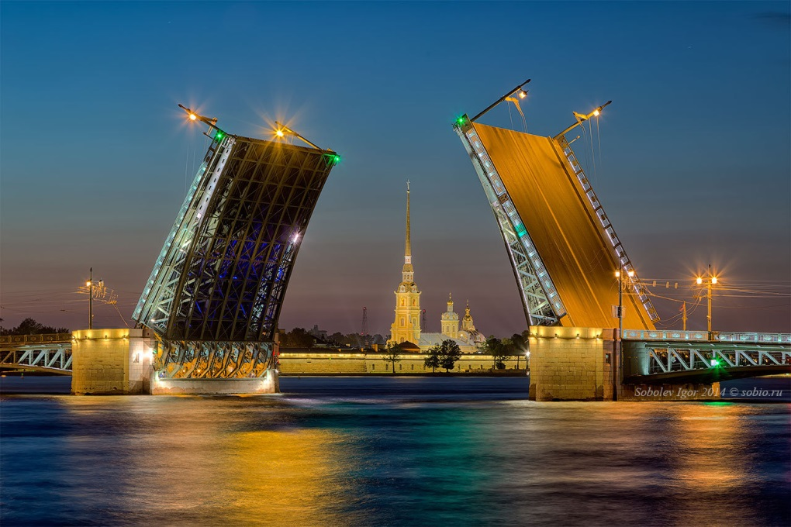
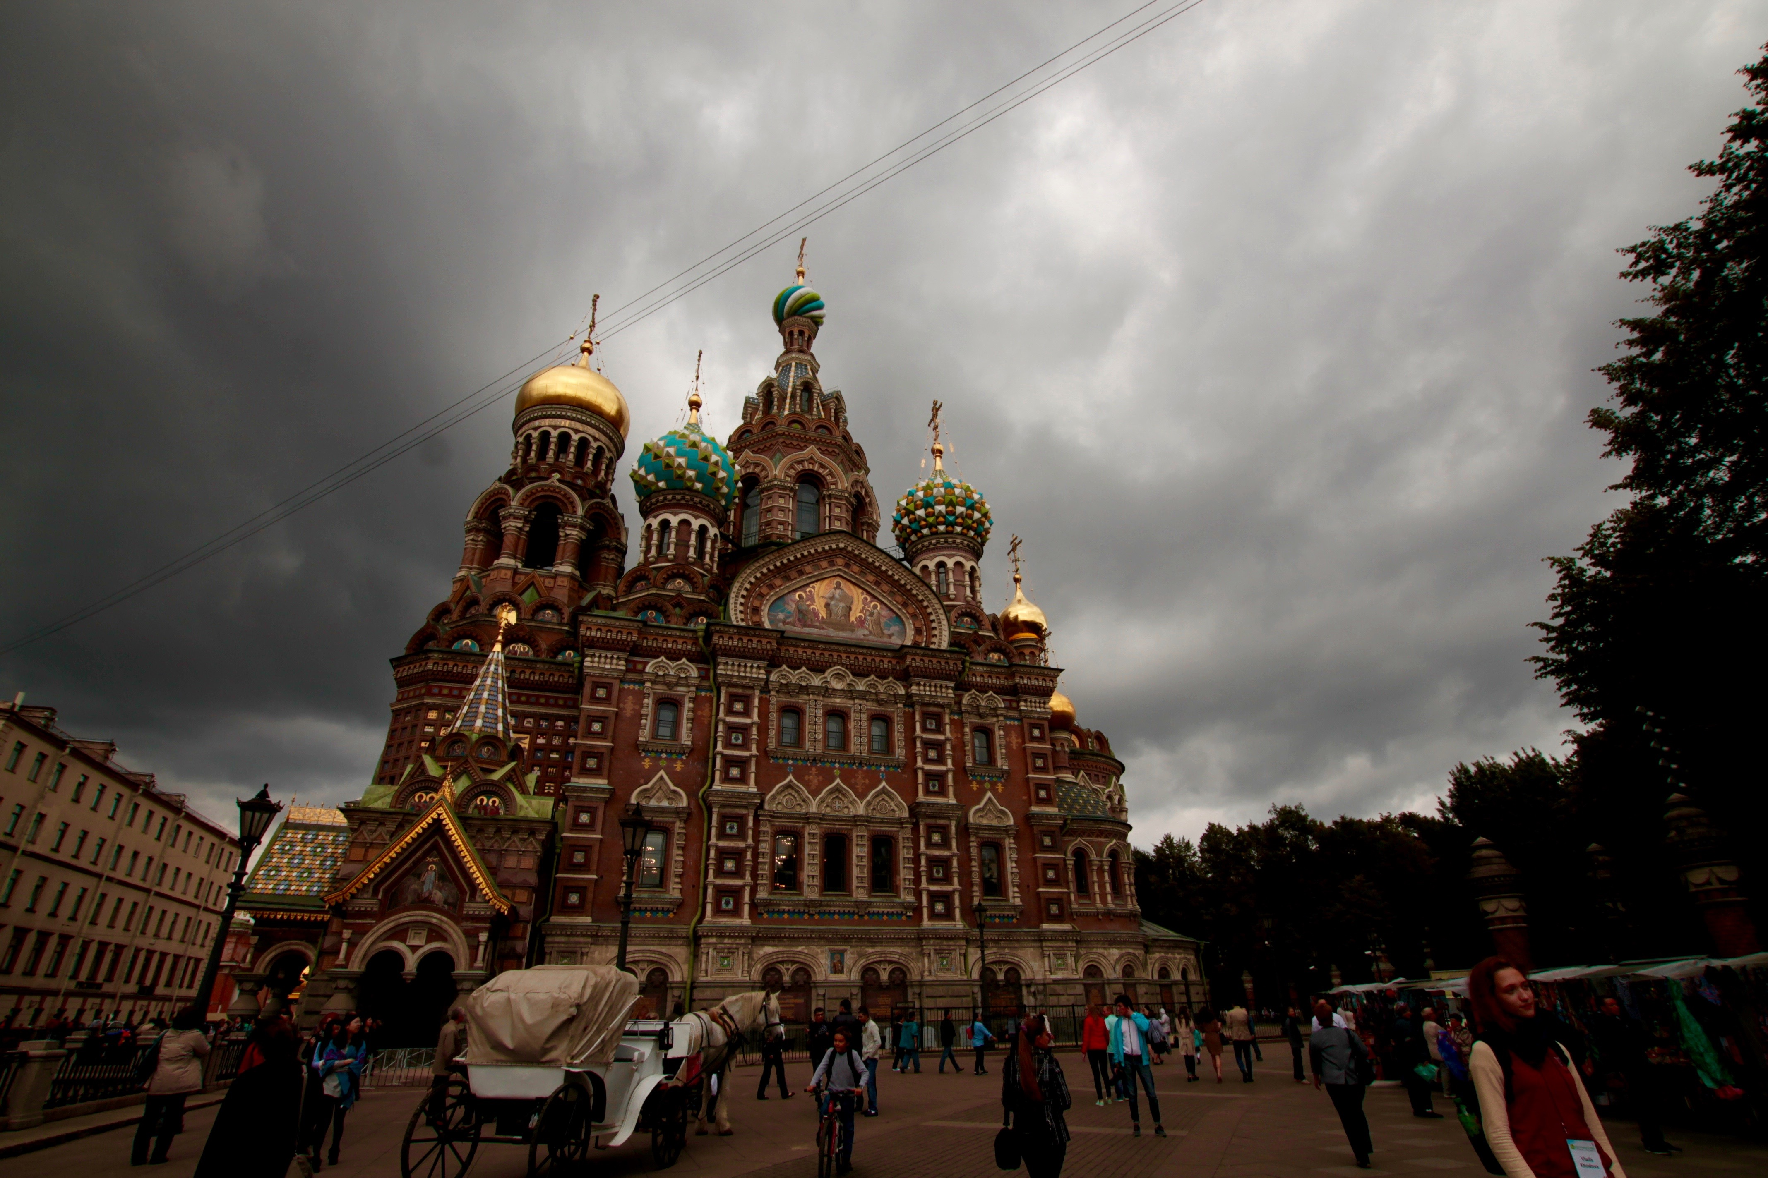
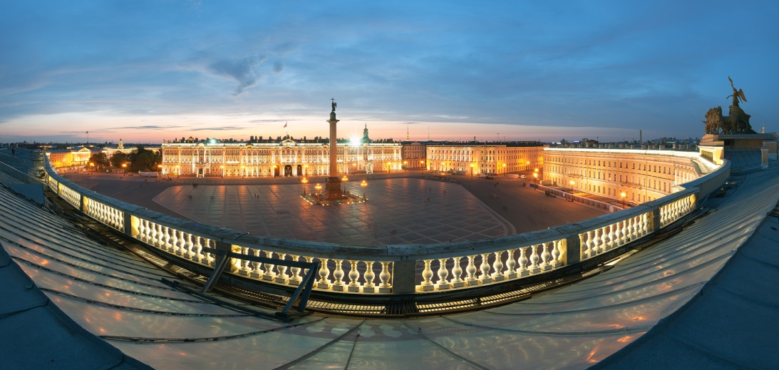
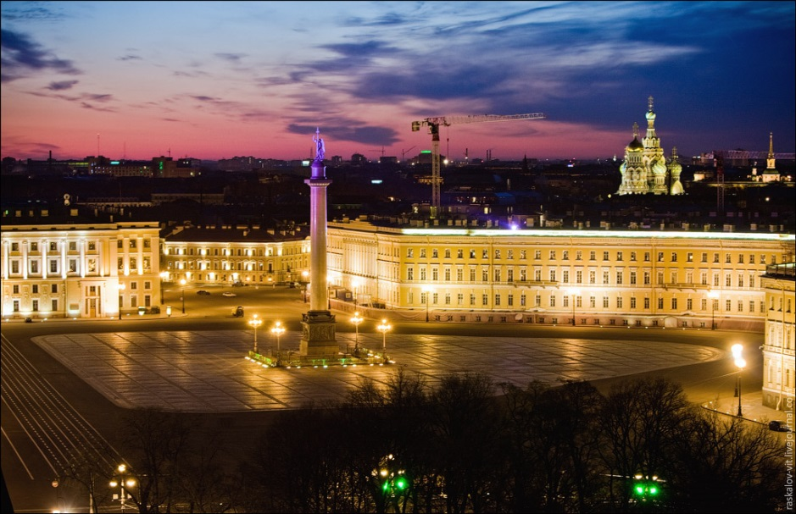
The Quiz
Saint Petersburg

Slide 2
THE FIELD OF MARS
When was
an Eternal Flame lit?
a in 1957
b in 1917
c in 1981

Slide 3
What was the first name
of the Fields of Mars?
a Tsarina’s Meadow
b the Great Meadow
c the Amusement Field

Slide 4
When was a monument
“To Fighters of Revolution”
erected?
a in 1945-1947
b in 2001-2002
c in 1917-1919

Slide 5
SAINT ISAAC’S SQUARE
1 What was the name
of Saint Isaac’s Square
between 1923 and 1944?
a Krasivin Square
b Vorovsky Square
c Ruzmatov Square

Slide 6
2 What famous Russian Institute
situated
in Saint Isaac’s Square?
a The first Medical Institute
b Saint-Petersburg State University
c The Russian Institute of Plant
Breeding

Slide 7
3. What is the name of the cathedral situated in Saint Isaac’s Square?
a Saint Isaac's Cathedral
b Kazan Cathedral
c Smolny Cathedral

Slide 8
1 How many parts does
Vasilyevsky Island
consist of geographically?
a three
b two
c four
VASILYEVSKY ISLAND

Slide 9
2. When did the present
Russian history of Vasilyevsky
Island begin?
a after the First World War
b after the Great Patriotic War
c after the Great Northern War

Slide 10
3. Where is Vasilyevsky
Island situated?
a in the delta of the Neva River
b in the source of the Neva River
c in the middle of the Neva River

Slide 11
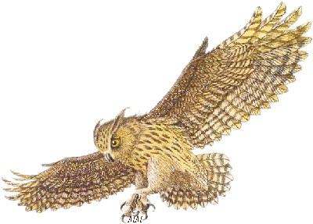
1. When was Peter and Paul
Fortress built?
a in 1705
b in 1703
c in 1712
PETER AND PAUL FORTRESS

Slide 12
2. Who was the architect of
Peter and Paul Fortress?
a Domenico Trezzini
b Rastrelli
c Felten

Slide 13
3. What is the height of the
Peter and Paul Cathedral?
a 132.5 m
b 82.5 m
c 122.5 m

Slide 14
1. What palace gave the name
to the square?
a the Winter Palace
b the Anichkov Palace
c the Usupov Palace
PALACE SQUARE

Slide 15
2. What was the architect of
the Alexander Column?
a Rastrelli
b Trezini
c Auguste de Montferrand

Slide 16
3. What is the height of the
Alexander Column?
a 34.5 m
b 47.5 m
c 51.5 m

Slide 17
NEVSKY PROSPECT
1. Who planned
Nevsky Prospect?
a Catherine the Second
b Peter the Great
c Auguste de Montferrand

Slide 18
2.How was Nevsky Prospect
named during the early Soviet
years(1918–44)?
a "Svetlanovsky Prospect",
"Avenue of the 17th of October"
b " Avenue of the 25th of October ",
"Khudoznikov Prospect"
c "Proletkult Street",
"Avenue of the 25th of October"

Slide 19
3. What underground stations
serve Nevsky Prospect?
a Admiralteyskaya, Nevsky Prospect, Gostiny Dvor, Mayakovskaya, Ploshchad Vosstaniya
b Viborgskaya, Lesnaya, Gostiny Dvor, Admiralteyskaya, Mayakovskaya
c Devyatkino, Kupchino,, Mayakovskaya, Ploshchad Vosstaniya

Slide 20
ARTS SQUARE
1. Where is Arts Square located?
a between Nevsky Prospect and
Sadovaya Street
b between Malaya and Bolshaya
Morskaya Streets
c between Engineering and Italian
Streets.

Slide 21
2.What monument is
in Arts Square?
a a monument to Peter the Great
b a monument to A.S. Pushkin
c a monument to Krilov

Slide 22
3. What was the initial name of
Arts Square?
a Mikhaylovskaya Square
b Palace Square
c Rastrannaya Square

Slide 23
THE END

