Slide 1
This can’t be art or can it?
English teacher: Natalie Ivanova
School 2070
Moscow

Slide 2
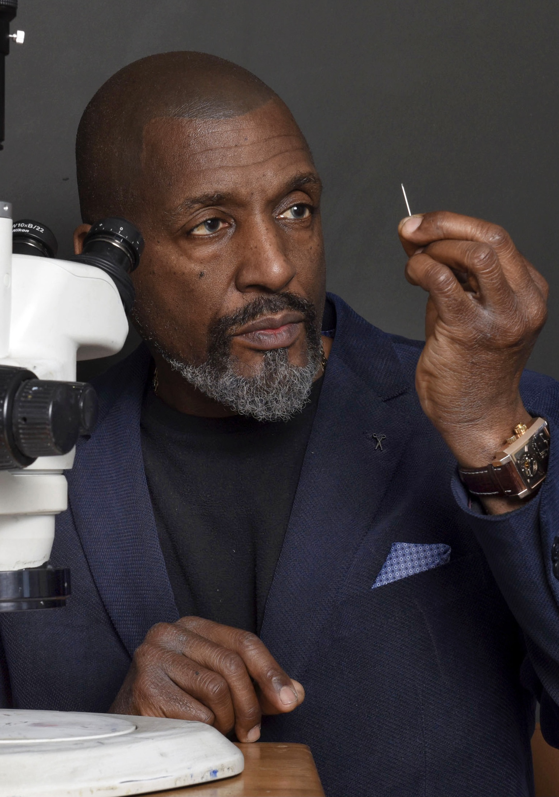
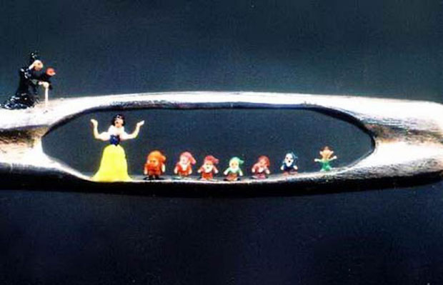
Micro-Sculptures
Willard Wigan (born 1957 in England) is the creator of the smallest works of art on Earth! His miniature sculptures include a Titanic on a pinhead, a cat on an eyelash, and the six wives of Henry VIII in the eye of a needle. Some are a lot smaller than the full stop at the end of this sentence.

Slide 3
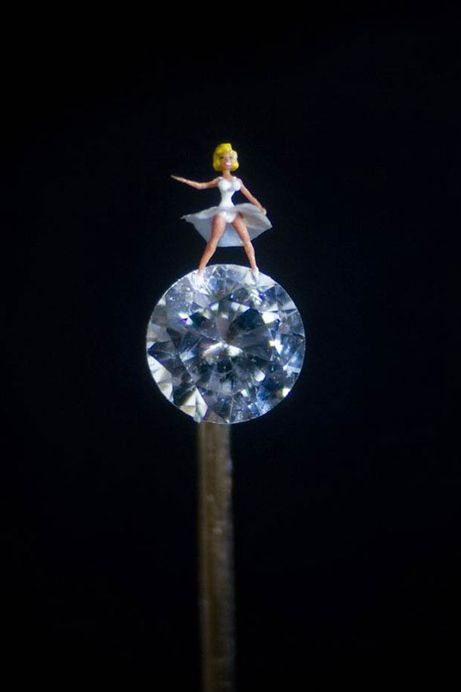
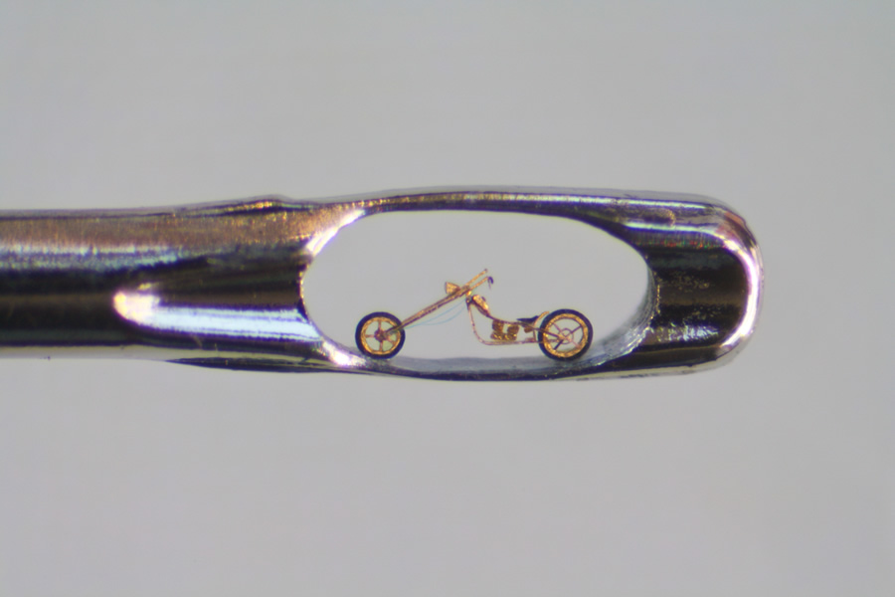
Wigan started making tiny things when he was a child. People made him feel small because he had learning difficulties, so he decided to show them how significant small could be!

Slide 4
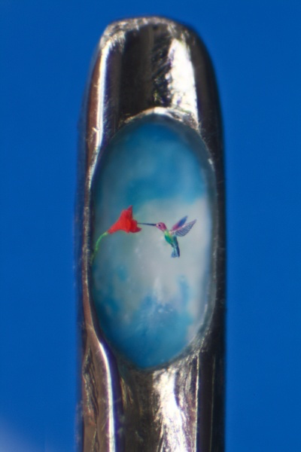
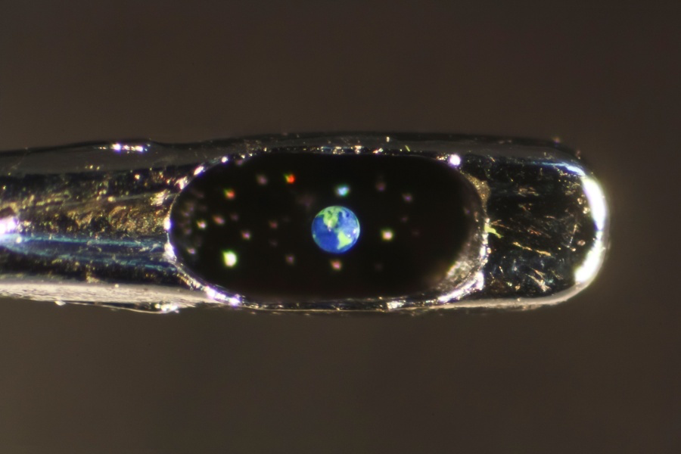
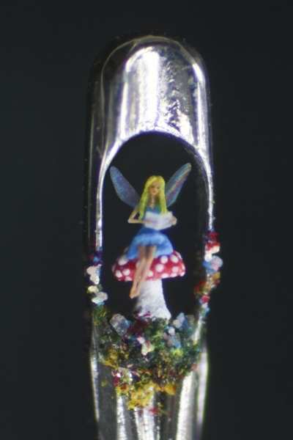
How does he create his unbelievable micro-sculptures? He slows his breathing, then patiently sculpts or paints between heartbeats, so that his hand stays perfectly still. He spends months carving his tiny creations from materials such as toothpicks, sugar crystals and grains of rice and then paints them with a tiny hair such as an eyelash. So how do visitors to Willard Wigan's exhibitions view his work? Through a microscope, of course!

Slide 5
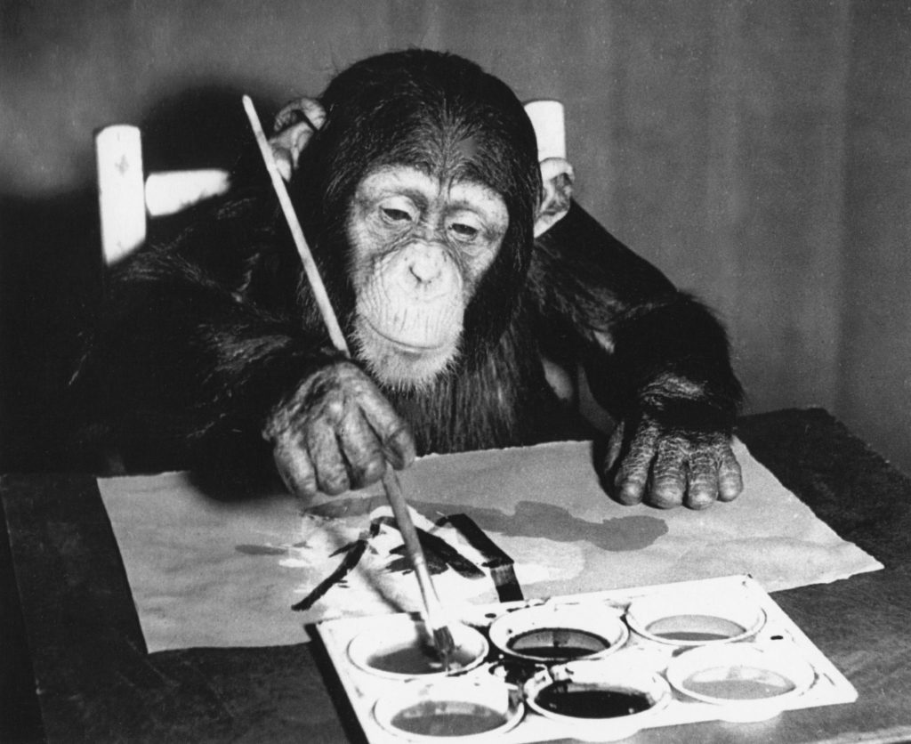
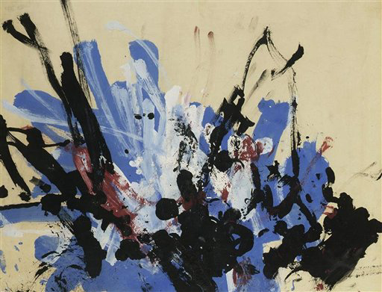
Chimpanzee Art
In 2005, three painting sold at an auction in London for £ 12,000. The painter was a chimpanzee. Congo did the paintings more than fifty years ago when he was three years old. Altogether, he did nearly four hundred drawings and paintings before he died in 1964.

Slide 6
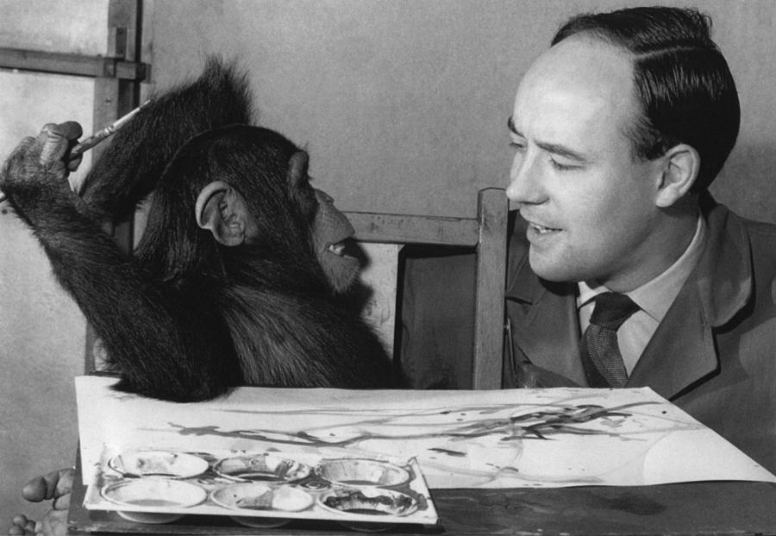
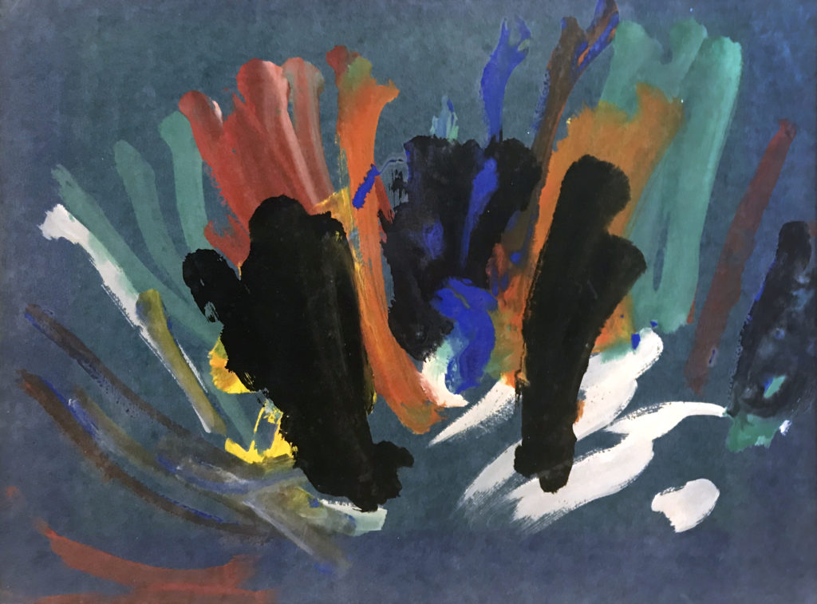
Congo was a popular guest on Zootime, a British TV show hosted by animal behaviourist Desmond Morris. In 1957, Morris held an exhibition of "Chimpanzee Art“, which included some of the Congo's works. He wanted to try to understand chimps’ ability to be creative, as well as our own human desire for artistic creativity. Congo’s art did not impress everyone, but, apparently famous artists Pablo Picasso and Joan Miró were his fans.

Slide 7
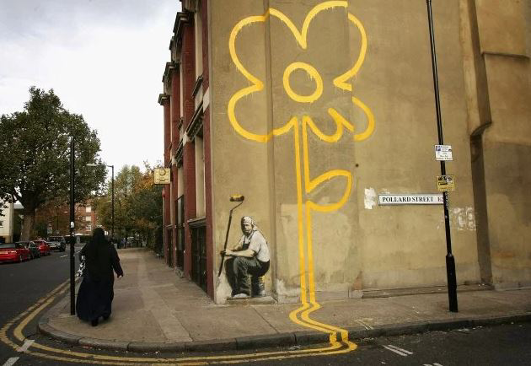
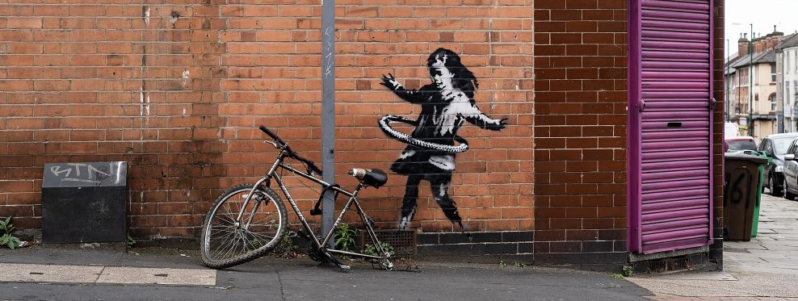
Urban Graffiti
Banksy (no one knows his real name) is a British street artist who is famous for his graffiti that has appeared on walls and buildings in cities around the world. He also sometimes holds "shows" of paintings, usually in warehouses. In February 2007, Sotheby’s auction house in London auctioned six of Banksy’s works, fetching almost £ 400,000 altogether. Later that year, Banksy won an art award, but he did not turn up to collect it - he prefers to remain anonymous.

Slide 8
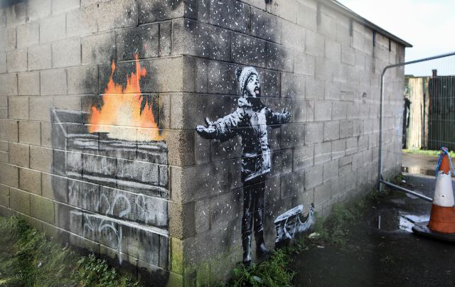
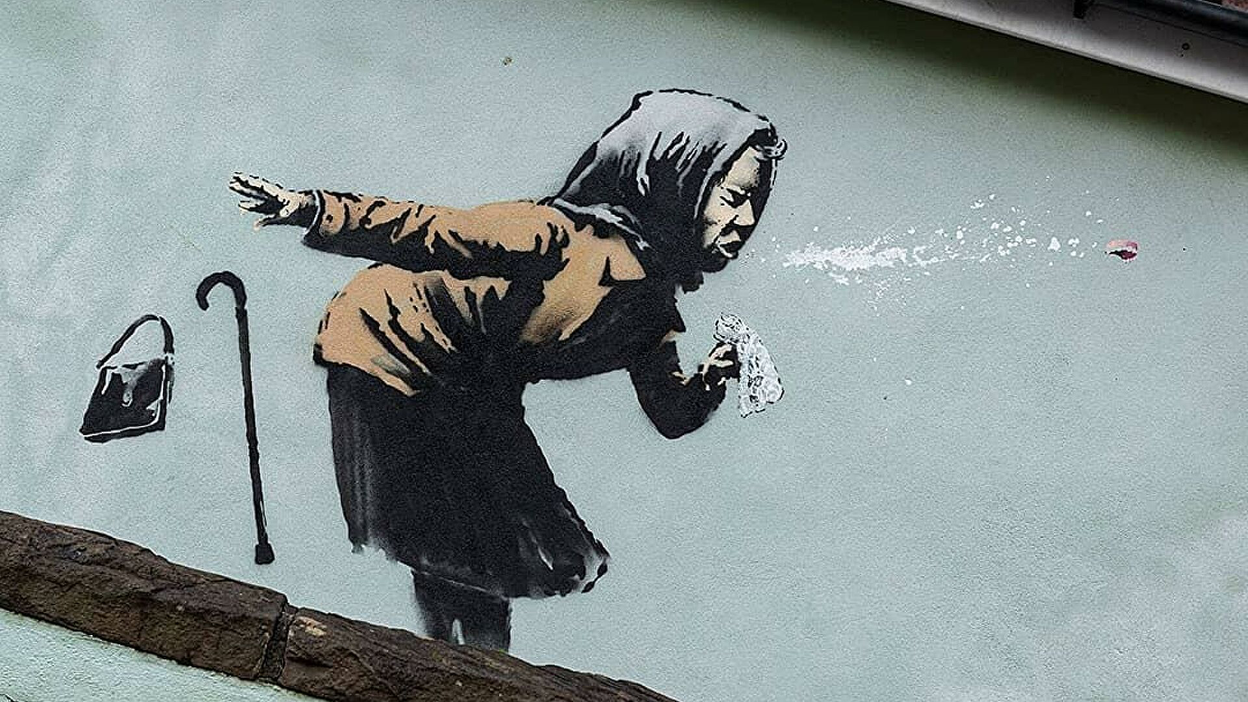
A lot of people see his work as vandalism rather than art. They see graffiti as ugly, irresponsible and childish and they say Banksy encourages more people to do it. Some city councils remove Banksy's works from their walls but they can’t do anything when it is on private property. In fact, many people want to keep his work on the walls of their buildings as it adds value to the property because it is considered by many to be a valuable work of art.

Slide 9
Thanks for attention!

