Slide 1
« Формирование читательской грамотности на уроках английского языка по английским сказкам».
Подготовил учитель английского языка:
Ляшенко Елена Владимировна
Декабрь,2022

Slide 3
12

Slide 4
Do you know what this word means?
Fairy [ˈfe(ə)rɪ] сказочный, волшебный
Tale [teɪl] сказ/ рассказ

Slide 5
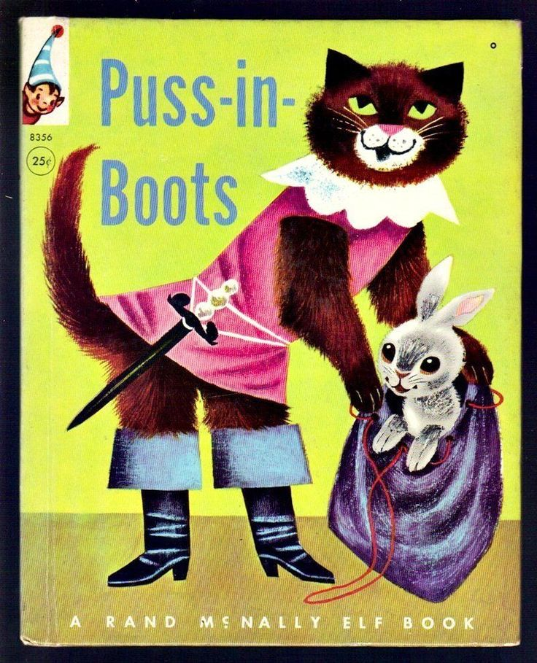
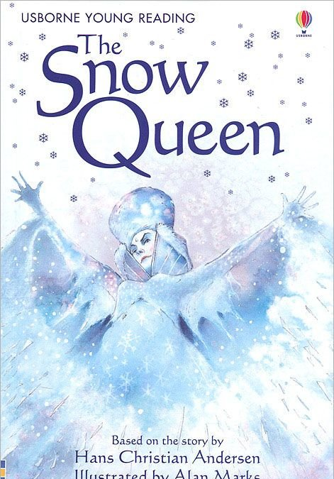
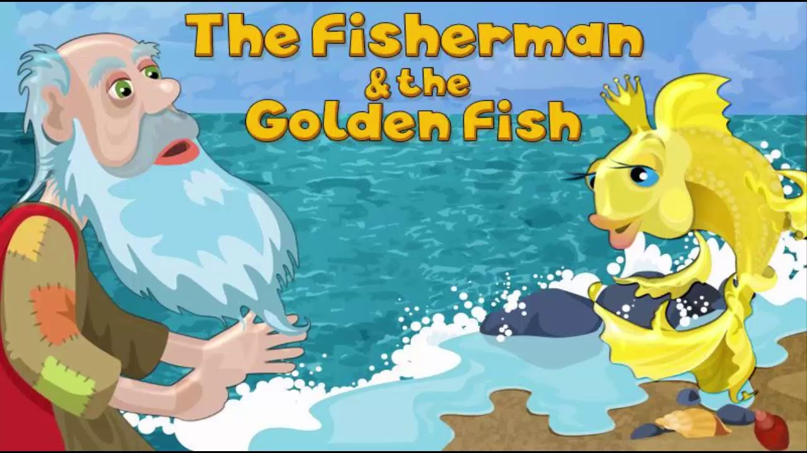
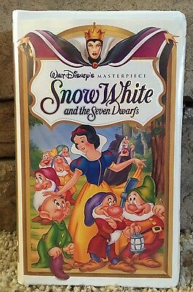
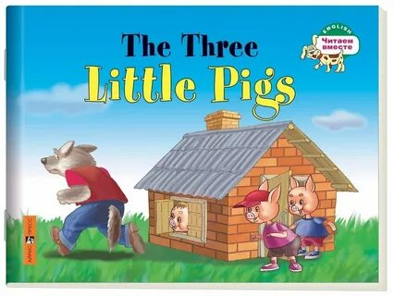
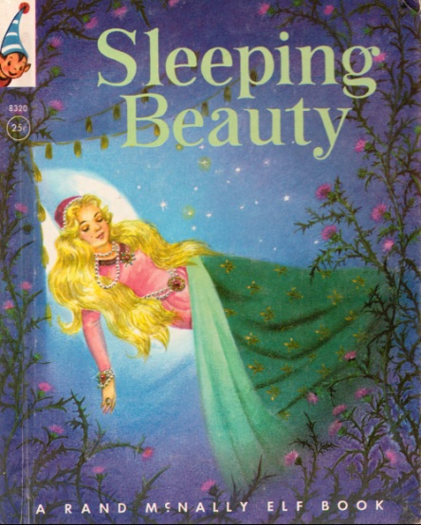
.
What Russian/English fairy tales do you know?

Slide 6
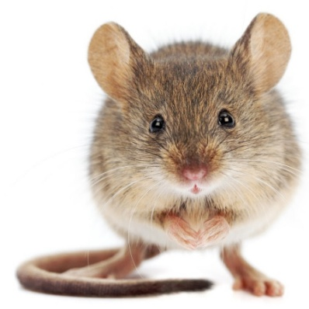
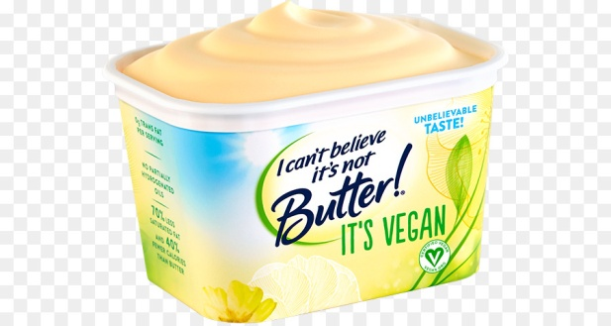
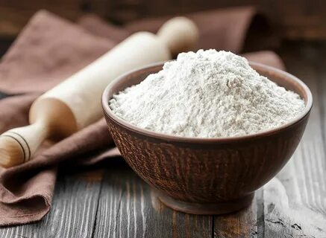
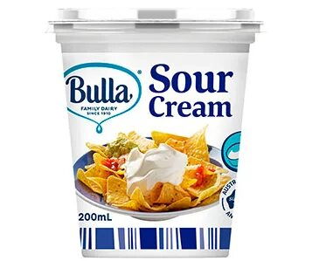
Riddles- загадки
Russian
Who broke the egg?
Who lived in Teremok?
What was Kolobok made from?

Slide 7
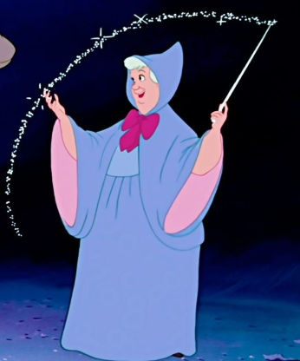
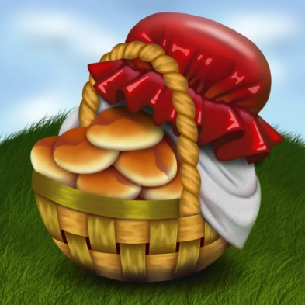
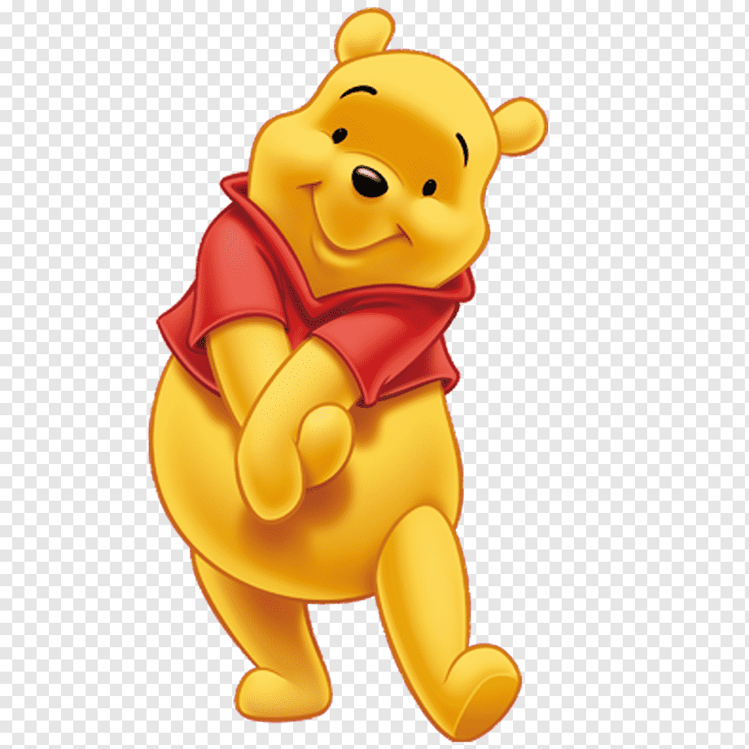
Riddles- загадки
International
Who helped Cinderella to reach the ball? Why did Little Red Riding Hood go to her grandmother?
I am small. I am thick. I like honey, jam. I have many friends: a donkey, a piglet. I live in the forest. You are welcome.

Slide 8
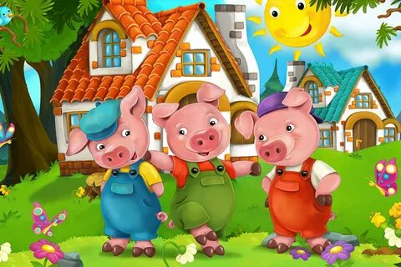
Riddles- загадки
English
What were 3 little pigs names?
What did Jack want to sale when his mother’s money and his own ones ran out?

Slide 9
Physical exercise
Hands up! Hands down!
Hands on hips! Sit down.
Stand up. Turn around.

Slide 10
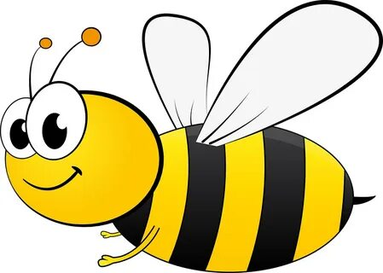
On the flower
In the tree
You can see
A yellow …..

Slide 11
Vocabulary

Slide 13
Reading
A bee and her friends

