Slide 1
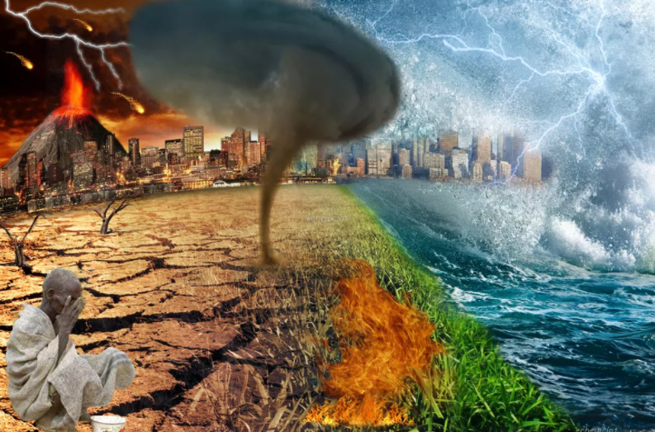
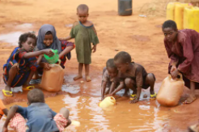
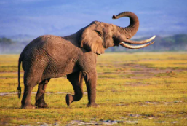
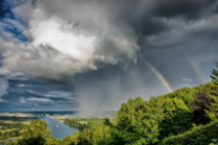
Module 5
‘Global issues’
In this module we will study about …
Natural disasters
Environmental problems
Animals
The weather

Slide 2
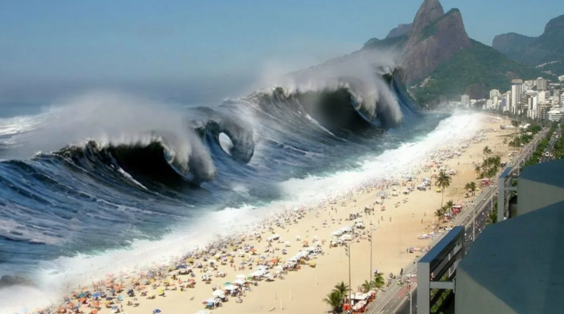
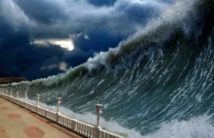
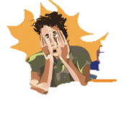
Look at the picture and listen to the sounds. Imagine the scene.
huge wave
to scream
Where are you? What is happening? What are people doing? How do you feel?
a beach
safety
scared
I am on the beach and I see huge waves coming towards me. People are screaming and running to safety. I feel really scared.

Slide 3
Before reading learn new words
to distribute
injury
to spin
распределять, раздавать
ушиб, рана
вертеть, вращать
disaster
ruined
to smash
катастрофа
разрушенный
разбивать в дребезги
emergency
to search
supplies
экстренная ситуация
искать, исследовать
запасы, продовольствие
to bury
to reach
threatening
хоронить
достигать, добираться
угрожающий, грозный
holidaymaker
to occur
to suffer
отдыхающий
случаться, происходить
страдать
to crack
to shake
to treat
трескаться
сотрясать, трясти
лечить
to drown
storey
survivor
тонуть
этаж, ярус
оставшийся в живых
violent
to hit
to scream
неистовый
ударять
визжать, кричать

Slide 4
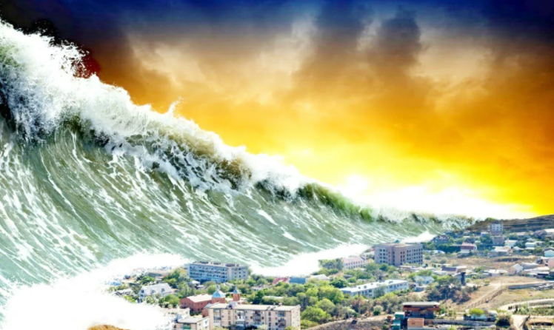
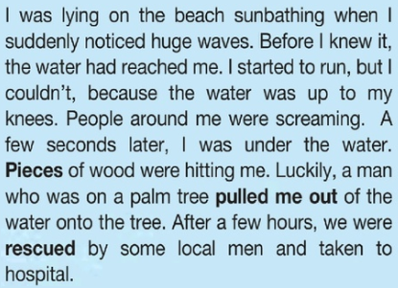
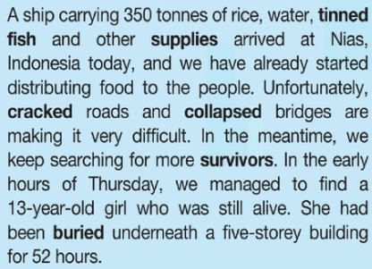
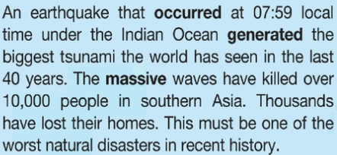
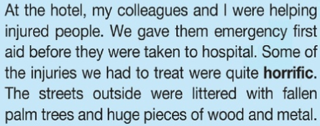
Listen, read and check
D
A
B
C
Jason
Sue
Bill
Alex

Slide 5
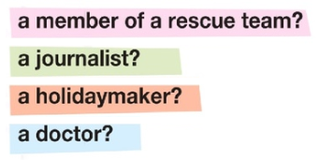
A. A ship carrying 350 tonnes of rice, water, tinned fish and other supplies arrived at Nias, Indonesia today, and we have already started distributing food to the people.
Which person was …
?
A
D
B
C
B. I was lying on the beach sunbathing when I suddenly noticed huge waves..
C. At the hotel, my colleagues and I were helping injured people.
D. An earthquake that occurred at 07:59 local time under the Indian Ocean generated the biggest tsunami the world has seen in the last 40 years..

Slide 6
Answer the following questions.
Which parts of the text helped you decide?
(my colleagues and I were helping injured people, gave them emergency first aid, some of the injuries we had to treat)
(distributing food, searching for more survivors, we managed to find a 13-year-old girl)
(managed to find a 13-year-old girl who was still alive)
(people around me were screaming)
(we were rescued by some local men and taken to the hospital)
Which person or people …
(pulled me out of the water)
(07.59 local time)
felt calm at first?
gives details about the time and place of the disaster?
was helped by someone else?
achieved something unexpected?
suffered injuries?
helped other people?
Sue
Jason
Bill
Alex
Bill
Jason
Bill
Alex
Bill
Jason
Sue

Slide 7
Find all passive verb forms in the text. Say the sentences in the active voice.
Text A:
She had been buried underneath a five-storey building for 52 hours.
A five –storey building had buried her.
Jason

Slide 8
Find all passive verb forms in the text. Say the sentences in the active voice.
Text B:
After a few hours we were rescued by some local men and taken to the hospital.
After a few hours some local men rescued us and took us to the hospital.
Bill

Slide 9
Find all passive verb forms in the text. Say the sentences in the active voice.
Text C:
… they were taken to the hospital.
We took them to the hospital.
The streets outside were littered with fallen palm trees and huge pieces of wood and metal.
Outside, fallen palm trees and huge pieces of wood and metal littered the streets.
Sue

Slide 10
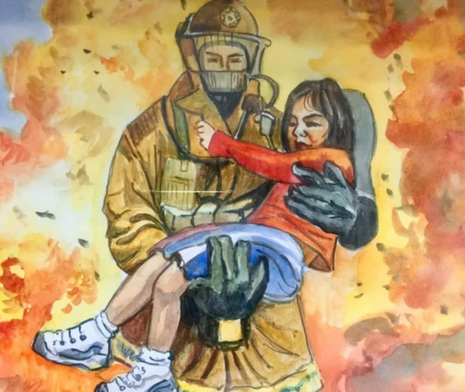
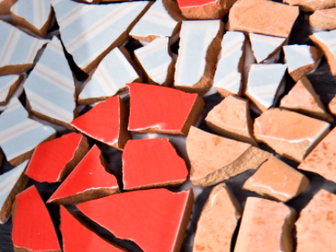
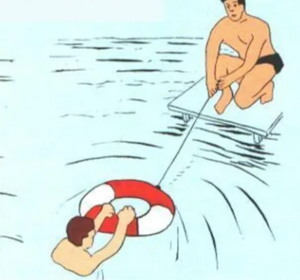
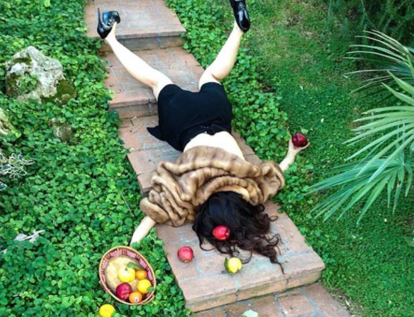
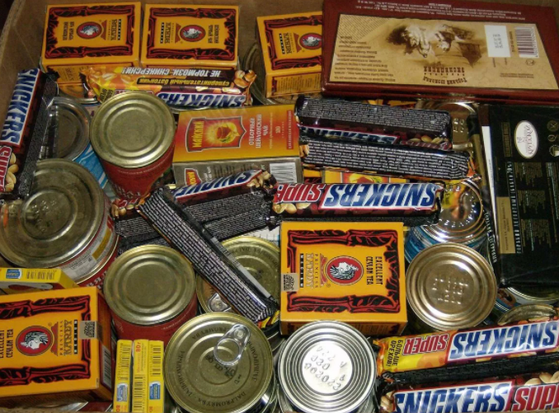
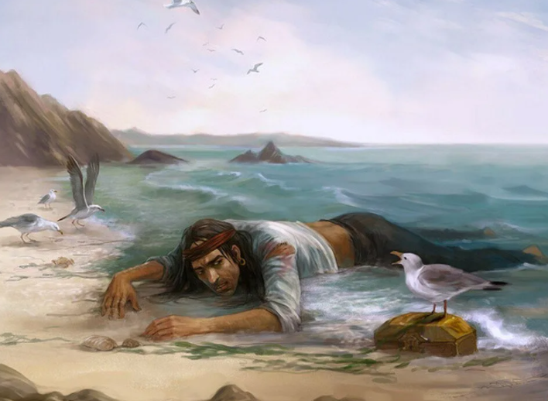
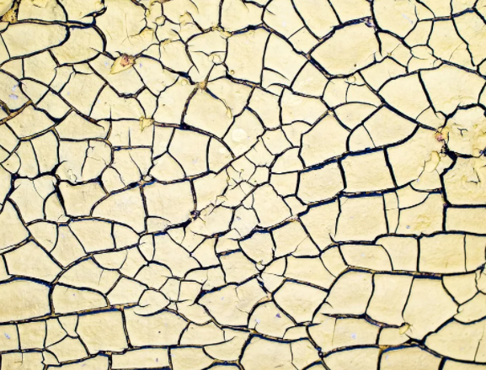
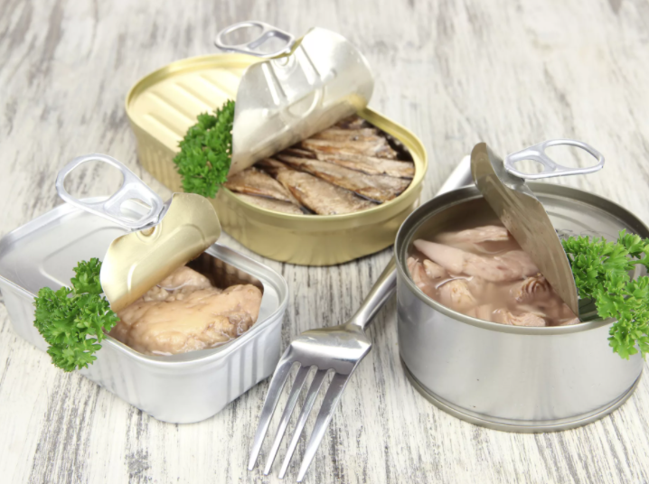
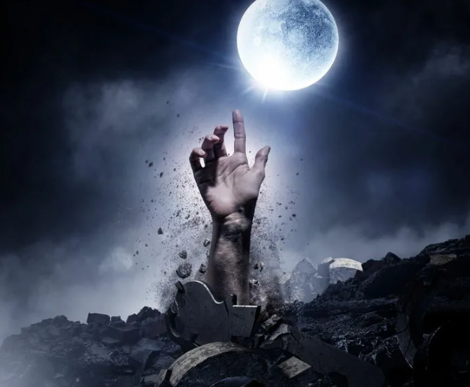
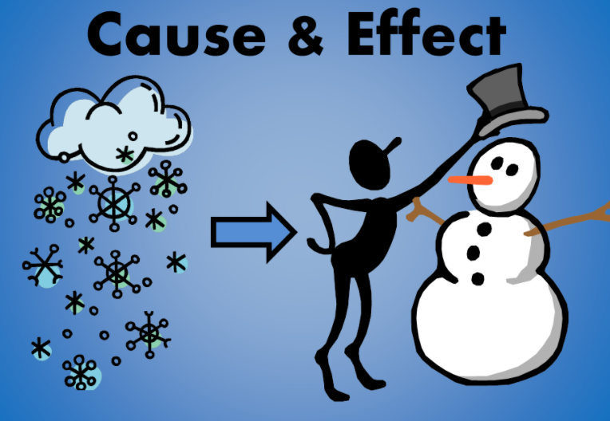
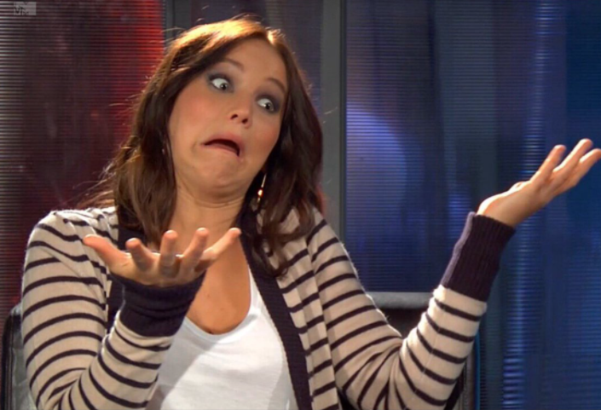
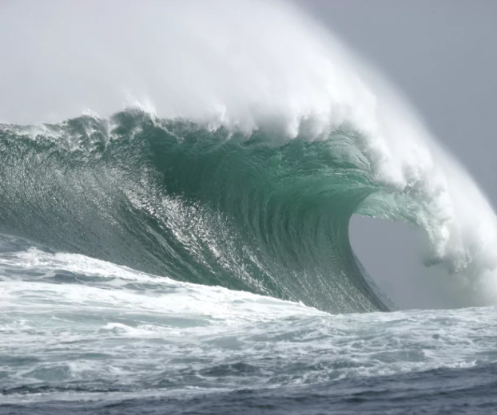
Match the words to their meanings
survivors
pieces
supplies
cracked
buried
horrific
pulled me out
generated
we were rescued
occurred
tinned fish
massive waves
Bits
Fallen down
With things lying on top so that you can’t escape
Very bad
Happened
Caused
Fish in tins
Very big waves
Were saved
Took me out of the water
Provisions, food and water
People who have are still alive after facing a danger
People who have are still alive after facing a danger
collapsed

Slide 11
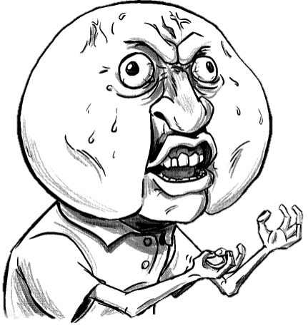
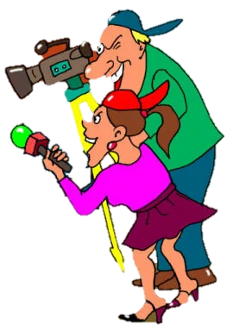
Work in groups of five. Interview the people who wrote texts A-D
Where did the tsunami happen?
How many people were killed?
Why did it happen?
What time did the earthquake happen?

Slide 12
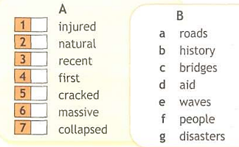
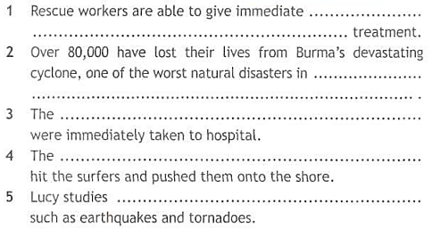
Match the words in column A to those in column B. then use five to complete B. then use five to complete the sentences below.
f
g
b
d
a
e
c

Slide 13
Underline the correct word.

Slide 14
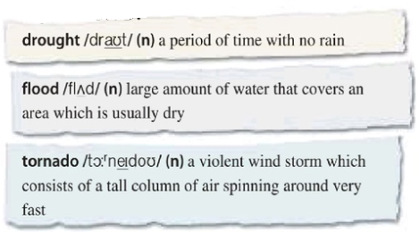
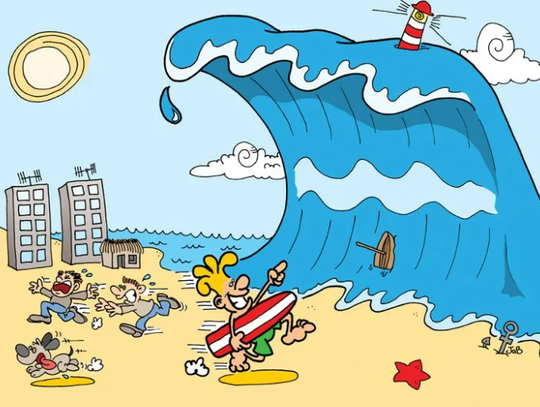
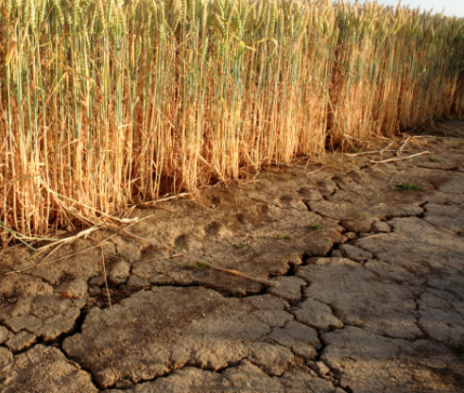
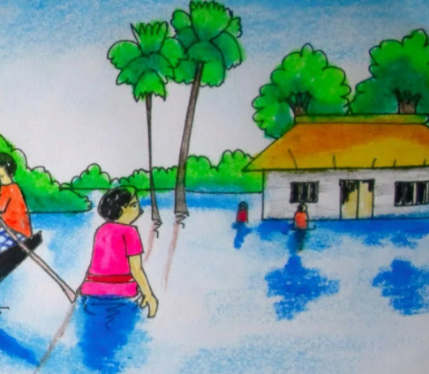
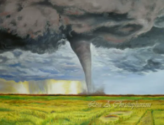
Read the dictionary entries. What are these disasters called in your language? What causes each one?
засуха
наводнение
торнадо
цунами

Slide 15
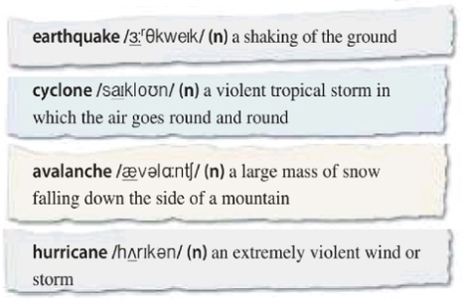
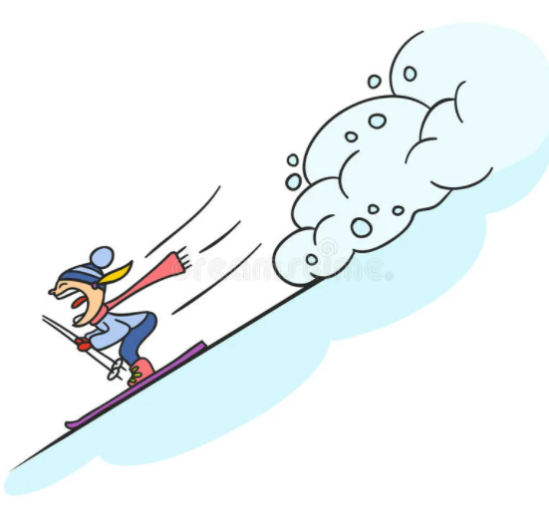
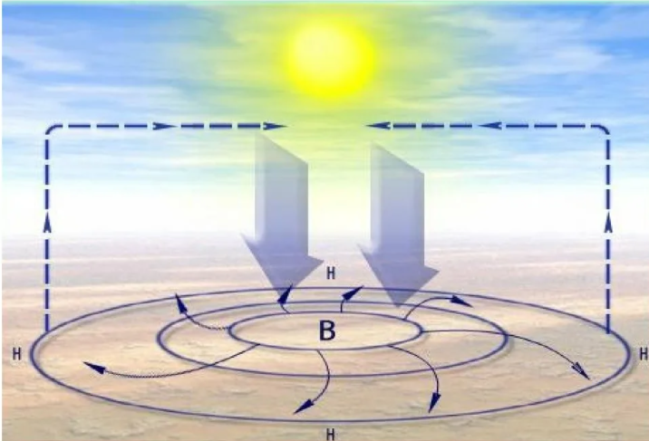
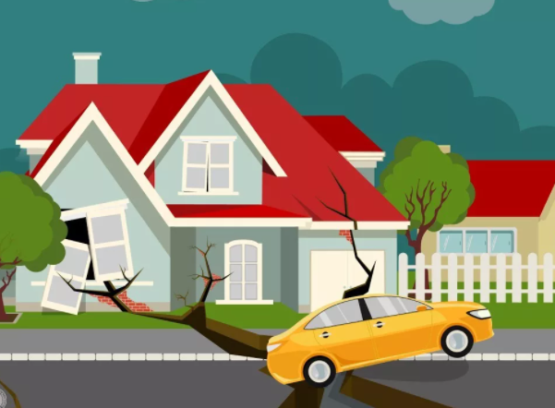
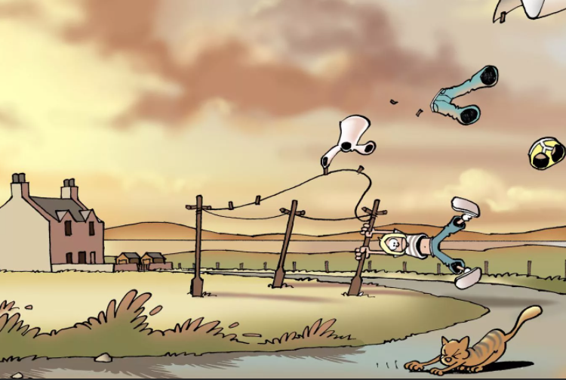
Read the dictionary entries. What are these disasters called in your language? What causes each one?
землетрясение
циклон
снежный обвал
ураган

Slide 16
Match the words to the pictures
1
3
2
4
5
6
8
7
cyclone
earthquake
hurricane
avalanche
tornado
drought
tsunami
flood

Slide 17
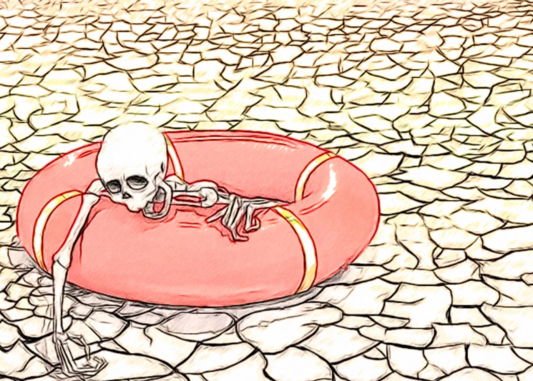
What is caused by lack or rain?
drought

Slide 18
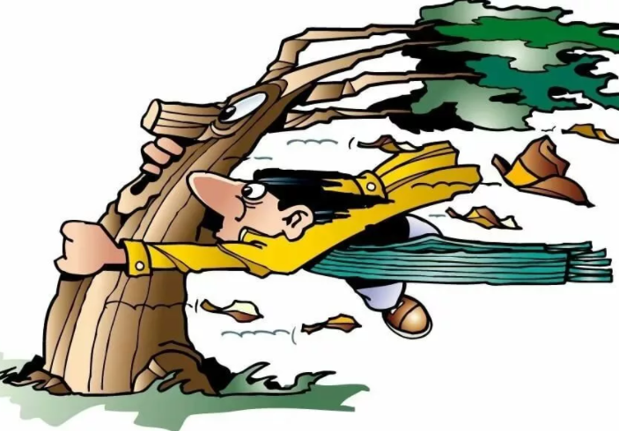
What is caused low pressure areas formed over warm water?
hurricane

Slide 19
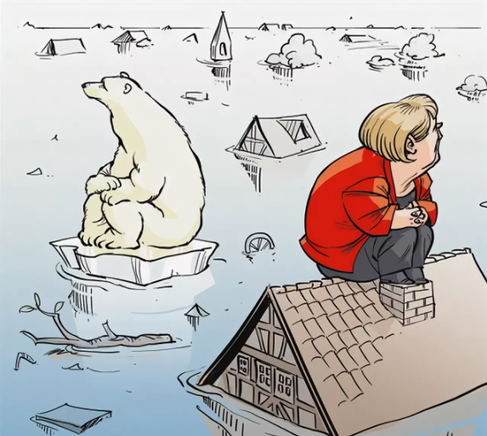
What is caused too much water?
flood

Slide 20
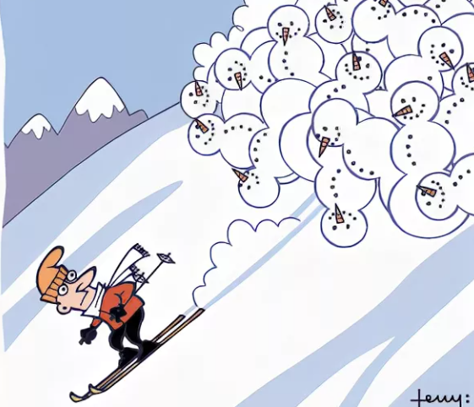
What is caused by a large amount of unstable snow on a mountain?
avalanche

Slide 21
What is caused by a tall column of air spinning around?
tornado

Slide 22
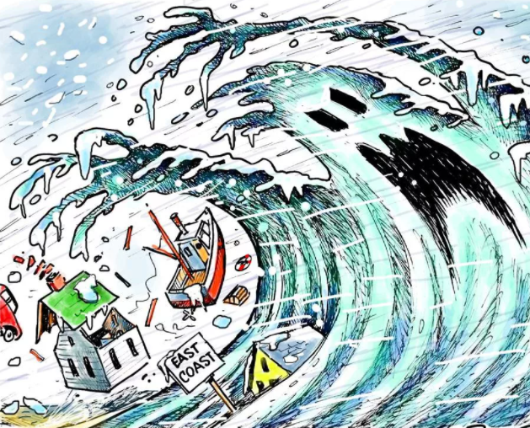
What is caused by an earthquake happening in the sea?
tsunami

Slide 23
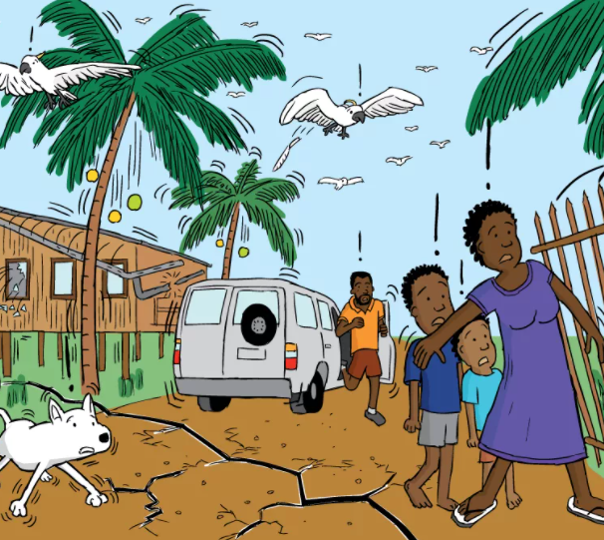
What is caused by movement of the earth’s crust?
earthquake

Slide 24
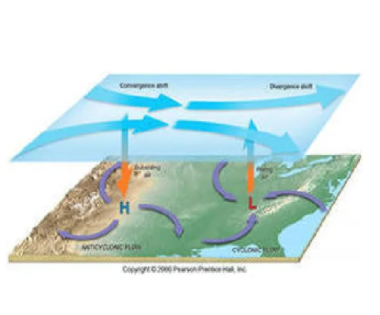
What is caused by air going round and round during low atmospheric pressure?
cyclone

Slide 25
Use the words in their correct form to complete the gaps.
tsunami
earthquake
flood
left
drowned
flood
lost
cracked
earthquake
collapsed
feared
avalanche
buried
covered
Which natural disasters is each sentence talking about?

Slide 26
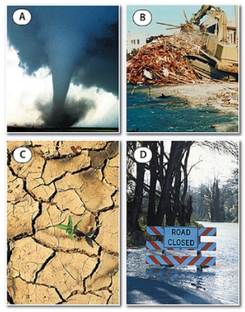
Which disasters can you see in the pictures? Which of these disasters are common in your country? Which is the most serious to you? Why?
I see a tornado, a drought, a flood and destruction from an earthquake or a hurricane. Forest fires and floods are the most common natural disasters in Russia. Tornados occur quite often and cause a lot of damage in populated areas near Moscow.
tornado
earthquake
destruction from an earthquake or a hurricane
drought

Slide 27
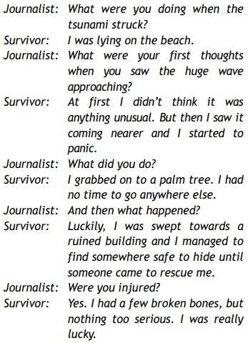
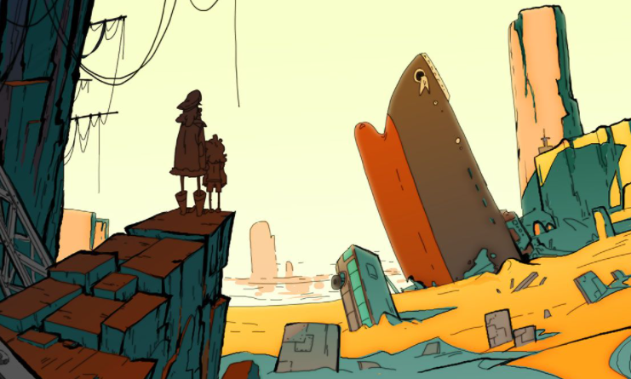
Work in pairs. Imagine you are a survivor of the tsunami disaster. Act out an interview with a journalist about your experience.
What were you doing when the tsunami struck?
What were your thoughts when you saw the huge wave approaching?
What did you do?
And then what happened?
Were you injured?
Alex
Bill
Jason
Sue
Answer

