Slide 1
Emotions and Body language

Slide 2
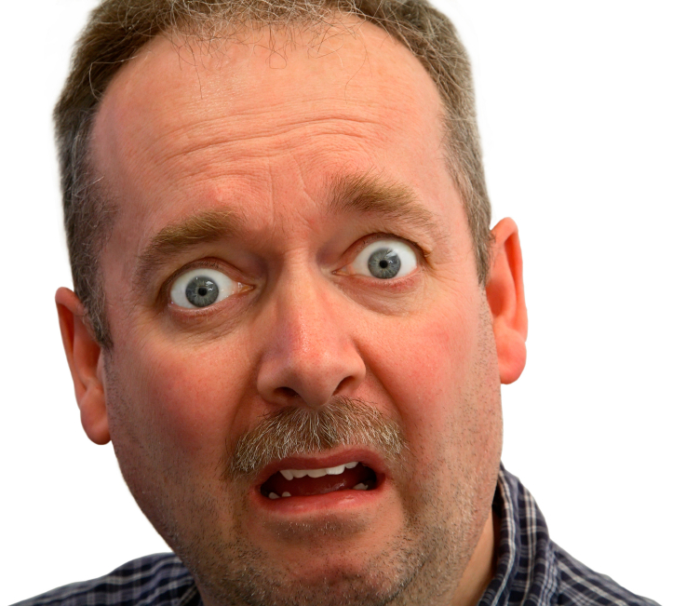
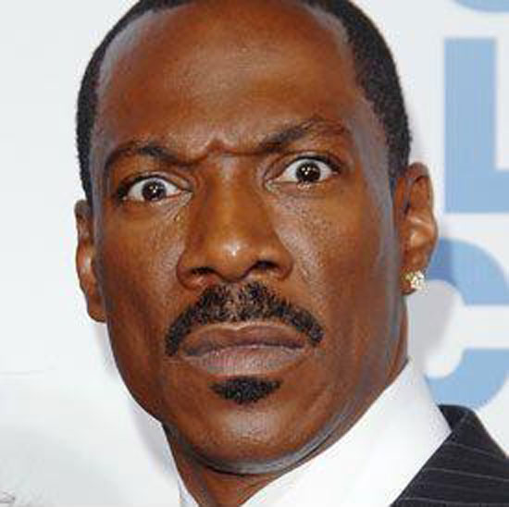
Surprise
Surprise is a momentary reaction . Stimulus surprise: the appearance of an object, sound, smell, touch something, a message, an idea. It should be noted the main manifestations of the reaction of surprise has an upturned eyebrows up, forehead wrinkles wide; eyes widely, relaxed, open, mouth opened.

Slide 3
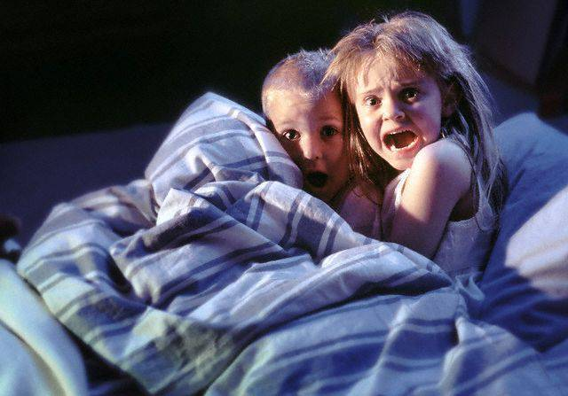
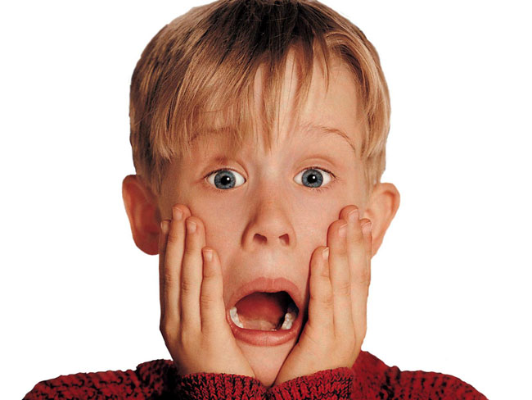
Fear
Fear is an emotion that occurs in anticipation of something extremely detrimental for the individual. The cause of the fear may be the expectation of physical pain, any unpleasant for the individual events which the person in forces to prevent . The basic responses of fear: eyebrows raised, stretched and flattened; short wrinkles on forehead eye is opened, the lower eyelid is very tense; the lips are drawn apart, too tight and drawn back.

Slide 4
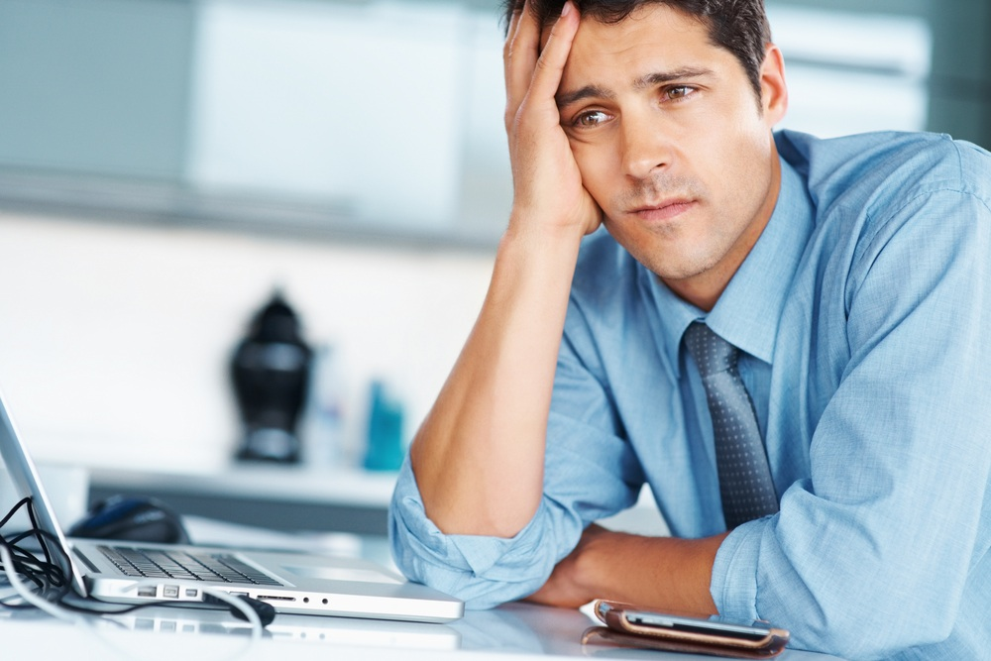
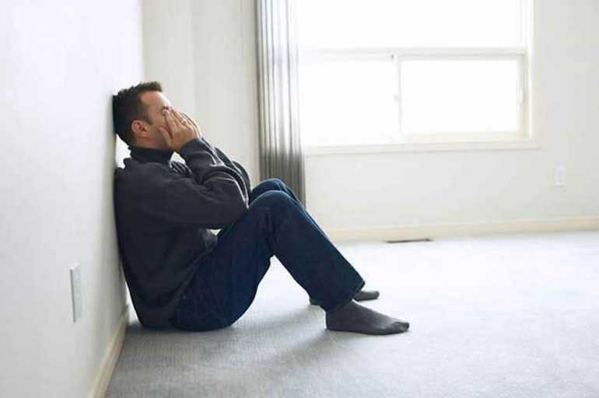
Sadness
Grief is most often caused some casualties. It is fixed on the face of from several minutes to several days. This emotion has quite a wide range — from a state of sorrow, grief and suffering The main manifestations of the reaction of sadness: eyebrows joined together, the outer ends of the eyebrows lowered between a small vertical fold; on the middle of the forehead short wrinkles, eyes slightly parted, and between the lower and the upper eyelid crease is formed in the shape of a triangle; the corners of the mouth down.

Slide 5
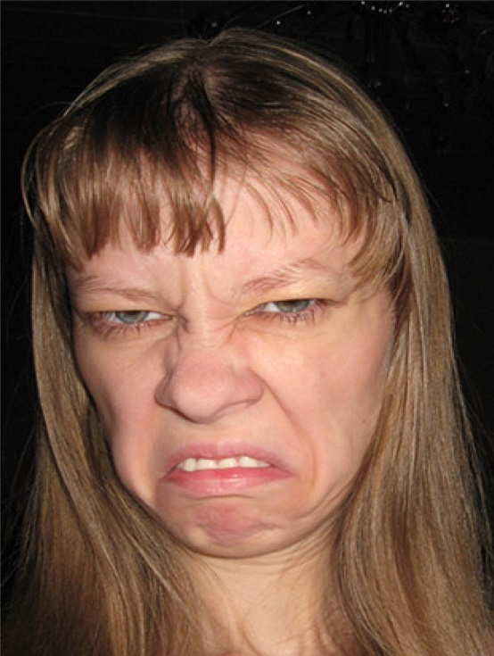
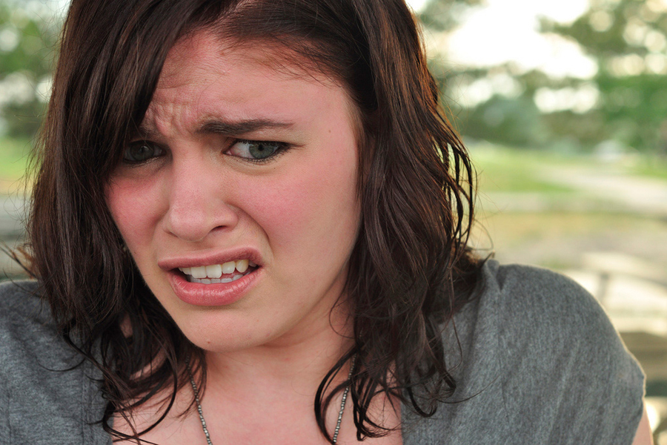
Disgust
Disgust is a reaction to the sense of taste, smell, sound, touch and appearance of some objects, including people. The main manifestations of the reaction of disgust: eyebrows lowered; the lack of wrinkles on his forehead; his eyes narrowed, almost closed; the corners of the lips lowered. Sometimes with a strong degree of aversion mouth open and intense as nausea, the protruding tongue, the nose wrinkles. The stronger the aversion, the more wrinkles and the more strenuous the nose.

Slide 6
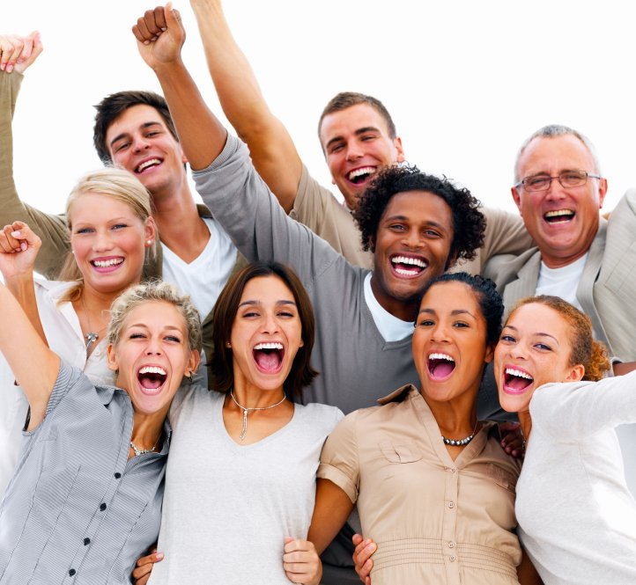
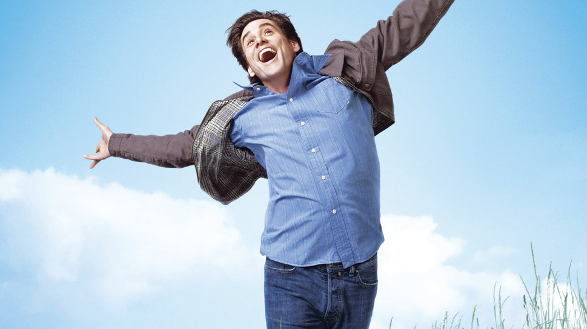
happiness
Joy is experienced as a sense of the exciting and uplifting, relief from something unpleasant or dangerous. The main manifestations of the reaction of joy: the eyebrows and forehead are almost not involved in the formation of the expression, the eyes are often narrow and shiny; mouth stretched corners of her mouth rise up .

Slide 7
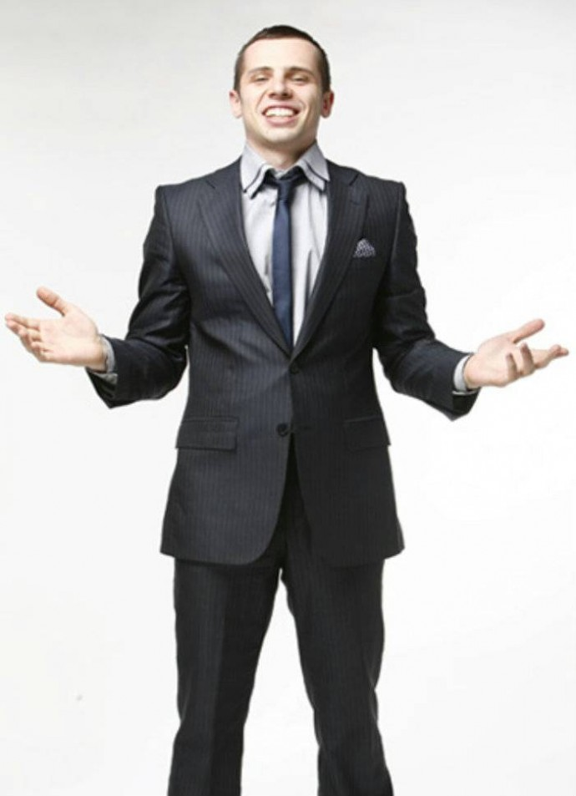
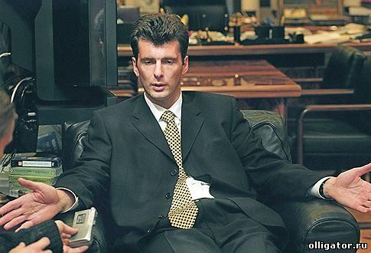
The gesture of openness
Among them are the following: Open hands palms up - a gesture relating to sincerity and openness, shrug, accompanied by the gesture of the open hand stands for openness of nature, the unbuttoning of jacket people are open and friendly you often unzips his jacket during a call and even shoot it in your presence.

Slide 8
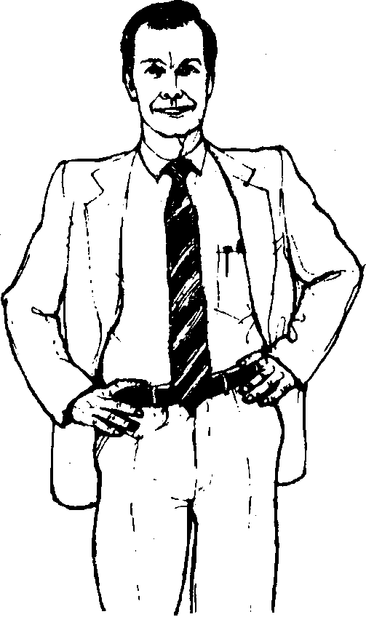
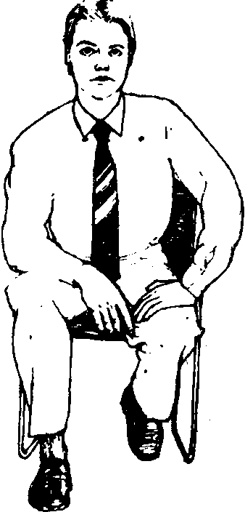
Gestures of readiness
Hands on hips is a sign of readiness it is often possible to observe the athletes waiting for their turn to speak. A variation of this posture in the sitting position - the man sits on the edge of the chair, the elbow of one hand and the palm of the other leans on his knees sitting directly in front of the Covenant. on the contrary, before you get up and leave.

Slide 9
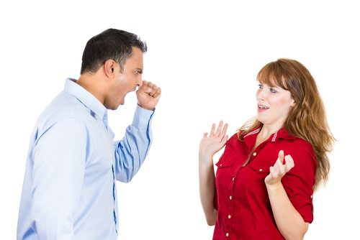
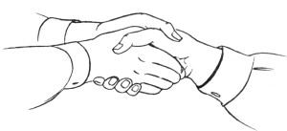
Gestures of dominance-subordination
Excellence can be expressed in a welcoming handshake. When a person firmly shakes your hand and turns it so that the hand rests on top of yours, he's trying to Express some kind of physical superiority. And, on the contrary, when he holds out his hand palm up, then he is willing to accept a subordinate role. When the hand of the interlocutor during a conversation casually stuffed into the jacket pocket, and the thumb while the outside is a trusted person in their superiority.

Slide 10
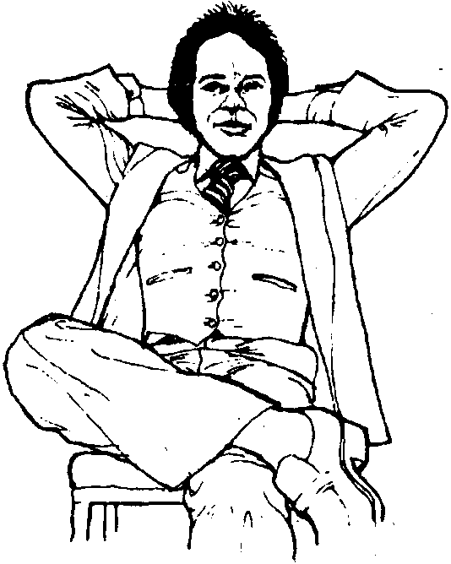
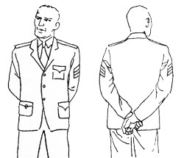
Gestures of authoritarianism
Arms linked behind his back, chin raised so often are the army commanders, the police, as well as senior management. In General, if you want to understand your superiority, you just have to physically climb over the opponent - to sit above it, if you're sitting, maybe stand in front of him.

Slide 11
thank you for your attention!!

