Slide 1
Урок английского языка
«Автомобиль. Салон автомобиля»
Фролова В.Н., преподаватель английского языка
Идентификационный номер:
244-147-402
Статья отнесена к разделу: Преподавание иностранных языков

Slide 2
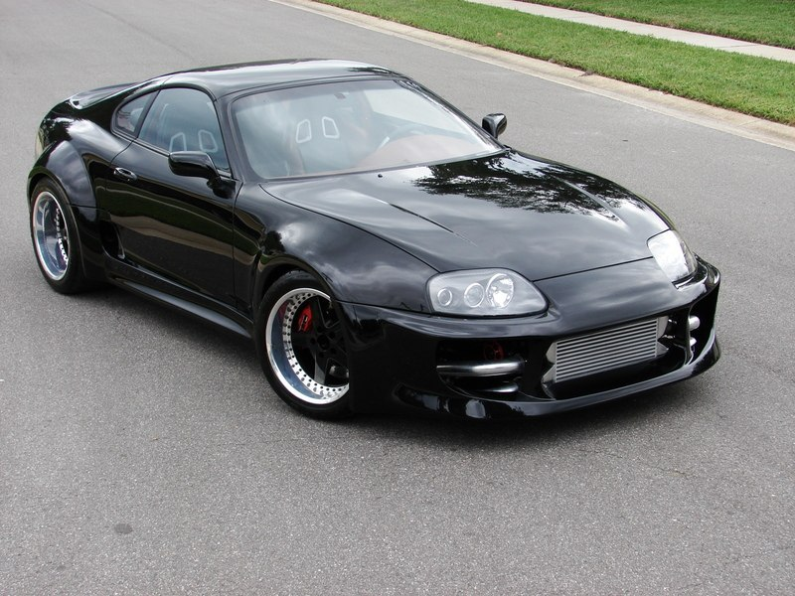


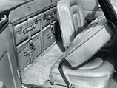
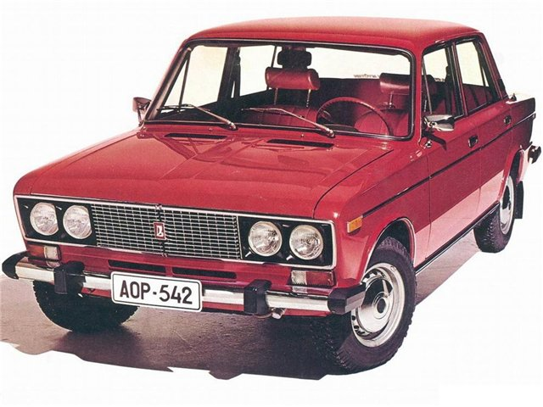
Тема занятия: Автомобиль. Салон автомобиля

Slide 3
Today at our lesson we will:
Learn new words;
get the information and talk about cars;
match the English words and word combinations with their Russian equivalents;
listen to the text for details “Inside the car”;
ask and answer the questions;
read dialogues and learn them.

Slide 4
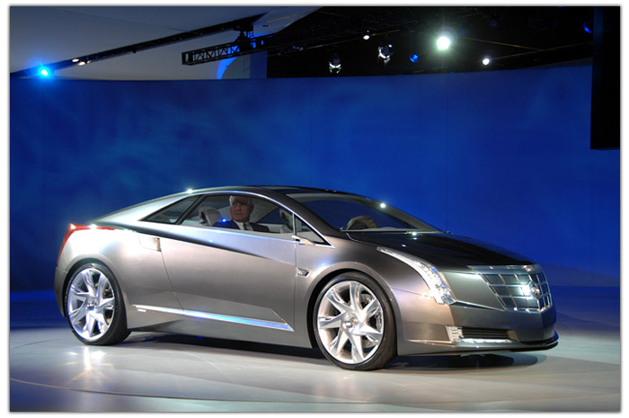
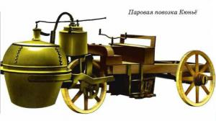


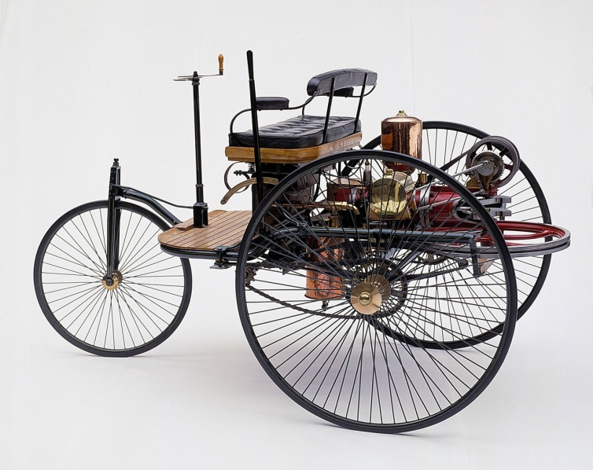

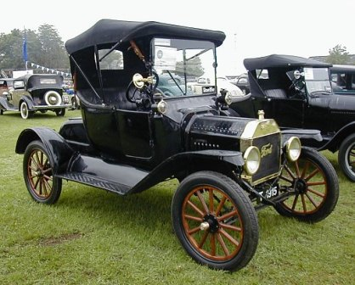
From the history of cars

Slide 5
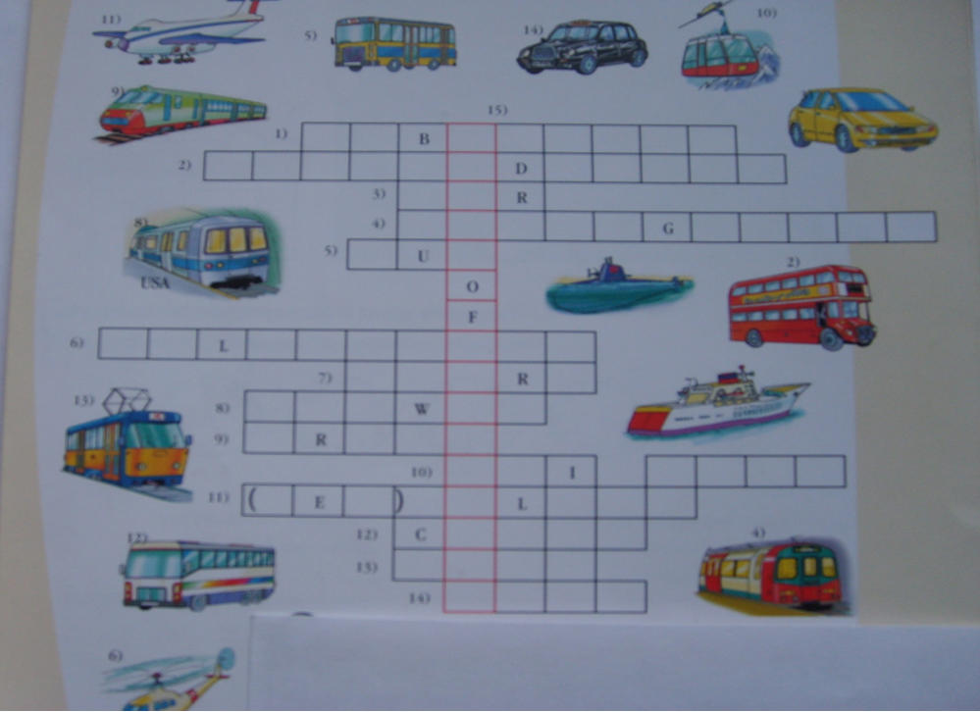

Slide 6
Do you know these cars?

Slide 7
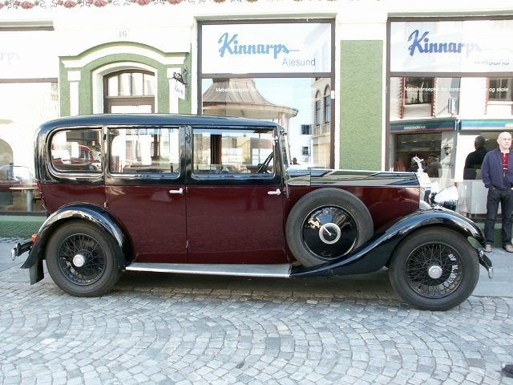


Slide 8
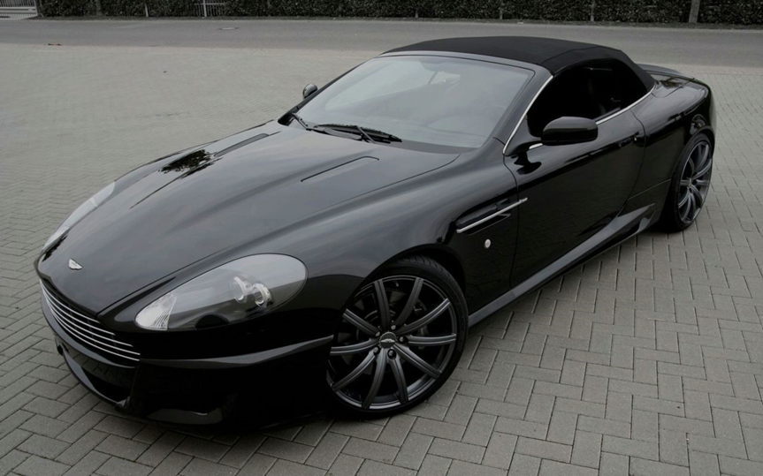
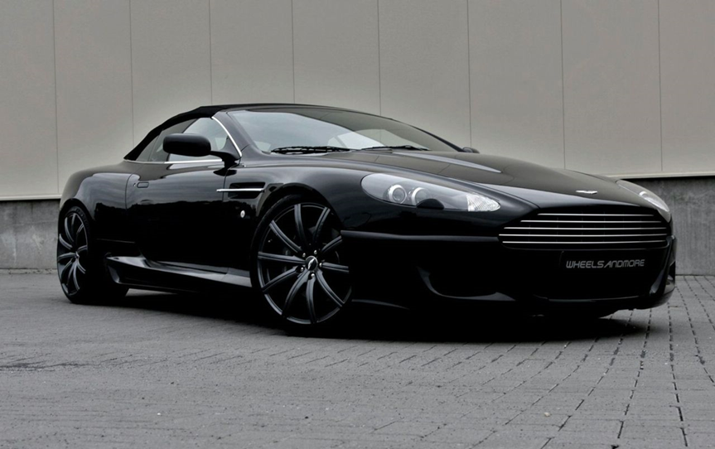

Slide 9
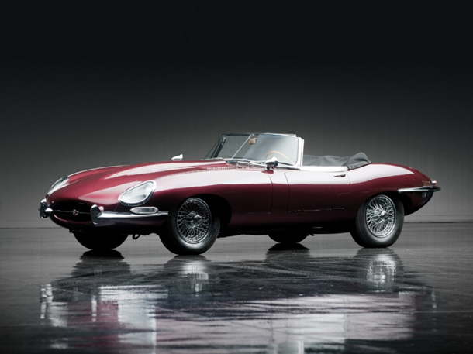
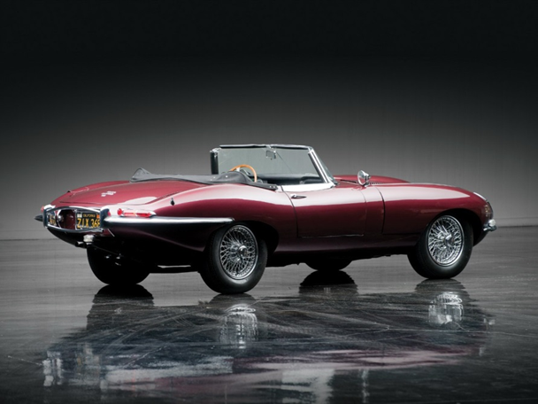

Slide 10
(Answers)
English cars:
Rolls-Royce car
Aston Martin DB9
Jaguar E-Type Open Two Seater Series

Slide 11
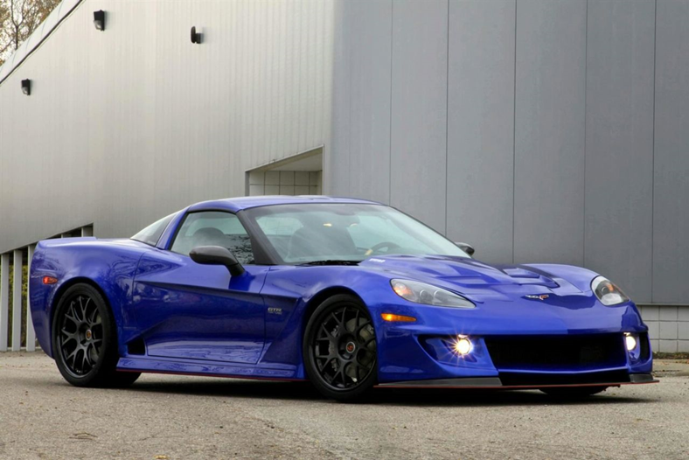
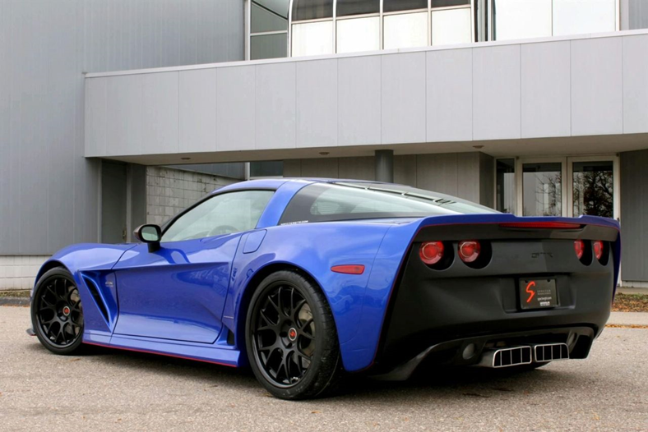

Slide 12
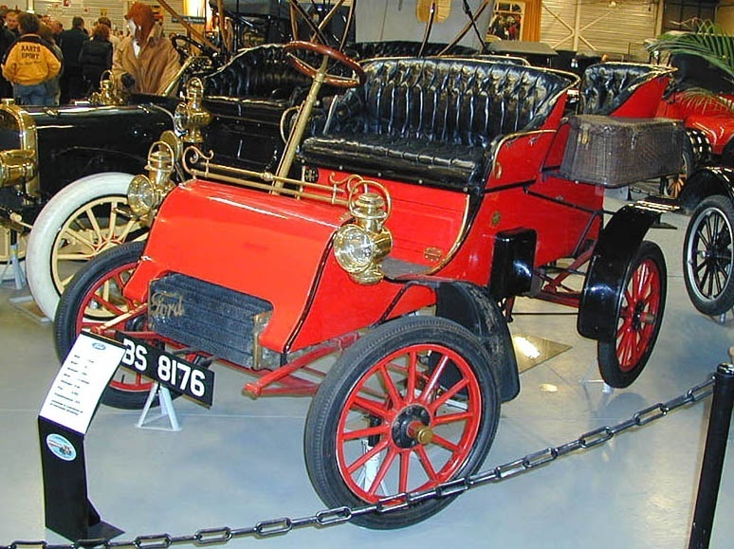
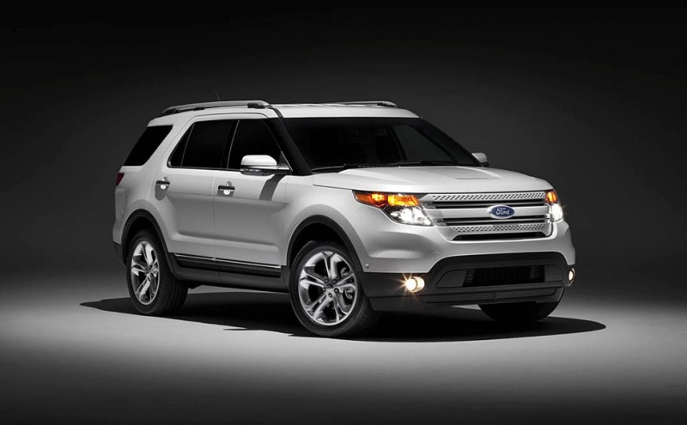

Slide 13
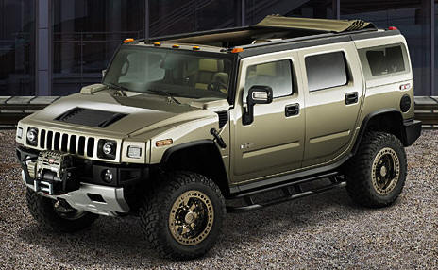
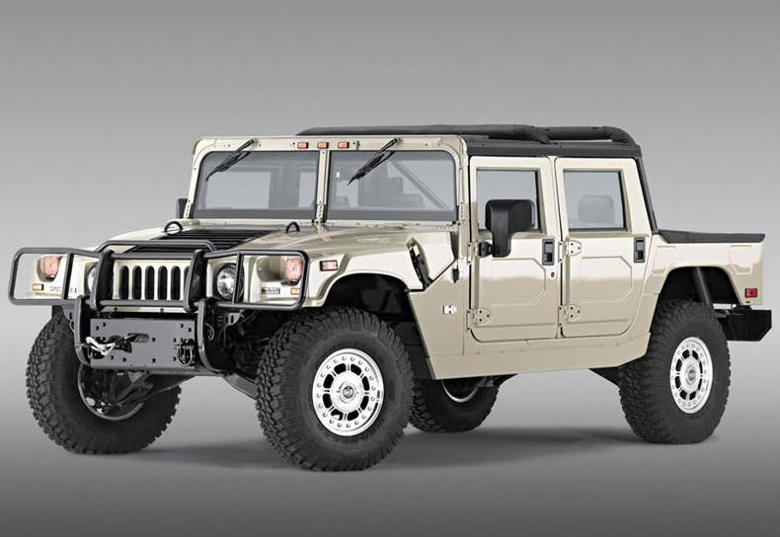
Нummer

Slide 14
(Answers)
American cars:
Corvette GTR
Ford
Hummer

Slide 15
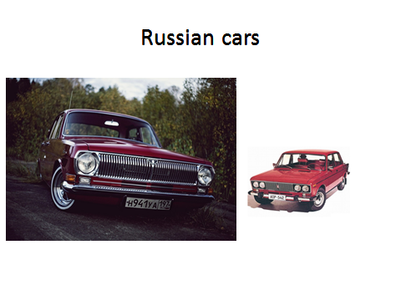

Slide 16
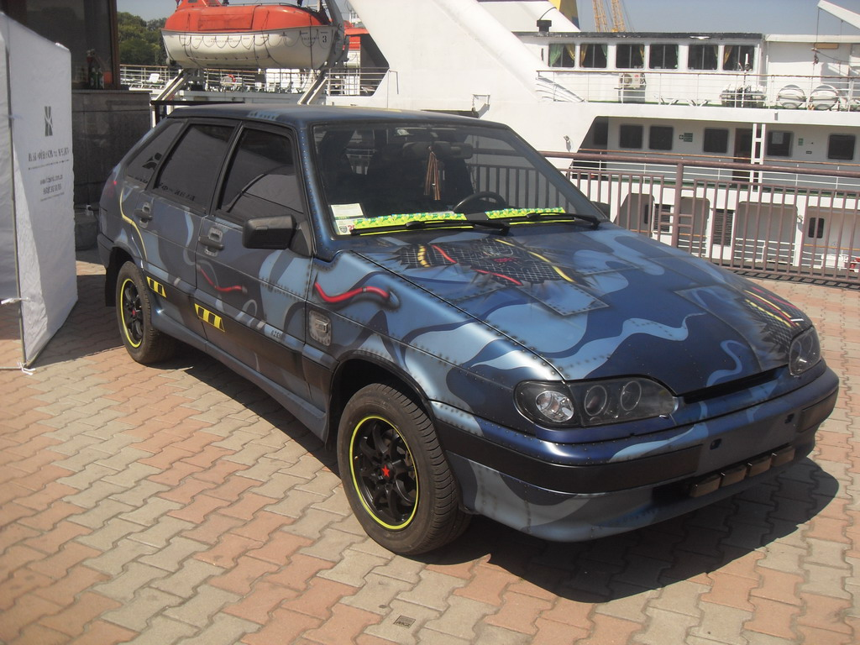
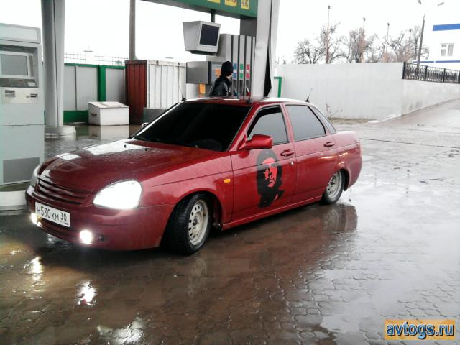
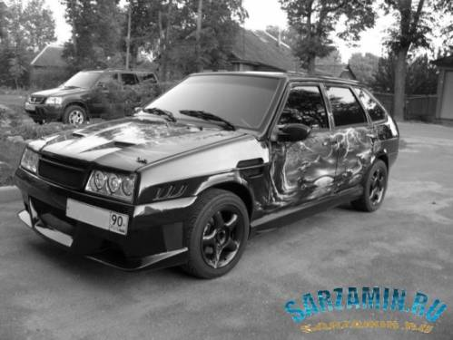
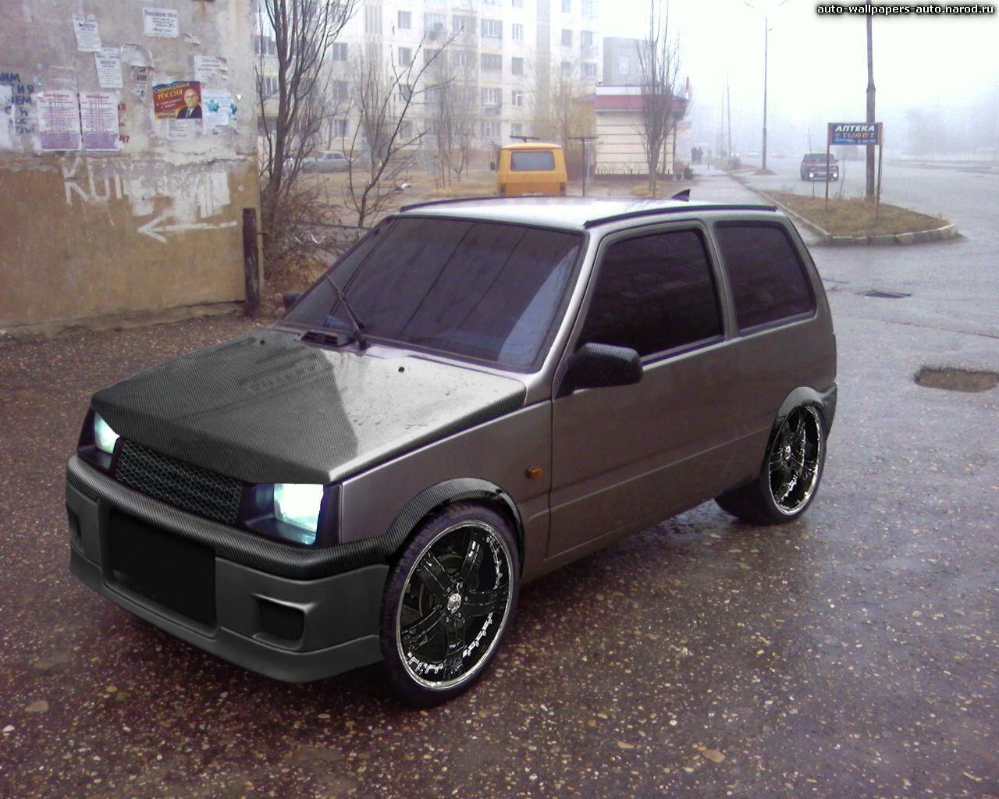
VAZ 2114
VAZ 21093
VAZ 1111
VAZ 2170 Priora

Slide 17
(Answers)
Russian cars
Gas 24
VAZ 2114
VAZ 21093
VAZ 1111
VAZ 2170 Priora

Slide 18
Describe the car’s parts
Look at these two pictures and give Russian equivalents to the following English words:

Slide 19
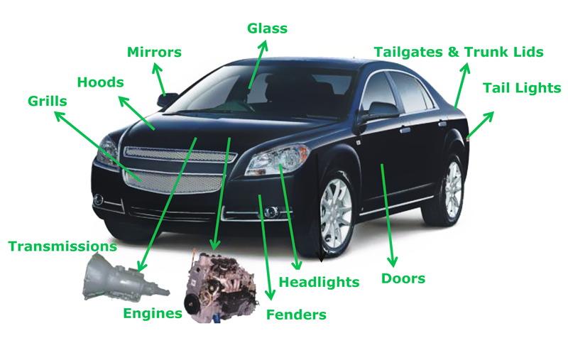

Slide 20
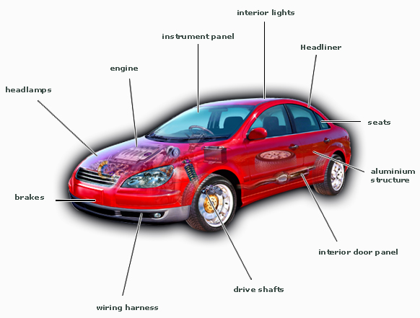


Slide 21
Pre-listening task
Read, write down and try to remember these words and word combinations from the text.
a car- автомобиль
a seat-сиденье
a driver- водитель
passengers-пассажиры
a windscreen- лобовое стекло
a steering wheel - руль
steering system-рулевое управление
windshield wipers-стеклоочистители, дворники
a brake-тормоз
gearbox-коробка передач
gear –передача
a gear lever-рычаг переключения передач
a clutch-сцепление
engine –двигатель, мотор
chassis-шасси
body-кузов
a hand-brake-ручной тормоз
an ignition-зажигание
wheels-колёса
fenders-крылья
hood-капот
a speedometer -спидометр
a thermometer –термометр
Armrest- подлокотник,
headrest- подголовник,
seatbelt ремень безопасности,
door lock дверной замок;
dashboard- приборная панель,
glove compartment- бардачок
fuel gauge- указатель уровня топлива,
air bag- подушка безопасности.

Slide 22
Translate the following words from the text. Match a word in A with a word in B.
A
1.car
2.seat
3.windscreen
4 windscreen wipers
5. steering wheel
6. engine
7. brake
8. passengers
9. driver
10. clutch
B
a.руль
b.пассажиры
c.тормоз
d.мотор
e.водитель
f.сцепление
g.дворники
h.лобовое стекло
i.сиденье
j.автомобиль

Slide 23
Translate the following word combinations from the text. Match a line in A with a line in B.
1.to sweep the rain off the windscreen;
2. to steer the car;
3. to brake the car;
4.gear lever;
5.to start the engine;
6. to switch on the ignition;
7. to press the starter,
8. foot-pedal;
9. steering wheel;
10.to change direction
a.сменить направление
b.руль
c. ножная педаль
d. нажать на стартёр
e. включить зажигание
f.завести мотор
g.рычаг переключения передач
h.тормозить автомобиль
i. управлять автомобилем
j.очистить от дождя ветровое стекло

Slide 24
Describe these two pictures.
Use new words and word combinations

Slide 25
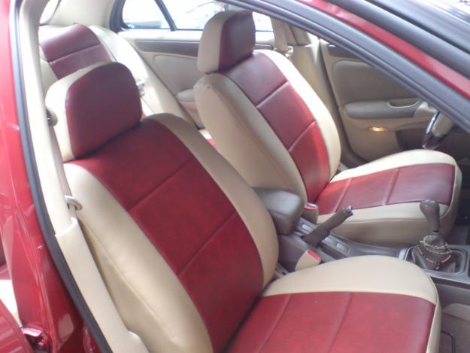

Slide 26
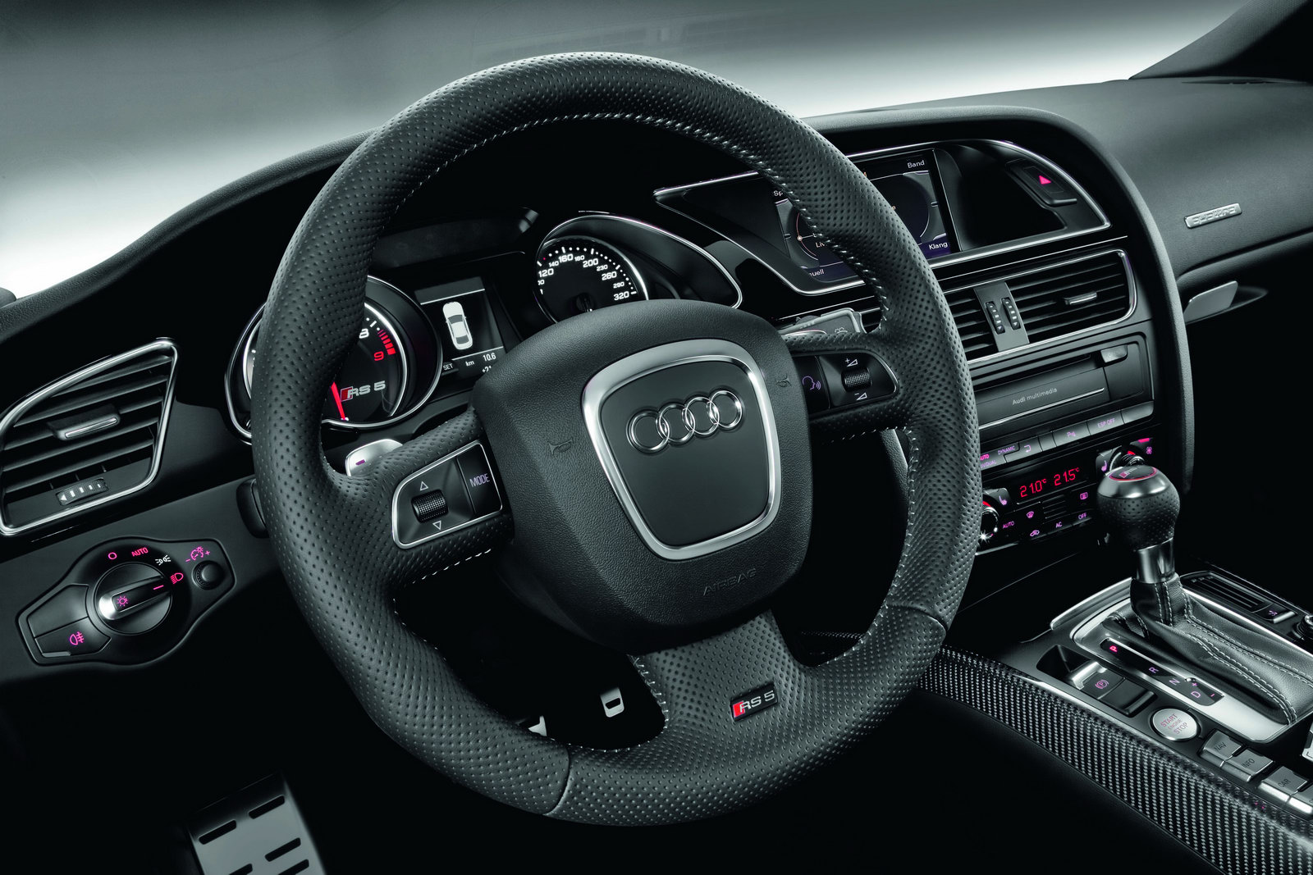

Slide 27
Listening and Speaking
Listen to the text «INSIDE THE CAR» (2)
We are inside the car. There is a seat for the driver in the front and four seats for passengers in the back. All round the car are windows to see out-except in the front. This is the windscreen and there are also things to sweep rain off it. We call them the windscreen wipers.
When we drive the car we steer with the steering wheel. If there are obstacles in the way we stop the car with the brake - we brake the car. When the way is clear to go again we accelerate to help us move off. The car has a gear-box and four gears. There is also a gear lever. We change gears by pushing the gear lever from one gear to the next. To help us to do this we have a foot-pedal. We call it the clutch. We put the clutch out to disengage the engine and we put the clutch in to make it drive again. When we want to stop the car we put on the hand brake. To start the engine we switch on the ignition and press the starter. And lastly to change direction we signal with the indicators. With our hands we steer with the steering wheel, change gear with the gear lever, and put on the hand-brake. With our feet we accelerate by using the accelerator, stop by using the foot-brake and change gear by using the clutch.

Slide 28
Are these sentences true or false? Correct the false sentences.
1.We are inside the car.
2.There is a seat for the passenger in the front.
3. When we drive the car we steer with the steering wheel.
4.The car has a gearbox and two gears.
5.To change direction we signal with the indicators.

Slide 29
The key
1.We are inside the car. (True)
2.There is a seat for the passenger in the front. (False).
(True- There is a seat for the driver in the front).
3. When we drive the car we steer with the steering wheel. (True)
4.The car has a gear-box and two gears. (False). (True-The car has a gear-box and four gears. )
5.To change direction we signal with the indicators. (True)

Slide 30
Match a line in A with a line in B. Закончите предложения выбрав соответствующее по смыслу окончание.
1 We are inside…
2.There is a seat for the driver in the front …
3.This is the windscreen and there are also things…
4.We call them the …
5.We steer with the …
6.We stop the car with…
7. The car has a gear-box and…
8.There is also a gear…
9.To start the engine we switch on…
10.To change direction we signal…
a). with the indicators
b). and four seats for passengers in the back
c). to sweep rain off it
d). steering wheel
e). windscreen wipers
f). the brake
g). four gears
h). lever
i). the ignition and press the starter
j). the car

Slide 31
Match a line in A with a line in B. Найдите ответы в колонке B на вопросы колонки A.
A
1. Where is a seat for the driver?
2. What windows are to see out in the car?
3. What do we call the windscreen wipers?
4. What do we steer with?
5. What do we stop the car with?
6. How do we change gears?
7. How do we start engine?
8. What do we do with our hands?
9. What do we do with our feet?
B
1There is a seat for the driver in the front.
2All round the car are windows to see out-except in the front.
3 The things to sweep rain off the windscreen we call the windscreen wipers.
4We steer with the steering wheel.
5We stop the car with the brake.
6 We change gears by pushing the gear lever from one gear to the next.
7 To start the engine we switch on the ignition and press the starter.
8With our hands we steer with the steering wheel, change gear with the gear lever, and put on the hand-brake.
9 With our feet we accelerate by using the accelerator, stop by using the foot-brake and change gear by using the clutch.

Slide 32
Match a line in A with a line in B. Выберите соответствующее определение назначения оборудования автомобиля
A
1. a steering wheel
2. windscreen wipers
3.a brake
4. a gear lever
5.a key
6. an ignition and a starter
7. indicators
8. accelerator
9.safety belt
10. a speedometer and an oil pressure gauge
B
a. to control the operation of the engine
b. to be safe
c. to accelerate
d. to change directions
e. to start the engine
f. to switch on the ignition
g. to change gears
h. to stop the car
i. to sweep rain off the windscreen
j.to steer the car

Slide 33
Answer the following questions.
1. When do we steer with the steering wheel?
2. When do we put the clutch out?
3. When do we put on the handbrake?
4. What do we do to start the engine?
5. What do we use bumpers for?
6. When do we use the spare wheel?
7. What do we use to keep the car straight or make it turn?

Slide 34
Answers
1.– ( When we drive the car we steer with the steering wheel.)
2.– (We put the clutch out to disengage the engine.)
3.– (When we want to stop the car we put on the hand-brake.)
4. - (To start the engine we switch on the ignition and press the starter.)
5.– (We use the bumpers to protect the bodywork.)
6. - (When a tyre goes flat all the air comes out of it because it has a puncture. So we lift the car on a jack, change the wheel and drive on.)
7.– (We use the steering to keep the car straight or make it turn.)

Slide 35
Look at these pictures and say a few words about what you can see inside the car.
Use these words:

Slide 36
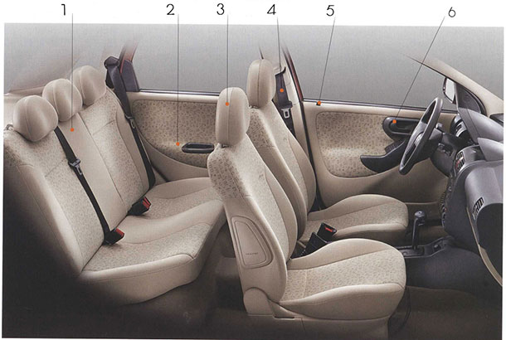

Slide 37
Bаck seat, armrest, headrest, seatbelt, door lock, door handle

Slide 38
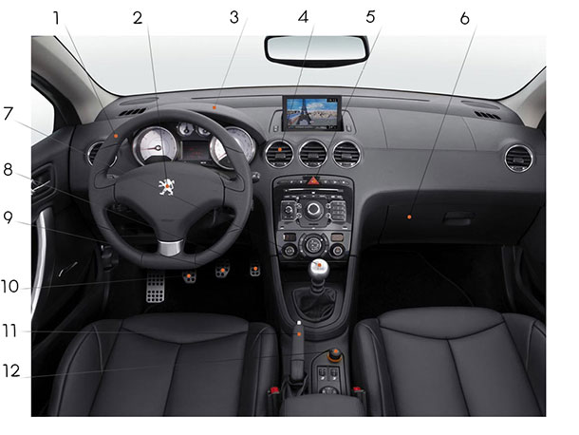

Slide 39
Steering wheel, horn, dashboard, air vent, hazard light switch, glove compartment, gear lever, accelerator, brake, clutch, handbrake, cigarette lighter

Slide 40
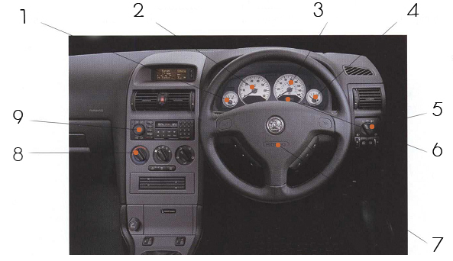

Slide 41
Temperature gauge, tachometer, speedometer, fuel gauge, lights switch, odometer, air bag, heater controls, car stereo.

Slide 42
Do the test.
1.The pedal which is used to stop the car.
a). clutch; b). brake; c). gearbox.
2.The top part of a car seat.
a). headrest; b). armrest c). dashboard
3.The pedal which is used to change the speed of the car.
a). clutch; b). brakes; c). accelerator.
4.Mechanism which is used to guide the car in one or the other directions.
a). clutch; b). brakes; c). steering system.
5.Device which is designed to measure the speed of the car.
a). heater; b). windscreen; c). speedometer.
6).The small cupboard in front of the passenger seat of a car.
a). glove compartment; b). dashboard; c). horn.
7.The part of a door or a window that you use for opening it.
a). armrest; b). handle; c). safety belt.

Slide 43
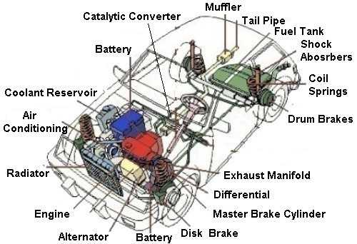
1-b, 2-a, 3-c, 4-c, 5-c, 6-a, 7-b.

Slide 44
I like the lesson very much. It was cool one! | I like the lesson | I don’t care about the lesson | I didn’t like the lesson at all

Slide 45
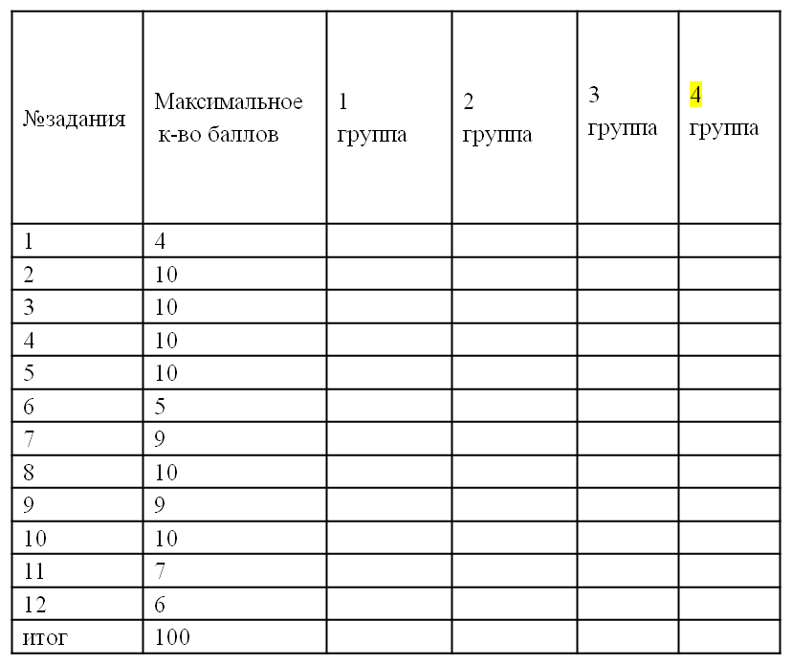
Оценка сформированности знаний и умений.
Критерии оценки
(каждый правильный ответ оценивается по 1 баллу - всего 100 баллов)
100-95 баллов - 5 «отлично»
94-75 баллов - 4 «хорошо»
74-50 баллов -3 «удовлетворительно»
Менее 50баллов -2 «неудовлетворительно»

Slide 46
Thank you for the lesson
and good luck!

