Slide 1
Describing your house
Hall,
kitchen,
living room,
bedroom,
bathroom

Slide 2
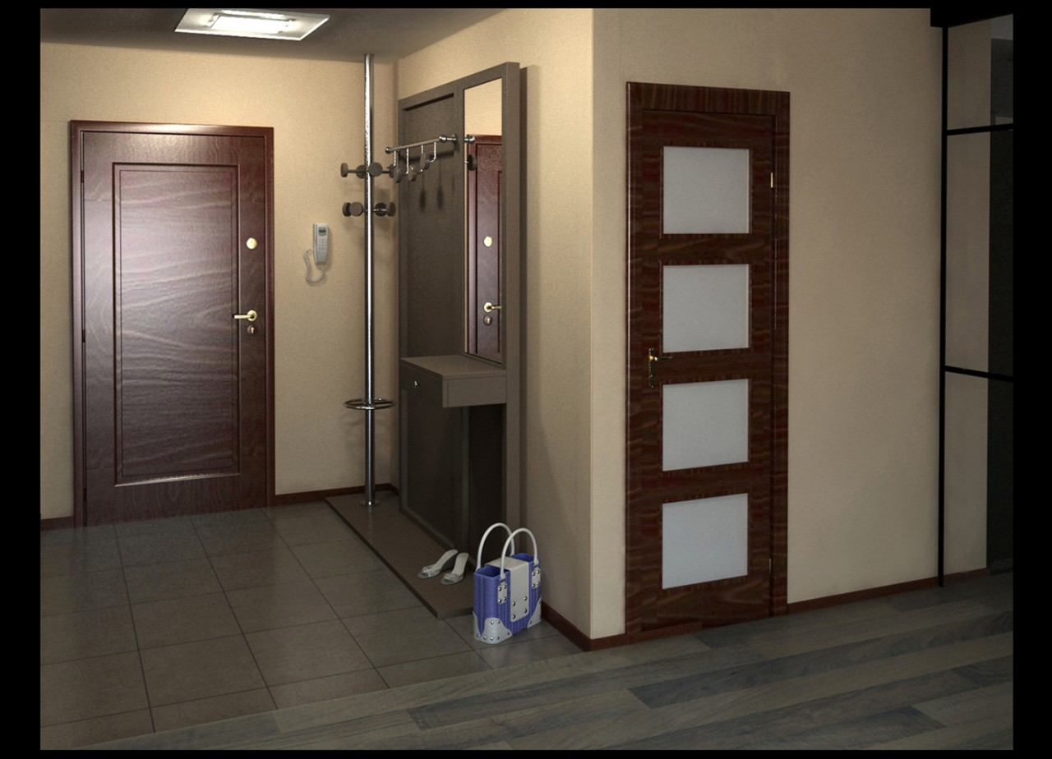
Hall
Lamp
Bag
Door
Wall
Floor
Telephone

Slide 3
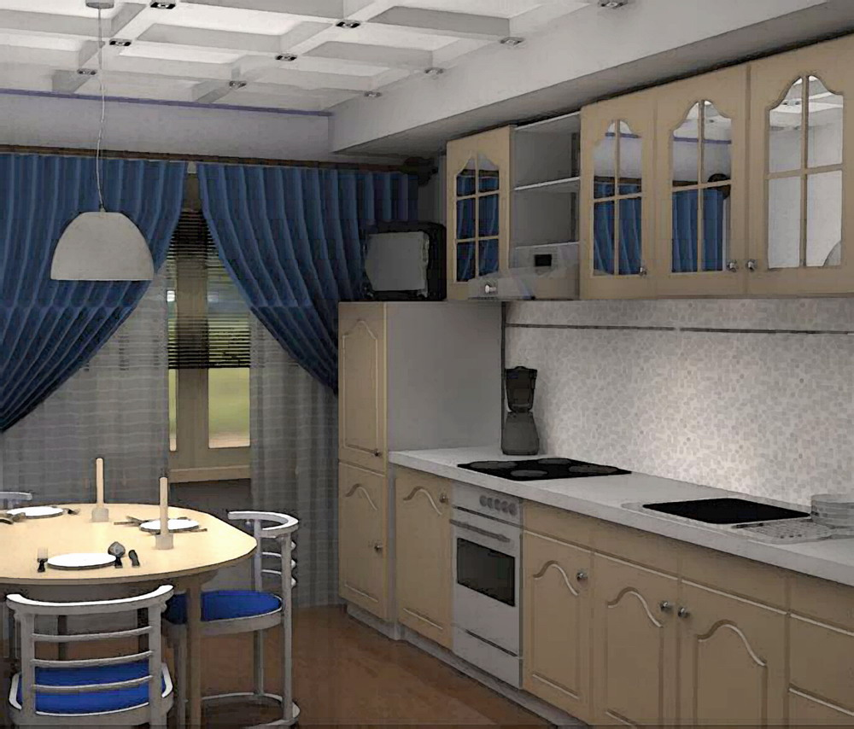
kitchen
Lamp
Table
Chair
TV
Wall
Floor
Window

Slide 4
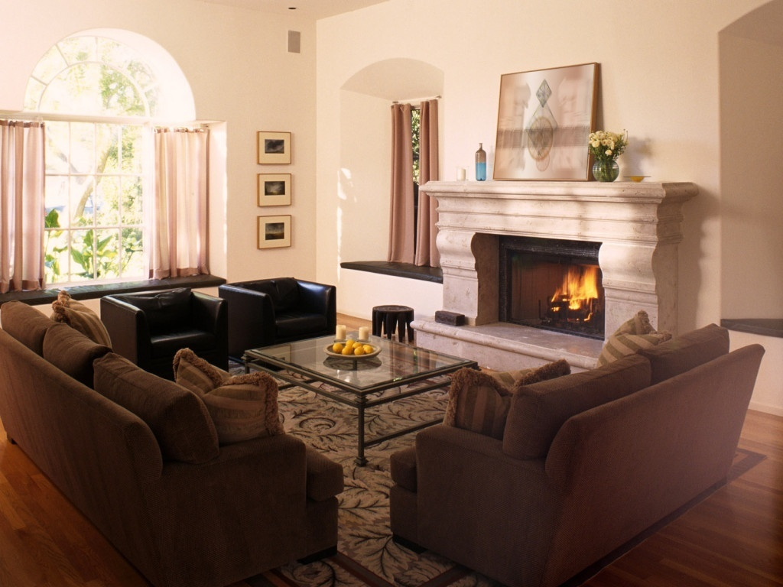
Living room
Sofa
Table
Carpet
Picture
Window
Wall
Floor
Armchair
Fireplace

Slide 5
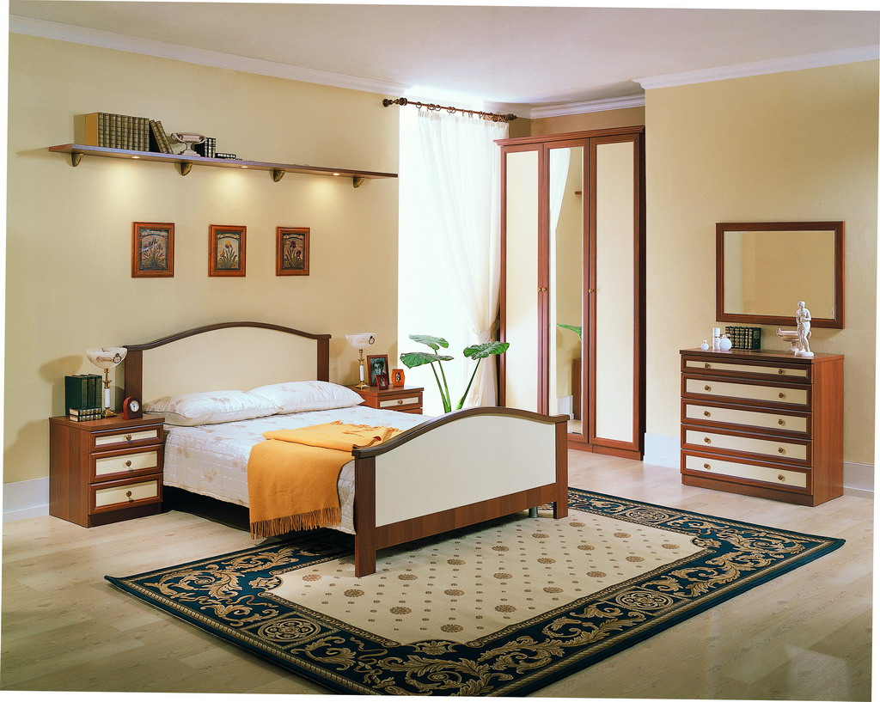
bedroom
Bed
Shelf
Picture
Carpet
Flower
Book
Wall
floor

Slide 6
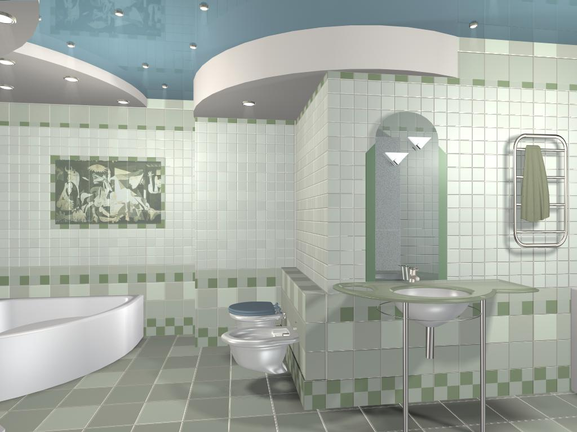
bathroom
Wall
Floor
Bath
Picture
Toilet
lamp

Slide 7
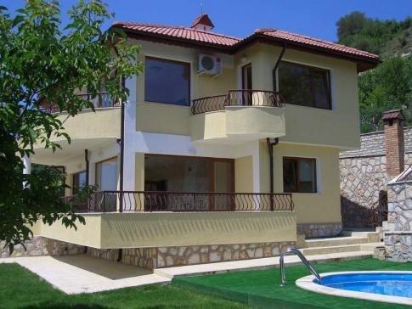
Составитель
Корепанова Тамара Геннадьевна
Учитель
английского языка
МОУ СОШ №9

