Slide 3
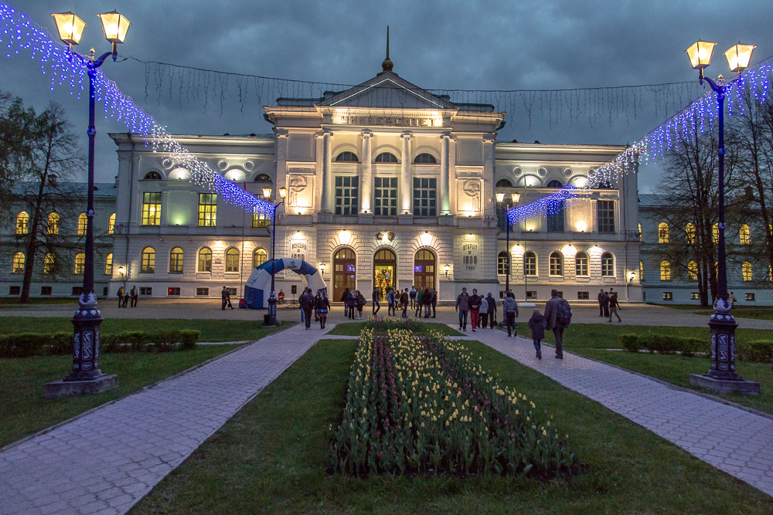
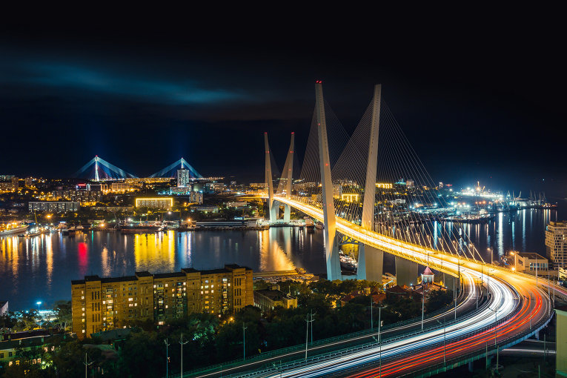
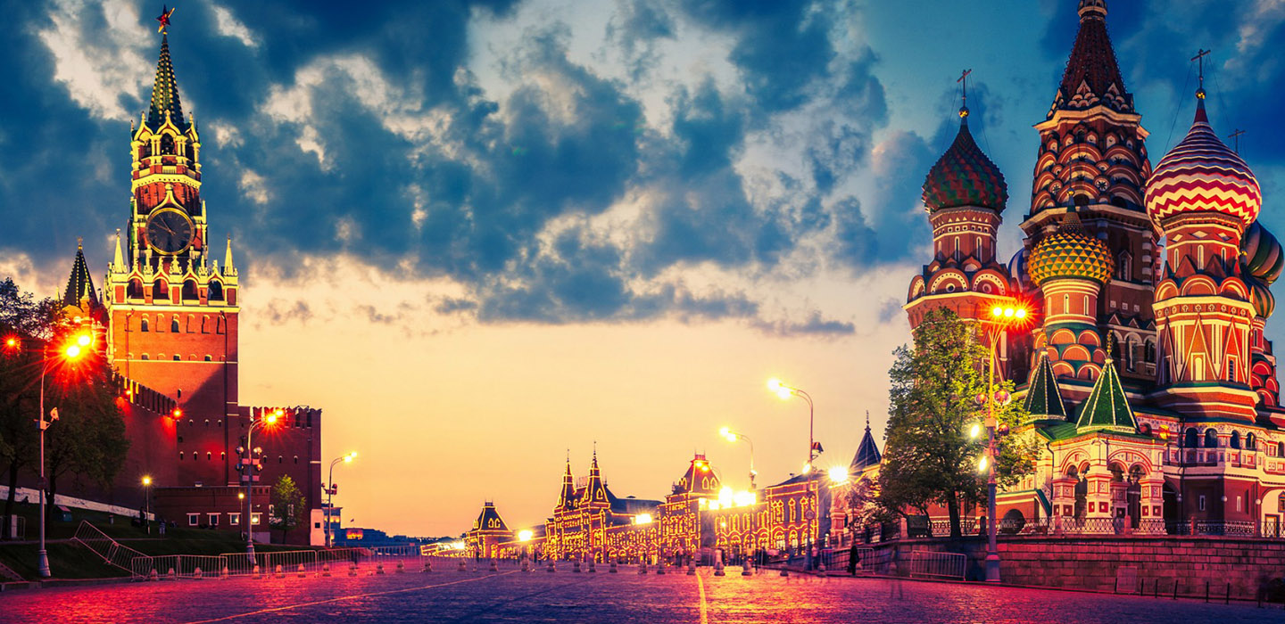

Slide 4
Places in town/ in city

Slide 5
We need:
Words
Phrases
Sentences

Slide 6
Where can I go in your city?

Slide 7
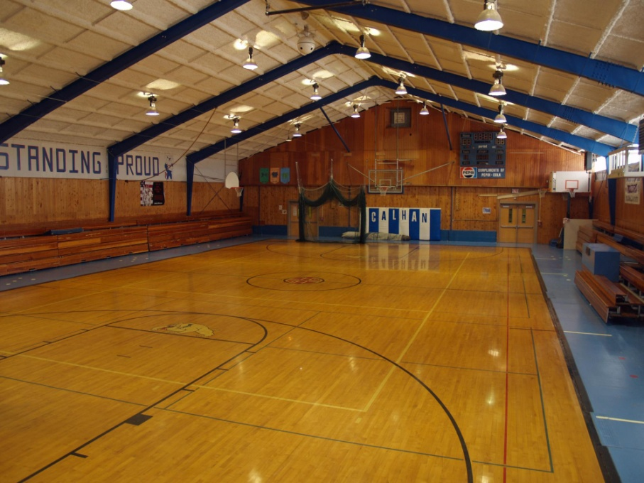
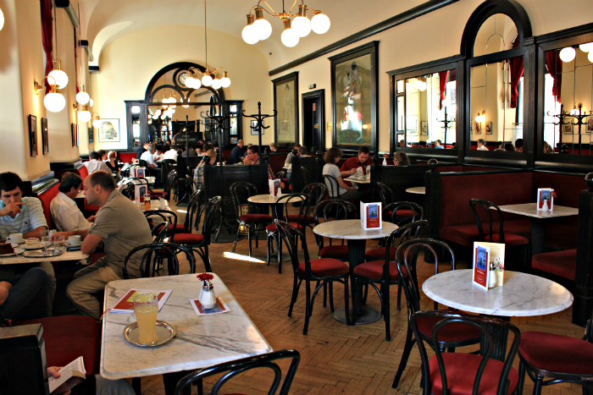
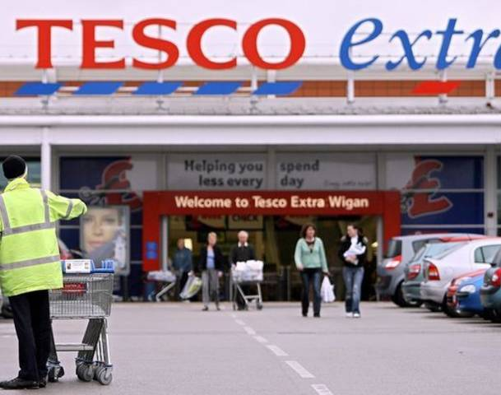
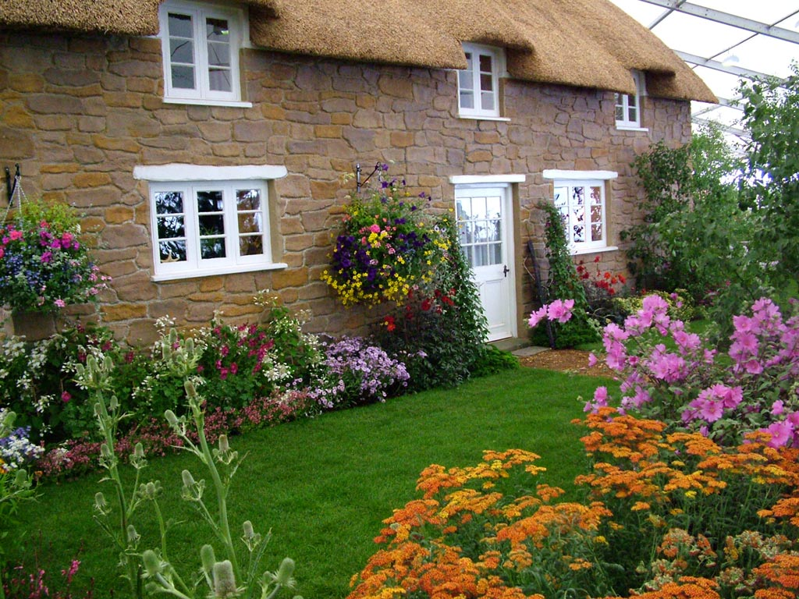
Where should I go?

Slide 9
Rules
 | Must | Mustn’t
Pay for an entrance ticket
Eat in there
Take pictures
Feed animals
Keep the ground clean
Speak quietly

Slide 10
What’s the weather like in your city?
Sunny
Cloudy
Rainy

Slide 11
Домашнее задание
Создайте рекламный буклет
для гостей города Cеверска
Начните с:
Welcome to Seversk.
Here you can go……

