Slide 1
Урок-викторина «Do you know English and American literature?
Левичева Елена Михайловна, учитель английского языка МОУ «Железногорская сош №4»

Slide 2
The role of literature
It’s very difficult to assess the role of
literature in human life. Books have educated more than one generation of people. As you know, books perform two main functions: informational and aesthetic. Literature teaches the beautiful, the good, and forms moral principles. Books form not only moral ideals, but also ideals of appearance and behavior.

Slide 3
The main features of British literature
The main feature of British literature is the mixture of different cultures. It intertwines the traditions of English, Scottish, Welsh, Irish and many other peoples who inhabited Foggy Albion. The same writer could be influenced by several cultures at the same time.

Slide 4
The main features of American literature
American literature is very peculiar. It includes
a reflection of the history of the development
of the continent, the war between north and south,
the war of independence, etc. The fast pace of American life led to the formation of a unique style - the short story.
Such famous writers as O. Henry, A. Bierce, Edgar Allan Poe, Mark Twain, Jack London and others worked in this genre. The short story form has become typical for American literature.

Slide 5
Let’s do the Quiz!
1. Who wrote the novel of Robinson Crusoe?
Daniel Defoe
Rudyard Kipling
Agatha Christie
Mark Twain

Slide 6
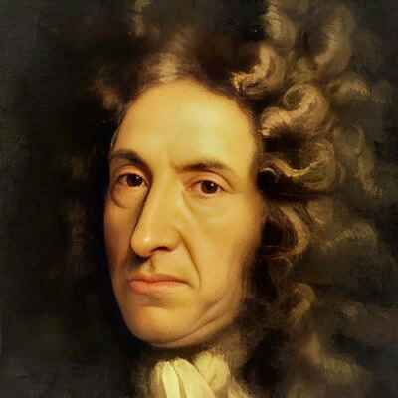
The Answer is:
Daniel Defoe - a writer and a publicist

Slide 7
Let’s do the Quiz!
2. Shakespeare was born in …
1454
1564
1754
1566

Slide 8
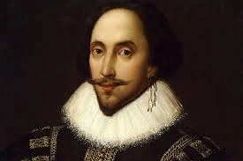
The Answer is:
1564

Slide 9
Let’s do the Quiz!
3. Shakespeare was born in …
Liverpool
London
Stratford-on-Avon
Cambridge

Slide 10
The Answer is:
Stratford-on-Avon

Slide 11
Let’s do the Quiz!
4. Agatha Christie is the “queen” of … stories.
Horror
Detective
Adventure
Comical

Slide 12
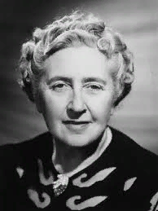
The Answer is:
Detective Stories

Slide 13
Let’s do the Quiz!
5. One of the greatest masters of short stories is…
Jack London
O’Henry
Charles Dickens
Conan Doyle

Slide 14
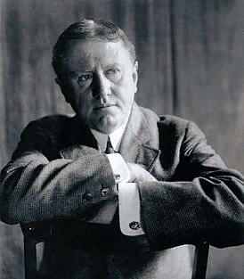
The Answer is:
O’Henry

Slide 15
Let’s do the Quiz!
6. This novel shows the events of the Civil War in the USA.
“The Catcher in the Rye”
“The Old Man and the Sea”
“Farewell to Arms”
“Gone with the Wind”

Slide 16
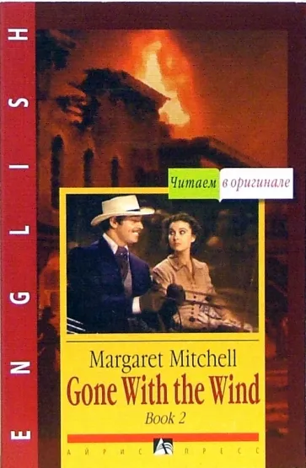
The Answer is:
“Gone with the Wind”

Slide 17
Let’s do the Quiz!
7. The words “Something is rotten in the state of Denmark” belong to …
Othello
Hamlet
King Lear
Romeo

Slide 18
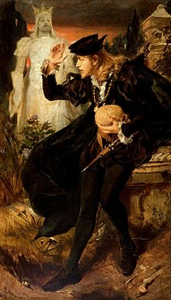
The Answer is:
Hamlet

Slide 19
Let’s do the Quiz!
8. Finish the saying “To be or not to be…”
and what may come
in this cruel world
that is the question
d) I don't know what to do

Slide 20
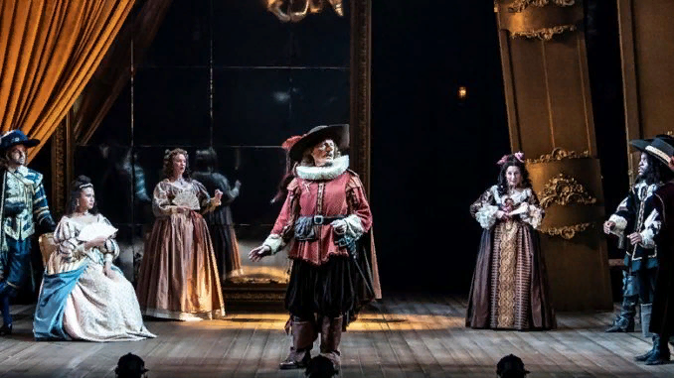
The Answer is:
… that is the question

Slide 21
Let’s do the Quiz!
9. The novel “Jane Eyre” was written by … Bronte.
Charlotte
Anne
Samantha
Emily

Slide 22
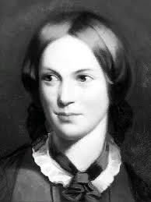
The Answer is:
Charlotte

Slide 23
Let’s do the Quiz!
10. The name of Mr. Rochester in the novel “Jane Eyre”.
Sean
Edward
David
Charles

Slide 24
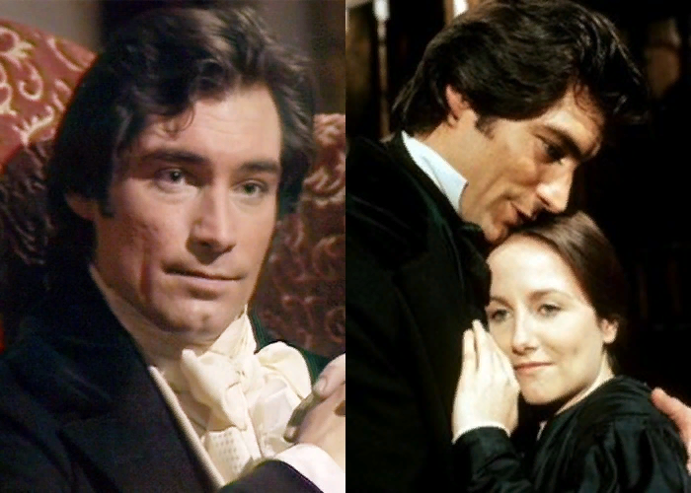
The Answer is:
Edward

Slide 25
Let’s do the Quiz!
11. Sherlock Holmes is the character of the books written by …
Edgar Poe
Mark Twain
Arthur Conan Doyle
Agatha Christie

Slide 26
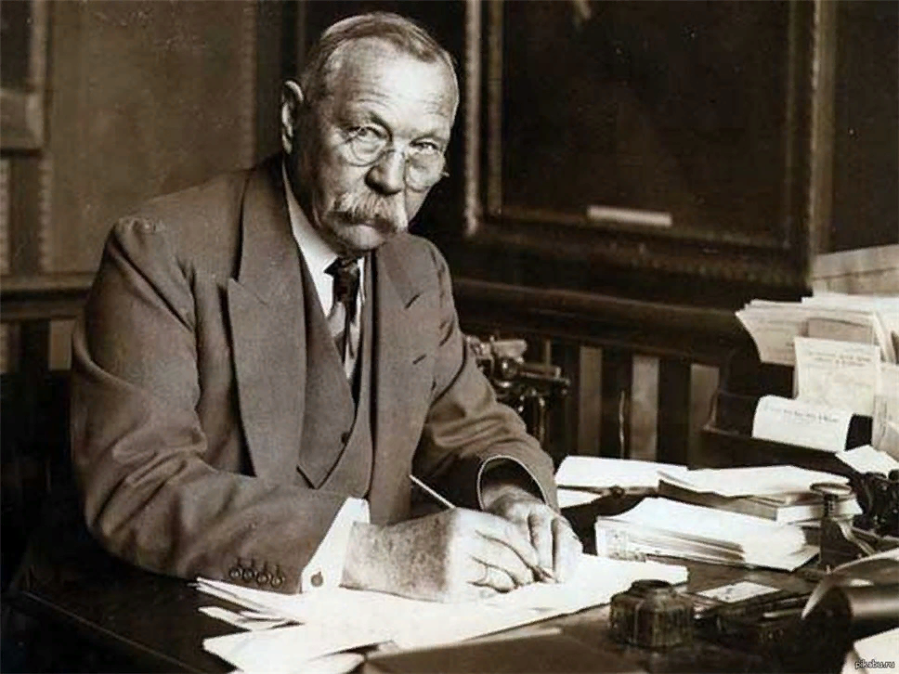
The Answer is:
Arthur Conan Doyle

Slide 27
Let’s do the Quiz!
12.The address of Sherlock Holmes’ museum.
221a, Baker St, London
221b, Baker St, London
222, Baker St, London
221b, Oxford St, London

Slide 28
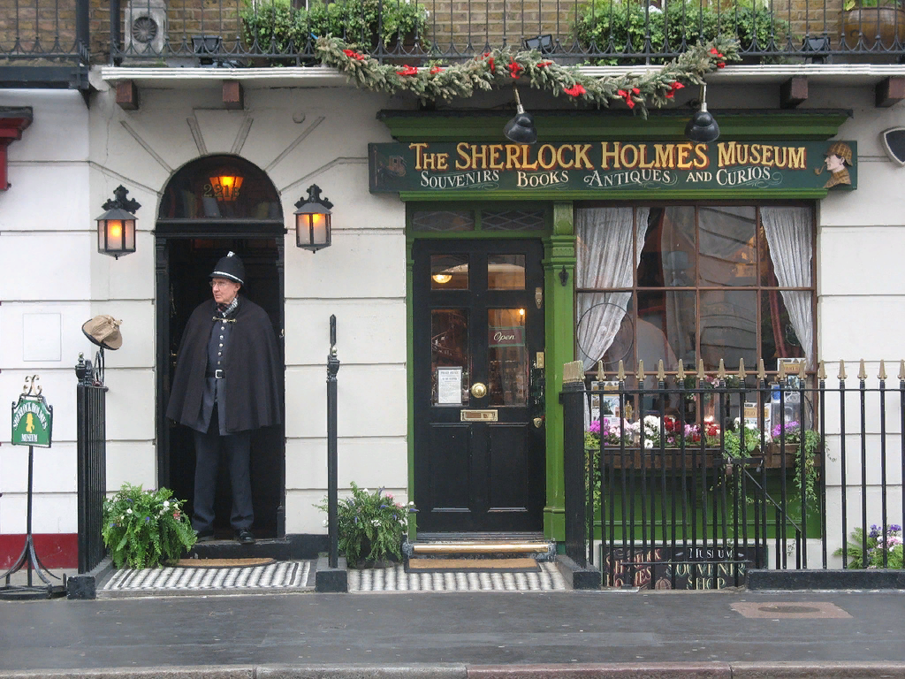
The Answer is:
221b, Baker St, London

Slide 29
Let’s do the Quiz!
13. The name of Gulliver in the novels by Jonatan Swift.
David
Benjamin
Mark
Lemuel

Slide 30
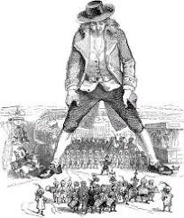
The Answer is:
Lemuel

Slide 31
Let’s do the Quiz!
14. Hamlet was the prince of …
Scotland
Denmark
Wales
England

Slide 32
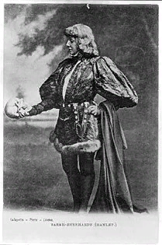
The Answer is:
Denmark

Slide 33
Let’s do the Quiz!
15. “Alice in Wonderland” was written by …
Lewis Carroll
b) Alexander Milne
c) Tolkien
d) Walter Scott

Slide 34
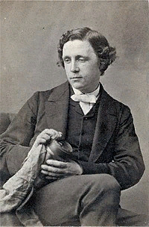
The Answer is:
Lewis Carroll

Slide 35
Let’s do the Quiz!
16. The other name of the novel about Alice.
a) Alice in the Magic Kingdom
b) Alice and her friends
c) Alice and Mad Hatter together
d) Alice through the Looking Glass

Slide 36
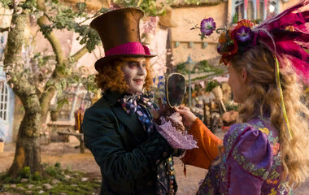
The Answer is:
Alice through the Looking
Glass

Slide 37
Let’s do the Quiz!
17. The name of the famous Walter Scott’s novel.
“Red and Black”
“Hound of the Baskervilles”
“Ivanhoe”
d) “Vanity Fair”

Slide 38
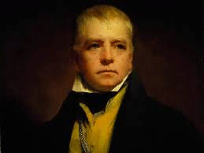
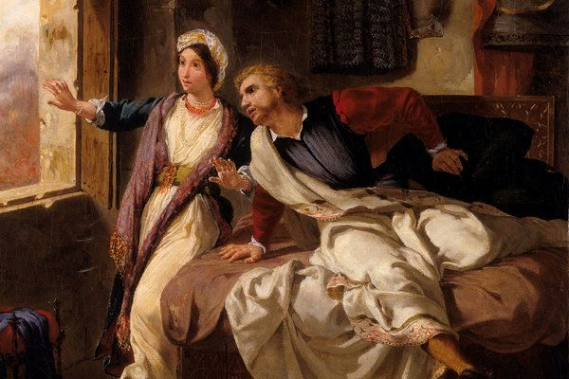
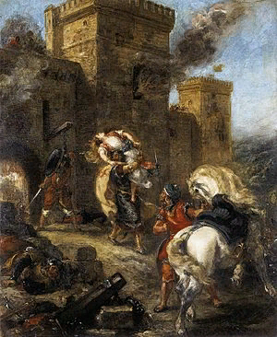
The Answer is:
“Ivanhoe”

Slide 39
Let’s do the Quiz!
18. Whose words are they: “You can’t stay in your corner of the forest waiting for others to come to you. You have to go to them sometimes”.
Alice
The Snow Queen
Winnie the Pooh
Little Red Riding Hood

Slide 40
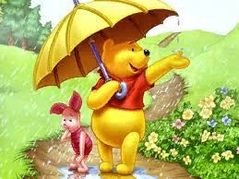
The Answer is:
Winnie the Pooh

Slide 41
Let’s do the Quiz!
19. King Lear had …. daughters.
Three
five
two
four

Slide 42
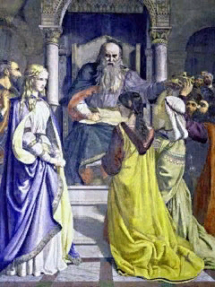
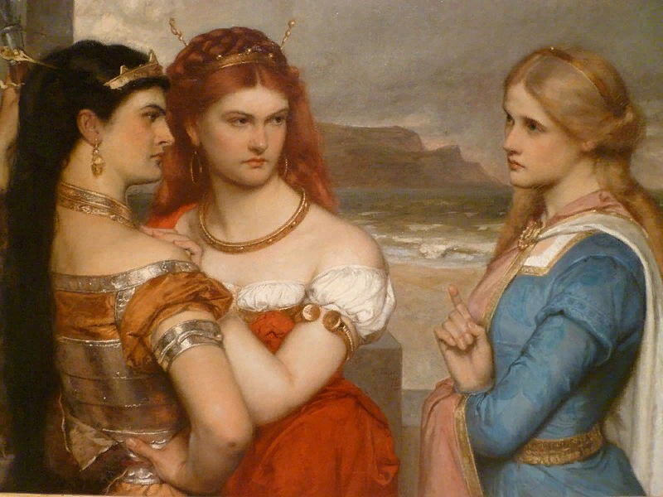
The Answer is:
Three

Slide 43
Let’s do the Quiz!
20. The number of sonnets William Shakespeare wrote.
174
154
205
100

Slide 44
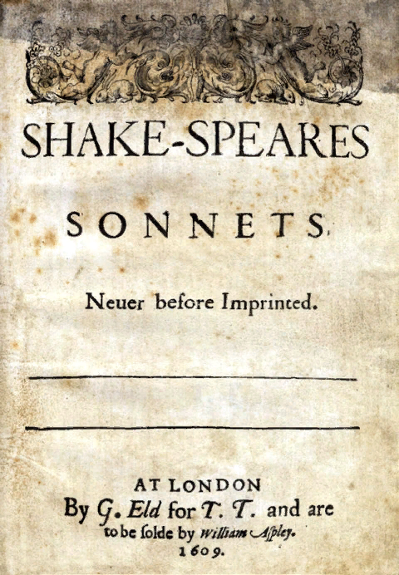
The Answer is:
154 sonnets

Slide 45
Let’s do the Quiz!
21. The number of novels Joanne Rowling wrote about Harry Porter.
5
3
9
7

Slide 46
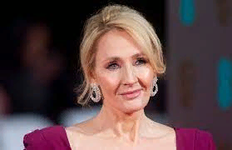
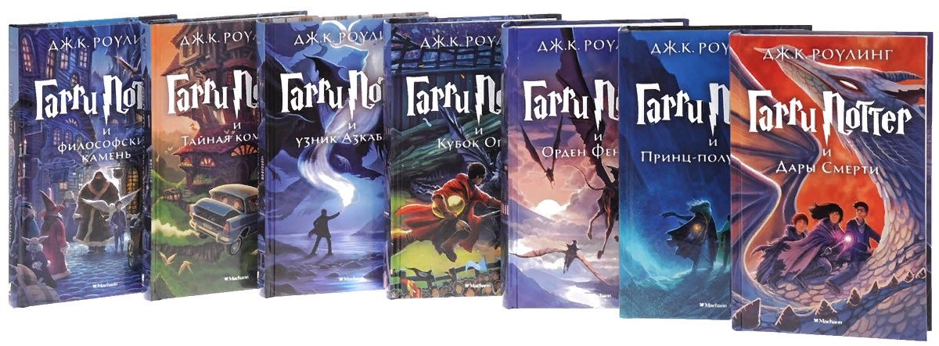
The Answer is:
7 novels

Slide 47
Let’s do the Quiz!
22. Who is the origin of the great private detective Hercule Poirot?
Belgian
Englishman
Frenchman
Austrian

Slide 48
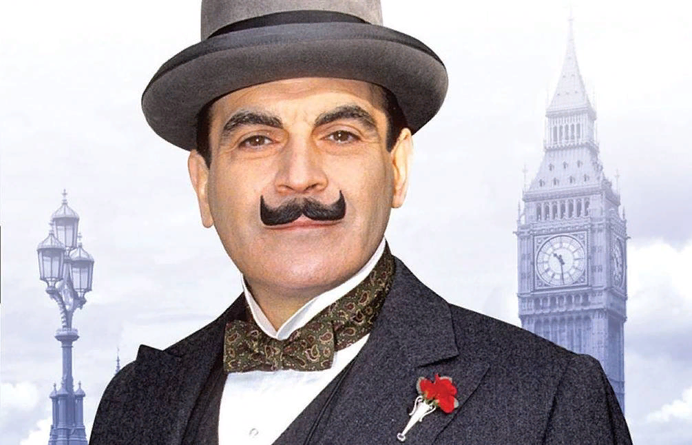
The Answer is:
Belgian

Slide 49
Let’s do the Quiz!
23. Alexander Selkirk was a prototype of …
Robinson Crusoe
Gulliver
Ivanhoe
Baron Munchausen

Slide 50
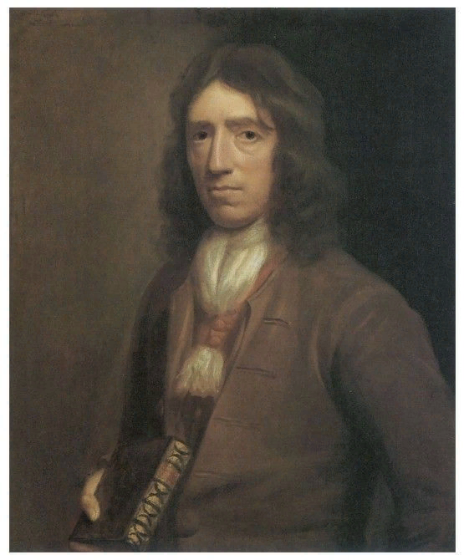
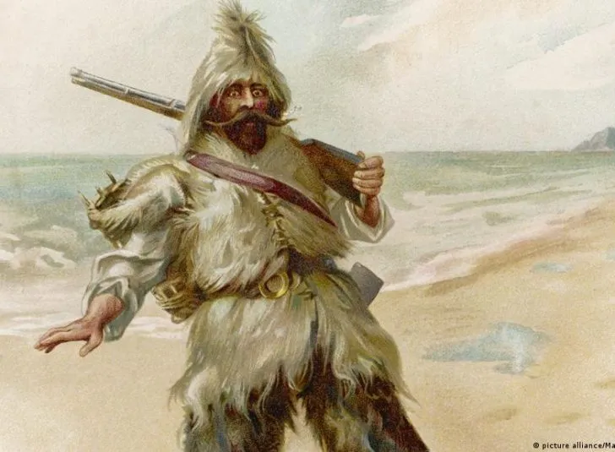
The Answer is:
Robinson Crusoe

Slide 51
Let’s do the Quiz!
24. One of these authors worked as a pilot when he was young.
Lewis Carroll
Alexander Milne
Mark Twain
Walter Scott

Slide 52
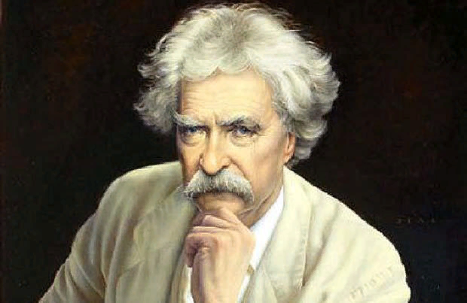
The Answer is:
Mark Twain

Slide 53
Let’s do the Quiz!
25. What is the name of Charles Dickens's first novel?
"The Adventures of Oliver Twist"
"Big hopes"
"Posthumous Papers of the Pickwick Club"
“David Copperfield”

Slide 54
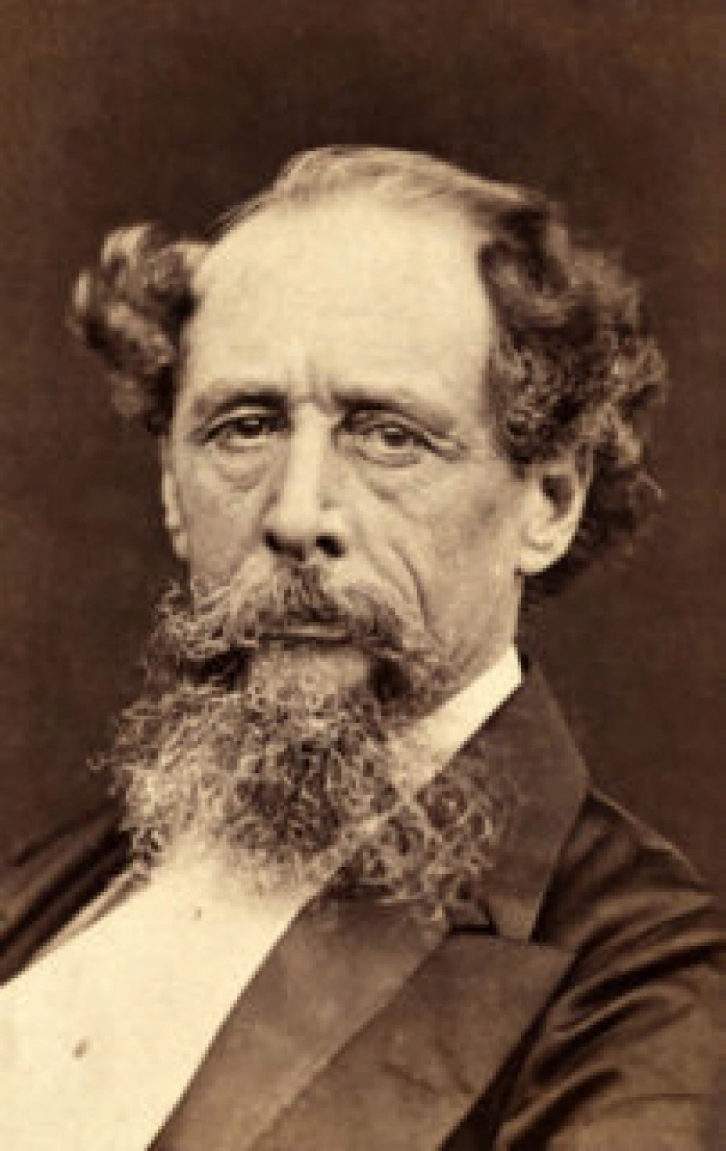
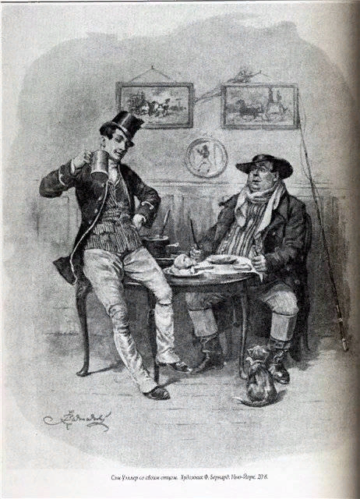
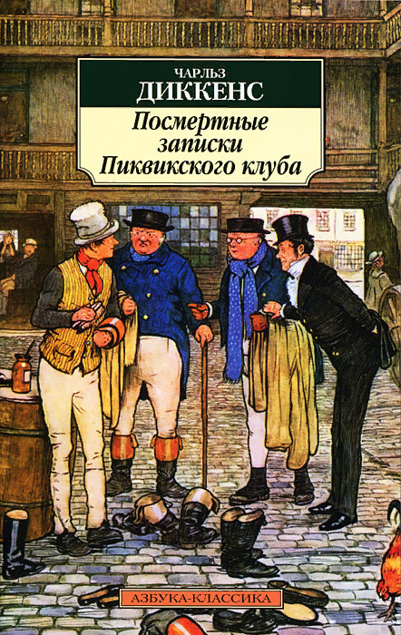
The Answer is:
"Posthumous Papers of
the Pickwick Club”

Slide 55
Love a book - it will make your life easier, it will help you in a friendly way to sort out the motley and stormy confusion of thoughts, feelings, and events. It will teach you to respect people and yourself, it inspires your mind and heart with a feeling of love for the world, for humanity.
M. Gorky

